Slide 1
Health Equity Zones Initiative
Community Advisory Council
Wednesday, February 15, 2023
Notes:
Delany & Marcus introductions

Slide 2
Meeting Outcomes
Key decision point on nomination form
Key decision point on proposed review and scoring process and rubric
Awareness of outreach tools and upcoming efforts
Discuss final selection and CAC in-person meeting
Notes:
BRI

Slide 3
Community Agreements
Assume positive intent.
Acknowledge and accept impact.
Be aware of the space you take up.
Engage in dialogue – not debate.
Hold yourself and others accountable for demonstrating cultural humility.
Be open, transparent, and willing to make mistakes.
Embrace the power of humble listening.
Create trusting and brave spaces – where a little bit of discomfort is okay.
Commit to having conversations that matter by speaking up to bridge divides.
Define terms – don’t assume that everyone knows specialty acronyms or terms.
Notes:
DELANY

Slide 4
Relationship Building
In the chat, please answer the following:
Name
Pronouns
Where are you calling in from?
What is something that brings you joy?
Notes:
BRI
Baby announcement!

Slide 5
Outreach Toolkit
Included in Outreach Toolkit on 2/10/23
Flyer
Frequently Asked Questions sheet
Email Template
Toolkit Guide
Social Media
Facebook, Instagram, Twitter
Translations
Notes:
DELANY
- The flyer will look like this (with a link and a QR code)
- You can print them and share them electronically
- We'll be sharing a PDF of frequently asked questions. You can use this to answer any questions that folx ask you, if the question isn't on there or you don't know you can always have them get in touch with the staff
- We'll share an email template that you can copy paste into a new email and attach the flyer, you are always welcome to write your own message as well
- There will be three social media posts from the DOH, you can do your own post on the same day or re-share the DOH post
- The flyer will be translated into 28 languages

Slide 6
Health Equity Zones Nomination Form
Notes:
BRI

Slide 7
Community Workgroup Survey on Zone Size
How would you describe the size of your community?
How would you tell someone where your community is located?
How do you define community?
Shared geographic area or neighborhood
Nearby towns where I access services
Collective group with common interests, experiences, and/or history
Community is a feeling and set of relationships
Rural/suburban area
A community within a community
By population or demographics
Regions
Area with a connection to shared history or other factors
Spread out – multiple towns sharing resources
Counties/towns/cities that are nearby or within the area I live
Neighborhood/zip code/school boundaries
Landmarks
Highways
Using GIS as tool
Notes:
KAELI
During the Jan CW meeting, many people shared about the limitations of using a zip code to define a health equity zone.
When providing this feedback to the Community Advisory Council, they wanted to seek further guidance from you all on how align the geographic size of a zone with how folx see their community.
We put together a 4-question survey to capture your input on other ways of defining the size of a zone.
Your responses will support the Community Advisory Council in finalizing the nomination form that is expected to launch at the end of February.
Total of 6 responses
BRI
*screenshare updated nomination form and highlight changes*
*screenshare sign-on letter*

Slide 8
Decision on nomination form and sign-on letter template
Notes:
BRI

Slide 9
Zone Selection Timeline
Nomination Form Launches
February 28, 2023
Nomination Form Closes
April 9, 2023
Zone Selection
June 2023
Notes:
BRI
On the screen is a timeline of key dates regarding the selection of the health equity zones
The nomination form will launch on February 28
After the launch, we will be hosting Informational Calls in March
While the form is open, staff will be providing technical assistance to interested communities – we will share later in the presentation about how DOH will support this process
The nomination form will close on April 7
Afterwards, the Community Advisory Council will review & score nomination forms
Staff will compile the scores & create data profiles for the highest ranked nominees
The Community Advisory Council will review the highest ranked nominees and then select the zones
Zone selection will take place in early June
Afterwards, the selected zones will each convene Community Collaboratives and identify a backbone organization to support the logistics of this work.
More information about technical assistance will be uploaded to the Health Equity Zones Initiative webpage.

Slide 10
Zone Selection Process Flow
Notes:
KAELI
*share process flow graphic*

Slide 11
Decision on process flow and timeline
Notes:
BRI/KAELI

Slide 12
Scoring Rubric
Notes:
KAELI

Slide 13
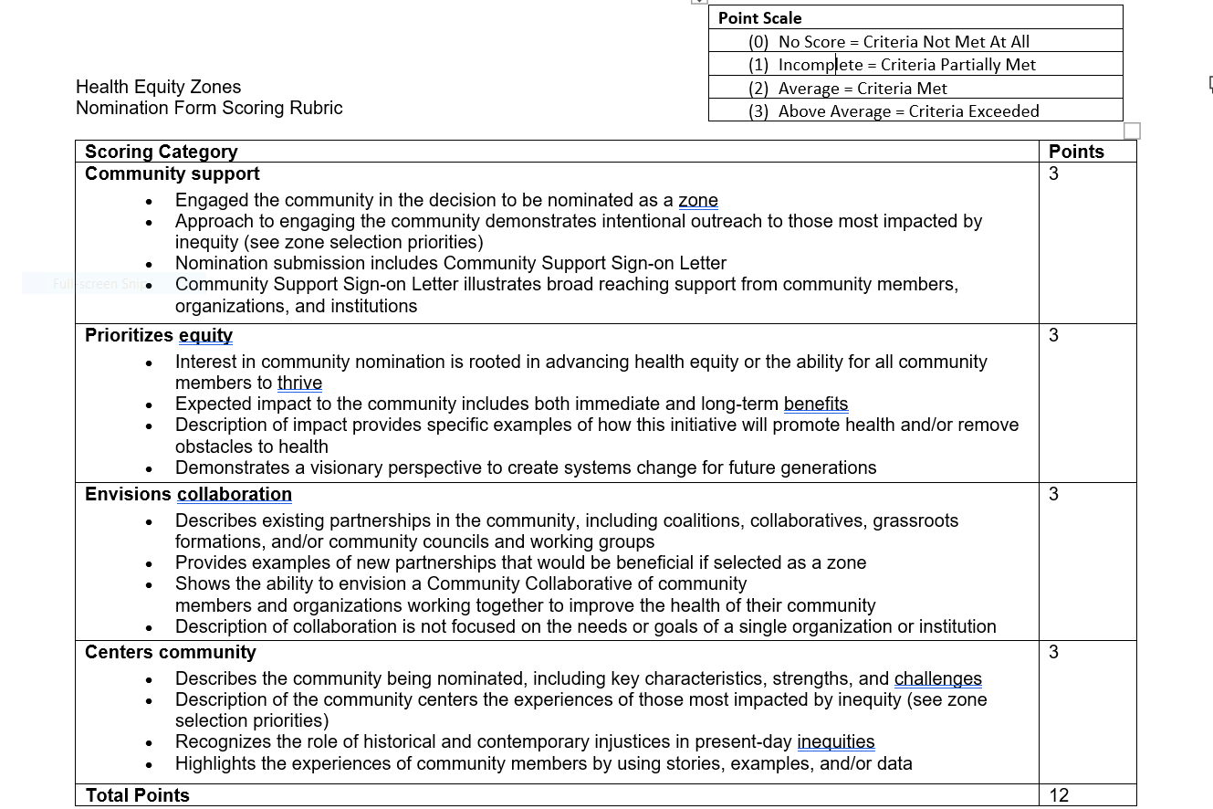
Notes:
KAELI
How it was created – guiding principles, past conversations – what would the ideal response look like, directly linked to questions in nomination form and zone selection priorities
How it will used – used in scoring (CAC members will review forms and score across each category). Also posted on webpage for those nominating their community to see how they will be scored
Read through categories and point scale
Key considerations – all categories weighted the same, 0-3 point scale
Questions
Is the scoring rubric and point scale clear and easy to understand?
Is there anything missing from the rubric? Gaps?
Are there other considerations we should we thinking about?
*split into 2 breakout rooms*

Slide 14
10 Minute Break
Notes:
Incorporate feedback during break

Slide 15
Decision on scoring rubric
Notes:
BRI/KAELI

Slide 16
Final Zone Selection
Notes:
BRI

Slide 17
What could final zone selection look like?
May in-person CAC meeting
Data profiles
Proposed considerations for decision-making beyond scoring rubric and data profiles:
Community readiness/feasibility (ex: ability to execute project plans)
Demonstrated need (ex: history of community being under resourced, lack of systemic support)
Ability to identify areas of support
Potential impact on community
Interviews – if a decision cannot be made using the considerations above, CAC may invite 2 nominees per zone for an interview
Notes:
BRI
*soft decision point regarding considerations and interviews*
-ask for volunteers to refine considerations
-want to be mindful about not packing March meeting

Slide 18
Next Steps & Announcements
CAC meetings:
March: training on how to use scoring tools, conflict of interest
April: preparing for May in-person meeting, supporting scoring process
May: in-person meeting to make final selection
Complete survey to determine location of in-person meeting *hold May 31 & June 1 on your calendars*
Share materials in Outreach Toolkit with your communities to announce nomination process launch on February 28!
Notes:
BRI

Slide 19
Planning for another in-person meeting!
Save the Date: May 31, 2023 - June 1, 2023
Meeting Outcomes:
Relationship building
Selection of zones
Logistics:
One night of lodging will be provided
Members will be provided travel reimbursement for those traveling by car
If you plan to travel by train or plane, tickets will need to be purchased by DOH
Fill out statewide vendor registration and non-employee travel authorization forms (if you haven’t already submitted them – staff can confirm if you have)
Hybrid option will be available
Group Feedback (please complete poll):
Location (SeaTac, Pasco, Wenatchee, Yakima, Ellensburg)
Accessibility support
Notes:
BRI
*paste poll link in the chat*
https://forms.office.com/g/Wpsm0UbLxj
-look into fleet vehicles?

