Slide 1
Health Equity Zones Initiative
Community Advisory Council
Wednesday, October 25, 2022

Slide 2
Meeting Outcomes
Awareness of the upcoming in-person CAC meeting and what to expect.
Shared understanding around what decisions have been made so far and what is upcoming.
Determine how communities most impacted by inequity will be identified.
Contribute to the development of a decision-making tool for zone selection.
Notes:
BRI

Slide 3
Community Agreements
Assume positive intent.
Acknowledge and accept impact.
Be aware of the space you take up.
Engage in dialogue – not debate.
Hold yourself and others accountable for demonstrating cultural humility.
Be open, transparent, and willing to make mistakes.
Embrace the power of humble listening.
Create trusting and brave spaces – where a little bit of discomfort is okay.
Commit to having conversations that matter by speaking up to bridge divides.
Define terms – don’t assume that everyone knows specialty acronyms or terms.
Notes:
KAELI
Put community agreements in chat as reminder

Slide 4
Relationship Building
In pairs, spend a few minutes connecting with one another (doesn’t have to be HEZ related!)
Guiding questions (but feel free to use your own):
What is your favorite holiday tradition?
What is a childhood memory that brings you joy?
Notes:
KAELI

Slide 5
Community Updates
Are there any resources, events, or updates happening in your community that you would like to share with the CAC?
Notes:
BRI
Pin – Cambodian community celebrates ancestors and loved ones who have passed on, starts Saturday evening with prayer until Sunday with offerings

Slide 6
Community Workgroup Update
WHO
There were 10 participants from across the state
Including 3 new CW members
WHAT
WHEN
Meetings take place on the 2nd Thursday of each month
The next meeting is on Thursday, December 8 from 1-3pm (revisiting time of meetings to increase participation)
Staff shared results from the evaluation survey and Jamboard activity
Orientation for new members from 12:30-1pm
Members reviewed and provided feedback on the HEZ strategy chart
Notes:
BRI

Slide 7
In-Person CAC Meeting: November 17
Meeting Outcomes:
Relationship building
Establish shared understanding of communities most impacted by inequities
Understanding of statewide health disparities data
Identify criteria for selecting zones
Logistics:
Lodging will be provided on Wednesday, November 16 at the Coast Wenatchee Center Hotel
Members will be provided travel reimbursement
Fill out statewide vendor registration and non-employee travel authorization forms
Hybrid option will be available
Notes:
BRI

Slide 8
What decisions have been made?
Developed a nomination process for selecting zones
Established criteria for which communities will be eligible to be nominated as zones, including,
Geographic size – cities, zip codes, neighborhoods, census-tracts
Population size – small enough so that every community member can participate
Types of groups – community-based organizations, coalitions, networks, collaboratives, non-profits, local government. For-profit organizations not eligible.
Determined the types of technical assistance that DOH will provide such as,
Q&A webinars
Data use trainings
Narrative writing support (consultant)
Accept submissions in written, video, or audio format
Offer and accept submissions in multiple languages
Notes:
BRI
7 months into the process – reflect and share out what decisions have been made so far and what is upcoming for the in-person CAC meeting

Slide 9
What decisions are upcoming?
Identifying priorities for zone selection that centers communities most impacted by inequities, including,
Type of geography – urban, rural
Demographics – communities of color, Native communities, immigrant populations, communities experiencing poverty
Communities impacted by specific health equity issues – mental health, social determinants, environmental injustice
Finalize nomination form and selection process
Notes:
KAELI
Build on the decisions that have already been made about criteria and the selection process by identifying priorities
Aligned with feedback from the Jamboard activity - "Feel like there's something missing: still haven't had difficult conversations around the different dimensions of equity and how we will prioritize them [in the selection of the first 3 zones].“ Pilot project – demonstrating success and proof of concept.
Several discussions over the past few months around zones potentially having a different profile – for example urban/rural.
We’ve also named the importance of recognizing the impact of systemic inequity for specific demographic groups. so the key decision we hope to make in the next meeting is what does it look like to prioritize them in zone selection?
Specific health equity issues have also been identified as priorities from the survey we did early on in the process where folx shared their top three. So we are hoping to make the connection between these issues that have been identified and the key demographic groups that are most impacted. Share Alina example.
Second upcoming decision is around finalizing the nomination form and selection process – in the next meeting we will have the form drafted for review and we can go through like a mock run through to identify additional considerations and revisions.
***Ask Alina to provide her example of priorities – e.g., maternal and infant health should be a priority because it disproportionately impacts Black, Brown and Native communities – this could be a consideration for selecting an urban zone

Slide 10
How do we identify communities most impacted by inequity?
Goals identified by the CAC
1.
Select zones based on communities with the greatest need
2.
Recognize the impacts of structural racism and systemic injustice
3.
Demonstrate transparency in the process
Notes:
KAELI
Ground ourselves in the prioritizing those most impacted

Slide 11
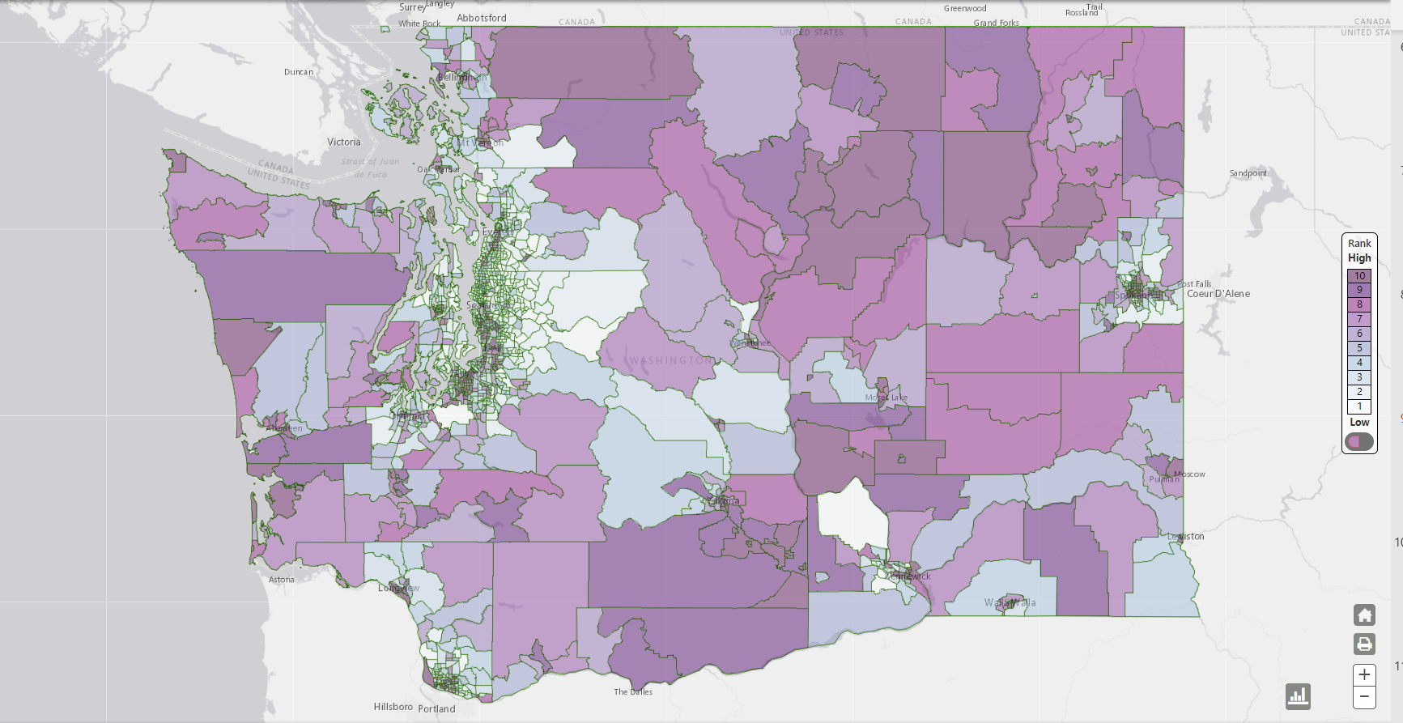
Proposed Metric Options
Life expectancy
Infant mortality
Poverty
Education
Food security
Noise and air pollution
Provider-to-population ratio
Travel time to nearest source of care
Uninsured
Notes:
KAELI
Life expectancy – how long people live is used to assess overall health of a population, strongly correlated to where people live. Differences in life expectancy across zip codes, for example, reflect socioeconomic inequity where even neighboring zip codes can have differences of up to 5-10 years. Also highlights the loss of elders which can have significant implications for passing down culture + language (known resiliency factors).
Infant mortality – number of infants deaths is similarly used as a marker for the overall health of a population. It also reveals disparities by race and socioeconomic status, where we know Black, Native, and Pacific Islander women are disproportionally impacted. This metric allows us to consider intergenerational impacts of poverty and other traumatic experiences. Important to note women recently immigrated to US may show lower mortality rates.
Poverty – income is connected to numerous health disparities and a major barrier to accessing not only health care but health protective resources such as food, housing, transportation, etc.
Education – often viewed a driver of opportunities and closely linked to income, wealth, overcoming cycles of poverty through employment, social status – all of which contribute to health and wellbeing.
Food security – strongly related to place and socioeconomic status – divestment from rural communities and historic redlining that has created food deserts where communities cannot access nutritious food. Which has implications for is connected to several other metrics listed including poverty/education/life expectancy.
Noise and air pollution – environmental injustice is a significant health equity concern that is closely linked to structural racism including the placement of airports/highways/other infrastructure projects that not only contribute to displacement but are correlated with disparate health outcomes such as respiratory issues and cancer. Air pollution is also an indicated of communities disproportionately impacted by climate change.
Provider-to-population ratio – number of providers is a community is a key measure of access to health care. This is a measure that is often used by federal agencies to identify medical shortage areas. Allows comparison between rural and urban areas. We can also look at primary care, mental health, and dental.
Travel time – whereas distance to nearest source of care reveal inequities in access that is especially important for rural communities. Urban communities may have clinics that are close but the ratio of providers may still be limited due to the large population they are expected to serve.
Uninsured – insurance status impacts a person’s ability to receive the care they need. Symetria shared a example previously regarding populations that are not eligible for Medicaid and that group in particular facing increased challenges to health equity.

Slide 12
10 Minute Break

Slide 13
Strategy Chart & Assessment Tool

Slide 14
Notes:
Updates:
Financial incentives
WSPHA conference
APHA conference

