Slide 1
Task Team Charter
Build upon the work of the IAWG subcommittees
Identifying overburdened communities and vulnerable populations,
Metrics & reporting, and
Budget & funding.
Develop a recommended approach for identifying vulnerable populations in overburdened communities to inform
Making, and
Tracking investments under HEAL and CCA (Climate Commitment Act).

Slide 2
Timeline
February 28: Check in with Gov/OFM
February 15: EJ Council Discussions
February 29: EJ Council Discussions
March 15: Ex-Officio Review
March 28: EJ Council Public Meeting Discussion
April 4: Recommendation for review to GOV & Subcabinet
April 21: Final Draft to GOVs Office
[Sept 1, 2024 - HEAL Published Dashboard]

Slide 3
Work Products
Map for tracking expenditures
Process for making expenditures
Legal review of recommendations
Proposed method of adoption
Implementation guidance

Slide 4
Alternatives under Consideration
1. Map for tracking expenditures | EHD 9-10 CEJST Disadvantaged Areas Tribal Land Map Layer
2. Process for making expenditures | For 2024 For 2025
3. Legal Review of recommendations | TBD for preferred alternative (March)
4. Proposed method of adoption | Governor Directive Official Governor action Formal Rulemaking
5. Implementation guidance | TBD After (Legal Review)

Slide 5
Recommendation 1: Overburdened Communities Map
Adopt the proposed map for initial identification of overburdened communities when making and tracking CCA and HEAL expenditures for the 2023-2025 biennium.
Geographic areas identified as overburdened communities include:
Census tracts ranked 9 or 10 on the Environmental Health Disparities Map (EHD Map), and
Geographic areas characterized as “disadvantaged” on the federal Climate and Economic Justice Screening Tool (CEJST), and
Any census tracts that have whole or partial overlap with Tribal Reservations.

Slide 6
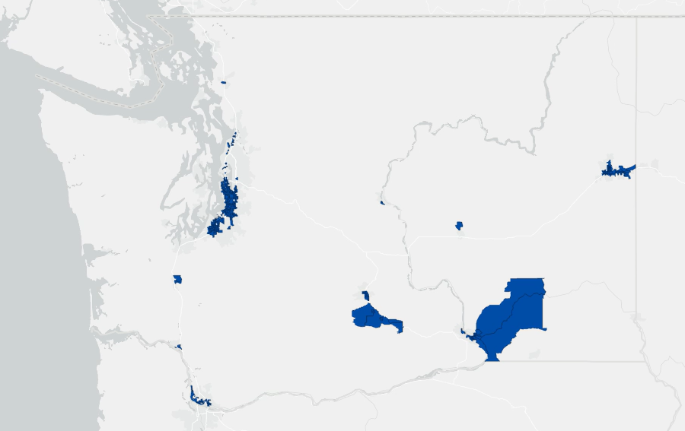
EHD 9 & 10

Slide 7
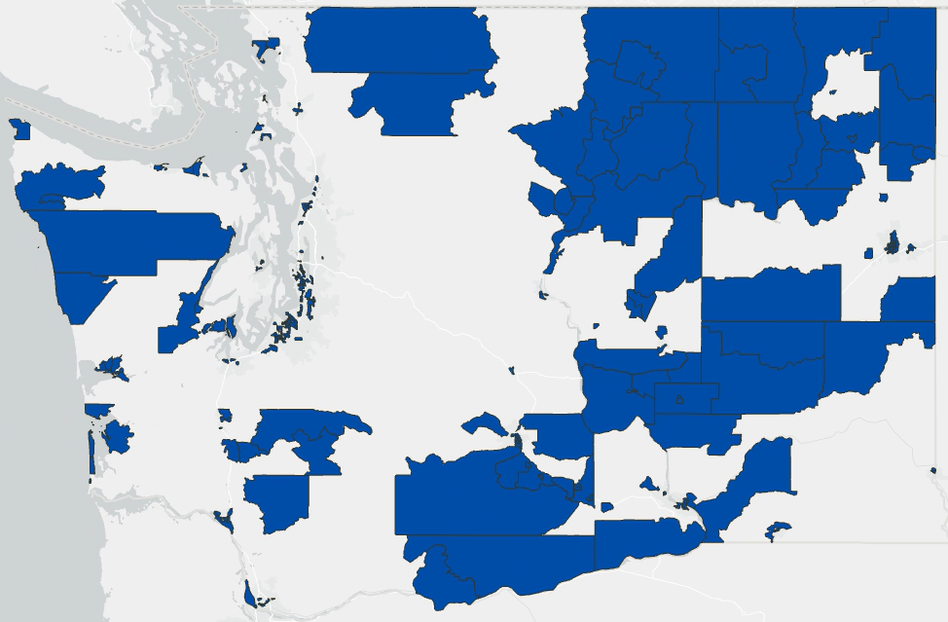
Climate Economic Justice Screening Tool (CEJST)
CEJST includes climate indicators and census tracts within Tribal Reservation lands as identified by the Bureau of Indian Affairs.

Slide 8
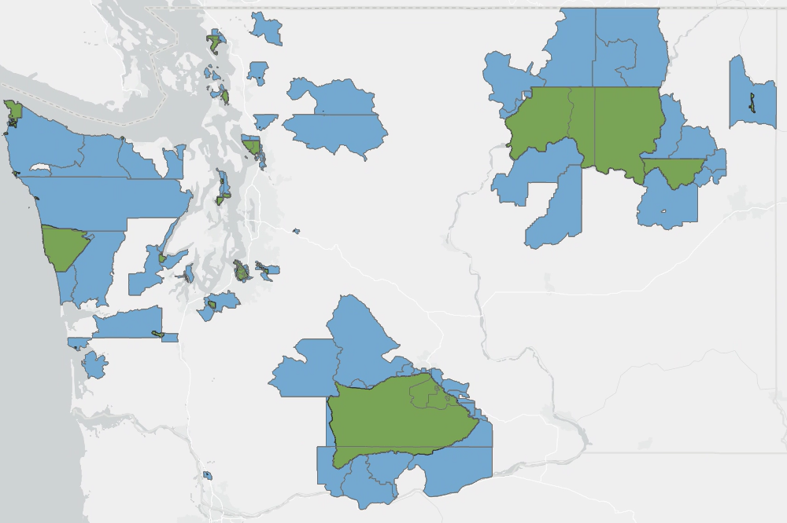
Tribal Lands Criteria
Census tracts with whole or partial overlap with Tribal Reservations (as identified by the Bureau of Indian Affairs).

Slide 9
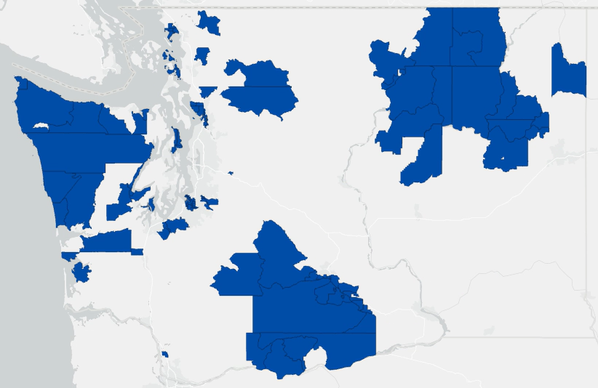
Tribal Lands Criteria
This expanded Tribal Lands map includes census tracts that have whole or partial overlap with Tribal Reservations.

Slide 10
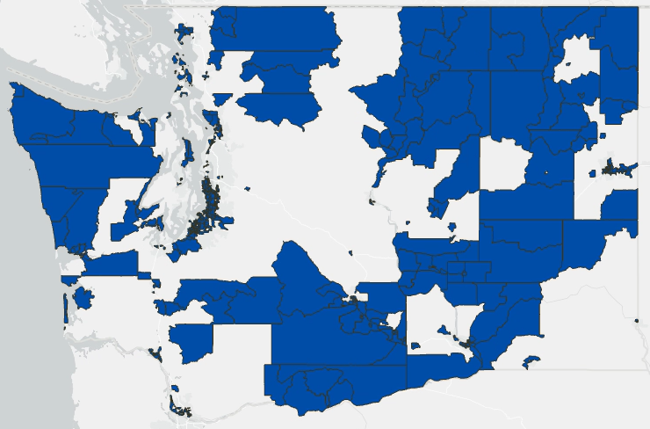
EHD 9/10 + CEJST + Tribal Lands
Notes:
About the Map:
Overburdened Communities
Total population: 2,253,740 (29.6%)
Total geographic area: 30,580 sq mi (45%)

Slide 11
Statutory Obligations: Tracking & Making Expenditures
Statutory Obligations:
HEAL Act goal of 40% of grants and expenditures “that creates environmental benefits to vulnerable populations and overburdened communities.”
CCA obligation of 35% minimum and goal of 40% of “total investments that provide direct and meaningful benefits to vulnerable populations within the boundaries of overburdened communities.”
CCA obligation of a minimum of 10% of “total investments that are used for programs, activities, or projects formally supported by a resolution of an Indian tribe.”

Slide 12
Recommendation 2: Tracking Expenditures
Adopt the following process for tracking CCA and HEAL expenditures.
For the 2023-2025 biennium, agencies statutorily required to establish HEAL budget equity goals or report CCA expenditures will identify and report the following information to OFM:
Whether the expenditure is located in an overburdened community based on the map.
Whether the expenditure is formally supported by a resolution of an Indian tribe.
Whether the expenditure creates environmental benefits based on HEAL statutory criteria or direct and meaningful benefits based on and CCA statutory criteria.
Whether the expenditure benefits a vulnerable population based on one or more of the “vulnerable populations” statutory criteria.

Slide 13
Recommendation 3: Making Expenditures
Adopt a process for making CCA and HEAL expenditure decisions.
The following criteria would be used:
Overburdened Communities: Determine if the proposed expenditure would be in an overburdened community.
Map based identification of overburdened communities.
Self-Identification for overburdened communities outside of the map.
Environmental Benefits: Determine if Proposed Expenditures Create Environmental Benefits
Vulnerable Populations: Determine if the proposed expenditure would benefit a vulnerable population.
Tribal Resolution: Determine (CCA reporting only)

