Slide 1

Module 2: Cancer Practice Activity
2.1 Align data to your storyboard and storyline
2.2 Align visualizations to your storyboard and storyline
2.3 Craft your call to action
2.4 Draft your story
2.5 Get Feedback

Slide 2
Background on the Cancer activity
Cancer is still the leading cause of death in the State of Washington. Keeping the public informed is key to raising awareness and implementing preventative measures.
In this activity, you will build on what you have already done in module 1 to do the following:
  Align data to your storyline
  Align visualizations to your storyline
  Draft your story
  Get feedback
A spreadsheet of cancer related data is available for your use in completing this activity (you received a link to get to it when you received the link to get to this file). Or if you prefer you can use your own sources of cancer related data.

Slide 3
Activity 2.1 Align data sources to your storyline
Identify and align potential data sources to your storyline.
Instructions
Look at the storyline you created. Think about the parts of your story.
Refer to the data dictionary for your data, either use what came from the source or create your own.
Use this information to identify data sources that will help present each of the following story parts
  The HOOK
  The RISING MOMENT
  The AHA MOMENT
Put your potential data sources into the template.

Slide 4
2.1 Align data to your storyboard and storyline
Storyline
Data
Visuals
Great story
References: Brent Dyles, Effective Storytelling and Catherine Cote Data Storytelling: How to Tell a Story with Data (hbs.edu)

Slide 5
2.1 Align data to your storyline: Process
Step 1. Identify data for your HOOK
Step 3. Identify data for your AHA MOMENT
Step 2. Identify data for your RISING POINTS
Review the hook from your storyline.
Review the rising points from your storyline.
Review the AHA moment for your storyline.
Review your data sources.
Review your data sources.
Review your data sources.
Identify the data that is relevant to your HOOK.
Identify the data that is relevant to your RISING POINTS.
Identify the data that is relevant to your AHA MOMENT.
Document in the Data Alignment Template.
Document in the Data Alignment Template.
Document in the Data Alignment Template.

Slide 6

2.1 Align data to your storyline
Step 1: Sample of completed Identify data for the HOOK
HOOK from the storyline we have prepared for the CDC:
COVID-19 risks are MEDIUM or HIGH in <#> US counties. <More, Fewer> counties are at elevated risk this week compared to last week.
From the data source provided by the CDC:
Data Column/Field | Description
County | Name of the county included in the hospital service area (HSA) reporting data
State | Name of the state or territory where the county is located
New Hospital Admissions | Total new hospital admissions for the HSA in the past week
New Hospital Admission Rate | Total new hospital admissions per 100K population for the HSA in the past week
Risk Level This Week | Hospital admission level this week:: LOW (<10 per 100K), MED (10 to 20), HIGH (>20)
Risk Level Last Week | Hospital admission level last week: LOW (<10 per 100K), MED (10 to 20), HIGH (>20)
Change in Admissions | Percent change in New Hospital Admissions compared to prior week
Capacity Utilization | Percent of staffed inpatient beds occupied by COVID-19 patients
Change in Capacity Utilization | Absolute change in Capacity Utilization compared to prior week
ICU Capacity Utilization | Percent of staffed intensive care unit (ICU) beds occupied by COVID-19 patients
Change in ICU Capacity Utilization | Absolute change in ICU Capacity Utilization compared to prior week
Our HOOK requires us to count counties that are in MEDIUM or HIGH COVID-19 risk levels.
“Risk Level This Week” is the most relevant data for this part of our HOOK.
Our HOOK also requires a comparison of risk levels this week compared to last week.
“Risk Level Last Week” is the data that will enable us to calculate if more or fewer (or the same number) of counties are at elevated risk.
Notes:
Look at what you documented under "Insights." Think of these connect to your provisional outline. If they don't then relook at your outline and consider revising it.

Slide 7
2.1 Align data to your storyline
Step 1: Identify data for the HOOK
HOOK : Some types of cancer have survival rates of less than 12%
From the data source :
Data Column/Field | Description
Type | Type of cancer
Survival Rate | 2020 Survival rate (deaths per 100,000)
Our HOOK requires the survival rates for each type of cancer
Need to capture the cancer(s) with the lowest survival rates

Slide 8
2.1 Align data to your storyline
Step 2: Identify data for the RISING MOMENT
RISING MOMENT : Other types of cancer have survival rates in the 90%
From the data source :
Data Column/Field | Description
Type | Type of cancer
Survival Rate | 2020 Survival rate (deaths per 100,000)
Our HOOK requires the survival rates for each type of cancer
Need to capture the cancer(s) with the lowest survival rates

Slide 9
2.1 Align data to your storyline
Step 3: Identify data for the AHA MOMENT
AHA MOMENT : The type of cancer that Reggie is worried about (breast cancer) has a high cure rate if caught early.
From the data source :
Data Column/Field | Description
Type | Type of cancer
Early survival rate | Survival rate if caught early (stage I or II)
Late survival rate | Survival rate if caught late (stage III or IV)
Breast cancer survival goes from 30% to 90% if detected early
Need to know the survival rates for each type of cancer
Also need to know what impact detection has on survival

Slide 10
2.1 Align data to your storyline
Sample of Completed Data Alignment Template
Storyline | Data Fields We Will Need | Why We Will Need Them
HOOK: COVID-19 risks are MEDIUM or HIGH in <#> US counties. <More, Fewer> counties are at elevated risk this week compared to last week. | Risk Level This Week Risk Level Last Week | Risk Level This Week enables us to count number of counties at MEDIUM or HIGH risk. Risk Level Last Week enables us to calculate if more or fewer counties are at elevated risk.
RISING POINT: Map of US County risk levels color-coded to highlight risk. For example, enabling identification of higher-risk clusters. | County State Risk Level This Week | County and State are needed for geo-coding to enable mapping. Risk Level This Week is needed to enable color coding on the map.
AHA MOMENT: COVID-19 risk level in <Community> is <Low, Medium, High>. For example, COVID-19 risk level in White County, Arkansas is HIGH. | County State Risk Level This Week Risk Level Last Week New Hospital Admission Rate | County, State and Risk Level This Week are needed to provide the AHA data point. Risk Level Last Week and New Hospital Admission Rate may be useful to provide additional context.
Notes:
Look at what you documented under "Insights." Think of these connect to your provisional outline. If they don't then relook at your outline and consider revising it.

Slide 11
2.1 Align data to your storyline:
Copy your results into the Data Alignment Template
Storyline | Data Fields We will Need | Why We Will Need Them
Hook: Some types of cancer have survival rates of less than 12% | Type Survival rate | Need to compare survival rates for different types of cancer, interested in the types with the lowest survival rates
Rising Moments: Other types of cancer have survival rates in the 90% | Type Survival rate | Need to compare survival rates for different types of cancer, interested in the types with the highest survival rates
AHA Moment: The type of cancer(breast cancer) that Reggie is worried about has a high cure rate if caught early. | Type Early survival rate Late survival rate | Need to know survival rates by cancer Need to know survival rates for breast cancer for early and late detection

Slide 12
Activity 2.2 Align visuals to your storyline
Identify and align potential visualizations to your storyline.
Instructions
Look at the storyline you created. Think about the parts of your story.
Use this information to identify visualizations that will help present each of the following story parts
  The HOOK
  The Rising Moment
  The AHA Moment
Put your potential visuals into the template.

Slide 13
2.2 Align data visuals to your story
Storyline
Data
Visuals
Great story
References: Brent Dyles, Effective Storytelling and Catherine Cote Data Storytelling: How to Tell a Story with Data (hbs.edu)

Slide 14
2.2 Align data visuals to your story: Process
Step 1. Identify visuals for your HOOK
Step 3. Identify visuals for your AHA MOMENT
Step 2. Identify visuals for your RISING POINTS
Review and analyze the data identified for the HOOK
Review and analyze the data identified for the RISING POINTS
Review and analyze the data identified for the AHA MOMENT
Choose and format visuals to enable your audience to most easily engage with your story.
is the best way to visualize that data?
Choose and format visuals to enable your audience to most easily continue engaging with your story.
Choose and format visuals to enable your audience to most easily obtain the key insight they need.

Slide 15
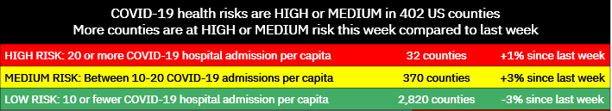
2.2 Align visuals to the storyline
Step 1: Sample of completed align visual to HOOK
HOOK: COVID-19 risks are MEDIUM or HIGH in 402 US counties. More counties are at elevated risk this week compared to last week.
From here …
To there …
Use text to make the HOOK obvious and easily digestible. This is better than the generic chart title on the left.
Use position to show HIGH risk first, helping audience to consume more important information first.
Use a data table to present just three numbers directly aligned to risk levels. Better than the chart showing each individual county hospital admission rate, requiring audience to translate from rate to risk level.
Use color to make it easier to see different levels of risk.
Share your thoughts in the chat:
How is the To There version better than the From Here version?
How could we further improve the To There version?

Slide 16
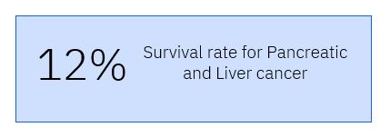
2.2 Align visuals to the storyline
Step 1: align visual to HOOK
HOOK: Some types of cancer have survival rates of less than 12%
From here …
To there …

Slide 17
2.2 Align visuals to the storyline
Step 2: align visual to RISING MOMENT
RISING MOMENT: Other types of cancer have survival rates of greater than 90%
From here …
To there …
Some types of cancers have over 90% survival rates
97%
98%
94%
95%
% Survival Rate
91%

Slide 18
2.2 Align visuals to the storyline
Step 3: align visual to AHA MOMENT
AHA MOMENT: Breast cancer can have survival rates of up to 90% if caught early
From here …
To there …
With early detection, breast cancer survival rates increase from 30% to 90%
Late detection
30 %
90 %
Breast cancer survival rates

Slide 19
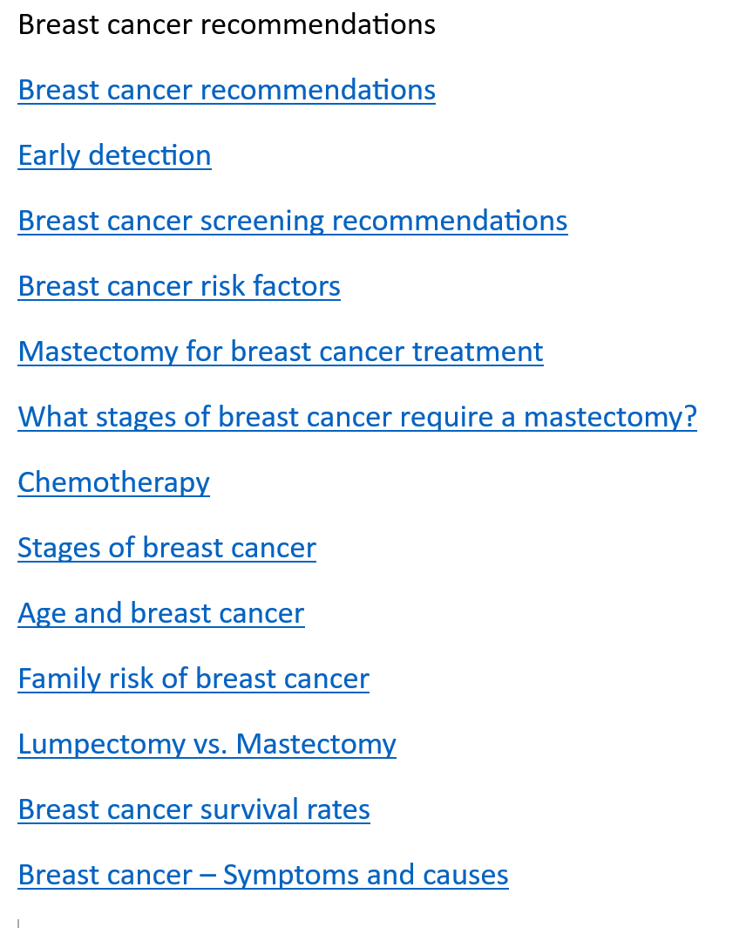
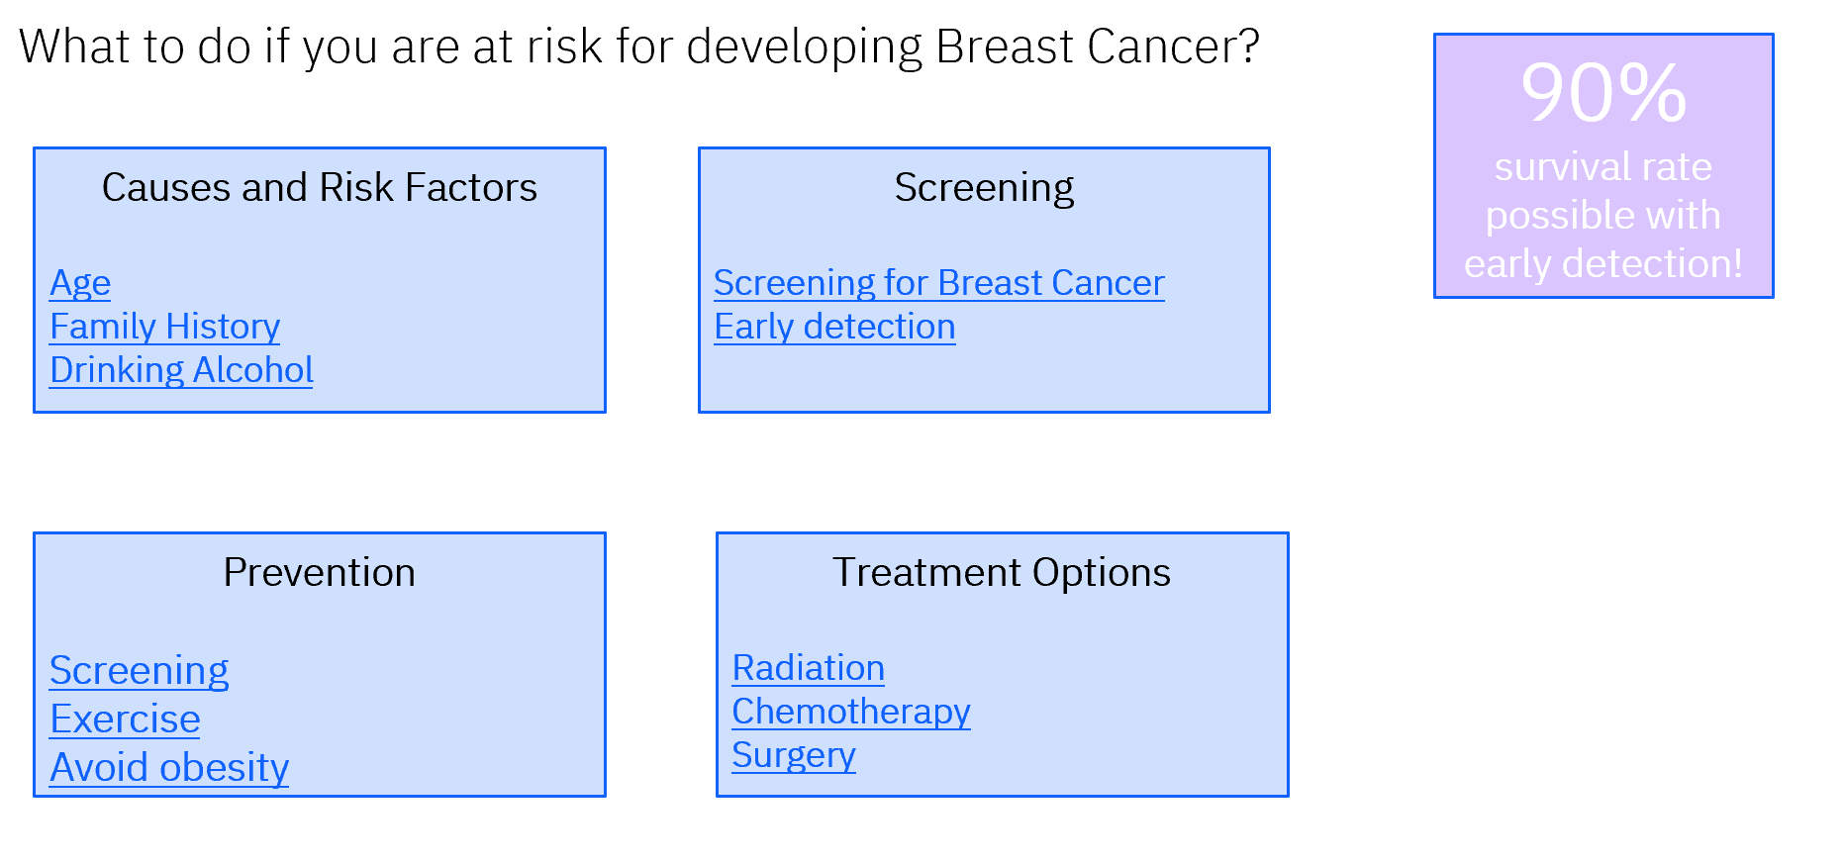
2.3 Craft your call to action
CALL TO ACTION: Specific recommendations tailored to breast cancer
From here …
To there …

Slide 20
Activity 2.4 Draft your story
Use the data and visuals you identified to move the storyline into a story.
Instructions
Look at the storyline you created. Think about the four parts of your story. Think about the data and the visuals you linked to each story part.
Use this information to create slides that will help present each of the story parts
  The HOOK
  The Rising Moment
  The AHA Moment
  The CALL TO ACTION
Put your data and visuals into the template (there are four of them).

Slide 21
2.4 Draft your data story
Assemble your storyline, data and visuals into a compelling data story.
Storyline
Data
Visuals
Great story
References: Brent Dyles, Effective Storytelling and Catherine Cote Data Storytelling: How to Tell a Story with Data (hbs.edu)

Slide 22
2.4 Draft your data story: Process
Step 1. Create the story for your HOOK
Step 3. Create the story for your AHA MOMENT
Step 2. Create the story for your RISING MOMENTS
Your storyline narrative for the hook becomes a slide headline or section header.
Your storyline narrative for the rising moments becomes the headline or section header.
Your storyline narrative for the AHA moment becomes a slide headline or section header.
Step 4. Create the story for your CALL TO ACTION
Your storyline narrative for the call to action becomes a slide headline or section header.
Assemble your data and visuals to support the HOOK.
is the best way to visualize that data?
Assemble your data and visuals to support the RISING MOMENTS.
Assemble your data and visuals to support the AHA MOMENT.
Assemble supporting information for your CALL to ACTION.

Slide 23
2.4 Draft your data story:
Step 1: sample of completed create story for the HOOK
COVID-19 health risks are HIGH or MEDIUM in 402 US counties. More counties are at elevated risk this week compared to last week.
Data through February 20, 2024

Slide 24
2.4 Draft your data story:
Step 1: create story for the HOOK
Some types of cancer have survival rates of less than 12%

Slide 25
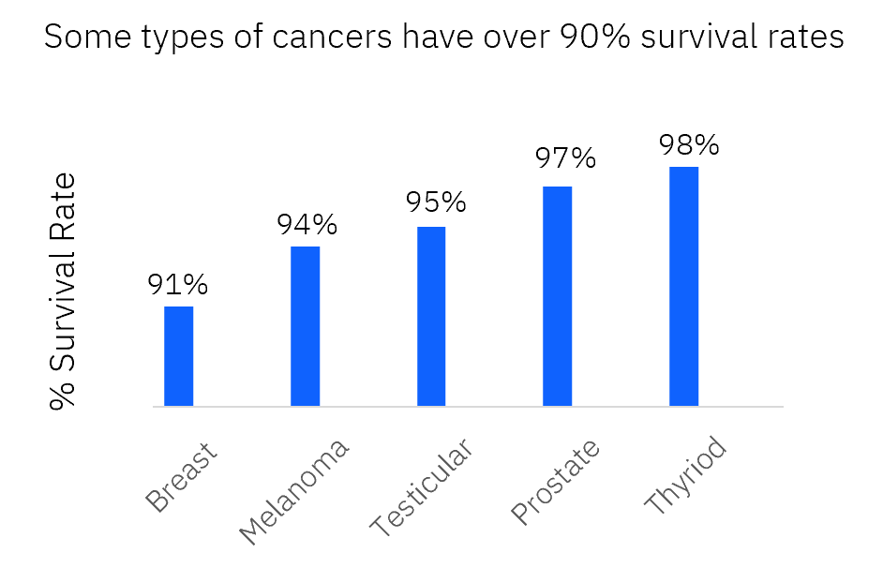
2.4 Draft your data story:
Step 2: create story for the RISING MOMENT
Other types of cancer have survival rates in the 90%

Slide 26
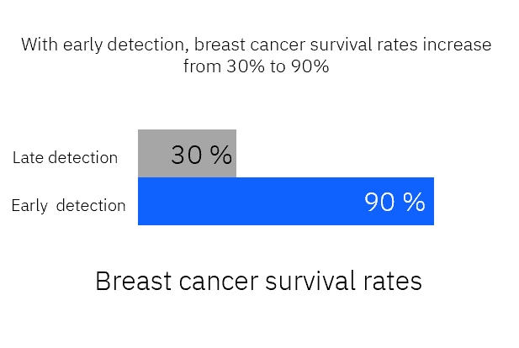
2.4 Draft your data story:
Step 3: create story for the AHA MOMENT

Slide 27
2.4 Draft your data story:
Step 4: create story for the CALL TO ACTION
Specific recommendations tailored to breast cancer

Slide 28
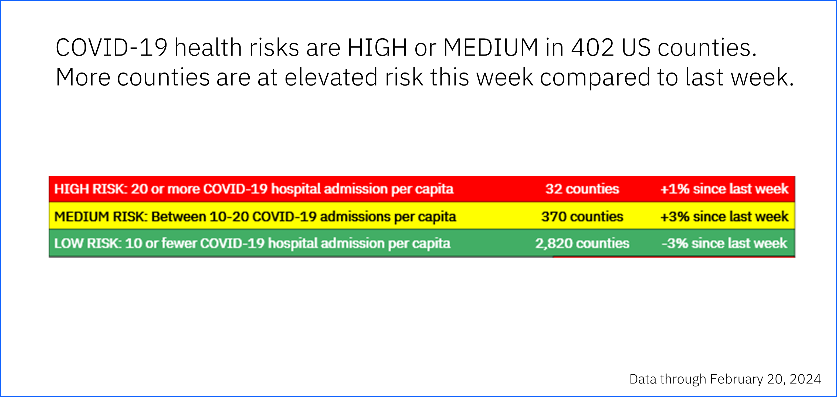
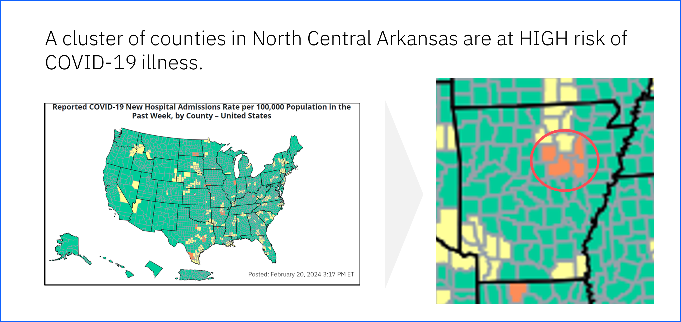
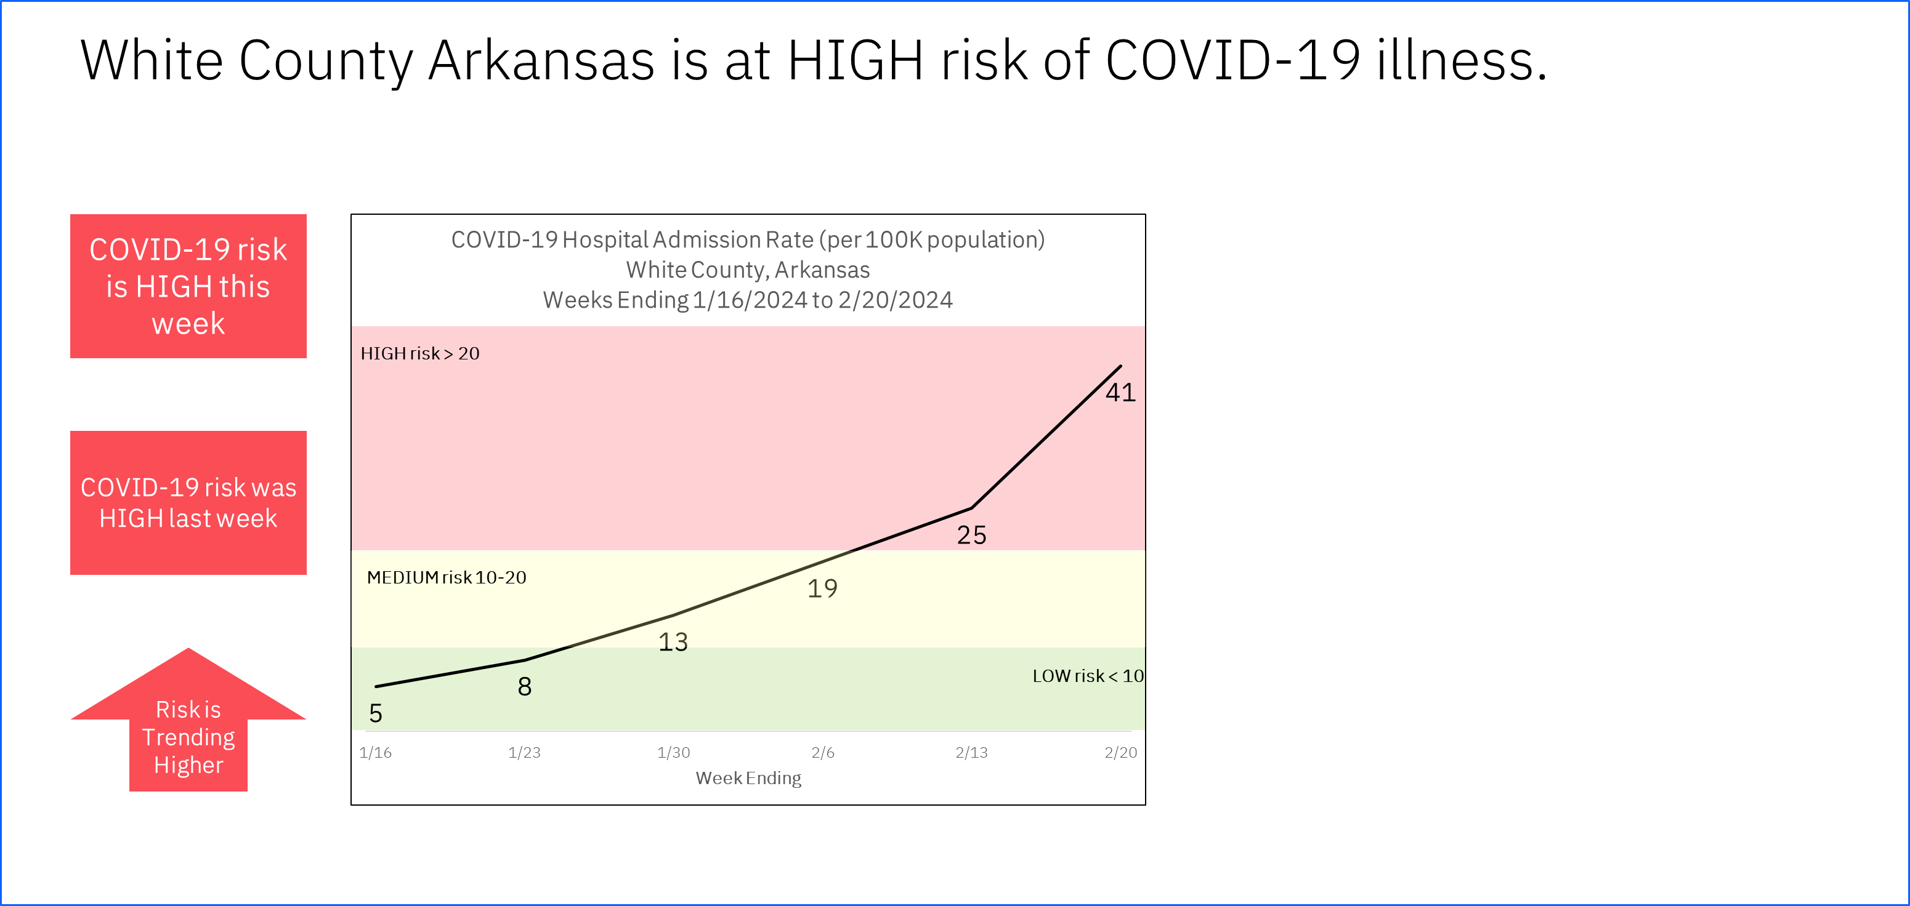
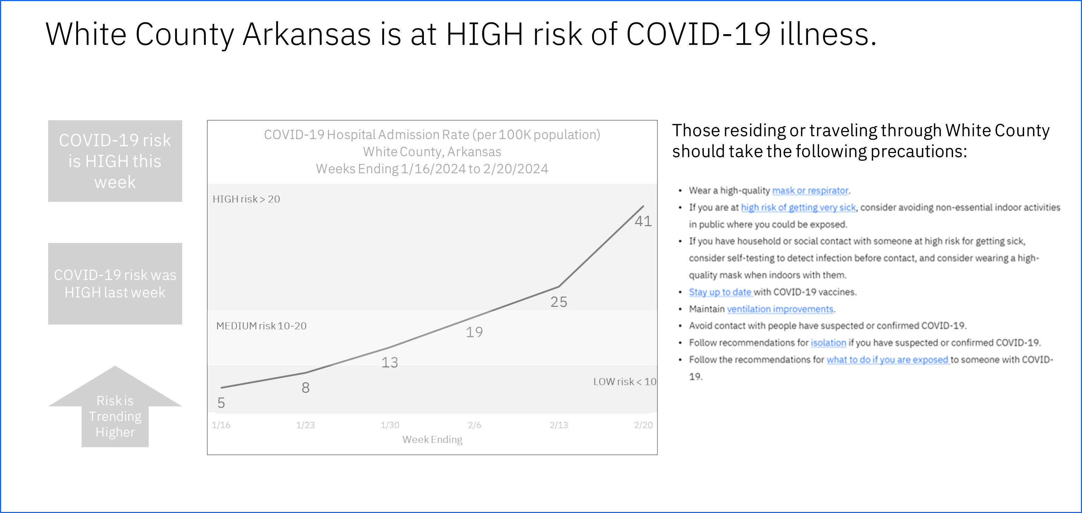
2.4 Draft your data story:
Sample of completed Pulling it all together
HOOK
RISING POINTS
AHA MOMENT
CALL TO ACTION

Slide 29
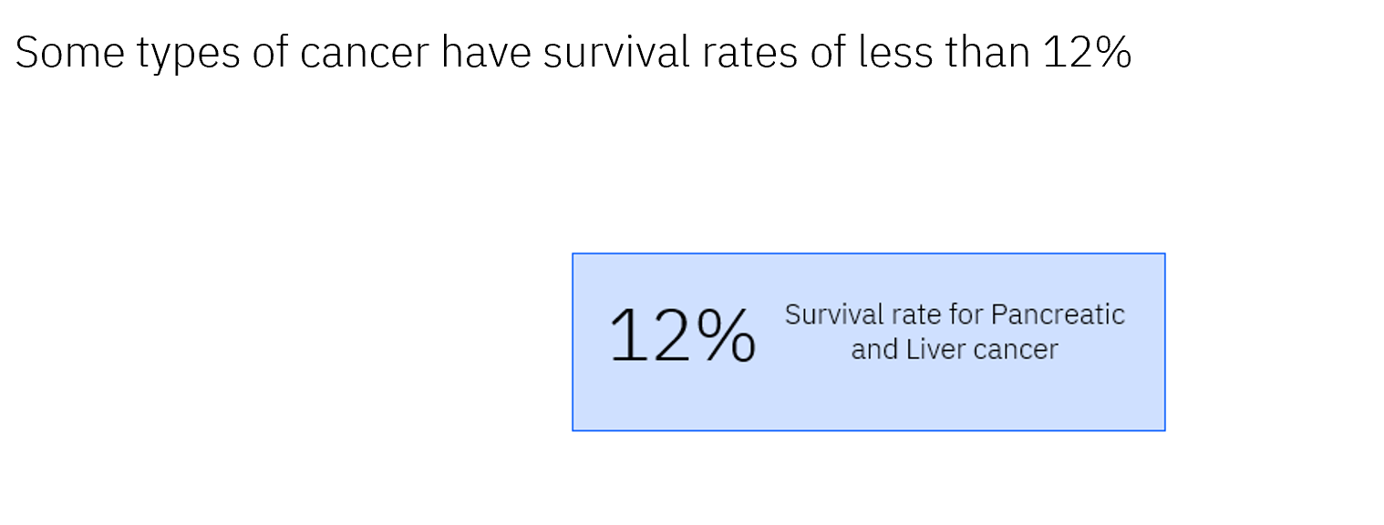
2.4 Draft your data story:
Pulling it all together
HOOK
RISING POINTS
AHA MOMENT
Specific recommendations tailored to breast cancer
CALL TO ACTION

Slide 30
Activity 2.5 Getting feedback
Tap into respondents that represent your persona to get feedback.
Instructions
Think about the persona. Think about other stakeholders (SME, communications staff, etc.).
  Use this information to identify people that represent these various stakeholders to provide you with feed back.
Obtain feedback
Update your draft story based on their feedback.
Place your updated story into the template.

Slide 31
2.5 Process for getting feedback
Step 1. Identify representatives to ask for feedback
Step 3. Update draft story
Step 2. Obtain feedback from representatives
Who can represent the concerned residents.
What questions can we ask to get information do we need from them?
Review each piece of feedback.
Are there others who need to be included e.g. SMEs, Communication office, etc.?
What can we ask them to ensure we get the feedback we need?
Does it really improve on the story?
Is the feedback representative of the larger group – or was it important to a few?
Enter potential candidates in template.
Enter questions in the template to gather their feedback.

Slide 32
2.5 Process for getting feedback
Step 1: Identify representatives to ask for feedback
People that have history of cancer in their family
People that have cancer
People that have close friends or family members with cancer
Oncologists
Cancer researchers
Communications person for your organization

Slide 33
2.5 Process for getting feedback
Step 2: Obtain feedback
I want to just know about the type of cancer I am worried about.
I don't like it when all they show are numbers – I don't know what I am supposed to look at.
Just tell me if I am at risk for getting cancer.
Information needs to be tailored to me.
I have a hard time with graphs and charts – I am not sure if it is good or bad.

Slide 34
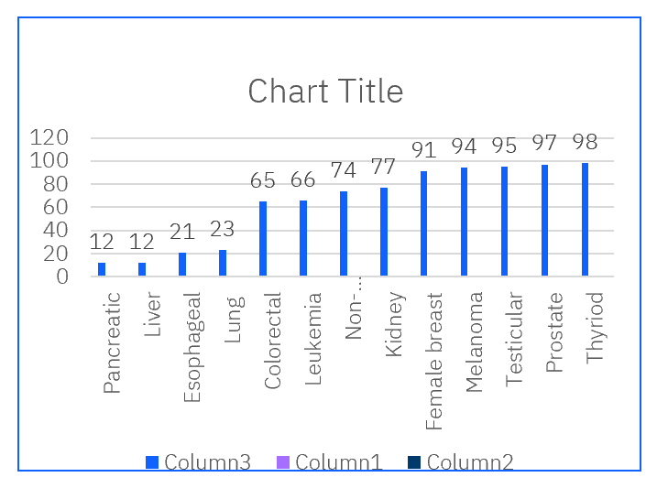
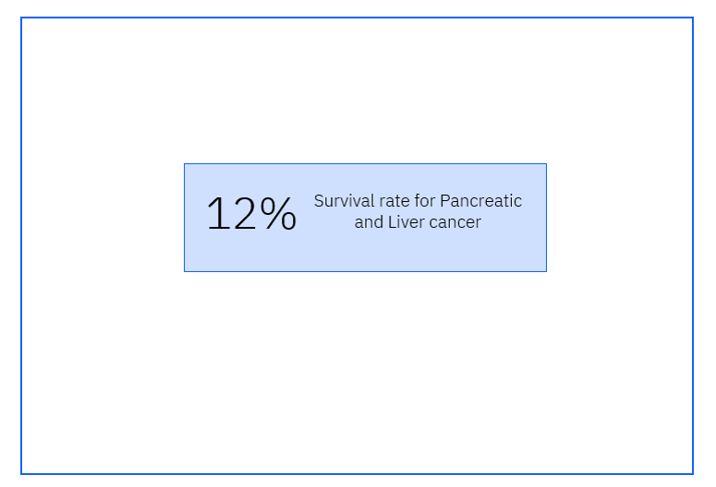
2.5 Getting feedback:
Step 3: Update the story based on feedback
Draft Visualization
Feedback
Final Visualization
Too busy Just want to see what are the types with the lowest survival rates Don’t want to have to dig for the information

Slide 35
You have completed the practice activities for Module 2.

