Slide 1
Module 2: Cancer Practice Activity 2.1 Align data to your storyboard and storyline 2.2 Align visualizations to your storyboard and storyline 2.3 Craft your call to action 2.4 Draft your story 2.5 Get Feedback

Slide 2
Background on the Cancer activity
Cancer is still the leading cause of death in the State of Washington. Keeping the public informed is key to raising awareness and implementing preventative measures.
In this activity, you will build on what you have already done in module 1 to do the following:
Align data to your storyline
Align visualizations to your storyline
Draft your story
Get feedback
A spreadsheet of cancer related data is available for your use in completing this activity (you received a link to get to it when you received the link to get to this file). Or if you prefer you can use your own sources of cancer related data.

Slide 3
Activity 2.1 Align data sources to your storyline
Identify and align potential data sources to your storyline.
Instructions
Look at the storyline you created. Think about the parts of your story.
Refer to the data dictionary for your data, either use what came from the source or create your own.
Use this information to identify data sources that will help present each of the following story parts
The HOOK
The RISING MOMENT
The AHA MOMENT
Put your potential data sources into the template.

Slide 4
2.1 Align data to your storyboard and storyline
Storyline
Data
Visuals
Great story
References: Brent Dyles, Effective Storytelling and Catherine Cote Data Storytelling: How to Tell a Story with Data (hbs.edu)

Slide 5
2.1 Align data to your storyline: Process
Step 1. Identify data for your HOOK
Step 3. Identify data for your AHA MOMENT
Step 2. Identify data for your RISING POINTS
Review the hook from your storyline.
Review the rising points from your storyline.
Review the AHA moment for your storyline.
Review your data sources.
Review your data sources.
Review your data sources.
Identify the data that is relevant to your HOOK.
Identify the data that is relevant to your RISING POINTS.
Identify the data that is relevant to your AHA MOMENT.
Document in the Data Alignment Template.
Document in the Data Alignment Template.
Document in the Data Alignment Template.

Slide 6
2.1 Align data to your storyline Step 1: Sample of completed Identify data for the HOOK
HOOK from the storyline we have prepared for the CDC:
COVID-19 risks are MEDIUM or HIGH in <#> US counties. <More, Fewer> counties are at elevated risk this week compared to last week.
From the data source provided by the CDC:
Data Column/Field | Description
County | Name of the county included in the hospital service area (HSA) reporting data
State | Name of the state or territory where the county is located
New Hospital Admissions | Total new hospital admissions for the HSA in the past week
New Hospital Admission Rate | Total new hospital admissions per 100K population for the HSA in the past week
Risk Level This Week | Hospital admission level this week:: LOW (<10 per 100K), MED (10 to 20), HIGH (>20)
Risk Level Last Week | Hospital admission level last week: LOW (<10 per 100K), MED (10 to 20), HIGH (>20)
Change in Admissions | Percent change in New Hospital Admissions compared to prior week
Capacity Utilization | Percent of staffed inpatient beds occupied by COVID-19 patients
Change in Capacity Utilization | Absolute change in Capacity Utilization compared to prior week
ICU Capacity Utilization | Percent of staffed intensive care unit (ICU) beds occupied by COVID-19 patients
Change in ICU Capacity Utilization | Absolute change in ICU Capacity Utilization compared to prior week
Our HOOK requires us to count counties that are in MEDIUM or HIGH COVID-19 risk levels.
“Risk Level This Week” is the most relevant data for this part of our HOOK.
Our HOOK also requires a comparison of risk levels this week compared to last week.
“Risk Level Last Week” is the data that will enable us to calculate if more or fewer (or the same number) of counties are at elevated risk.
Notes:
Look at what you documented under "Insights." Think of these connect to your provisional outline. If they don't then relook at your outline and consider revising it.

Slide 7
2.1 Align data to your storyline Step 1: Identify data for the HOOK
HOOK :
Enter your HOOK narrative
From the data source :
Data Column/Field | Description
Copy in the data dictionary if needed
Enter the fields that could be used to support the HOOK.

Slide 8
2.1 Align data to your storyline Step 2: Identify data for the RISING MOMENT
HOOK :
Enter your RISING MOMENT narrative
From the data source :
Data Column/Field | Description
Copy in the data dictionary if needed
Enter the fields that could be used to support the RISING MOMENT.

Slide 9
2.1 Align data to your storyline Step 3: Identify data for the AHA MOMENT
HOOK :
Enter your AHA MOMENT narrative
From the data source :
Data Column/Field | Description
Copy in the data dictionary if needed
Enter the fields that could be used to support the AHA MOMENT.

Slide 10
2.1 Align data to your storyline Sample of Completed Data Alignment Template
Storyline | Data Fields We Will Need | Why We Will Need Them
HOOK: COVID-19 risks are MEDIUM or HIGH in <#> US counties. <More, Fewer> counties are at elevated risk this week compared to last week. | Risk Level This Week Risk Level Last Week | Risk Level This Week enables us to count number of counties at MEDIUM or HIGH risk. Risk Level Last Week enables us to calculate if more or fewer counties are at elevated risk.
RISING POINT: Map of US County risk levels color-coded to highlight risk. For example, enabling identification of higher-risk clusters. | County State Risk Level This Week | County and State are needed for geo-coding to enable mapping. Risk Level This Week is needed to enable color coding on the map.
AHA MOMENT: COVID-19 risk level in <Community> is <Low, Medium, High>. For example, COVID-19 risk level in White County, Arkansas is HIGH. | County State Risk Level This Week Risk Level Last Week New Hospital Admission Rate | County, State and Risk Level This Week are needed to provide the AHA data point. Risk Level Last Week and New Hospital Admission Rate may be useful to provide additional context.
Notes:
Look at what you documented under "Insights." Think of these connect to your provisional outline. If they don't then relook at your outline and consider revising it.

Slide 11
2.1 Align data to your storyline: Copy your results into the Data Alignment Template
Storyline | Data Fields We will Need | Why We Will Need Them
Hook:
Rising Moments:
AHA Moment:
Copy your story line here.
Enter potential data fields for each story part here.
Write in your reason for picking those data fields here.

Slide 12
Activity 2.2 Align visuals to your storyline
Identify and align potential visualizations to your storyline.
Instructions
Look at the storyline you created. Think about the parts of your story.
Use this information to identify visualizations that will help present each of the following story parts
The HOOK
The Rising Moment
The AHA Moment
Put your potential visuals into the template.

Slide 13
2.2 Align data visuals to your story
Storyline
Data
Visuals
Great story
References: Brent Dyles, Effective Storytelling and Catherine Cote Data Storytelling: How to Tell a Story with Data (hbs.edu)

Slide 14
2.2 Align data visuals to your story: Process
Step 1. Identify visuals for your HOOK
Step 3. Identify visuals for your AHA MOMENT
Step 2. Identify visuals for your RISING POINTS
Review and analyze the data identified for the HOOK
Review and analyze the data identified for the RISING POINTS
Review and analyze the data identified for the AHA MOMENT
Choose and format visuals to enable your audience to most easily engage with your story.
is the best way to visualize that data?
Choose and format visuals to enable your audience to most easily continue engaging with your story.
Choose and format visuals to enable your audience to most easily obtain the key insight they need.

Slide 15
2.2 Align visuals to the storyline Step 1: Sample of completed align visual to HOOK
HOOK: COVID-19 risks are MEDIUM or HIGH in 402 US counties. More counties are at elevated risk this week compared to last week.
From here …
To there …
Use text to make the HOOK obvious and easily digestible. This is better than the generic chart title on the left.
Use position to show HIGH risk first, helping audience to consume more important information first.
Use a data table to present just three numbers directly aligned to risk levels. Better than the chart showing each individual county hospital admission rate, requiring audience to translate from rate to risk level.
Use color to make it easier to see different levels of risk.
Share your thoughts in the chat:
How is the To There version better than the From Here version?
How could we further improve the To There version?

Slide 16
2.2 Align visuals to the storyline Step 1: align visual to HOOK
From here …
To there …
HOOK:
HOOK:
Put your visual that supports the HOOK here
Can you think of ways to improve your visual? Think about simplifying and focusing. Put your revised visual here.

Slide 17
2.2 Align visuals to the storyline Step 2: align visual to RISING MOMENT
From here …
To there …
RISING MOMENT:
RISING MOMENT:
Put your visual that supports the RISING MOMENT here
Can you think of ways to improve your visual? Think about simplifying and focusing. Put your revised visual here.

Slide 18
2.2 Align visuals to the storyline Step 3: align visual to AHA MOMENT
From here …
To there …
AHA MOMENT:
AHA MOMENT:
Put your visual that supports the AHA MOMENT here
Can you think of ways to improve your visual? Think about simplifying and focusing. Put your revised visual here.

Slide 19
2.3 Craft your call to action
CALL TO ACTION:
Insert your CALL TO ACTION narrative here
From here …
To there …
Put CALL TO ACTION visual here
Can you think of ways to improve your visual? Think about simplifying and focusing. Put your revised visual here.

Slide 20
Activity 2.4 Draft your story
Use the data and visuals you identified to move the storyline into a story.
Instructions
Look at the storyline you created. Think about the four parts of your story. Think about the data and the visuals you linked to each story part.
Use this information to create slides that will help present each of the story parts
The HOOK
The Rising Moment
The AHA Moment
The CALL TO ACTION
Put your data and visuals into the template (there are four of them).

Slide 21
2.4 Draft your data story
Assemble your storyline, data and visuals into a compelling data story.
Storyline
Data
Visuals
Great story
References: Brent Dyles, Effective Storytelling and Catherine Cote Data Storytelling: How to Tell a Story with Data (hbs.edu)

Slide 22
2.4 Draft your data story: Process
Step 1. Create the story for your HOOK
Step 3. Create the story for your AHA MOMENT
Step 2. Create the story for your RISING MOMENTS
Your storyline narrative for the hook becomes a slide headline or section header.
Your storyline narrative for the rising moments becomes the headline or section header.
Your storyline narrative for the AHA moment becomes a slide headline or section header.
Step 4. Create the story for your CALL TO ACTION
Your storyline narrative for the call to action becomes a slide headline or section header.
Assemble your data and visuals to support the HOOK.
is the best way to visualize that data?
Assemble your data and visuals to support the RISING MOMENTS.
Assemble your data and visuals to support the AHA MOMENT.
Assemble supporting information for your CALL to ACTION.

Slide 23
2.4 Draft your data story: Step 1: sample of completed create story for the HOOK
COVID-19 health risks are HIGH or MEDIUM in 402 US counties. More counties are at elevated risk this week compared to last week.
Data through February 20, 2024

Slide 24
2.4 Draft your data story: Step 1: create story for the HOOK
Copy the narrative for the HOOK here as the title
Insert your HOOK visual

Slide 25
2.4 Draft your data story: Step 2: create story for the RISING MOMENT
Copy the narrative for the RISING MOMENT here as the title
Insert your RISING MOMENT visual

Slide 26
2.4 Draft your data story: Step 3: create story for the AHA MOMENT
Copy the narrative for the AHA MOMENT here as the title
Insert your AHA MOMENT visual

Slide 27
2.4 Draft your data story: Step 4: create story for the CALL TO ACTION
Copy the narrative for the CALL TO ACTION here as the title
Insert your CALL TO ACTION visual

Slide 28
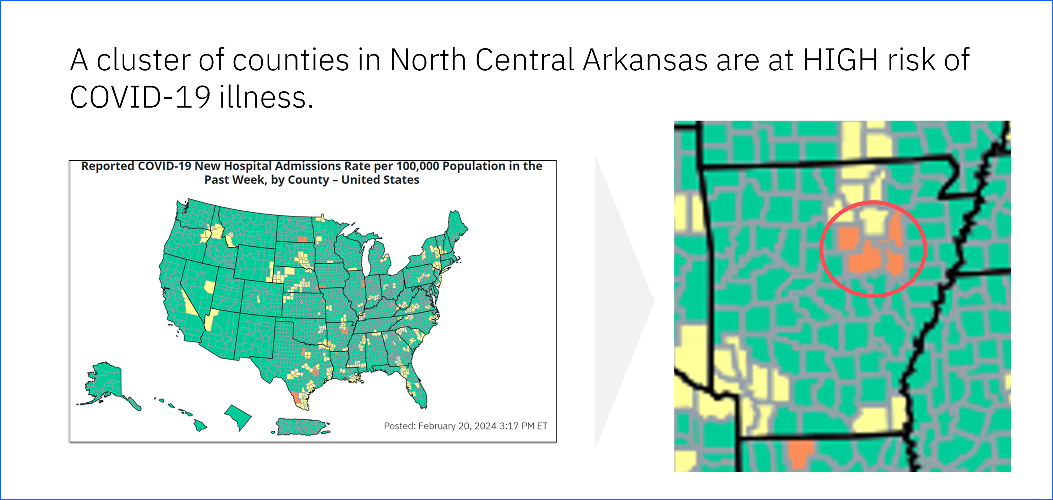
2.4 Draft your data story: Sample of completed Pulling it all together
HOOK
RISING POINTS
AHA MOMENT
CALL TO ACTION

Slide 29
2.4 Draft your data story: Pulling it all together
HOOK
RISING POINTS
Insert your HOOK visual
Insert your RISING POINTS visual
AHA MOMENT
CALL TO ACTION
Insert your AHA MOMENT visual
Insert your CALL TO ACTION visual

Slide 30
Activity 2.5 Getting feedback
Tap into respondents that represent your persona to get feedback.
Instructions
Think about the persona. Think about other stakeholders (SME, communications staff, etc.).
Use this information to identify people that represent these various stakeholders to provide you with feed back.
Obtain feedback
Update your draft story based on their feedback.
Place your updated story into the template.

Slide 31
2.5 Process for getting feedback
Step 1. Identify representatives to ask for feedback
Step 3. Update draft story
Step 2. Obtain feedback from representatives
Who can represent the concerned residents.
What questions can we ask to get information do we need from them?
Review each piece of feedback.
Are there others who need to be included e.g. SMEs, Communication office, etc.?
What can we ask them to ensure we get the feedback we need?
Does it really improve on the story?
Is the feedback representative of the larger group – or was it important to a few?
Enter potential candidates in template.
Enter questions in the template to gather their feedback.

Slide 32
2.5 Process for getting feedback Step 1: Identify representatives to ask for feedback
List your potential representatives here

Slide 33
2.5 Process for getting feedback Step 2: Obtain feedback
Record any feedback here

Slide 34
2.5 Getting feedback: Step 3: Update the story based on feedback
Draft Visualization
Feedback
Final Visualization
Put your draft visualization here
Put the feedback here
Put the revised visual here

Slide 35
You have completed the practice activities for Module 2. You can check your work against the sample answer.

