Slide 1
Module 2: Drug Practice Activity 2.1 Align data to your storyboard and storyline 2.2 Align visualizations to your storyboard and storyline 2.3 Craft your call to action 2.4 Draft your story 2.5 Get Feedback

Slide 2
Background on the Drug Overdose activity
Drug overdose deaths in the State of Washington is a cause for concern. The number of drug overdose deaths is rising each year.
In this activity, you will build on what you have already done in module 1 to do the following:
Align data to your storyline
Align visualizations to your storyline
Draft your story
Get feedback
A spreadsheet of drug overdose related data is available for your use in completing this activity (you received a link to get to it when you received the link to get to this file). Or if you prefer you can use your own sources of drug overdose related data.

Slide 3
Activity 2.1 Align data sources to your storyline
Identify and align potential data sources to your storyline.
Instructions
Look at the storyline you created. Think about the parts of your story.
Refer to the data dictionary for your data, either use what came from the source or create your own.
Use this information to identify data sources that will help present each of the following story parts
The HOOK
The RISING MOMENT
The AHA MOMENT
Put your potential data sources into the template.

Slide 4
2.1 Align data to your storyboard and storyline
Storyline
Data
Visuals
Great story
References: Brent Dyles, Effective Storytelling and Catherine Cote Data Storytelling: How to Tell a Story with Data (hbs.edu)

Slide 5
2.1 Align data to your storyline: Process
Step 1. Identify data for your HOOK
Step 3. Identify data for your AHA MOMENT
Step 2. Identify data for your RISING POINTS
Review the hook from your storyline.
Review the rising points from your storyline.
Review the AHA moment for your storyline.
Review your data sources.
Review your data sources.
Review your data sources.
Identify the data that is relevant to your HOOK.
Identify the data that is relevant to your RISING POINTS.
Identify the data that is relevant to your AHA MOMENT.
Document in the Data Alignment Template.
Document in the Data Alignment Template.
Document in the Data Alignment Template.

Slide 6
2.1 Align data to your storyline Step 1: Sample of completed Identify data for the HOOK
HOOK from the storyline we have prepared for the CDC:
COVID-19 risks are MEDIUM or HIGH in <#> US counties. <More, Fewer> counties are at elevated risk this week compared to last week.
From the data source provided by the CDC:
Data Column/Field | Description
County | Name of the county included in the hospital service area (HSA) reporting data
State | Name of the state or territory where the county is located
New Hospital Admissions | Total new hospital admissions for the HSA in the past week
New Hospital Admission Rate | Total new hospital admissions per 100K population for the HSA in the past week
Risk Level This Week | Hospital admission level this week:: LOW (<10 per 100K), MED (10 to 20), HIGH (>20)
Risk Level Last Week | Hospital admission level last week: LOW (<10 per 100K), MED (10 to 20), HIGH (>20)
Change in Admissions | Percent change in New Hospital Admissions compared to prior week
Capacity Utilization | Percent of staffed inpatient beds occupied by COVID-19 patients
Change in Capacity Utilization | Absolute change in Capacity Utilization compared to prior week
ICU Capacity Utilization | Percent of staffed intensive care unit (ICU) beds occupied by COVID-19 patients
Change in ICU Capacity Utilization | Absolute change in ICU Capacity Utilization compared to prior week
Our HOOK requires us to count counties that are in MEDIUM or HIGH COVID-19 risk levels.
“Risk Level This Week” is the most relevant data for this part of our HOOK.
Our HOOK also requires a comparison of risk levels this week compared to last week.
“Risk Level Last Week” is the data that will enable us to calculate if more or fewer (or the same number) of counties are at elevated risk.
Notes:
Look at what you documented under "Insights." Think of these connect to your provisional outline. If they don't then relook at your outline and consider revising it.

Slide 7
2.1 Align data to your storyline Step 1: Identify data for the HOOK
HOOK : There was a 16% increase in drug overdose deaths from last year.
From the data source :
Data Column/Field | Description
Drug deaths | Number of drug deaths (total)
Years | Years
Drug type | Type of drugs (Cocaine, Heroin, Stimulants, etc.)
Gender | Gender
Age | 15-24 only
Want to show the increase since last year
Don’t need any other information yet

Slide 8
2.1 Align data to your storyline Step 2: Identify data for the RISING MOMENT
RISING MOMENT : Overdose deaths are higher depending on the drugs being used.
From the data source :
Data Column/Field | Description
Drug deaths | Number of drug deaths (total)
Years | Years
Drug type | Type of drugs (Cocaine, Heroin, Stimulants, etc.)
Gender | Gender
Age | 15-24 only
Want to see the break down of deaths by drug type.
Might need years if we want to also look at the overdose by type of drug over years to see if that has changed.

Slide 9
2.1 Align data to your storyline Step 3: Identify data for the AHA MOMENT
AHA MOMENT : Some overdose deaths are due to fentanyl even those users were not using Opioids.
From the data source :
Data Column/Field | Description
Drug deaths | Number of drug deaths (total)
Years | Years
Drug type | Type of drugs (Cocaine, Heroin, Stimulants, etc.)
Gender | Gender
Age | 15-24 only
Need number of deaths by drug type
This time we need to look at fentanyl deaths alone and in combination with other drugs.
Reports are coming in about other non-opioids being contaminated with fentanyl.
We are really interested in cocaine deaths which does not have the highest death rate – but we can see that fentanyl in combination with cocaine accounts for 74% of the cocaine deaths

Slide 10
2.1 Align data to your storyline Sample of Completed Data Alignment Template
Storyline | Data Fields We Will Need | Why We Will Need Them
HOOK: COVID-19 risks are MEDIUM or HIGH in <#> US counties. <More, Fewer> counties are at elevated risk this week compared to last week. | Risk Level This Week Risk Level Last Week | Risk Level This Week enables us to count number of counties at MEDIUM or HIGH risk. Risk Level Last Week enables us to calculate if more or fewer counties are at elevated risk.
RISING POINT: Map of US County risk levels color-coded to highlight risk. For example, enabling identification of higher-risk clusters. | County State Risk Level This Week | County and State are needed for geo-coding to enable mapping. Risk Level This Week is needed to enable color coding on the map.
AHA MOMENT: COVID-19 risk level in <Community> is <Low, Medium, High>. For example, COVID-19 risk level in White County, Arkansas is HIGH. | County State Risk Level This Week Risk Level Last Week New Hospital Admission Rate | County, State and Risk Level This Week are needed to provide the AHA data point. Risk Level Last Week and New Hospital Admission Rate may be useful to provide additional context.
Notes:
Look at what you documented under "Insights." Think of these connect to your provisional outline. If they don't then relook at your outline and consider revising it.

Slide 11
2.1 Align data to your storyline: Copy your results into the Data Alignment Template
Storyline | Data Fields We will Need | Why We Will Need Them
Hook: There was a 16% increase in drug overdose deaths from last year. | Drug Deaths Years | Need the year data so that we can calculate increase from last year Need overdose counts
Rising Moments: Overdose deaths are higher depending on the drugs being used. | Drug Deaths Drug Type | Need overdose number for types of drugs
AHA Moment: Some overdose deaths are due to fentanyl even those users were not using Opioids. | Drug Deaths Drug Type | Need overdose numbers for fentanyl alone and in combination with other drug

Slide 12
Activity 2.2 Align visuals to your storyline
Identify and align potential visualizations to your storyline.
Instructions
Look at the storyline you created. Think about the parts of your story.
Use this information to identify visualizations that will help present each of the following story parts
The HOOK
The Rising Moment
The AHA Moment
Put your potential visuals into the template.

Slide 13
2.2 Align data visuals to your story
Storyline
Data
Visuals
Great story
References: Brent Dyles, Effective Storytelling and Catherine Cote Data Storytelling: How to Tell a Story with Data (hbs.edu)

Slide 14
2.2 Align data visuals to your story: Process
Step 1. Identify visuals for your HOOK
Step 3. Identify visuals for your AHA MOMENT
Step 2. Identify visuals for your RISING POINTS
Review and analyze the data identified for the HOOK
Review and analyze the data identified for the RISING POINTS
Review and analyze the data identified for the AHA MOMENT
Choose and format visuals to enable your audience to most easily engage with your story.
is the best way to visualize that data?
Choose and format visuals to enable your audience to most easily continue engaging with your story.
Choose and format visuals to enable your audience to most easily obtain the key insight they need.

Slide 15
2.2 Align visuals to the storyline Step 1: Sample of completed align visual to HOOK
HOOK: COVID-19 risks are MEDIUM or HIGH in 402 US counties. More counties are at elevated risk this week compared to last week.
From here …
To there …
Use text to make the HOOK obvious and easily digestible. This is better than the generic chart title on the left.
Use position to show HIGH risk first, helping audience to consume more important information first.
Use a data table to present just three numbers directly aligned to risk levels. Better than the chart showing each individual county hospital admission rate, requiring audience to translate from rate to risk level.
Use color to make it easier to see different levels of risk.
Share your thoughts in the chat:
How is the To There version better than the From Here version?
How could we further improve the To There version?

Slide 16
2.2 Align visuals to the storyline Step 1: align visual to HOOK
HOOK : There was a 16% increase in drug overdose deaths from last year.
From here …
To there …
16%
Increase in Deaths
In 2021 there were 106,699 deaths due to overdose. An increase of 16% over the previous year.

Slide 17
2.2 Align visuals to the storyline Step 2: align visual to RISING MOMENT
RISING MOMENT : Overdose deaths are higher depending on the drugs being used.
From here …
To there …
Death rates vary widely based on drug type
Opioids (including Fentanyl) account for most of the drug related deaths.
# of deaths

Slide 18
2.2 Align visuals to the storyline Step 3: align visual to AHA MOMENT
AHA MOMENT : Some overdose deaths are due to fentanyl even those users were not using Opioids.
From here …
To there …
74% of cocaine related deaths also had fentanyl present in addition to cocaine
Cocaine with NO fentanyl
6,333 deaths
Cocaine with fentanyl
18,153 deaths
Number of cocaine related deaths

Slide 19
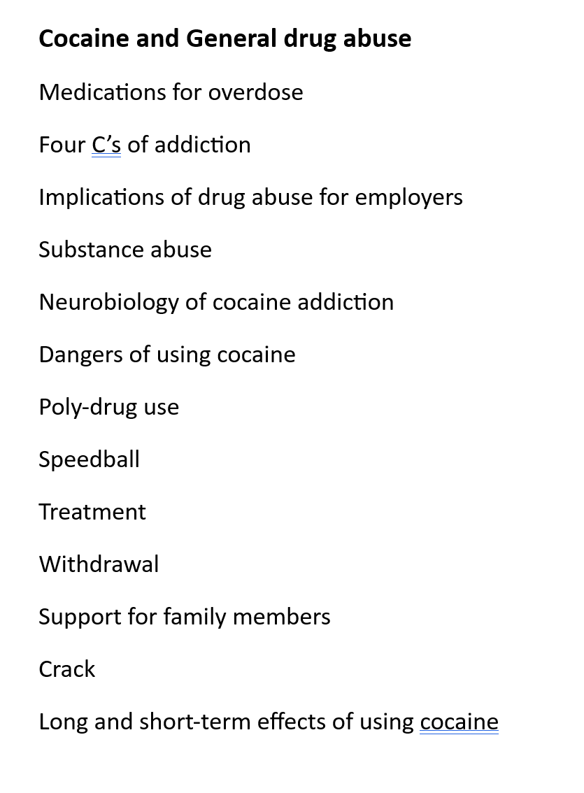
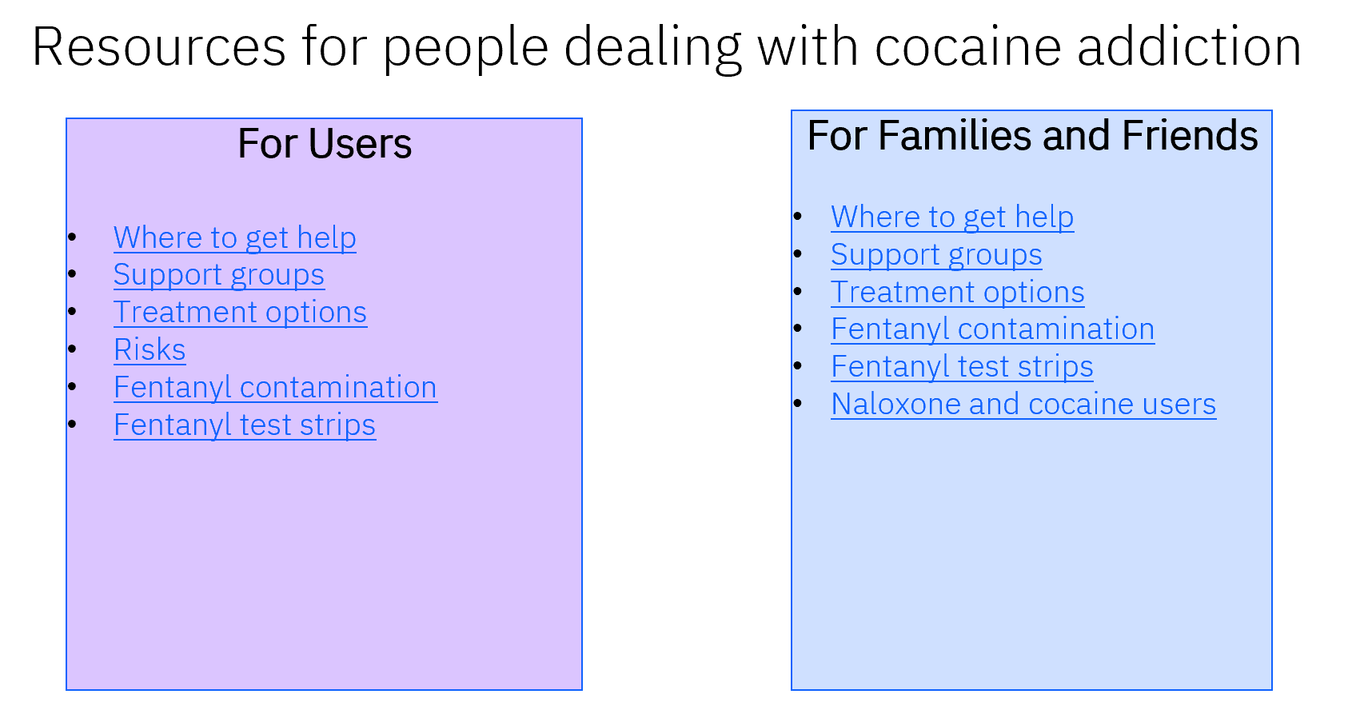
2.3 Craft your call to action
CALL TO ACTION: Reggie is presented with a tailored list of recommended actions for cocaine.
From here …
To there …

Slide 20
Activity 2.4 Draft your story
Use the data and visuals you identified to move the storyline into a story.
Instructions
Look at the storyline you created. Think about the four parts of your story. Think about the data and the visuals you linked to each story part.
Use this information to create slides that will help present each of the story parts
The HOOK
The Rising Moment
The AHA Moment
The CALL TO ACTION
Put your data and visuals into the template (there are four of them).

Slide 21
2.4 Draft your data story
Assemble your storyline, data and visuals into a compelling data story.
Storyline
Data
Visuals
Great story
References: Brent Dyles, Effective Storytelling and Catherine Cote Data Storytelling: How to Tell a Story with Data (hbs.edu)

Slide 22
2.4 Draft your data story: Process
Step 1. Create the story for your HOOK
Step 3. Create the story for your AHA MOMENT
Step 2. Create the story for your RISING MOMENTS
Your storyline narrative for the hook becomes a slide headline or section header.
Your storyline narrative for the rising moments becomes the headline or section header.
Your storyline narrative for the AHA moment becomes a slide headline or section header.
Step 4. Create the story for your CALL TO ACTION
Your storyline narrative for the call to action becomes a slide headline or section header.
Assemble your data and visuals to support the HOOK.
is the best way to visualize that data?
Assemble your data and visuals to support the RISING MOMENTS.
Assemble your data and visuals to support the AHA MOMENT.
Assemble supporting information for your CALL to ACTION.

Slide 23
2.4 Draft your data story: Step 1: sample of completed create story for the HOOK
COVID-19 health risks are HIGH or MEDIUM in 402 US counties. More counties are at elevated risk this week compared to last week.
Data through February 20, 2024

Slide 24
2.4 Draft your data story: Step 1: create story for the HOOK
There was a 16% increase in drug overdose deaths from last year.
16%
Increase in Deaths
In 2021 there were 106,699 deaths due to overdose. An increase of 16% over the previous year.

Slide 25
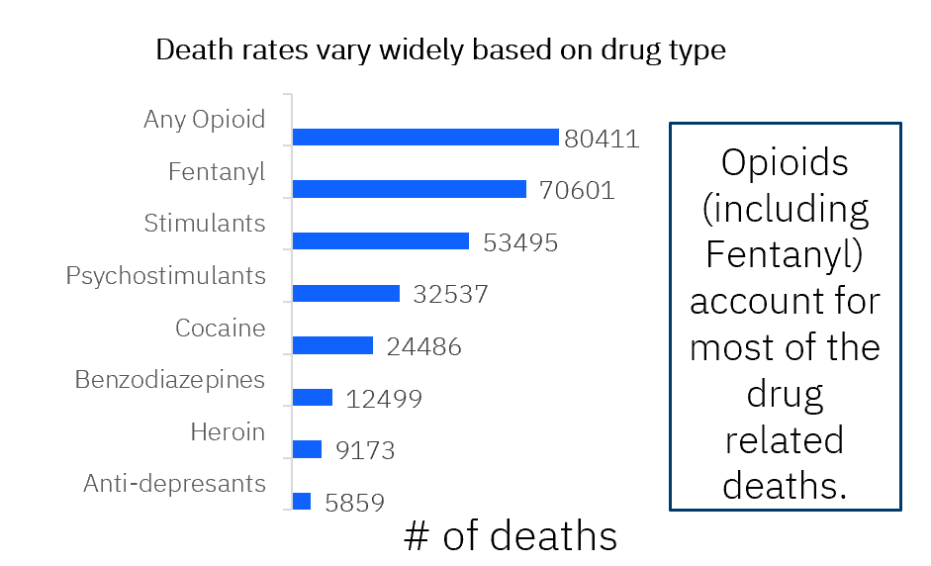
2.4 Draft your data story: Step 2: create story for the RISING MOMENT
Overdose deaths are higher depending on the drugs being used.

Slide 26
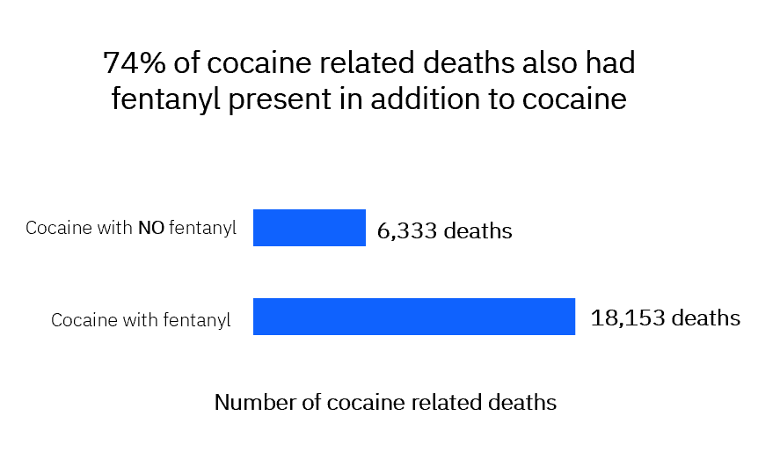
2.4 Draft your data story: Step 3: create story for the AHA MOMENT
Some overdose deaths are due to fentanyl even those users were not using opioids.

Slide 27
2.4 Draft your data story: Step 4: create story for the CALL TO ACTION
Reggie is presented with a tailored list of recommended actions for cocaine.

Slide 28
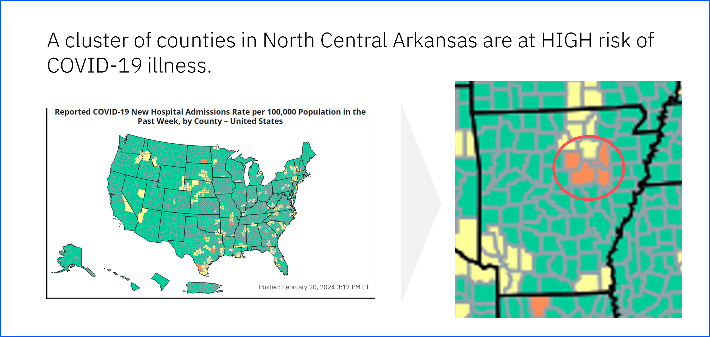
2.4 Draft your data story: Sample of completed Pulling it all together
HOOK
RISING POINTS
AHA MOMENT
CALL TO ACTION

Slide 29
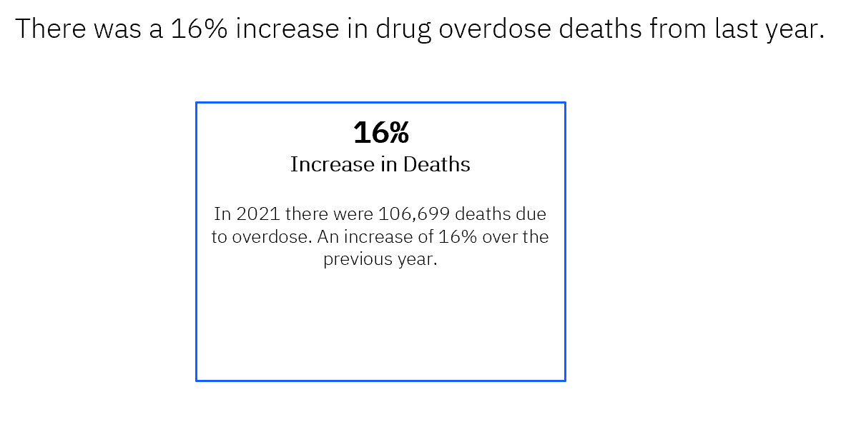
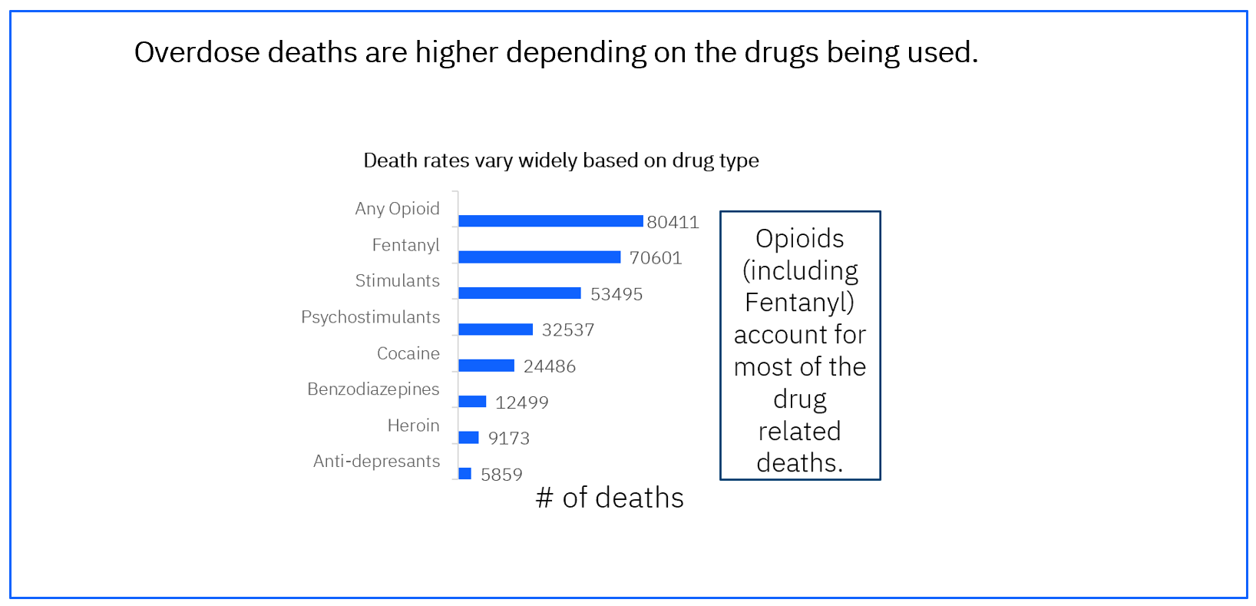
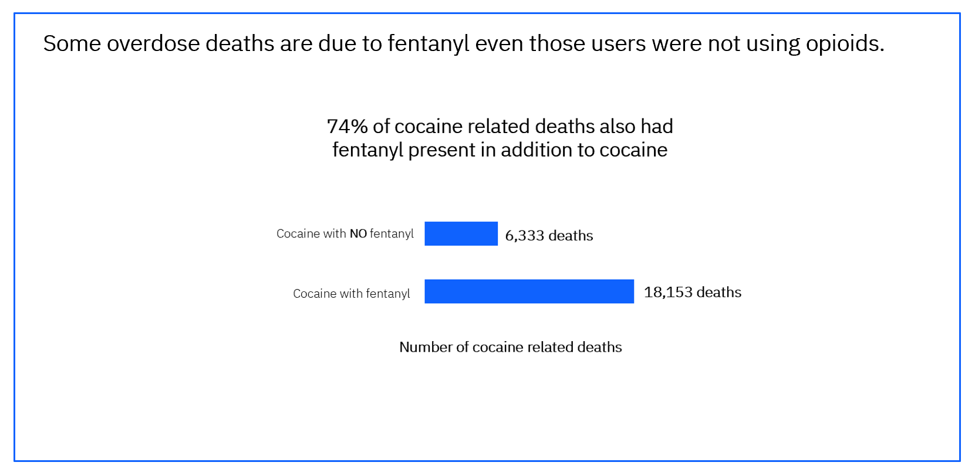
2.4 Draft your data story: Pulling it all together
HOOK
RISING POINTS
AHA MOMENT
CALL TO ACTION

Slide 30
Activity 2.5 Getting feedback
Tap into respondents that represent your persona to get feedback.
Instructions
Think about the persona. Think about other stakeholders (SME, communications staff, etc.).
Use this information to identify people that represent these various stakeholders to provide you with feed back.
Obtain feedback
Update your draft story based on their feedback.
Place your updated story into the template.

Slide 31
2.5 Process for getting feedback
Step 1. Identify representatives to ask for feedback
Step 3. Update draft story
Step 2. Obtain feedback from representatives
Who can represent the concerned residents.
What questions can we ask to get information do we need from them?
Review each piece of feedback.
Are there others who need to be included e.g. SMEs, Communication office, etc.?
What can we ask them to ensure we get the feedback we need?
Does it really improve on the story?
Is the feedback representative of the larger group – or was it important to a few?
Enter potential candidates in template.
Enter questions in the template to gather their feedback.

Slide 32
2.5 Process for getting feedback Step 1: Identify representatives to ask for feedback
Family members of addicts
Addicts
Social workers
Counselors
Clergy
Communications team members
Subject matter experts

Slide 33
2.5 Process for getting feedback Step 2: Obtain feedback
Too many numbers
Don’t know how to read charts
Is my family member at risk?
Too many colors
I don’t know where to click
Needs to be simple

Slide 34
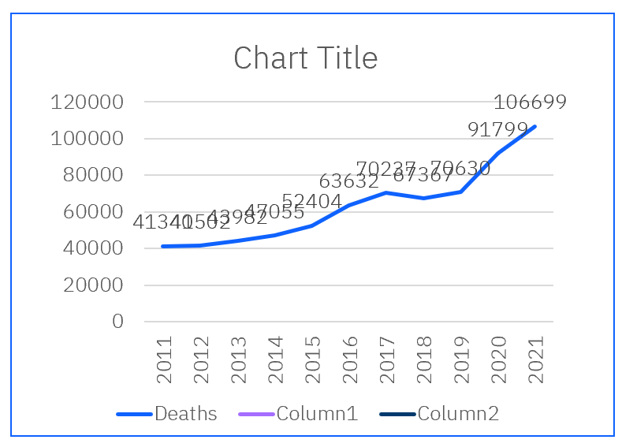
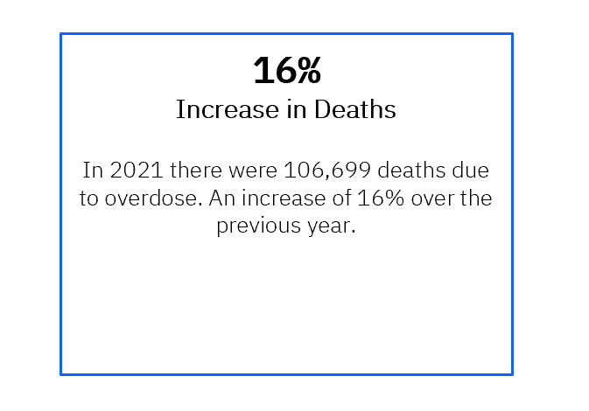
2.5 Getting feedback: Step 3: Update the story based on feedback
Draft Visualization
Feedback
Final Visualization
Too many numbers Don’t know how to read charts Is my family member at risk? Too many colors I don’t know where to click Needs to be simple

Slide 35
You have completed the practice activities for Module 2.

