Slide 1
Washington State
Colorectal Cancer Task Force
November 23rd , 2023
Notes:
9:00 am- 9:02
Thank you for joining us. We will get started in just a moment.
Good morning and Welcome to the CRC Task Force’s last quarterly meeting in 2023! Thank you everyone for joining us today, appreciate it!
For your information, today’s meeting will be recorded, will share with you all later along with the meeting notes.

Slide 2
Agenda
Introductions & Icebreaker Qn
Announcements
Sharing updates and Events
Updated Mission Statement
Presentation and Q& A
CRC National & State Data Overview
2024 Project Brainstorming
Wrap up & Next Steps
Notes:
9:02- 9:05
Here is our agenda for this meeting
We’ll start with introductions and ice breaker question, and then we’ll share a couple exciting announcements
Then we’ll have some time for everyone to share any upcoming events or updates that you think would be great the Task Force members
After that we’ll review the updated mission statement, seek feedback one last time before we finalize it
We have two amazing speakers from Fred Hutch joining us today Ari- Bell Brown and Amanda Kimura , they are going to do a presentation on a Colorectal Cancer Screening Program done by Fred Hutch and UW Medicine Population Health.
After the presentation, there will be a 10-minute break,
and we will rejoin for a CRC Data Review by Kayla Kenyon from Fred Hutch’s Office of Community Outreach and Engagement
And we’ll have 2024 project Brainstorming section with Katie Treend
We’ll wrap up 10:55 am

Slide 3
Introduction & Icebreaker
In the chat, please put your :
Name, Organization & Role
What is one thing you are truly looking forward to doing before the end of this year?
Notes:
9:05- 9:10
Please put your name, organization and Role in the chat
And answer this icebreaker question- what is one thing you are truly looking forward to doing before the end of this year?
You can put it in the chat, or if you would like to unmute and speak, feel free to do that!
Thank you everyone, for sharing your responses, it looks like I’m not the only one who have incomplete new year resolution! That’s actually good to know, relieving!

Slide 4
Announcements
Northwest CRC Task Force
2024 Meeting Dates
February 27th, 2024, (Tuesday) 9:00am - 11:00am
June 4th, 2024 (Tuesday) 9:00am- 11:00am
October 1st, 2024 (Tuesday) 9:00am- 11:00am
Notes:
9:10- 9:15
Here are some announcements:
We are excited to share with you all that we are transforming to Northwest CRC Task Force as we now have members from OR CRC Task Force. It feels like a natural merger –as you know we like to expand our partnership, Orgon has similar population as WA, and faces same challenges, also working on same mission- so these collective efforts will help us achieve the mission.
Meeting schedule for 2024
We have changed our day of meeting from Friday to Tuesday, same time 9:00 am- 11:00am
The quarterly Meeting dates are- February 27th, June 4th and October 1st . Don’t worry, we’ll send a calendar invite to put a hold on your calendar for these dates and time

Slide 5
Sharing Updates and Events
Cancer Action Plan of WA ( CAPOW) Meeting
Date: January 24^{th,} 2024 (Wednesday)
Location: Hybrid- Olympia, and in Online; Hubs in Poulsbo and Spokane
Contact Katie Treend at Katie.Treend@doh.wa.gov
Do you have any updates or upcoming events to share with the Task Force?
Notes:
9:15- 9:20
Here is one upcoming event we would like share with you all, and after that we’ll have time for everyone to share We wanted to check you all do you have any events coming up? Do you have any resources to share? Feel free to unmute and speak or type in the chat.
The Cancer Action Plan of WA (CAPOW) – our statewide cancer coalition’s next meeting will be on January 24th, the meeting is hybrid, with main venue in Olympia, and hubs in Spokane and Poulsbo, where can attend the meeting in person, and for who can’t attend in-person, they can join online. The registration for this meeting now open. Please contact Katie Treend for more info.

Slide 6
Updated Mission Statement
“Our mission is to reduce the burden of colorectal cancer and related health inequities in the Northwest region by improving cancer screening rates and outcomes. We strive to reduce the burden of colorectal cancer in the state through collaborative efforts and fostering partnerships with diverse populations and organizations working across cancer care continuum to:
Increase prevention efforts
Promote screening
Improve access to care
Bolster survivorship support
Spread awareness.”
Notes:
9:20- 9:30 am
For those who newly joined the task force, here is a little bit of context,
In our last meeting we had robust discussion on updating our mission statement as we were relaunching our CRC TF after the pandemic.
We wanted to make sure that mission statement aligns with everybody’s goals, activities and current state of CRC in WA.
We received such a great feedback and revised the old mission statement based on that.
Thank you everyone for sharing your thoughts and insights and contributing to this updated mission statement.
If you haven’t gotten a chance to review in the reminder email, here is the updated mission, and please take a moment to review it.
Here is one last chance to give your feedback before we finalize it,
What do you think about it, Do you approve this Mission and Vision Statement?
If you approve- Yes
No – please provide what is missing or should be changed.

Slide 7
Presentation
The Fred Hutch/UW Medicine Population Health
Colorectal Cancer Screening Program
Speakers: Ari Bell-Brown, Amanda Kimura
Fred Hutchinson Cancer Center
Notes:
9:30 – 10:00 am
Pass it to Aden to introduce speakers

Slide 8
The Fred Hutch/UW Medicine Population Health Colorectal Cancer Screening Program
Ari Bell-Brown, MPH & Amanda Kimura, MPH
Hutchinson Institute for Cancer Outcomes Research
Fred Hutchinson Cancer Center
November 3, 2023

Slide 9
Program Overview
Community Engagement
Research Projects

Slide 10
Program Overview

Slide 11
Population Health Colorectal Cancer (CRC) Screening Program
Joint program established in September 2021 by UW Medicine & Fred Hutchinson Cancer Center
Mission: To improve CRC screening completion for all UW Medicine patients and to evaluate interventions to increase screening participation equitably for all individuals
Impact: We expect the program to improve patient care quality, increase health care equity, and drive additional payor contracts across our health system

Slide 12
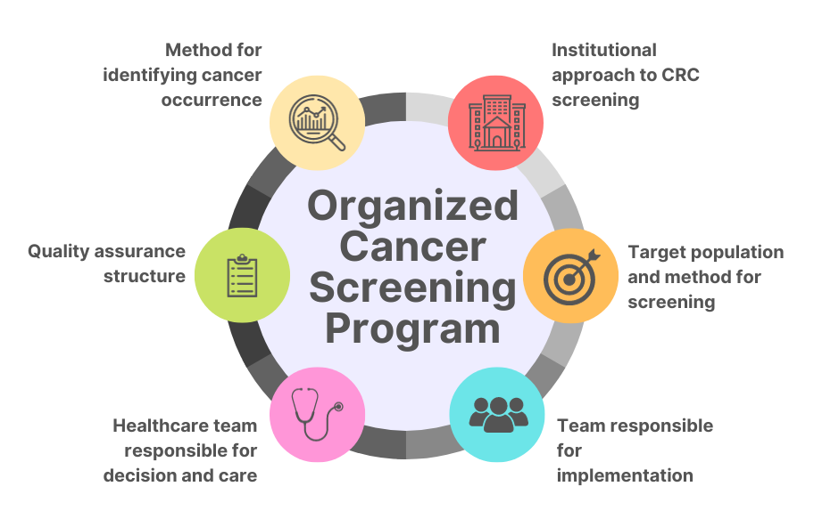
Year 1 - Implementing the CRC screening program
Dominitz JA et al. Gastro Endo Clin N Am, 2020
Kimura A et al. AJPM Focus, 2023
Notes:
Using an accepted framework, we defined the process that would lead to implementing an organized screening program that would yield the results we hoped to achieve
We started by defining the institutional approach ….

Slide 13
Year 1 – Establishing mailed FIT workflow
Kimura A et al. AJPM Focus, 2023

Slide 14
Year 2 - mailed FIT outreach
9,719 Patients received outreach
3,102 Patients completed screening
87 Patients with abnormal results completed colonoscopy
31 Patients with CRC or high-risk lesions needing closer surveillance
Notes:
Our program year occurs in 2 phases, Jan – July (we ID and reach eligible people via outreach), July – Dec (analyze data and prepare for the next year’s outreach)
Using best practices inclusion and exclusion criteria, we identified 9719 of the 22,721 patients due for screening that would be appropriate for mailed FIT outreach.
32% completed screening by mailed FIT or colonoscopy and ~6% had abnormal results that required follow-up
Of the 31 patients, 6 had CRC and 25 had other high-risk lesions requiring close follow-up

Slide 15
Year 2 Impact – CRC screening by race
Kimura A et al. AJPM Focus, 2023

Slide 16
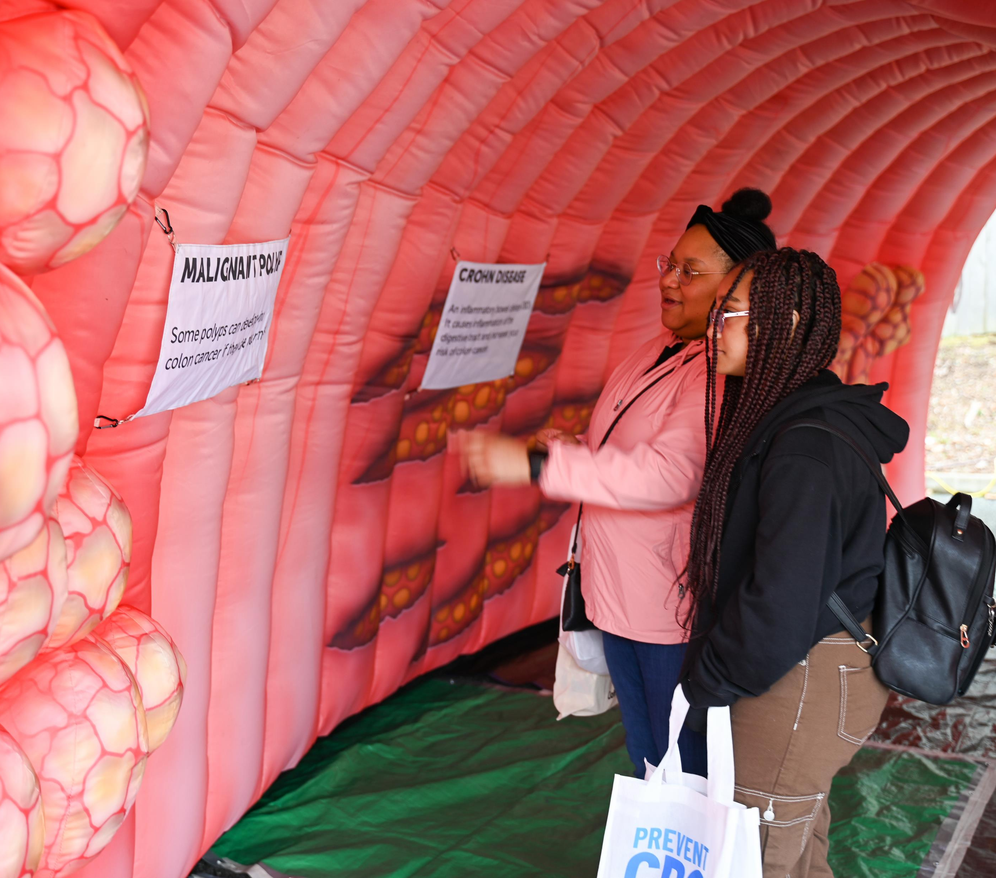
2022- 2023 Program Highlights Towards Health Equity
Payment Assistance Program
We allocated funds to cover the costs of screening for patients who faced financial barriers to CRC screening. To date, over 90 uninsured/ underinsured patients have used this resource.
Language Access Expansion
We expanded the program material languages from English and Spanish to include Arabic, Chinese, Khmer, Russian, Somali and Vietnamese, enabling us to reach an additional 500 patients.
Photo by Leah Blanton

Slide 17
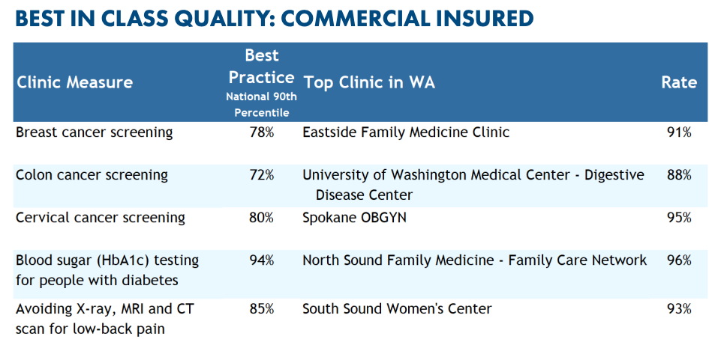
Program Impact – 2023 WA Health Alliance Report
www.wahealthalliance.org
Notes:
Since 2008, the Washington Health Alliance has been reporting on the quality of care in our state.
Overall in WA state, CRC screening is between the 25th to 50% national percentile set by NCQA (state average 61% and the national 90th% is 72%)
UWMC was recognized as the top performer for CRC screening among commercially insured patients!

Slide 18
2023 Mailed FIT Outreach - Ongoing
14,521 Patients received outreach
4,703 Patients completed screening
73 Patients with abnormal results completed colonoscopy
176 Patients with abnormal FIT results
Notes:
- In the current program year, 45 to 49 year olds are included in the eligible patient population due for CRC screening (53263/82113 = 65% UTD with screening).
- Of the ~29,000 patients due for CRC screening, we identified 14,500 eligible for mailed outreach, Increasing our program by ~50% compared to the prior year and growing from 16 to 28 clinics.
Screenings to date: FITs: 4,521 Colonoscopies: 182

Slide 19
Looking Ahead – Year 03 Goals and Priorities
Screening in 45 to 49 years olds
Decreasing racial disparities in screening
Focusing on follow-up colonoscopy
Optimizing program communications
Streamlining data management

Slide 20
Community Engagement

Slide 21
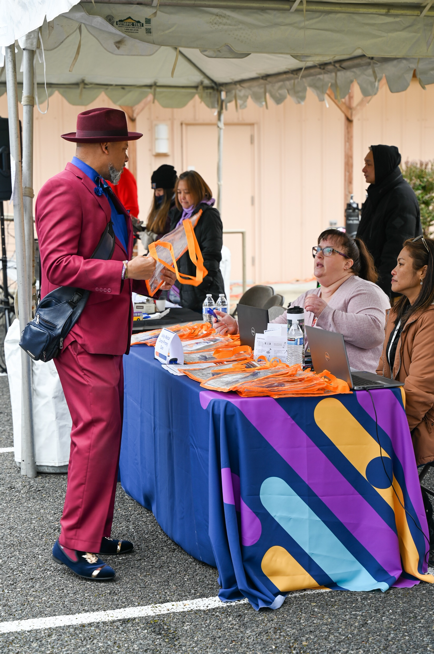
March CRC Community Awareness Event
Community members had the opportunity to take home screening tests, schedule primary care appointments on site, and learned how to prevent and reduce their risk for colorectal cancer.
Knowledge of age to begin CRC screening nearly doubled (28% to 54%) among participants who attended the event.
All photos by Leah Blanton

Slide 22
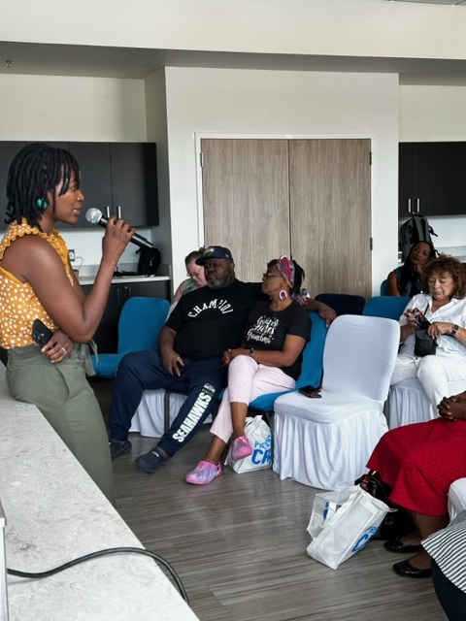
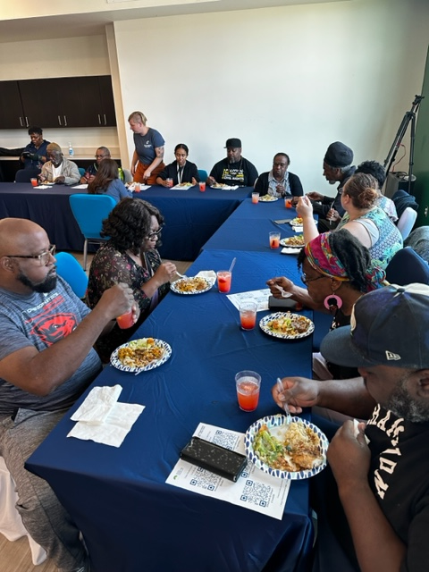
Colon Health Event at The Marvin Williams Center- Bremerton
Attendees talked about colorectal cancer prevention with members of the program team, walked through the inflatable colon, and a chef cooked a delicious and colon healthy lunch!
Use the QR code to access one of the Cook For Your Life recipes used at the event!
Photos from Dr. Lillian Robertson

Slide 23
Research Projects

Slide 24
Lack of follow-up colonoscopy impact millions of people
7 to 9 million people complete an annual stool test for CRC screening
6% to 10% will have an abnormal result requiring follow-up
50% to 60% will complete a colonoscopy within 1 year of result
3% to 5% will ultimately be diagnosed with CRC
Meester RG er al. Cancer. 2015
Chubak J et al. CEBP. 2016
Issaka RB et al. Am J Gastro. 2017
Jensen CD et al. Ann Int Med. 2016
Selby K et al. J Med Screen. 2020
American Cancer Society. Colorectal Cancer Facts & Figures 2020-2022
Notes:
Our research largely focuses on how to improve follow-up for patients that have an abnormal non-invasive test, such as a FIT, which is an annual stool test to screen for CRC
In the U.S. 7 to 9 million people will complete an annual stool test for CRC screening, with the majority being FIT
These numbers are even greater globally when considering countries with FIT-based population screening programs.
Approximately 6 to 10% will have an abnormal result that requires follow-up.
To put this in numerical context, this equates ~420,000 – 900,000 people in the U.S. alone yearly.
Yet we know that depending on the health system, allocated resources, and other social demographic factors not all patients will complete a follow-up colonoscopy.
In fact, in the U.S. follow-up for abnormal FIT results rarely exceeds 50% in non-integrated health systems like KP
And ultimately 3-5% of these individuals will ultimately be diagnosed with CRC

Slide 25
Preliminary Work
As part of Dr. Issaka's K08 award, we conducted a mixed-methods analysis evaluating reasons for lack of follow-up colonoscopy in patients with abnormal FIT results in a safety-net health system (Harborview Medical Center)
Persistent barriers to follow-up colonoscopy completion that were cited included:
Lack of Transportation
Fear of colonoscopy procedure/bowel prep
Fragmented care/lack of navigation
Issaka RB et al, Prev. Med Reports, 2022
Issaka RB et al. JAMA Net Open. 2021
Notes:
- Working on research projects that address transportation and fear barriers
- Fragmented care being address by patient navigation via crc screening program

Slide 26
Operationalizing rideshare for colonoscopy completion
Hypothesis: Rideshare non-emergency medical transportation (NEMT) platforms are a potentially scalable and cost-effective strategy to increase colonoscopy completion
Aim 1: Identify barriers, facilitators, and process recommendations to implement a rideshare NEMT for patients receiving procedural sedation in a safety-net system
Aim 2: Pilot a rideshare NEMT in a safety-net population requiring colonoscopy for CRC screening

Slide 27
Operationalizing rideshare for colonoscopy completion
Informal stakeholder engagement meetings
Aug 2020 - Aug 2021
22 data collection points from 34 individuals
Storyboards to engage stakeholders
Nominal group technique with 5 stakeholders to finalize the rideshare NEMT workflow
Stakeholders
Patient(s) | Chief of Anesthesia | Endoscopy Business Operations Supervisor | Risk Management & Compliance | Health System Contracting
Primary Care & Ambulatory Care Medical Directors | Chief of Nursing | Patient Care Coordinators | Infection Prevention | Rideshare Healthcare Senior Manager
Gastroenterology Medical Director | Procedural Unit Nurse Manager | Endoscopy Nurses | Social Work | Rideshare Contracting
State Healthcare Authority | Managers of Healthcare System Transportation Vendors
Bell-Brown et al, Front Hlth Ser, 2022
Notes:
Through this process obtained buy-in and institutional support from HMC, Lyft, WA State Health Care Authority and many others
Finalized a contract and began piloting this program at HMC in the spring of 2022
Initially excluded patients on Medicaid as requested by WA Health Care Authority, after realizing the number of people we were turning away, we re-engaged them in conversation and obtained buy-in to include Medicaid patients.

Slide 28
Pilot Study Workflow

Slide 29
Rideshare pilot program – preliminary results
Demographics
As of 10/23/23, 44 patients have consented to the study and 39 rides have been completed
Majority are men (75%) and primarily speak English (89%)​
50% self-identify as White, 18% Black, 14% Asian, 5% AI/AN and 2% as multi-racial ​
18% self-identify as Hispanic or Latinx
Issaka, et al. Clin Gastro Hep, 2023
Notes:
I’m excited to share some of this preliminary data To date we’ve consented 44 patients to date to use this program at HMC
Demographics of these participants are included here. 75% are men, 52% racial/ethnic minorities, 55% on public insurance and 4 uninsured
Majority (64%) live less than 30 minutes away from HMC

Slide 30
Rideshare program pilot – preliminary results, cont'd
To date, 44 patients have consented to the study and 39 rides have been completed
Ride cost and distance
To date:
The average cost of ride is $23.84
(range $9.99-$54.49)
The average distance of ride (in miles) is 3.98 (range 0.19-13.80)
The average length of ride (in minutes) is 13.81 (range 2.98-28.57)
Issaka, et al. Clin Gastro Hep, 2023

Slide 31
Rideshare pilot program – preliminary results
All 39 patients got to their destination safely and in post-ride interviews (n=36 to date) said they would use the service again and recommend to others getting procedural sedation
“I just feel like there’s a lot of need for people who are … low income and …, have disabilities and stuff just to be able to rely on this more….the option would be to not have the procedure…, that’s not a really good…that’s not ideal.”
- Participant
Key barriers that the program addresses include:
“Well, I would like to thank you because everything went smoothly with no problem at all and I got home safe and sound. Great service!” - Participant
Access to procedure: patients noted they would have to reschedule or cancel without this option
Autonomy: not having to rely on an escort allowed for autonomy in attending to health needs
Issaka, et al. Clin Gastro Hep, 2023

Slide 32
Future Research
Interventions to improve follow-up colonoscopy completion are sparse and typically only address a single barrier to care
To date, few interventions have been developed and deployed in safety-net healthcare systems
We are working on a multilevel intervention that addresses barriers at multiple levels of care for patients who receive care in safety-net healthcare systems
Healthcare system level (addressing fragmented care and lack of navigation)
Patient level (addressing transportation barriers and fear of colonoscopy)

Slide 33
Conclusions
Providing accessible screening options (e.g., mailed FIT) and improving follow-up colonoscopy after abnormal non-invasive tests is important in improving CRC outcomes
Interventions that target multiple barriers of care simultaneously are needed to improve CRC screening and mortality, especially in safety-net settings
A combination of strategies including research, quality improvement programs, community outreach, and policy changes are all critical to moving the needle to achieve health equity in CRC

Slide 34
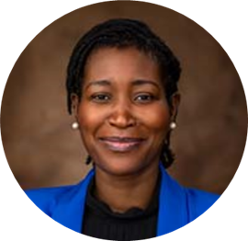
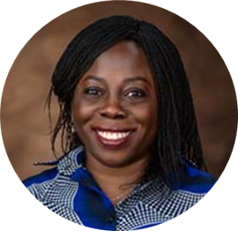
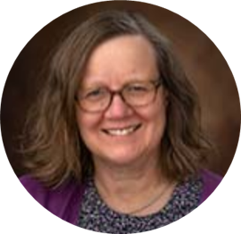
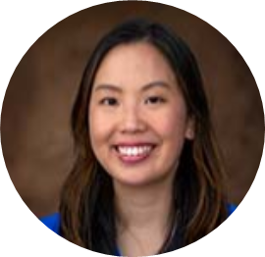
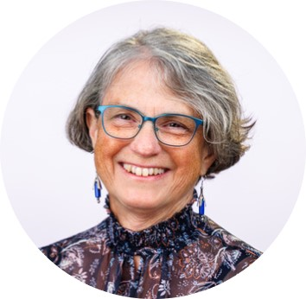
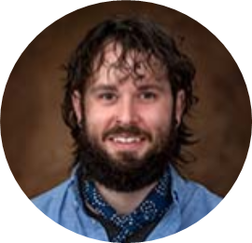
Acknowledgments
Funding Sources
American College of Gastroenterology
Fred Hutchinson Cancer Center
Carl Hassen Family Fund
NIH/NCI K08 CA241296
NIH/NCI P30 CA015704
NIH/NCI P50 CA244432
Kathryn Surace-Smith Endowment
UW Medicine
Population Health CRC Screening Team
HICOR
Talor Hopkins
Health Equity Working Group
Bryan Balmadrid, MD
Vida Henderson, PhD
La Shanda Hurst
Anita Mitchell Isler
Richard Kincade, MD, MSHA
Susan Onstad
Martine Pierre-Lewis, MPH
Joycelyn Thomas, DNP, ARNP
Harborview Medical Center
EthnoMed
GI nurses and care coordinators
Interpreter services
Community Partners
BLKHLTH
Colon Cancer Stars
Colorectal Cancer Alliance
Fight Colorectal Cancer
Marvin Williams Recreation Center
New Beginnings Christian Fellowship
Public Health Seattle & King County
Urban League of Metropolitan Seattle
Fred Hutch Office of Community Outreach & Engagement
And many others!
Dr. Rachel Issaka
Nkem Akinsoto
Ari Bell-Brown
Dr. Victoria Fang
Amanda Kimura
Amy Peck
Jerry Wood

Slide 35
Thank You
Contact Us!
crcscreening@fredhutch.org
Pop Health CRC Program
Notes:
Access out the program website including the full year 02 report

Slide 36
BREAK
Notes:
We have Break until 10:10
10:00- 10:10

Slide 37
Presentation
CRC National & State Data Overview
Speaker: Kayla Kenyon
Fred Hutch Cancer Center

Slide 38
National and State Colorectal Cancer Data Overview
Kayla Kenyon Community Health Educator for Rural Populations, Office of Community Outreach and Engagement
Notes:
General Outline:
We are all here today because we have a shared mission of reducing colorectal cancer burden and learning more about how we can contribute to the work being done towards cancer prevention and treatment. It can be difficult to know where to start without knowing where we currently stand, so, today we wanted to give a general overview of where we are now with our efforts towards addressing colorectal cancer rates.
We hope for this data overview to be a helpful addition to our direction as we learn the areas of colorectal cancer we are all most interested in addressing.

Slide 39
1
National Data
2
Washington State Data
3
Qualitative Data from WA
Notes:
In this brief presentation, we will go over national CRC data, see where WA state ranks comparatively, and identify some areas of interest in our region. To the folks on this meeting from Oregon, we apologize we weren’t able to include you in this data collection, but feel free to share any data with us and we can include this into future decision making.

Slide 40
Notes:
Nationally, screening rates have been steadily on the rise since 2012. We are still seeing that younger screening-eligible age groups are getting screened in much lower rates than older groups.
Screening remains lowest in the following categories nationwide:
People between the ages of 45-49 (20% up-to-date screening)
Asian-Americans (50% up-to-date screening)
Individuals with less than a high school education (48% up-to-date screening)
Uninsured (21% up-to-date screening)
Recent immigrants (29% up-to-date screening)

Slide 41
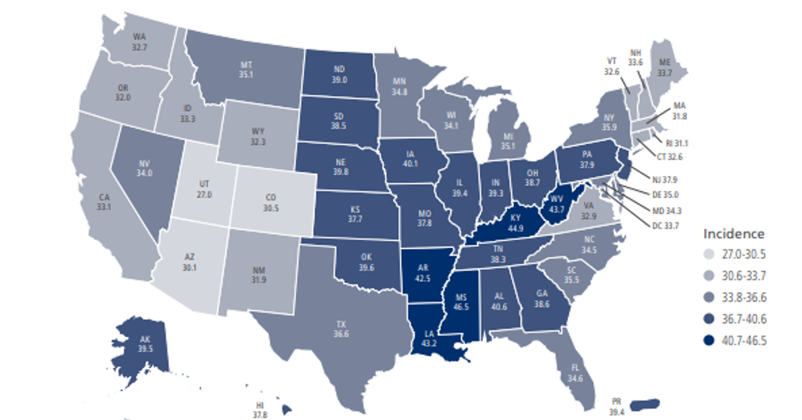
Notes:
Washington State and Oregon have similar colorectal cancer incidence rates with 32.7 and 32.0 per 100,000 cases. Nationwide, WA and OR are states among the lower middle range for CRC incidence in the country.

Slide 42
Notes:
Similar story for mortality rates in both Oregon and Washington

Slide 43
Section title here or key statement
Notes:
We were not able to collect data on Oregon for this presentation so we will be focusing on Washington State metrics for the remainder of the presentation. In Washington State, colorectal cancer was the 5th most common type of cancer incidence between 2015-2019 so it remains a priority for cancer prevention and care.

Slide 44
Notes:
Luckily, compared to the entirety of the US, Washington State experiences a slightly lower overall CRC incidence rate at about 8% lower overall. Though this statistic is not equally experienced by each subsection of the population. Let’s take a deeper dive into this data

Slide 45
Washington State Screening by Geographic Location
Notes:
Now, let’s take a look at how geographic delineations impact screening rates. We can see that we go more rural, rates of up-to-date screening decline, highlighting that there may be barriers and obstacles for rural populations to access screening, and an opportunity to close the screening gap.

Slide 46
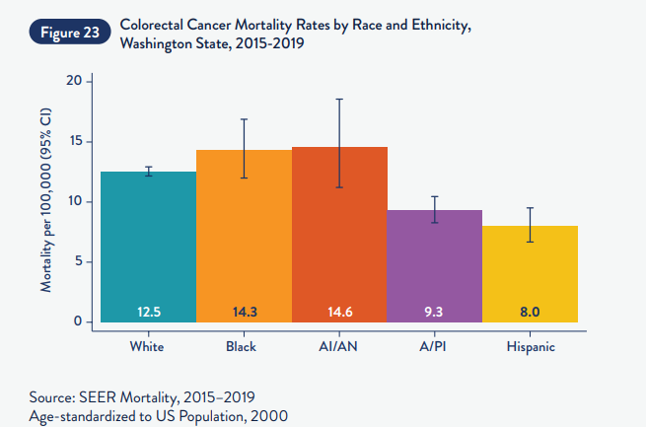
Washington State CRC Data by Race/Ethnicity
Notes:
Looking at race and ethnicity data, we see that for incidence and mortality, Black and AI/AN populations are disproportionately impacted by colorectal cancer. This shows an area of improvement for WA state priorities

Slide 47
AI/AN Population Data
Notes:
Looking further into AI/AN data, we can see that colorectal cancer incidence impact is greater. WA state AI/AN populations experience around 20% higher rates of CRC than in the US average, and it is one of the more prominent cancers in AI/AN populations in our state.

Slide 48
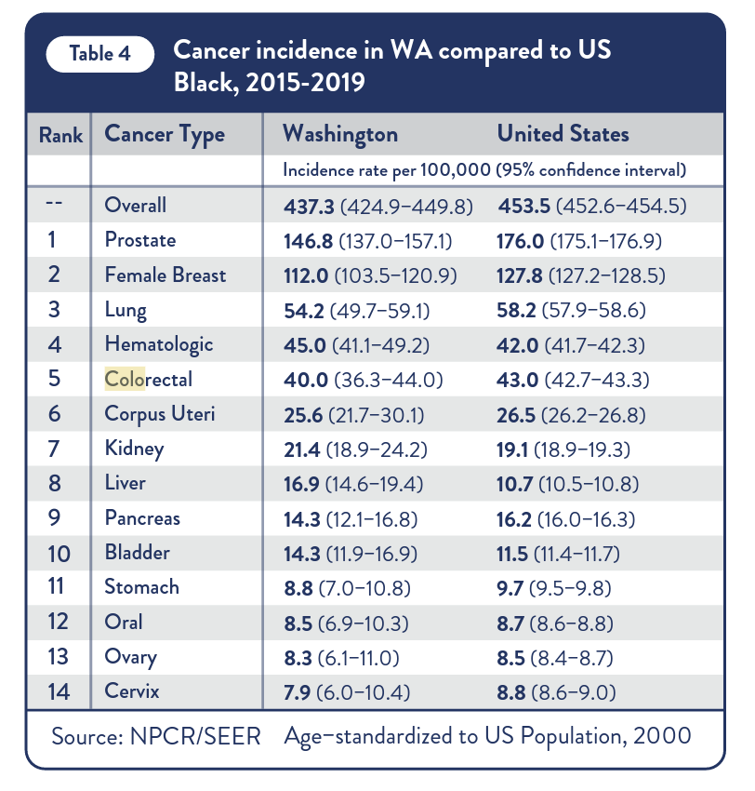
Black/African-Descent Populations
Notes:
For black populations in Washington State, we see a similar pattern of colorectal cancer being one of the more prominent cancers experienced, but we also see that mortality rates compared to the nation are lower in Washington state

Slide 49
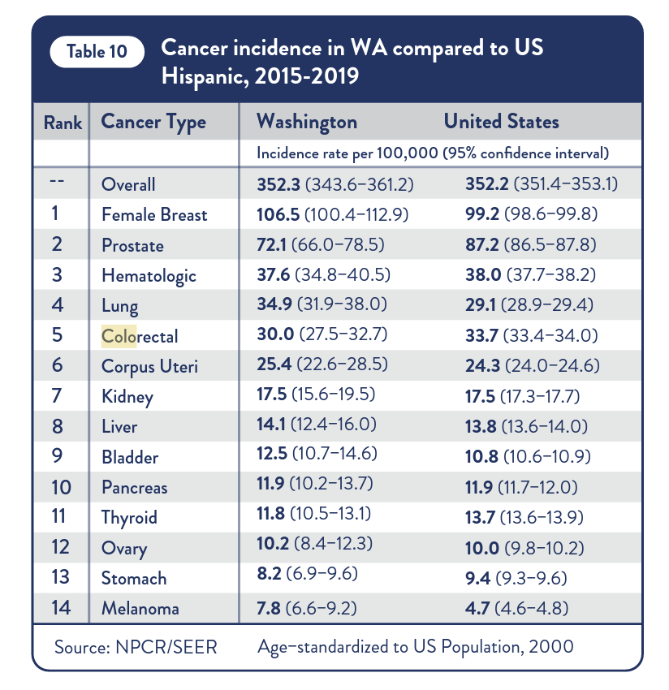
Hispanic Populations
Notes:
It is also important to acknowledge areas our efforts are showing, and as we can see above, mortality rates for CRC in Hispanic populations in Washington state are significantly lower than national averages. Many of our community partners whom work with Hispanic populations have credited this to having dedicated bilingual staff to effectively serve their population. It is still a prevalent cancer among Hispanic populations however and remains a priority to continue providing adequate services

Slide 50
Qualitative Data
Community-informed outreach
Dedicated bilingual staff that mirror served community
Best practices for rural service distribution
Range of media to conduct outreach
Notes:
Our community report highlighted voices from community that mentioned the following as critical to conducting better outcomes for cancer across Washington state

Slide 51
Thank you

Slide 52
Project Brainstorming
Communication Campaign 2024
Facilitator: Katie Treend
WA DOH

Slide 53
Brainstorm
Communication Campaign 2024

Slide 54
Past Campaign Work
Weekly Blasts:
General Information Campaign
Causes, Risk Factors, and Prevention
Early Detection/Diagnosis
Significant Barriers to Screening
Hereditary Components and Wrap Up
Social Media
In-Person Events
Inflatable Colon

Slide 56
Tips on Action Steps
Take the pledge: Join the 1,700+ organizations committed to working toward our shared goal to reach an 80% screening rate nationwide by increasing the number of people screened for colorectal cancer in their communities.
Spread the word: Many patients and providers either don’t know or consider all the options for colorectal screening. Your voice can help connect them to a testing option that is right for them.
Join the conversation: Keep us informed of your community’s success and conversations by using #80inEveryCommunity on social media.

Slide 59
Personal Stories Matter

Slide 60
Brainstorm

Slide 61
Brainstorm
What topics should be considered?

Slide 62
Brainstorm
What methods of Communication
Should be Considered?

Slide 63
Brainstorm
Are you interested in joining a small
workgroup to compile materials?

Slide 64
Brainstorm
Are you interested in facilitating
an in-person Event?

Slide 65
Brainstorm
What other Projects or Focus Areas
Should the task force Cover in 2024?

Slide 67
Next Steps
Next meeting
February 27th, 2024 (Tuesday) 9:00 am – 11:00 am
WA Cancer Coalition Meeting:
January 24th, 2024 (Wednesday)
Contact Katie Treend
Next Steps:
Communication Campaign Workgroup Meeting

Slide 68
Contacts
Sahla Suman, DOH
Sahla.Suman@doh.wa.gov
360-742-1467
Kayla Kenyon, OCOE
kkenyon@fredhutch.org

