Slide 1
Washington State
Colorectal Cancer Task Force
March 3, 2023
Contributors: Katie Treend, Mary Miller, Kayla Kenyon, Daniel Padron, Aden Afework, Sahla Suman, & Char Raunio

Slide 2
Agenda
Introductions
CRC Task Force History & Context
Brainstorm & Discussion
Looking Forward

Slide 3
CRC Task Force History & Context
Katie Treend, WA DOH

Slide 4
Welcome back!

Slide 5
You May Have Questions…
What happened to our previous Task Force?
There was a CRC Task Force before now?
What things did the Task Force do before?
What can the Task Force do?
Who should attend Task Force Meetings?
Can I make requests for information, training, or resources?

Slide 6
CRC Task Force History
Active in this capacity since 2016
But work goes back even farther
Formerly run by American Cancer Society
Last meeting January 27th, 2021
Impacted by COVID-19
Aligned with National CRC Roundtable
Previous Campaigns
80% by 2018
Current National CRC Campaign
80% in Every Community

Slide 7
Past Meetings Have Included:
In-person Training and Technical Assistance
Coordinated Medica/Communication Campaigns
Inflatable Colon Education Events
Keynote Speakers:
Researchers, National Roundtable Representatives, Local Champions.
Colorectal Cancer Data
Incidence rates, mortality rates, differences among demographics.

Slide 8
Task Force Model
Can Provide:
Education
Training
Latest Research
Data
Resources and Materials
Networking with Peers
Coordinate efforts, overcome challenges and accomplish goals together.

Slide 9
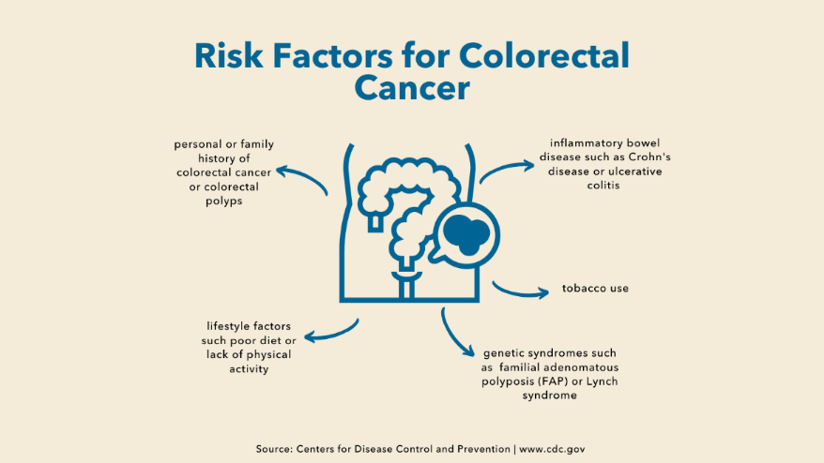
March is CRC Awareness Month
Easily adapt messages or share pre-made content
Use Toolkits like this one from GWU

Slide 10
Discussion
What do you want to see happen in this space?
What are barriers to screening?
What do you want to see happen in your own communities?

Slide 11
Next Steps
Save the Date for our next meeting
June 23rd, 2023
Quarterly Meeting Cadence
Happening Now:
Communication for Colorectal Cancer Awareness Month
Expand Partnership
Near Future:
Formalized shared Mission or Vision
Set Goals
1 Year vs. 5 Year

Slide 12
Contacts
Katie Treend, DOH
Katie.Treend@doh.wa.gov
360-236-3674
Mary Miller, OCOE
MMiller2@fredhutch.org
509-280-3863

