Slide 1
Washington State
Colorectal Cancer Task Force
June 23, 2023
Contributors: Katie Treend, Kayla Kenyon, Aden Afework, Sahla Suman, & Char Raunio

Slide 2
Agenda
Introductions
CRC Task Force Old mission, State Cancer Plan
Presentation
New Mission Statement: Brainstorm & Discussion
Looking Forward

Slide 3
Introduction & Icebreaker
Name, Pronouns, Title , Organization
Your favorite outdoor activity in summer

Slide 4
Presentation
Colorectal Cancer Task Force Mission & State Cancer Plan
Katie Treend, WA DOH
Notes:
Note: This is just a place holder slide, Katie will use share the slides she prepared for the presentation

Slide 5
CRC Task Force Misson, Vision, Goals
Katie Treend
Comprehensive Cancer Control Program Coordinator

Slide 6
CRC Task Force
Mission, Vision, and Goal(s)

Slide 7
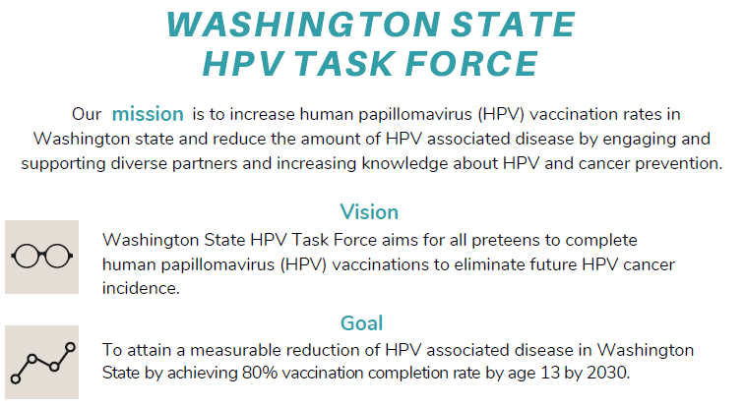
Example

Slide 8
Previous Mission Statement
The Washington State CRC Task Force’s Mission is to bring together a diverse group of stakeholders with the intent to improve existing screening programs through partnerships, the promotion of screening options, and the overall education of Washington residents on colorectal cancer prevention.

Slide 9
CRC Cancer Burden in WA

Slide 10
Cancer in WA (2019)
43,211 residents diagnosed (in situ and invasive) with cancer
12,959 died due to cancer
Lung and Bronchus Cancer is the leading cause of cancer death in men and women
Top five common types of cancer in WA:
Female Breast
Melanoma of the skin
Prostate
Lung and bronchus
Colorectal
Disparities exist by Race and Ethnicity and at County level.

Slide 11
Age-adjusted incidence rate per 100,000 for all cancer sites combined and five most common cancer types, Washington State, 2019
Cancer Site | Incidence Rate* | Incidence Count | 95% Confidence Interval (CI)
All Cancers Combined | 474.6 | 43,211 | (470.0-479.2)
Female Breast | 163.6 | 7,510 | (159.8-167.5)
Prostate | 98.2 | 4,685 | (95.4-101.2)
Melanoma of the Skin | 53.2 | 4,753 | (51.7-54.8)
Lung and Bronchus | 48.0 | 4,554 | (46.6-49.4)
Colorectal | 33.0 | 2,912 | (31.8-34.2)
*Rates per 100,000 adjusted to the US standard population Data Source: Incidence Data: Washington State Department of Health, Washington State Cancer Registry, released in April 2022.

Slide 12
Age-adjusted mortality rate per 100,000 by cancer types, Washington State, 2019
Cancer Site | Mortality Rate* | Mortality Count | 95% Confidence Interval (CI)
All Cancers Combined | 142.0 | 12,959 | (139.6-144.6)
Female Breast | 19.2 | 916 | (17.9-20.5)
Prostate | 18.9 | 727 | (17.5-20.4)
Melanoma of the Skin | 2.3 | 205 | (2.0-2.7)
Lung and Bronchus | 30.6 | 2,842 | (29.5-31.8)
Colorectal | 11.9 | 1,070 | (11.1-12.6)
*Rates per 100,000 adjusted to the US standard population Data Source: Incidence Data: Washington State Department of Health, Washington State Cancer Registry, released in April 2022.

Slide 13
Colorectal Cancer (2019)
2,912 residents diagnosed (in situ and invasive).
1,070 died from colorectal cancer.
Disparities (higher than the state as a whole) 2015-2019 combined:
By Race and Ethnicity:
For both sexes combined black people and American Indian or Alaska Native people had higher age-adjusted incidence and mortality rates compared to whites.
By County:
Higher Age-Adjusted Incidence Rate: Adams, Grays Harbor, Island, King, and Snohomish.
Higher Age-Adjusted Mortality Rate: Cowlitz, Island, Lewis, and Spokane.
5-Year Relative Survival (%), All Types of Cancer, All Races and Ethnicities, Male and Female
Overall survival rate for all stages and all types of cancer - 69.4%
Colorectal – 67%
Data Sources: U.S. Cancer Statistics Working Group, U.S. Cancer Statistics Data Visualizations Tool, based on 2021 submission data (1999-2019).
Data Source: Incidence Data: Washington State Department of Health, Washington State Cancer Registry, released in April 2022.

Slide 14
5-Year Cancer Plan
Screening and Early Detection

Slide 15
Goal 7: Increase number of people who complete recommended cancer screenings.
Objective 12: Increase the percentage of adults aged 45-75 who get screened for colorectal cancer
Baseline: 73.5% (BRFSS, 2020)
Target: 80%
Strategies:
Conduct communication and media awareness campaigns about the importance of early detection.
Implement tailored client reminders to inform patients that they are due for screening.
Reduce structural barriers to screening (e.g., transportation assistance, flexible clinic hours to screening, alternative screening sites, child care, scheduling assistance, translation services).
Reduce out of pocket costs to patients, including co-pays and deductibles for patients needing colonoscopies.
Promote patient navigation to facilitate timely access to screening.
Promote the importance of cancer screening; empower those who are eligible for cancer screening to make informed decisions.
Develop and promote patient navigation and case management programs specific to lung cancer screening.
Educate health care providers about developing a lung cancer screening program and overcoming structural barriers.
Establish a shared decision-making process as required by Medicare for lung cancer screening and certification.
Establish integrated multidisciplinary teams to deliver lung cancer screening services.

Slide 16
Goal 7: Increase number of people who complete recommended cancer screenings.
Strategies:
Conduct communication and media awareness campaigns about the importance of early detection.
Implement tailored client reminders to inform patients that they are due for screening.
Reduce structural barriers to screening (e.g., transportation assistance, flexible clinic hours to screening, alternative screening sites, child care, scheduling assistance, translation services).
Reduce out of pocket costs to patients, including co-pays and deductibles for patients needing colonoscopies.
Promote patient navigation to facilitate timely access to screening.
Promote the importance of cancer screening; empower those who are eligible for cancer screening to make informed decisions.
Develop and promote patient navigation and case management programs specific to lung cancer screening.
Educate health care providers about developing a lung cancer screening program and overcoming structural barriers.
Establish a shared decision-making process as required by Medicare for lung cancer screening and certification.
Establish integrated multidisciplinary teams to deliver lung cancer screening services.

Slide 17
Goal 8: Increase access to genetic counseling
Objective 18: Increase the proportion of people with colorectal cancer who get tested for Lynch syndrome.
Baseline: TBD
Target: TBD
Strategies
Coordinate with Washington State Cancer Registry to collect and report cancer genetics/genomics data and health disparity data.
Develop a workgroup for Washington State CARES about Cancer Coalition
Increase access to genetic services in underserved areas.
Provide resources, training, and education for providers to increase referrals to genetic counseling.
Increase education and resources for public education related to hereditary cancer risk factors and how to find cancer genetics specialists.

Slide 19
Want to Provide Feedback on Plan?
Who can provide feedback? Everyone! We are looking for feedback from all who are interested in providing. Please feel free to forward this on to those who may be interested.
What type of feedback is requested? All feedback is valuable and wordsmiths are welcome. Below is a list of things we are looking for specifically
Accuracy: Do these goals and objectives accurately reflect what we are working on? Are these goals and objectives going to reduce cancer burden?
Data: Are current sources of data appropriate? Are sources able to be identified? Are targets too bold or too safe?
What’s Missing? Goals, Objectives, Strategies, General Topic Areas
When do I need to submit feedback? Feedback will be collected in stages. Please see the due dates below for when to provide feedback by section.
How to provide feedback?
Use the Draft Cancer Plan Word Document to provide track changes and/or comments.
Feedback can be sent directly back to me (Katie.Treend@doh.wa.gov).
Section | Due Date
Primary Goals | August 3rd
Primary Prevention | August 3rd
Screening and Early Detection | August 17th
Survivorship | August 31st

Slide 20
Presentation
Health System Capacity Building Initiative- in partnership with Virginia- Mason Franciscan Health and ACS focused on CRC screening
Elizabeth Dahle, VM(FH)
Cindee DeWitt, ACS

Slide 21
Final Report for the 2022PPresented by: Elizabeth Dahle, RN Educator Virginia Mason Franciscan Health Cindee DeWitt, Associate Director, Cancer Center Partnerships ACS pilot
Hospital Systems Capacity Building Initiative (HSCB)
June 23, 2023
Notes:
Make a statement about being photographed, releases signed...if you do not wish to have your photo taken please let us know

Slide 22
Acknowledgements
This project is supported by the Centers for Disease Control and Prevention of the U.S. Department of Health and Human Services (HHS) as part of a financial assistance award totaling $500,000 with 100 percent funded by the CDC/HHS. The contents are those of the author(s) and do not necessarily represent the official views of, nor an endorsement, by CDC/HHS, or the U. S. Government.
Notes:
We would like to acknowledge the Centers for Disease Control and Prevention as our project funder. Without them, this work would not be possible.

Slide 23
American Cancer Society
Hospital Systems Capacity Building Initiative
CDC funded
Engage hospital systems in a Community of Practice (COP) model
5- year cooperative agreement (2018-2023)
Help facilitate community partnerships to better address cancer prevention and screening priorities.
Incorporate cancer prevention and screening interventions into a hospital systems’
mission priority setting, quality standards and investment practices
Notes:
The ACS hospital systems capacity building initiative was designed to support the reduction of the cancer burden through the engagement of hospitals systems in a communities of practice model. This supports them in incorporating cancer prevention and screening interventions into their systems, and developing community partnerships that engage diverse populations to improve health outcomes.

Slide 24
COP Site Location by Focus Area
CRC Focused Site
HPV Focused Site
BHE Focused Site
Notes:
We recruited 20 sites in two cohorts. The first cohort was selected in June 2019 and the second in September 2020. This map shows the location of sites in both cohorts. Sites had a focus area of either breast health equity, colorectal cancer screening, or hpv vaccination.

Slide 25
Capacity Building Activities
Resource Development and Dissemination
CBA Calls
Peer to Peer Learning
Monthly with ACS Leads
Quarterly with Subject Matter Experts (SME), external and internal partners
Resource dissemination webinars
ECHO model in Y2-3
Site presentations on wins, challenges, and new CAP
ACS staff peer to peer
COP sites peer to peer
Evidence Based Intervention (EBI) Guide
HSCB PartnerHub and HSCB external websites
Social Determinants of Health Assessment
Sustainability Assessment
Notes:
We supported COP Sites with a number of different capacity building activities....Over the course of the project we held monthly calls by focus area, supported over 200 1-1 calls with site team members, held 45 quarterly SME calls, hosted 25 other CBA events- webinars, ECHO sessions, etc., We also developed and disseminated 30 + resources.

Slide 26
Key Outcomes of the HSCB Initiative
Increase capacity to…
Establish & Maintain Partnerships
Identify & Customize Programs & Services
Respond to Priorities Strategically
Implement
EBIs
MIXED-METHODS EVALUATION APPROACH
Biannually sites submitted data that included screening/vaccination rates, information about activities and EBIs implemented, and partnership outcomes.
Additionally, ACS conducted key informant interviews and focus groups throughout the project.
Notes:
The evaluation plan was designed to measure success in building COP teams (hospital system and health department) capacity to :
Establish and maintain partnerships within and across sectors to create a shared vision of health
Identify, prioritize, and customize relevant program and services to address public health needs
Respond to public health priorities collaboratively and strategically
Implement evidence-based/informed public health programs, policies and services to address public health need
The long-term outcome is to increase the number of youth receiving HPV vaccination, increase colorectal cancer screening rates, and improve breast health equity

Slide 27
Impact on Rates
83% of COP Sites increased their screening or vaccination rates from project baseline to final submission.
Colorectal Cancer
HPV Vaccination
Breast Health Equity
100% of sites increased or maintained rates.
100% of sites increased initiation and completion rates.
83% of sites increased or maintained rates.
The average increase was 7%.
The average increase in initiation rates was 16% and completion was 10%.
The average increase was 7.5%.
The range across sites was 1-19%.
The range across sites for initiation was 1-45% and completion was 2-25%.
The range across sites was 1-22%.
Notes:
Almost all COP sites, for whom we have baseline and final project data, saw their efforts translating to increases in screening or vaccination rates throughout the initiative. When looking by focus area:
-83% of CRC sites increased or maintained their rates from baseline to now. The average increase was 7%
-100% of HPV sites increased both their initiation and completion rates. The average initiation rate increase was 16% and the average completion rate increase was 10%
-83% of BHE sites increased or maintained their rates. The average increase was 7.5%

Slide 28
Colorectal Cancer Screening
Virginia Mason Franciscan Health
Notes:
I am now going to turn the presentation over to your project leads to share site specific sucesses.

Slide 30
Colin Walker: Division Director, Ambulatory Quality and Population Health, VMFH
Elizabeth Dahle: RN Educator, Ambulatory Quality and Population Health, VMFH
COP
Team Members
Michael Anderson: Division Vice President, Ambulatory Quality and Population Health, VMFH
Cindee DeWitt: Associate Director, Cancer Center Partnerships, ACS

Slide 31
Successful Evidence-Based Interventions (EBIs)
Activity
Mailers sent to patients due for screening
Activity
Patient secure messaging with reminder of
screening and education about how to schedule and
complete
Patient Reminders
42K patients reached
*per year
Activity
Patient communication about screening during
annual VMFH CRC screening challenge
Clinic and exam room posters
Social media posts
Call to Action on VMFH website

Slide 32
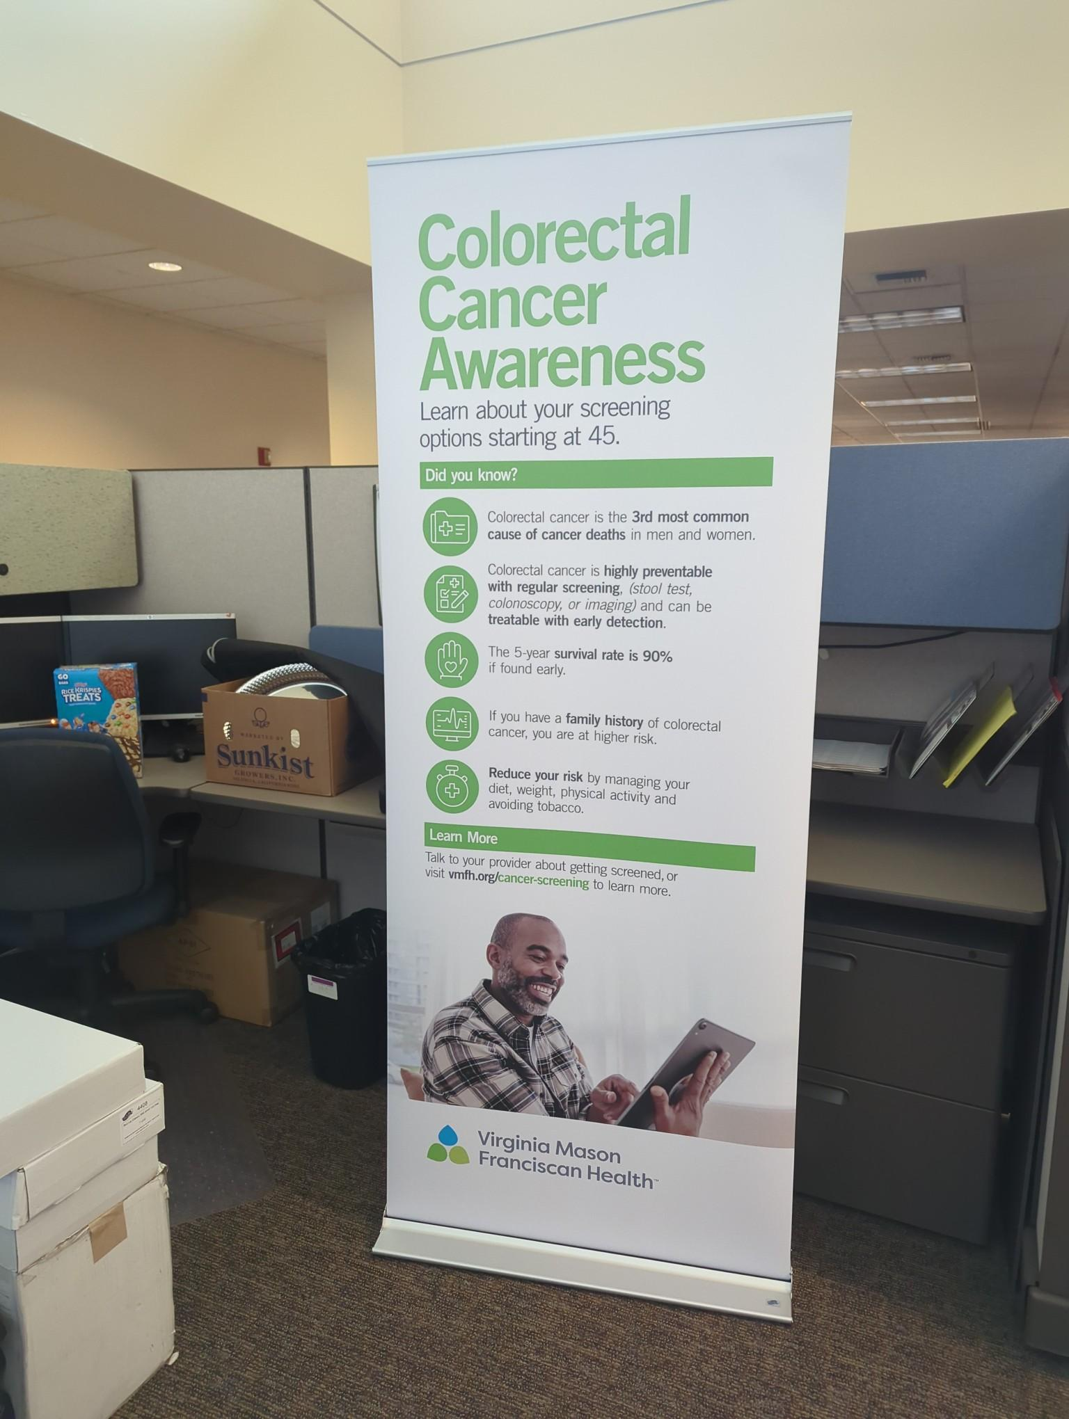
Highlights

Slide 33
Successful Evidence-Based Interventions (EBIs)
Activity
Provider scorecards to encourage CRC screening rate improvement
Provider Assessment/ Feedback
Activity
Monthly provider meetings with updated metrics and tailored analysis
215 providers reached
Activity
Quality Boards in clinics give physical reminder and progress towards goals

Slide 34
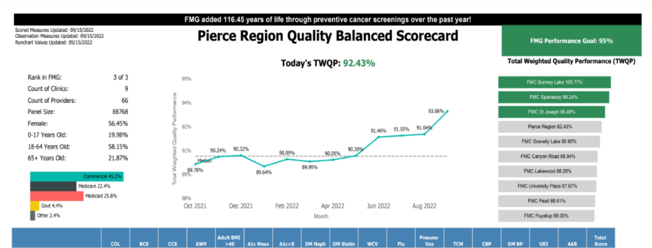
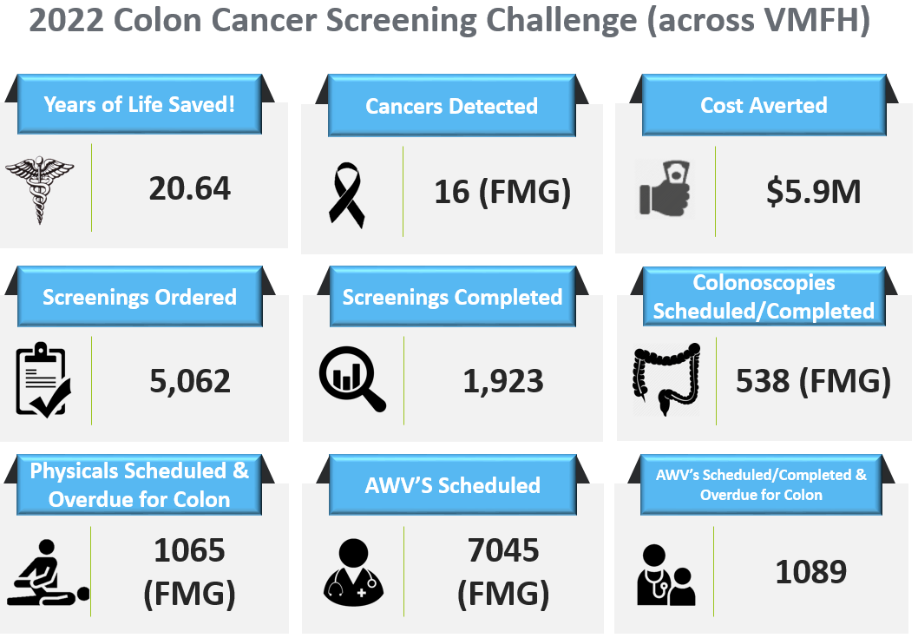
Highlights

Slide 35
Successful Evidence-Based Interventions (EBIs)
Activity
Created and utilized conversation cards to help
Providers educate patients about the options and
importance of CRC screening
Professional Education
Activity
RN educator provides training in staff meetings,
new staff orientation and quality review meetings
657 Healthcare team members educated
Activity
Clinic rounding for scorecard review at the provider
and clinic level

Slide 36
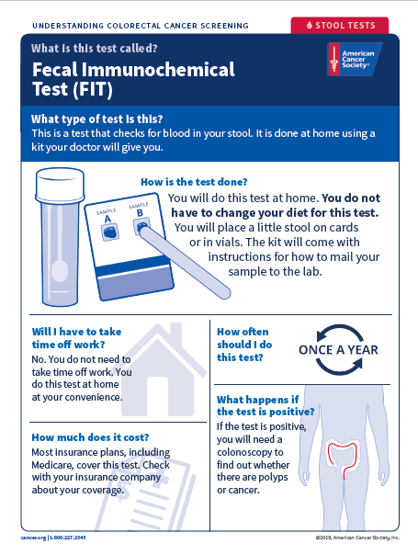
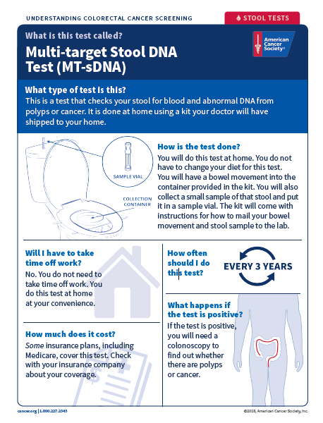
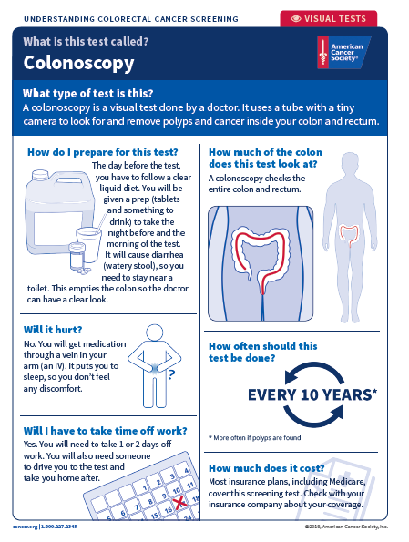
Highlights
“

Slide 37
Impact Quote ”Our COP team’s concerted focus mobilized our organization’s tracking and processing results including differentiating our testing modalities and closing the loop with follow up for positive screens. With regular meetings, we discussed strategies, shared ideas and planned next steps creating a robust CRC Screening program. Partnering within this project helped us to focus our efforts, dig further and ask more questions to improve and expand our CRC screening rates.”
37

Slide 38
Lessons Learned
Through regular meetings with the COP it was helpful to learn what approaches other health systems were taking to see what might work for us. It was at a COP meeting that we learned of some recommendations regarding the LGBTQ community and how to improve that populations’ screening rates.
The success of the bi-directional interface with Cologuard and FMG within EPIC has been valuable to improving screening rates and reducing administrative documentation.

Slide 39
Resources:
Virginia Mason Franciscan Health:
Cancer Risk Assessment: Cancer Prevention & Screenings (vmfh.org)
Colorectal Resources and FAQ’s: Resources & FAQs (vmfh.org)
Colon and Rectal Disorders, diagnosis and treatment info: Colorectal Center of Excellence (vmfh.org)
American Cancer Society:
Hospital Systems Capacity Building Initiative: Hospital Systems Capacity Building Home - Hospital Systems Capacity Building Initiative (acs4ccc.org)
Screening for Social Determinants of Health Toolkit: Health Systems Screening for Social Determinants of Health - Hospital Systems Capacity Building Initiative (acs4ccc.org)
Resource Links for HSCB initiative: Resource Links - Hospital Systems Capacity Building Initiative (acs4ccc.org)
Questions?

Slide 40
BREAK
10 minutes

Slide 41
Old Mission Statement
“Bring together a diverse group of stakeholders with the intent to improve existing screening programs through partnerships, the promotion of screening options, and the overall education of Washington residents on colorectal cancer prevention.”
Notes:
Kayla

Slide 42
Break out Room Discussion
How do you feel about the old mission statement?
How do you feel about the cancer plan objectives?
Do these match with the Task Force mission?
What are your priorities with Colorectal Cancer outcomes?
If your priorities aren’t present in that mission statement, how would you include them in the task force work?
Notes:
Kayla

Slide 43
Next Steps
Save the Date for our next meeting
November 3rd, 2023
Quarterly Meeting Cadence
WA Cancer Coalition Meeting:
October 5th, 2023
Contact Katie Treend
Near Future:
Set Goals
1 Year vs. 5 Year
Notes:
If you are interested joining the planning committee of CRC TF please send me an email: Sahla.suman@doh.wa.gov

Slide 44
Contacts
Katie Treend, DOH
Katie.Treend@doh.wa.gov
360-236-3674
Kayla Kenyon, OCOE
kkenyon@fredhutch.org

