Slide 1
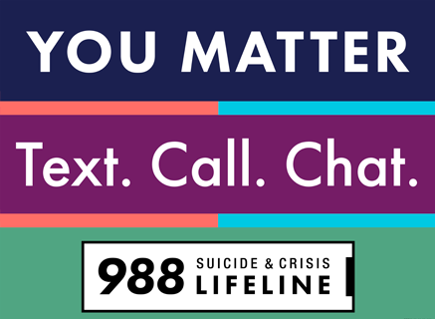
988 Suicide & crisis lifeline general awareness
988 Crisis Systems Section, Office of Healthy and Safe Communities
Notes:
Reminder to give self-care message
share screen and share audio
Elizabeth
Today’s presentation is to : Inform partners about DOH grass roots efforts to empower them with 988 knowledge and resources to share with communities they serve.
This presentation is a shortened version of a 30 mn basic awareness presentation the DOH has been providing to established partners to increase awareness of 988 in WA state.
The 30 minute presentation covers what you will see here today + overview of crisis centers, crisis counselor training, current usage data, when to call 911 vs 988 and more.
This work compliments the 988 Media Awareness (Launching soon) Campaign by providing those most likely to work with help-seekers valuable insight to answer questions about 988.

Slide 2
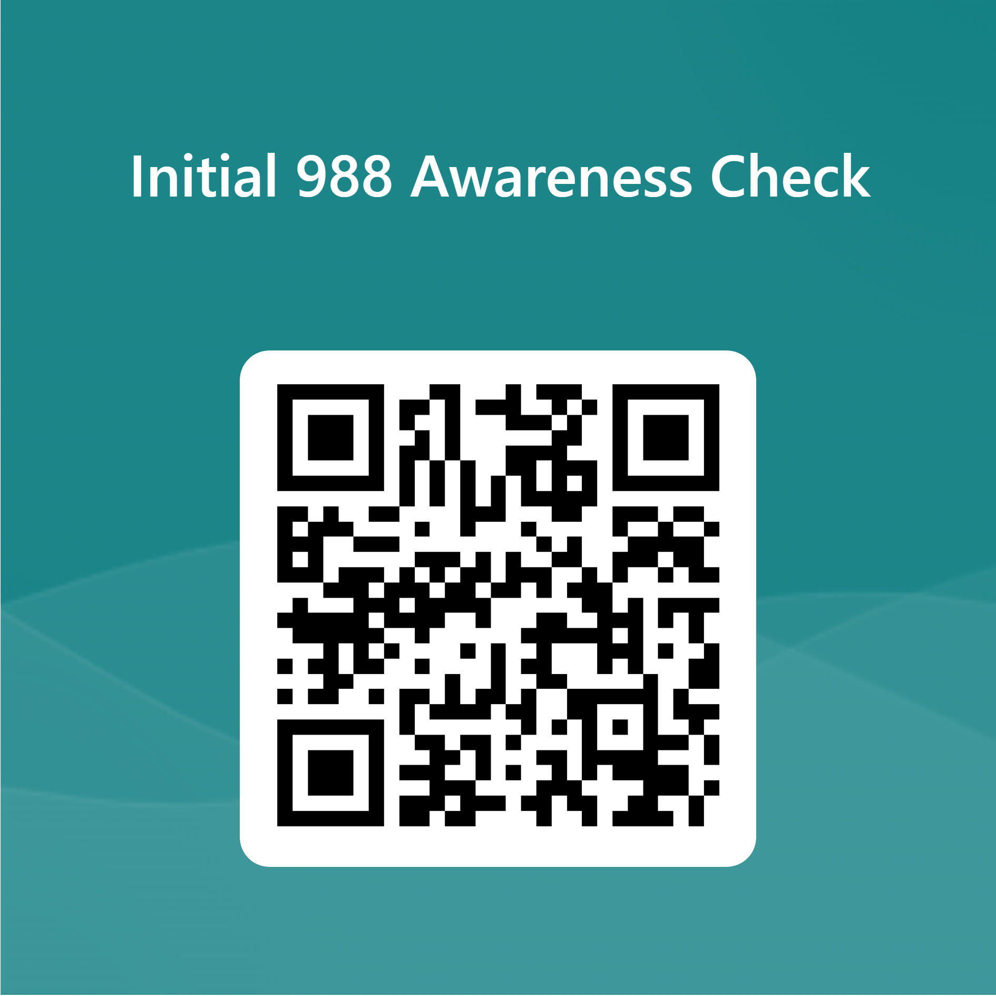
How familiar are you with 988?
Notes:
https://forms.office.com/g/h8gQF3Hskv
(for 8/13/24 and on)
Available now!
Current state basic overview
The 988 Suicide & Crisis Lifeline is provides a free and direct connection to confidential support and resources for anyone in crisis – 24/7/365.
The goal of the 988 Lifeline is to give people in crisis somewhere to get help for themselves or loved ones
988 is not a complete mental health crises response system-
It is not a replacement for regular mental health care needs however they will provide referrals to support follow-up care.

Slide 3
Department of Health Team
Elizabeth Emmet
she/her
Krystle Edwards
she/her
______
Community Engagement Coordinator
______
Change Manager
Office of Innovation & Technology
988 Crisis Systems Section
Notes:
Add a slide with Sierra
This is a particularly useful slide for webinars, so that participants can visualize the speakers.
This slide can be used for internal or cross agency presentations.
Visual description

Slide 4
Creation of 988 and Current Status
National Suicide Hotline Designation Act
Launch of 988 and the Native and Strong Lifeline
Fully fund crisis call center platform
National Suicide Hotline Designation Act
2020
2021
2022
2023
2026
Passage of House Bill 1477
Passage of House Bill 1134
Notes:
Consider adding information about governance: LE subcommittee and CRIS committee

Slide 5
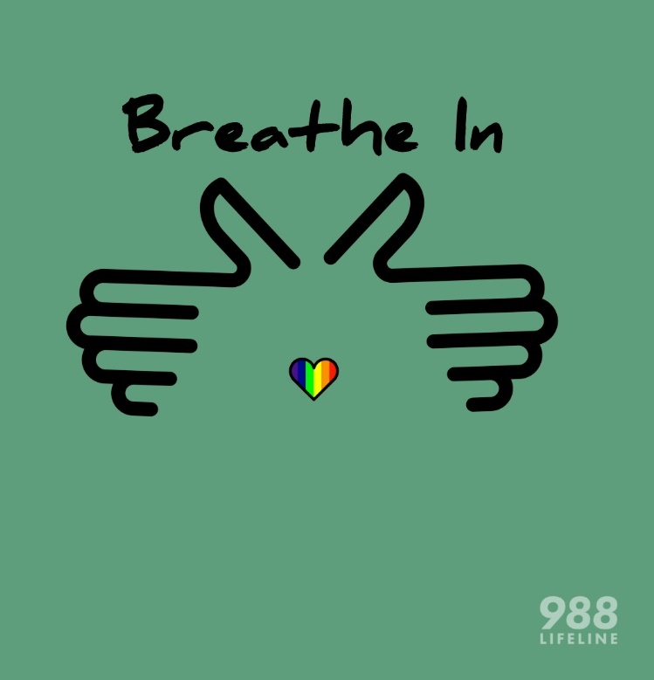
988 Suicide & Crisis Lifeline
The 988 Suicide & Crisis Lifeline launched in July 2022.
988 is the three-digit dialing code for suicide prevention and crisis support.
Call, text, or chat the 988 Lifeline to get support for:
Thoughts of suicide
Substance use concerns
Any type of emotional distress
A loved one who may be in need of crisis support
The 988 Lifeline is free, confidential, and available 24/7/365.
Interpretation services available in over 240 languages.
A green circle with two hands connected at wrists holding a small, rainbow heart in the center.

Slide 6
Specialized Lines
The 988 Lifeline has 4 specialized lines:​
Veterans Crisis Line: Call 988 and choose option 1, chat online, or text 838255​
Spanish Language Line: Call, text, or chat 988 and choose option 2​
LGBTQIA+ Youth Line: Call, text, or chat 988 and choose option 3​
Native and Strong Lifeline: Call 988 and choose option 4​.
You can also get support in American Sign Language (ASL) by:
Visiting the 988 Lifeline website
Clicking the “For Deaf & Hard of Hearing” link at the top of the page
Choosing “ASL Now”
A person wearing a yellow
sweater looking at a cell phone.
A person wearing a white tee-shirt in front of a laptop using sign language.
Notes:
There are 4 Specialized lines available when utilizing 988.
Veterans Crisis Line
Press 1 to be connected to the Veterans Crisis Line. You can also chat online or text 838255
The Veterans Crisis Line serves veterans, service members, National Guard and Reserve members, and those who support them. You don’t have to be enrolled in VA benefits or health care to call.
o Spanish Language Line
To get crisis support in Spanish, you can call, text, or chat the 988 Lifeline and choose option 2.
o Languages other than English and Spanish
You can get support in languages other than English or Spanish by calling the 988 Lifeline and saying the name of the language you need. The 988 Lifeline offers interpretation services in more than 240 languages and dialects. These services are available 24/7/365.
o LGBTQI+ Youth Line
Choose option 3. to connect with a crisis counselor who can provide LGBTQIA2s+ affirming support
The 988 Lifeline has a specialized line for lesbian, gay, bisexual, transgender, queer or questioning, intersex, asexual, and two-spirit (LGBTQIA2S+) teens and young adults between the ages of 13 and 24.
o The Native and Strong Lifeline
Select option 4. to be transferred to Native crisis counselors who are tribal members and descendants closely tied to their communities.
o People who use American Sign Language (ASL)
The 988 Suicide & Crisis Lifeline offers ASL services for people in crisis. To get help now in ASL, you can follow these steps:
· Visit 988lifeline.org
· Select the “For Deaf & Hard of Hearing” link
· Select “ASL Now” on the next page
You can also call 1-800-273-TALK (8255) from your videophone to get crisis support for yourself or a loved one.

Slide 7
Crisis Counselor Training
Trained crisis counselors are ready to handle a variety of situations.
Each of Washington’s 988 Lifeline crisis centers must meet the 988
Lifeline’s minimum training requirements by providing trainings:
Specific to crisis counseling
Specific to internal systems
That meet requirements around cultural humility and
diversity, equity, and inclusion (DEI)
Example framework from a 988 Lifeline crisis center:
Extensive New Hire Training Academy (18+ courses)
Extensive RCL/988 Lifeline Crisis Triage Specialist's Onboard Training Program (20+ courses)
Extensive Online Training Portal + virtual trainings + in-person trainings
Crisis counselors also participate in mock calls as preparation for working with help-seekers.
A person answers a headset in front of a computer screen.
Notes:
Elaina
The 988 Lifeline currently requires all network centers adhere to specific standards regarding Suicide Risk Assessment and Imminent Risk interventions — however, each crisis center also develops their own specific training to meet organizational needs. The 988 Lifeline Core Clinical Training is self-paced online training that covers essential skills for crisis counselors who answer calls, chats, or texts within the 988 Lifeline network. Development of additional training is ongoing to address the specific needs of populations at higher risk of suicide.
5 Major Training Elements- each element has many extensive and impressive training courses ranging from data collections procedures, confidentiality to practical applications including crises intervention, de-escalation, mental health first aid. Counselors review case studies, learn several assessment protocols and participate in Mock calls
New Hire Training Academy:
RCL/988-Lifeline Crisis Triage Specialist’s Onboard Training Program:
Lifeline Online Learning Portal:
Relias On-line or Virtual Trainings:
Diversity, Equity, and Inclusion Training (DEI)
Additional In-Person Trainings
_____________________________________________________________________________
New Hire Training Academy: Ethics Part 1 & 2, Electronic Medical Record, The Volk Decision, Psychological Testing, Outpatient Psychiatric Services, Release of Information, Recovery Model, Crisis Intervention Application Part 1 & 2, ITA (Involuntary Treatment Act), Inpatient, Psychiatric Services, Risk Assessment, Least Restrictive Alternatives, Accessing Community Resources, Self-care/Vicarious Trauma, Substance Use Disorder and Co-Occurring Disorders
2. RCL/988-Lifeline Crisis Triage Specialist’s Onboard Training Program: Accuracy of Records and Documentation, Compliance with Federal and State Laws, Client’s Rights/Confidentiality; Fraud, Abuse, and Anti-Fraud Education; Electronic, Media, Communications Usage & Processes; Mobile Crisis Teams & Mobile Crisis’ Referral Criteria; CTS Telecommunication (phone) System; Third-party referrals; Client Connection through Engagement & Active Listening Skills; Imminent Risk and Active Rescue & Suicide Risk Assessments; Establishing a Follow-Up & Conducting Follow-Up Contact ; Assessing Safety and Suicide Risk & Asking/Talking About Suicide [Engagement, Assessment, Intervention], Mandatory Reporting, Mental Health Case Laws, Special Considerations: Deaf Individuals & Interpreter/Translation, LRAs – Least Restrictive Alternatives, Self-Care, 988 Lethality Assessment Training [988-Lifeline 4 Core Principles of Suicide Risk & Basic Goals/Objectives for Every Call, Assessing the caller's DESIRE to die/end painful feelings. Assessing the caller’s INTENT to follow through on thoughts or plans of suicide. Assessing the caller’s CAPABILITY to cause lethal harm to themselves. Assessing the caller’s BUFFERS or protective factors that help an individual stay safe in the moment.],Mock Calls
3. Lifeline Online Learning Portal:
Fundamentals of Crisis Counseling, Essential Skills in Crisis Counseling, Assessing Safety and Suicide Risk, Imminent Risk of Suicide, Substance Use and People in Crisis, Individuals Familiar to the 988 Lifeline, Simulation Trainings
4. Relias On-line or Virtual Trainings: Conflicts of Interest, Cultural Competence, Duty to Warn
Minimizing Trips, Slips, and Falls, Standards of Conduct, Understanding Bloodborne Pathogens, Violence Prevention & De-escalation, Workplace Violence
Annual Compliance and HIPAA, Privacy & Security, Fraud & Abuse Policy, Documentation 101; Medicare: Combating Medicare Parts C and D Fraud, Waste, and Abuse; Clinical 3--Online Marty Smith Safety Training: General Clinical Strategies, Sexual Abuse Awareness Training, FBH Safety Emergency Protocol and Safety Emergency Preparedness, Psychopharmacology Basics for Behavioral Health Professionals, ITA 101 (Involuntary Treatment Act 101), The Columbia Suicide Risk Assessment, Treatment & Management
5. Diversity, Equity, and Inclusion Training (DEI)
AgriSafe: Farm Response
LGBTQIA2S+
SAMHSA Technical Assistance Tribal Training
Veteran/Active Military & families
Cultural Training
Individuals experiencing socioeconomical disadvantages (poverty)
Persons with Intellectual Disabilities
Intimate Partner Violence/Domestic Violence
6. Additional In-Person Trainings
ASIST (Applied Suicide Intervention Skills Training)
Mental Health First Aid
Motivational Interviewing Part 1 and 2
FBH Cultural Competency

Slide 8
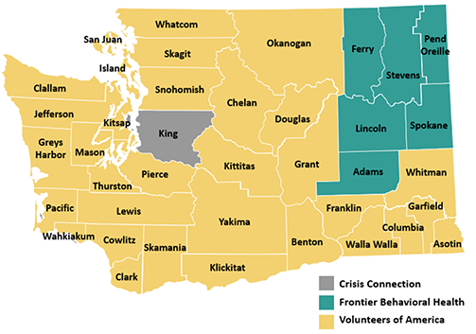
988 Lifeline Crisis Centers
In Washington, there are 3 crisis centers that answer 988 calls, texts, and chats:
Volunteers of America Western Washington (VOAWW): Serves 32 counties and administers the Native and Strong Lifeline and the Native Resource Hub
Frontier Behavioral Health: Serves Adams, Ferry, Lincoln, Pend Oreille, Stevens, and Spokane Counties
Crisis Connections: Serves King County
Any calls that can’t be answered by a Washington crisis center will be routed to another crisis center in Washington.
VOAWW and Crisis Connections both answer 988 texts and chats.
Map of Washington state that identifies primary coverage by each crisis center.

Slide 9
Mental Health Crisis Call Diversion Initiative
Pilot Program
Year-long pilot partnerships between 3 988 Suicide & Crisis lifeline centers, and 3 of the state’s 65 PSAPs/911 centers ended in January
Crisis counselors are co-located at the PSAP or embedded from a remote location where they can access the same systems
Provides opportunity to create a more efficient and compassionate system for people dealing with mental health crises and substance use concerns by:
Helping people in crisis connect quickly to trained 988 crisis counselors for support
Diverting crisis calls made to 911 to reduce the demand on emergency services
Warm Transfer Protocols
Grant-funded project to develop protocols to transfer mental health related calls received by 911 to 988 when emergency services are not needed
These protocols will be adapted regionally for use by all PSAPs/911 centers
Notes:
Elaina
DOH is utilizing Cross-System Collaboration Subcommittee to advise the team around ensuring protocols are adaptable to regional needs
DOH has scheduled tribal and community listening sessions for feedback

Slide 10
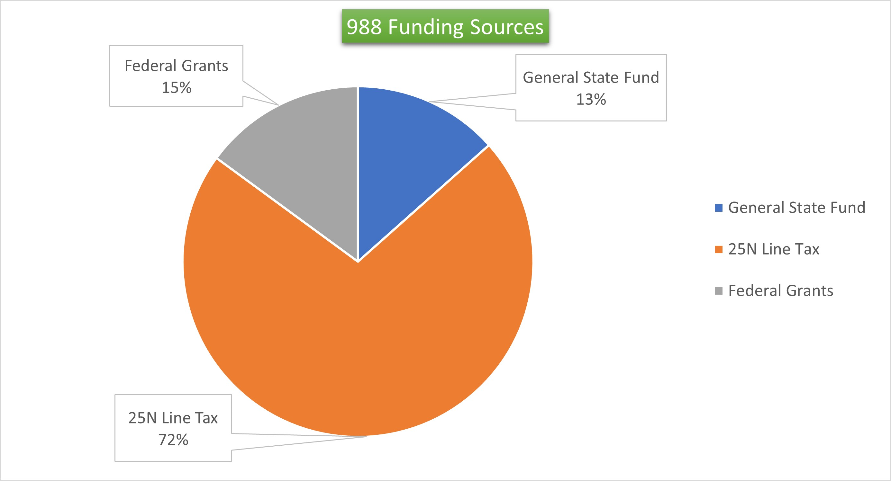
988 Funding
988 is a free service and there will never be a charge for contacting it.
State funds:
A state tax – $.40/month on every cell phone, landline, voice over internet protocol line
State funds– funds the crisis centers to implement diversity, equity, and inclusion activities
Grant funds:
Substance Abuse and Mental Health Services Administration grants
National Association of State Mental Health Program Directors grant
Grants 15%
Notes:
Elaina
Q: How is 988 being funded?
Funding allows 988 to remain a free service for help seekers.
A: Congress has provided the Department of Health and Human Services workforce funding through the American Rescue Plan, some of which will support the 988 workforce.
The President’s Fiscal Year 2022 budget request provides additional funding for the Lifeline itself and for other federal crisis funding sources.
At the state level, in addition to existing public/private sector funding streams, the National Suicide Hotline Designation Act of 2020 allows states to enact new state telecommunications fees to support 988 operations.

Slide 11
Anyone Can Call 988
Some research indicates people are more likely to turn to trusted messengers such as a spouse/partner, parent, or sibling for help or advice during mental health crisis.
You
Family
Friends
A person wearing glasses looks at their smartphone while sitting on a bus.
Two people sitting together on a train have their hands clasped together on top of a cane.
A person stands behind another person while holding on to their shoulders.
Notes:
-You can call 988 to get help for yourself, a friend, or a loved one
-You can call 988 to get help for yourself or support for a loved one if you believe they may be dealing with a mental health crisis
In the initial 988 Formative Research study, participants indicated that when they’re struggling with their mental health or are in crisis, they most often turn to their spouse/partner, mother, siblings, and friends for help and advice. These trusted messengers are also the ones participants said they’d most trust information on 988 from, giving them a vital role in helping encourage, nudge, and influence their loved ones/close connections to seek support through 988
_____________________________________________________________________________________________________________________________________________________________
Add data from trusted messengers: 988 FR_Trusted Messenger_Toolkit_Final-508.pdf (suicidepreventionmessaging.org)
Co-workers
Teachers
Concerned neighbors or community members
Sport coaches
Student Peers
Family caring for someone with mental illness or substance use issues

Slide 12
988 Lifeline Data: November 2024
Washington State text/chat:
Received: 4,693
Answered: 4,573
Average time to answer: 14.1 seconds
Average talk time: 35.7 minutes
Washington State calls:
Received: 10,285
Answered: 9,622
Average time to answer: 21.8 seconds
Average talk time: 13.2 minutes
Native and Strong Lifeline (November 2024):
Received: 689
Answered: 646
Average time to answer: 13 seconds
Average talk time: 13.57 minutes

Slide 13
What to Expect When Contacting 988
An automated message tells you that you’ve reached 988 and offers some options.
You can choose one of the prompts to reach a specialized line or stay on the line to be transferred to a crisis center.
If you’ve called the 988 Lifeline, you’ll hear some music while you wait to be transferred.
A crisis counselor will pick up your call, text, or chat.
Crisis counselors will listen and provide support.
Crisis counselors can also share resources for longer-term support.
988 Greeting
Notes:
- We know it takes courage to reach out for help. You don’t need to know what to say or how to say it.
- When you call...
o You’ll hear an automated message telling you that you’ve reached 988 and hear a series of options:
Dial 0 or stay in the line to move passed the specialized prompts
§ Press 1 for the Veterans Crisis Line
§ Press 2 to get support in Spanish
§ Press 3 for the LGBTQI+ Youth Line
§ Press 4 for the Native and Strong Lifeline
o If you don’t select any of the options, you will be automatically routed to a counselor closest to you (based on your area code)
- A trained crisis counselor will answer the call, listen, offer support, collaborate with you on ways to feel better, and share resources for additional or ongoing support.
- You will never be put on hold.
Chat:
Texters/chatters get a pre-contact survey. I'd advise that you open the 988 lifeline chat website as if you were going to use the service just to take a look at what info is asked
You will complete a pre-chat survey and enter
Zip Code *
Series of optional prompt
Name/alias & age
Gender Identity
Select boxes with main concerns
Additional text box to write in concerns if not listed
Option to select for LGBTQI+ under age of 25
Select options regarding thoughts of suicide and rate intensity of your feelings*
Option to provide a phone number for counselor to check in after each call.
Follow up services:
Diagram of call flow and prompts with dedicated lines (maybe slide 5 from core deck?)
What happens if people don’t select a prompts
Washington has three 988 Lifeline crisis centers that answer calls, texts, and chats from around the state:
o Volunteers of America Western Washington
o Frontier Behavioral Health
o Crisis Connections
Your call, text, or chat will be directed to one of these crisis centers based on your area code.

Slide 14
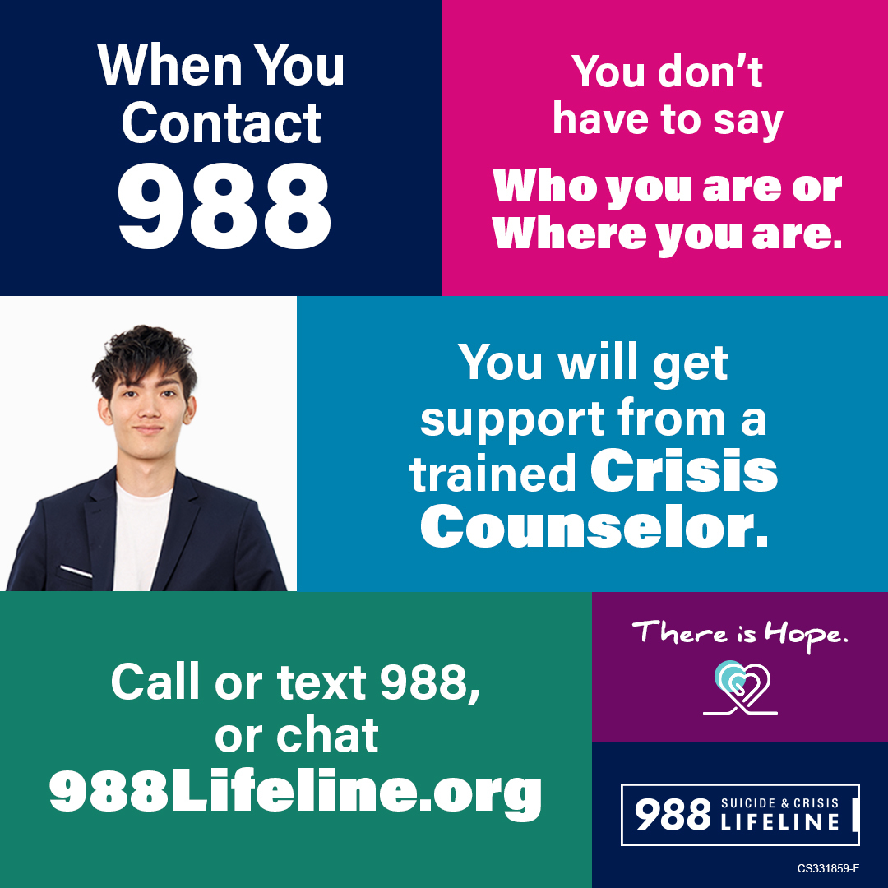
Contacting 988
When you reach out to 988, the 988 Lifeline crisis counselor knows only your phone number if you call or text, or your IP address if you use chat.
What you say about yourself is your choice.
A white square with a person wearing a blue blazer with white tee-shirt.

Slide 15
Which Number Should I Use?
Thoughts of suicide
Feelings of anxiety
Someone to talk to
Substance use challenges
Drug overdose or serious self-injury
Unconsciousness
Suicide attempt in progress
Life-threatening event
Utility assistance
Food
Housing
Health care
Child care
Elder care
988
911
211
Suicide prevention & mental health crises
Medical & public safety emergencies
Local services & resources

Slide 16
Does the 988 Lifeline Contact 911?
More than 98% of 988 calls are handled without involving emergency services.
Calls will only be transferred to emergency services when a person is in immediate danger and the risk to their life can’t be reduced during the conversation.
In these cases, the crisis counselor shares information with 911 that is crucial to saving a life. In most of these cases, the help-seeker consents to 911 involvement.

Slide 17
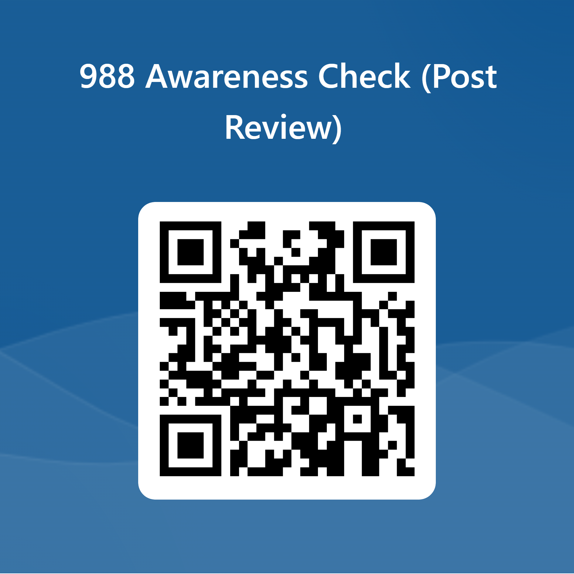
Questions?

Slide 18
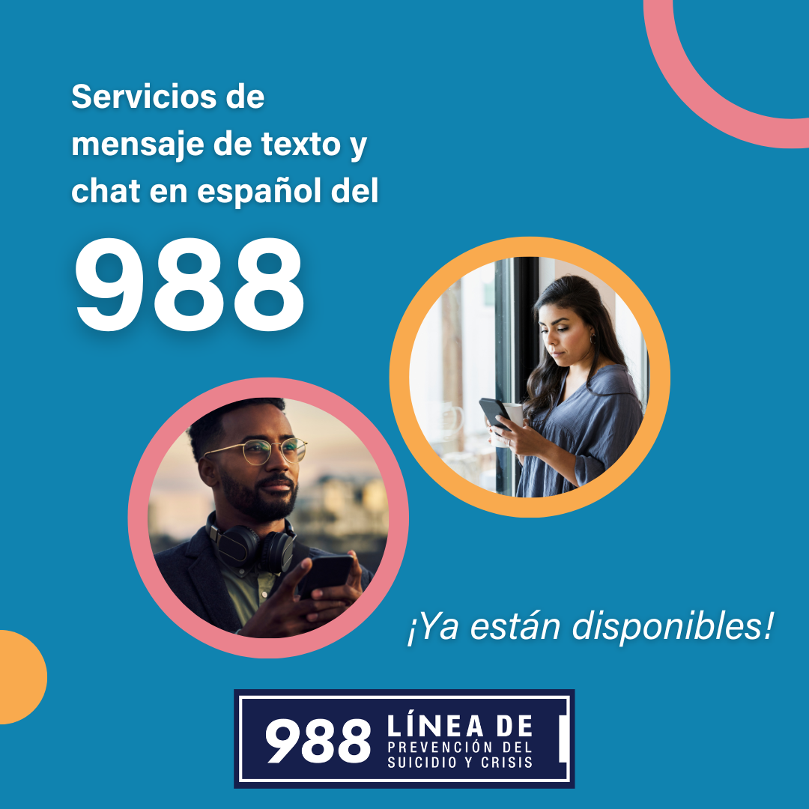
Resources
Order Materials Here
These toolkits contain social media shareables, video, print materials, radio ads, FAQs, messaging and communications to trusted messengers, and other marketing materials to promote the 988 Suicide & Crisis Lifeline.
The toolkits are designed for communities and other partners.
You can adapt these outreach materials and build upon them with community coalitions to meet the needs of their specific audiences.
988 Suicide & Crisis Lifeline - Call. Text. Chat. (988lifeline.org)
For questions about the 988 program at the Washington State Department of Health, please email 988ProgramInfo@doh.wa.gov or Elizabeth Emmet at elizabeth.emmet@doh.wa.gov.
A blue square with a pink circle that has a picture of a person wearing glasses and holding a mug and a yellow circle with a person holding a cell phone while looking at the screen.
SAMHSA 988 Partner Toolkit
DOH Partner Toolkit
988 Trusted Messenger toolkit
Media Campaign Toolkit
A person wearing a cap is looking across a corn field with their hands resting on a pole.
Notes:
Krystle
SAMHSA Toolkit
https://www.samhsa.gov/resource-search/988
DOH Toolkit
https://doh.wa.gov/sites/default/files/2022-07/971056-988LifelinePartnerToolkit.pdf?uid=63520dd975c1d
988 Trusted Messenger toolkit:
https://suicidepreventionmessaging.org/sites/default/files/2024-05/988 FR_Trusted Messenger_Toolkit_Final-508.pdf
Media Campaign Toolkit:
Partner Toolkit | 988 (wa988.org)
Ordering Materials
orders.gpo.gov/SAMHSA988/Pubs.aspx#top
Please feel free to drop any questions in the chat or email me!
elizabeth.emmet@doh.wa.gov
_________________________________________________________________________________________________________________________
These buttons lead you to the SAHMSA and DOH Partner Toolkits
Flyer print outs, social media posts, videos
The 988 graphics and videos used in this power point were retrieved from the SAHMSA toolkit, there are many options to choose from I encourage you to take a look at what's available to help raise awareness about 988 with your community.
If you are interested in presenting this information to others in your community let us know and we can schedule some time discuss what that could look like and next steps.
Please let us know if you have any questions.

Slide 19
To request this document in another format, call 1-800-525-0127. Deaf or hard of
hearing customers, please call 711 (Washington Relay) or email civil.rights@doh.wa.gov.
Notes:
to Chat
Please complete the 1 question post presentation awareness check by scanning the QR code or using the link here
https://forms.office.com/g/KcbKEqz1DV

