Slide 1
March 12, 2025
12 de Marzo 2025

Slide 2
WELCOME
Please share in the chat your name, pronouns and what are you looking forward to with the spring upon us?
BIENVENIDOS
Por favor, utilice el chat para díganos su nombre y a ¿Qué es lo usted espera con la llegada de la primavera?
Today's music for the Collaborative: local Native musician Arlie Neskahi
Música de hoy para el Colaborativo: músico nativo local Arlie Neskahi
Notes:
Poll Question:
Approximately what percent of native populations live in urban areas?
Less than 10%
30%
50%
70%
90%

Slide 3
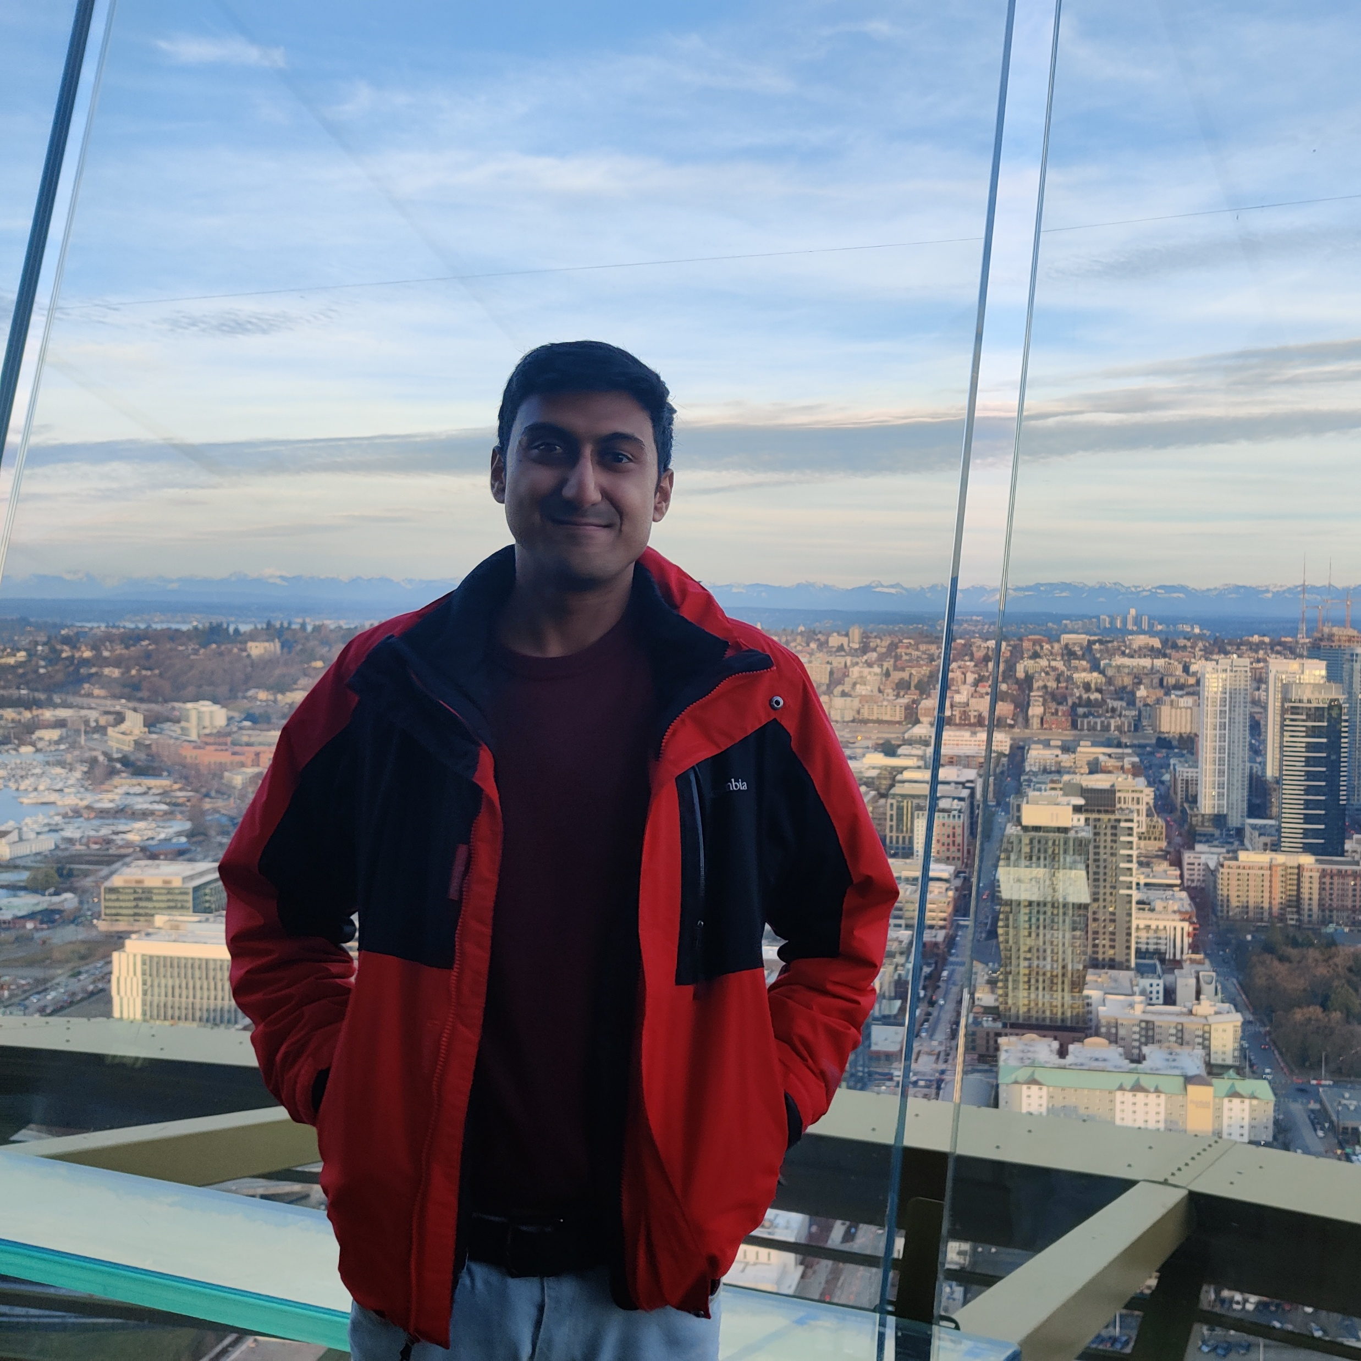
Keshreeyaji Oswal
Founding Member of
D-AFN Workgroup
Miembro Fundador del Grupo de Trabajo D-AFN

Slide 4
Agenda
Versión en Español: https://waportal.org/partners/ community-collaborative/meeting-notes-and-slides
3:35: Announcements // Anuncios
3:45: Thought Partner Update // Actualización de Thought Partner
4:00: Health Equity Zones // Zonas de Equidad en Salud
4:20: Emergency Response // Respuesta de Emergencia
4:55: Close // Cierre

Slide 5
ANNOUNCEMENTS
ANUNCIOS

Slide 6
Grants Available: Dementia Awareness
Small grants of $2500 to $10,000
Increase awareness of dementia and its risk factors
Promote brain health through community-based:
Education
Communication
Connection to resources
Priority populations
Black, Hispanic/Latino/Latina and AIAN
Rural counties and counties with high rates of dementia
How to Apply
Applications are due April 4th
See application summary and details of the application and scoring criteria.
Tiffany.Turner@doh.wa.gov
Building Our Largest Dementia (BOLD) Infrastructure Program Coordinator

Slide 7
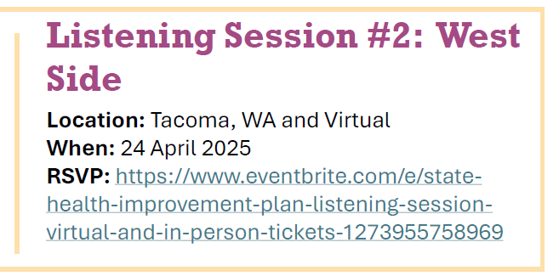
State Health Improvement Plan (SHIP)
The SHIP is a long-term, system-wide plan to focus efforts on critical health issues facing Washingtonians
Take the short Public Feedback survey
Compensation for attending meetings to provide input is available through the Community Collaborative
Web site: https://doh.wa.gov/about-us/state-health-improvement-plan
Email SHIP@doh.wa.gov with questions or for invites in Spanish, Russian or Vietnamese

Slide 8
THOUGHT PARTNER UPDATE
ACTUALIZACION DE THOUGHT PARTNER

Slide 9
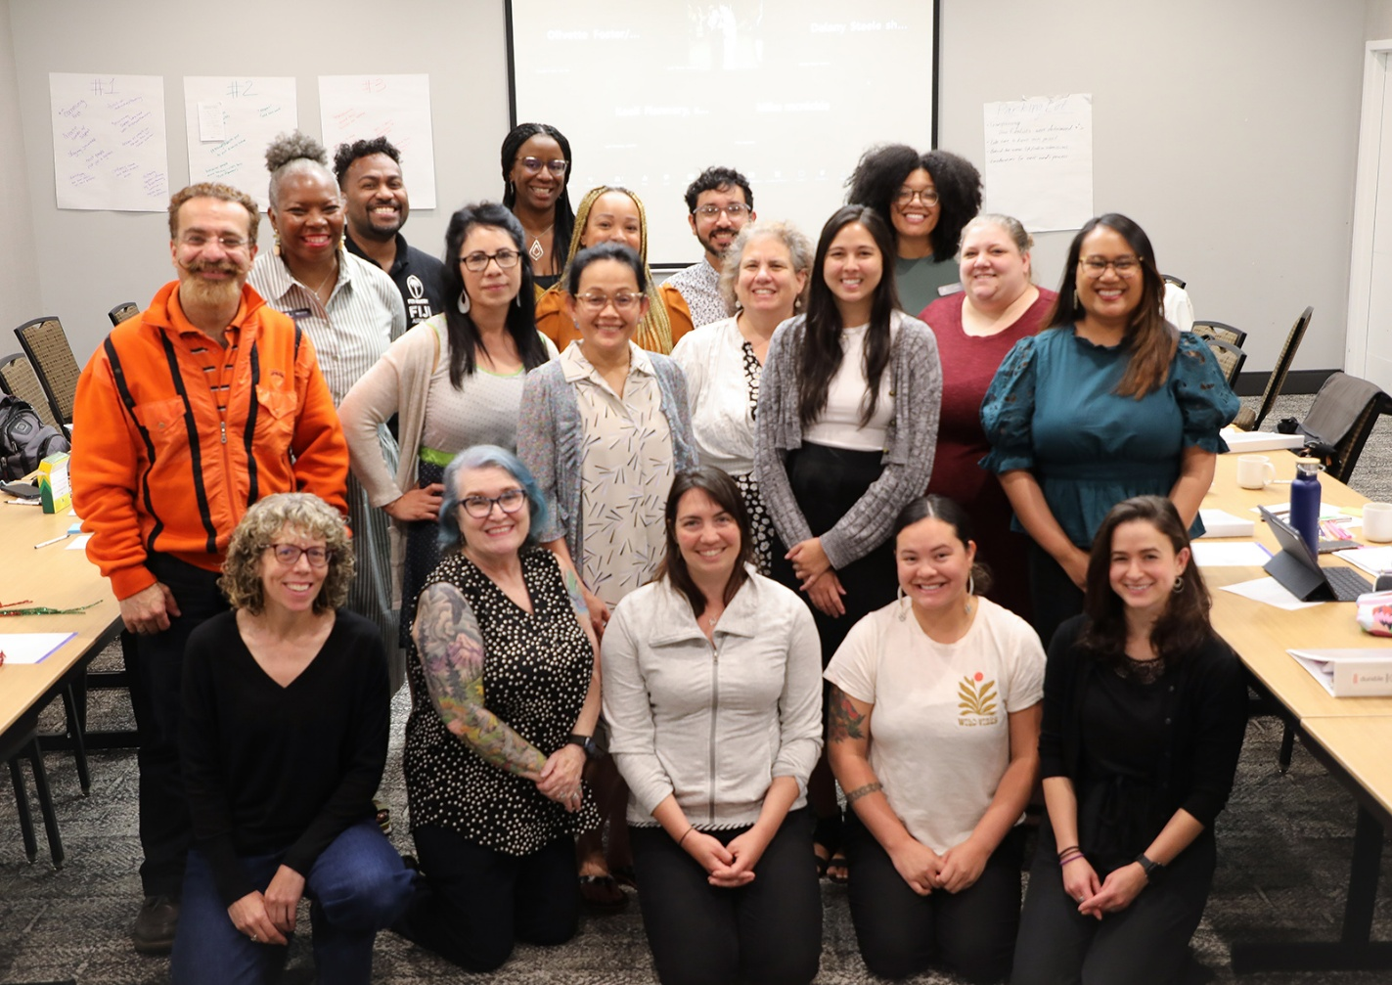
Health Equity Zones Marco de las Zonas de Equidad Sanitaria
Community-Led Decision Making Toma de Decisiones Liderada por la Comunidad

Slide 10
Health Equity Zones Framework
Place-Based
Community Investment
Reimagines Systems
Community Power-Building
Notes:
The HEZ Initiative was created by legislation in 2021, recognizing the impact of place-based health inequities in communities across Washington and the importance of community-driven decision-making to address the social determinants of health.
The vision of Health Equity Zones is for powerful and connected communities to lead decision-making to achieve self-determined health and wellbeing.
We accomplish this through our four core strategies:
Place-based: This work centers local needs, assets, and solutions and place is self-defined by the community. We support community power, collaboration, and collective action in the defined geographic areas.
Community Investment: A core strategy of the initiative is to invest in communities and their strategies for health equity.
Reimagines Systems: The initiative aims to change how government agencies partner with communities. The hope is that the learnings from this process will change how government collaborates with community and strengthens partnerships and trust.
Community Power-Building: We approached this work with a community-centered and collaborative process from the beginning, supporting cross-community collaboration, skill-building, and collective action. This meant implementing a community-driven decision-making process in the design of the initiative and selection of the zones.

Slide 11
Washington’s Health Equity Zones
Rural Zone:
East Whatcom County
(Mount Baker School District)
(New) Zone for Native Communities:
Ancestral Lands of the Port Gamble S’Klallam Tribe
(Kitsap, Clallam, Jefferson, Mason, and San Juan Counties)
Urban Zone: South King County
(SeaTac-Burien-Tukwila)
Notes:
Rural and Urban Zones were selected in August 2023 by the CAC and are currently in the community outreach stage
The Zone for Native Communities was selected by an Indigenous Advisory Panel in October

Slide 12
Participatory Action Evaluation
The Health Equity Zones participatory action approach to evaluation means those involved in the initiative develop the evaluation and use
the findings for collective action.
Notes:
KF
Over the course of the two year zone selection process, we used a participatory action evaluation approach to embed learning and reflection, and to center the voices of community members in the evaluation.
PAE is defined as those involved in the initiative...
We formed an evaluation team composed of community partners and staff.
Together they developed each step of the evaluation (defining questions/success, collecting data, analyzing data, sharing findings).
Decided how to use the findings for collective action such as program improvements and strategic direction.

Slide 13
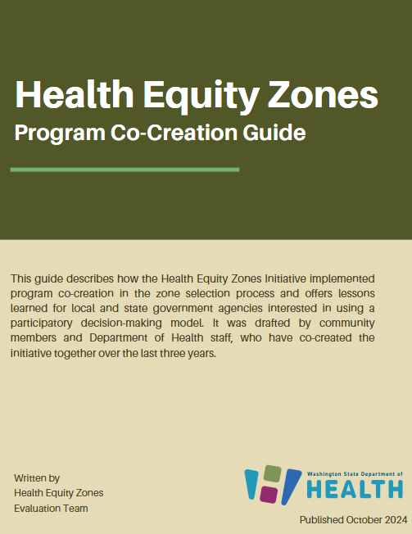
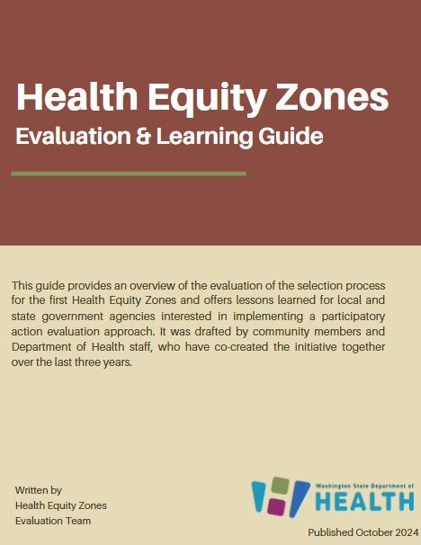
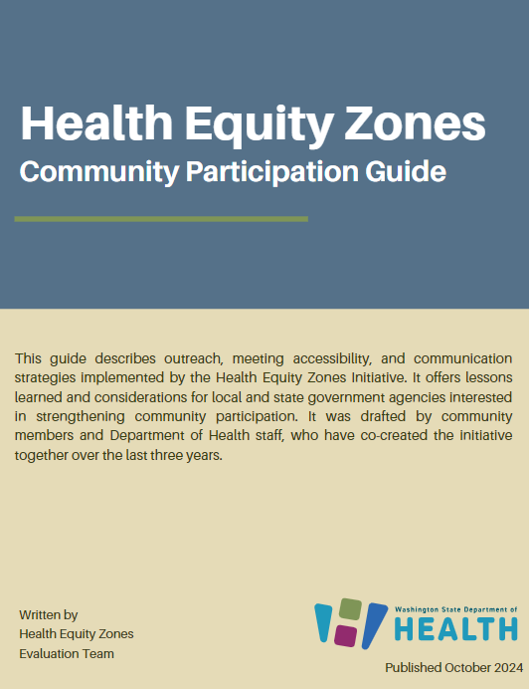
Evaluation Guides
Notes:
KF
In October of last year we released 4 materials documenting the zone selection process and evaluation of community engagement strategies.
Case study provides an overview of the zone selection and key learnings.
The program co-creation guide includes lessons learned on supporting community-led decision-making and leadership.
The evaluation & learning guide shares lessons learned from our participatory action approach, data equity principles co-developed with community partners, supporting data ownership and governance.
The community participation guide focuses on lessons learned on outreach, communications, and meeting planning. We share how we engaged trusted messengers and prioritize accessibility.
Each guide highlights our hurdles in the process and the learnings we took.
You can access the materials on our webpage in English & Spanish.

Slide 14
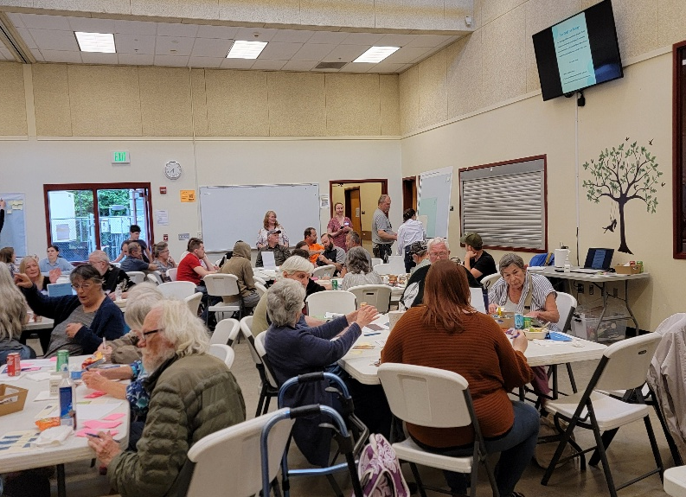
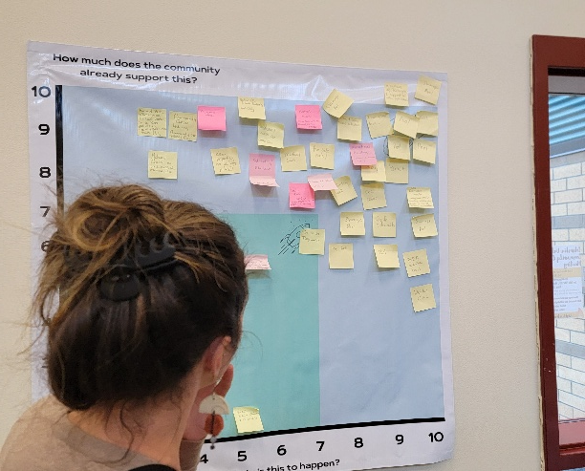
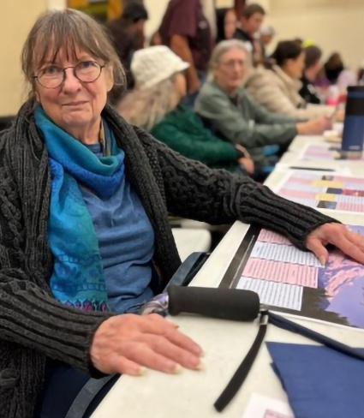
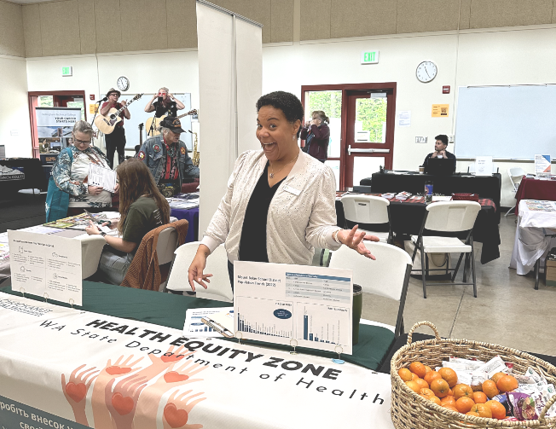
Whatcom HEZ
Spring 2024
Fall 2024
Spring 2025
Outreach Phase 1
Outreach Phase 2
Community Advisory Board
and Project Proposals
"I came because it’s my community, and to support everyone else who is really working hard for the community.”
Notes:
DELANY

Slide 15
Spring and Summer 2025
January - March
March - April
May - July
August – Sept.
Conclude Outreach Phase 2, recruit Community Advisory Board
Establish Community Advisory Board
Community Advisory Board establishes project planning and criteria process for ideas raised by community
Community Advisory Board presents most feasible project plans to community for voting
Notes:
DELANY

Slide 16
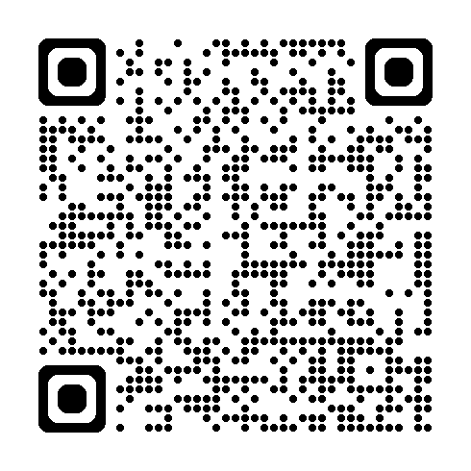
South King County HEZ
Translated Outreach Surveys Available Here:
Centered in SeaTac, Burien, & Tukwila
Focus on newcomer communities
Learning about health priorities & goals/potential project ideas
Partner organizations:
Somali Health Board
Congolese Integration Network
Partner in Employment
Outreach phase:
Focus groups and listening sessions
Online Survey (available in Dari, English, French, Oromo, Pashto, Portuguese, Russian, Somali, Spanish, Swahili, & Ukrainian)
https://waportal.org/partners/health-equity-zones-initiative/health-equity-zones/south-king-county-hez
Notes:
SHAAN

Slide 17
Stay Connected
Email: HealthEquityZones@doh.wa.gov
Newsletter: https://public.govdelivery.com/accounts/WADOH/subscriber/new?topic_id=WADOH_687
Website:
https://waportal.org/partners/health-equity-zones-hez-initiative

Slide 18
EMERGENCY RESPONSE
RESPUESTA DE EMERGENCIA
Versión en Español:
https://waportal.org/partners/community-collaborative/meeting-notes-and-slides

Slide 19
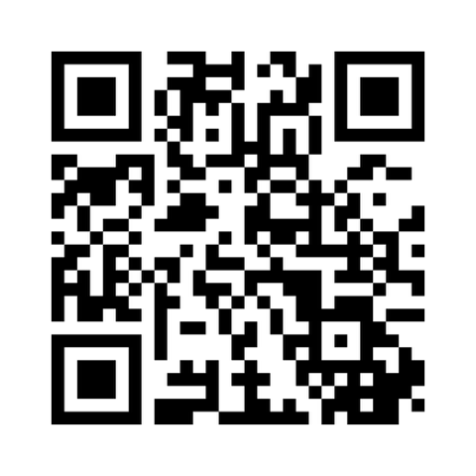
Which social determinants of health put your communities more at risk in a natural disaster or pandemic?
¿Cuáles son los determinantes sociales de la salud que podrían poner en un riesgo mayor a sus comunidades en un desastre natural o pandemia?
Notes:
Add this link into the chat: https://www.menti.com/al3kkxt2pmhd

Slide 20
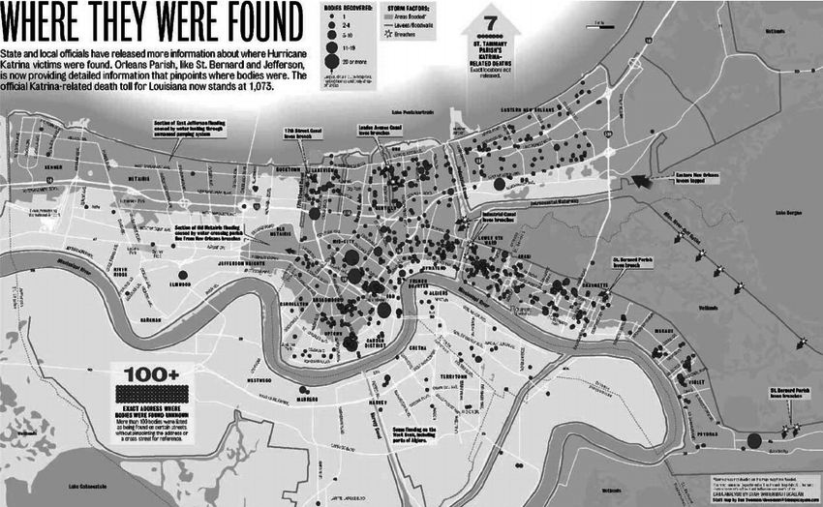

Slide 21
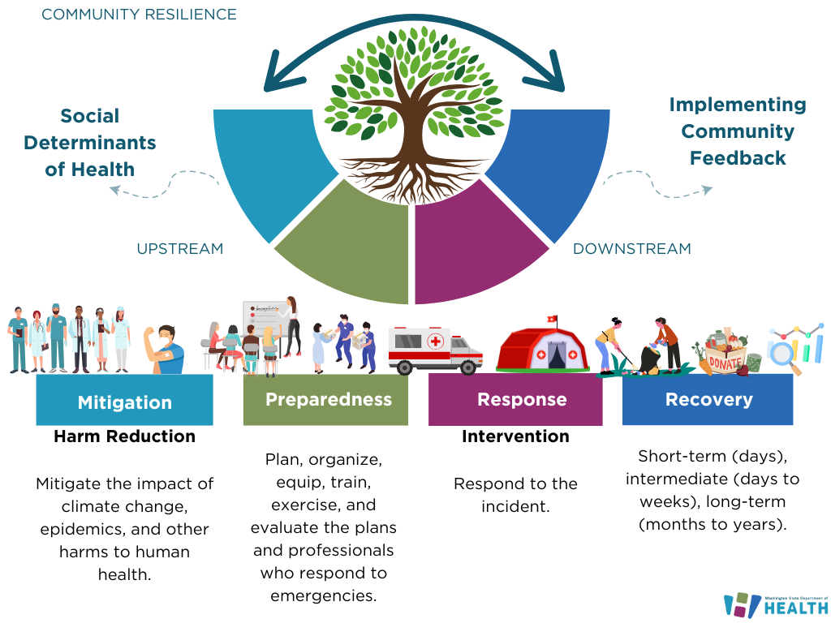

Slide 22
Public Health Advisory Board Recommendations
Prioritize Community Integrated Health and Emergency Response Planning that Supports Improved System Capacity, Funding Flow, and Decision Making:
Integrate health equity into planning and policy efforts to address disparities in access to healthcare, testing, treatment, and vaccination efforts.
Create capacity for regular training and exercise cycles that include partners.
Flexible systems to ensure resources are distributed equitably during emergencies.
View the report on WaPortal

Slide 23
Future Opportunities for Community Feedback
Base Plan
Recovery Annex
Equity Annex
Exercises – Tabletops and Workshops
Trainings + Technical Assistance
Ongoing community engagement opportunities
(Workgroup Coming Soon) Statewide Preparedness and Response Equity Action Advisory Committee
Notes:
Which social determinants of health put your communities more at risk in a natural disaster or epidemic/pandemic?
What factors do you believe are necessary for a community to be resilient to disaster?

Slide 24
Emergency Management Resources
Public Health + Healthcare Emergency Preparedness and Response
Public Health Emergency Preparedness (PHEP) Program and Guidance | State and Local Readiness | CDC
Administration for Strategic Preparedness and Response ASPR Home
Hospital Preparedness Program (HPP)
Washington State Emergency Management Division
Emergency Management Division | Washington State Military Department, Citizens Serving Citizens with Pride & Tradition
Federal Emergency Management Agency Homeland Security Exercise and Evaluation Program
Homeland Security Exercise and Evaluation Program | FEMA.gov
Incident Management
ICS Organizational Structure and Elements
All-Hazard Incident Management Team Overview
Incident Recovery
National Disaster Recovery Framework

Slide 25
To request this document in another format, call 1-800-525-0127. Deaf or hard of
hearing customers, please call 711 (Washington Relay) or email civil.rights@doh.wa.gov.

Slide 26
9 April – Medicaid, Open Forum
7 May – 988 Follow Up
14 May – Budget Updates
Next Meetings //
Próxima Reunión
https://waportal.org/partners/community-collaborative

Slide 27
“Nothing we accomplish in life is totally free of the influence of spirit and community. We do nothing alone.”
― Tricia Hersey
Rest Is Resistance: A Manifesto
“Nada de lo que logramos en la vida está totalmente libre de la influencia del espíritu y de la comunidad. No hacemos nada solos”.
—Tricia Hersey
El Descanso es Resistencia: Un Manifiesto

Slide 28
To request this document in another format, call 1-800-525-0127. Deaf or hard of
hearing customers, please call 711 (Washington Relay) or email civil.rights@doh.wa.gov.

