Slide 1
April 9, 2025
9 de Abril 2025
Notes:
Opening song: https://www.youtube.com/watch?v=S2T216XgiO0

Slide 2
WELCOME
Please share in the chat your name, pronouns, and where is love or laughter showing up in your life these days?
BIENVENIDOS
Por favor, utilice el chat para díganos su nombre y ¿En qué parte de tu vida se está manifestando el amor o la risa?

Slide 3
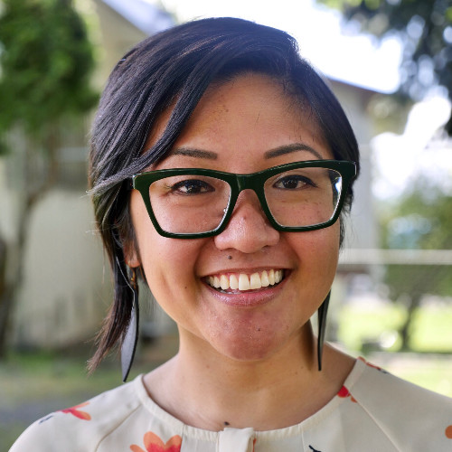
Shalom Agtarap
Community Thought Partner

Slide 4
Agenda
3:35: Announcements
3:50: DOH Leadership Updates – Jesscia Todorovich, Interim Secretary of Health
4:25: HCA Medicaid Updates – Dr. Charissa Fotinos, WA State Medicaid and Behavioral Health Medical Director
4:58: Close
3:33: Land/Labor Acknowledgement

Slide 5
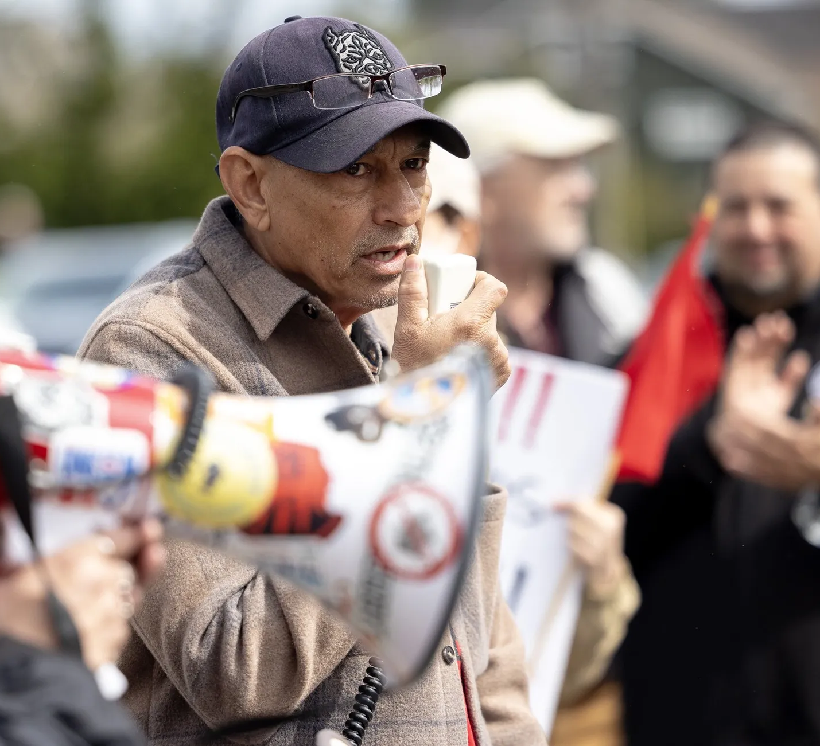
(Left) Crisanto Serrano, who was fired by mushroom producer Windmill Farms, speaks about his experience Monday outside a Safeway in Tacoma (Nick Wagner / The Seattle Times)
(Right) Image of protests from United Farm Workers

Slide 6
ANNOUNCEMENTS
ANUNCIOS

Slide 7
SURVEY: https://forms.office.com/g/FDvqm9e2hV
Notes:
https://forms.office.com/g/FDvqm9e2hV

Slide 8
State Health Improvement Plan (SHIP)
The SHIP is a long-term, system-wide plan to focus efforts on critical health issues facing Washingtonians
Compensation for attending meetings to provide input is available through the Community Collaborative
Listening Session #2
April 24, 2025 1 - 3:30 p.m.
Tacoma Library: 215 South 56th Street
Or via Zoom
https://www.eventbrite.com/e/state-health-improvement-plan-listening-session-virtual-and-in-person-tickets-1273955758969
Web site: https://doh.wa.gov/about-us/state-health-improvement-plan
Email SHIP@doh.wa.gov with questions or for invites in Spanish, Russian or Vietnamese

Slide 9
DOH LEADERSHIP UPDATES
Jessica Todorovich, Interim Secretary of Health, DOH

Slide 10
To request this document in another format, call 1-800-525-0127. Deaf or hard of
hearing customers, please call 711 (Washington Relay) or email civil.rights@doh.wa.gov.

Slide 11
MEDICAID UPDATES
Charissa Fotinos WA State Medicaid and Behavioral Health Medical Director

Slide 12
14 May – Meeting Cancelled
9 June – Briefings & Open Forum
Next Meetings //
Próxima Reunión
https://waportal.org/partners/community-collaborative

Slide 13
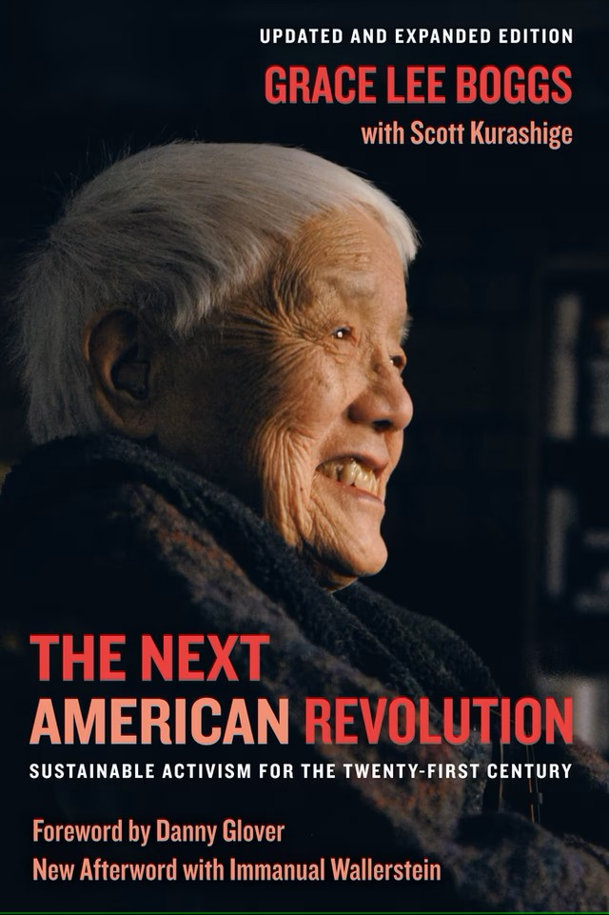
“Movements are born of critical connections rather than critical mass.”
Grace Lee Boggs The Next American Revolution: Sustainable Activism for the Twenty-First Century
“Los movimientos nacen de conexiones críticas más que de masas críticas.”

Slide 14
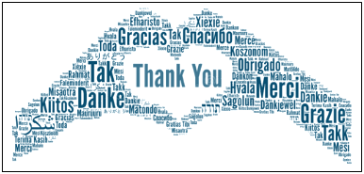
To request this document in another format, call 1-800-525-0127. Deaf or hard of
hearing customers, please call 711 (Washington Relay) or email civil.rights@doh.wa.gov.

