Slide 1
SEPTEMBER 10, 2025

Slide 2
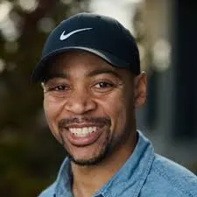
Community
Thought Partner
Cyril Walrond
Notes:
Cyril Walrond
Davven Davenport
Grady Mitchell
Ireion Turner
Jerry Thomas
Marriam Oliver
Matthew Durham
Robb Hampton
Russell Williams
Thomas Hill
Tiana Wood-Sims

Slide 3
Agenda
Welcome
Just Futures – A Model for Participatory Decision-Making
Q&A with Sec. Dennis Worsham
Next Meeting and Close
Notes:
Cyril Walrond
Davven Davenport
Grady Mitchell
Ireion Turner
Jerry Thomas
Marriam Oliver
Matthew Durham
Robb Hampton
Russell Williams
Thomas Hill
Tiana Wood-Sims

Slide 4
Washington State’s Approach to Co-creation and Power Sharing
Notes:
Everyone introduces themselves briefly - name, org, role
Welcome-

Slide 5
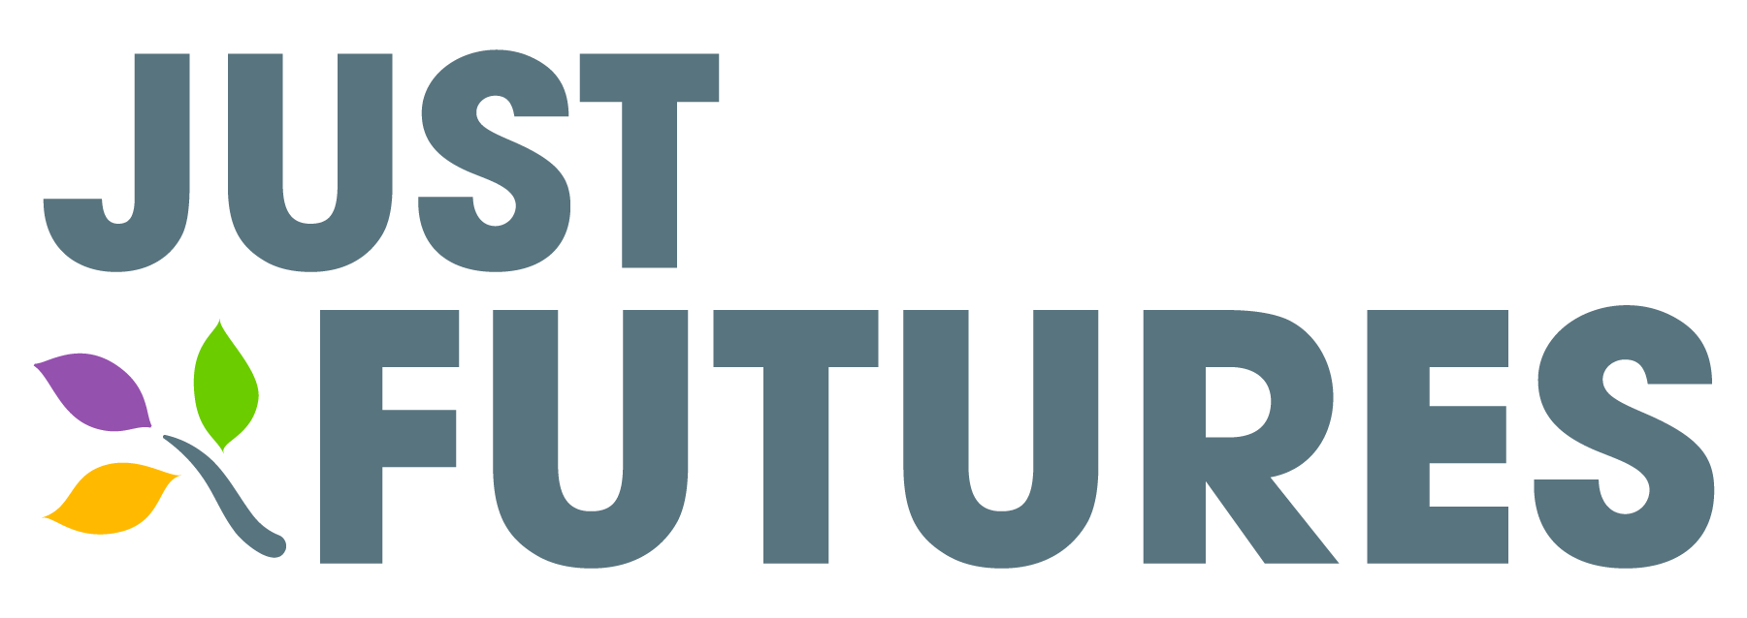
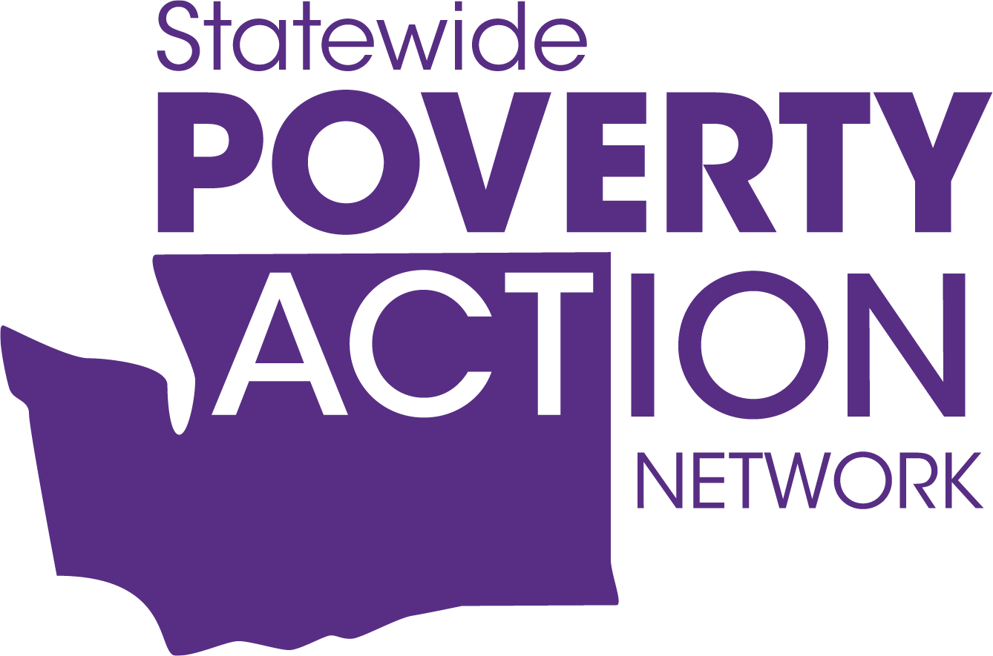
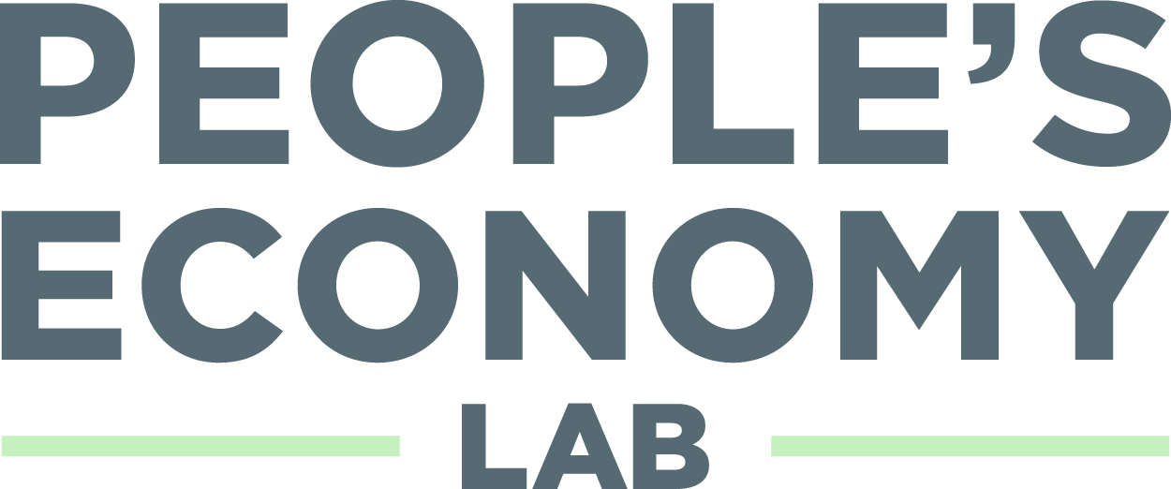
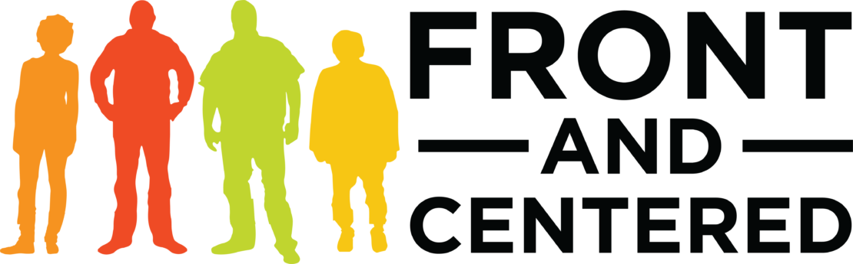

The Just Futures Initiative
Since 2021, a coalition of community-based organizations has worked to create the Just Futures initiative: an effort to center those who stand to benefit the most to co-create Washington State’s policy and investment.
Notes:
Faduma

Slide 6
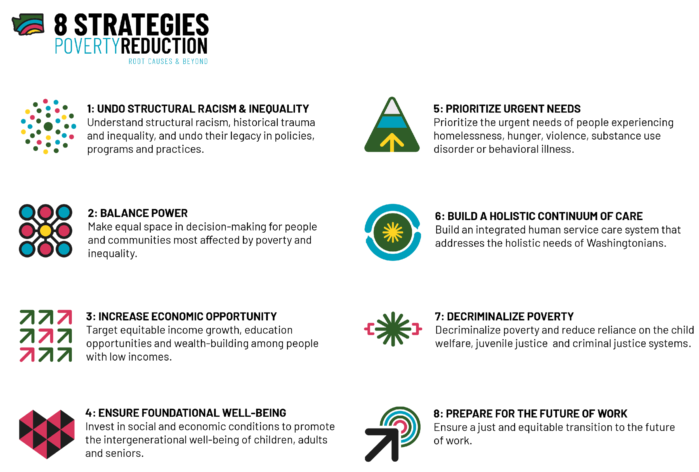
Just Futures Initiative
Goal & Objectives of the Just Futures Project
Goal
To define, measure and build accountability toward a just and equitable future in Washington.
Objectives
Build a community-led vision and definition for what a just and equitable future means.
Create state accountability toward vision with a process to measure, track and publicize progress to decision makers.
Ensure expertise and solutions of people and communities historically excluded from well-being are elevated in state budget and policy decisions.
Notes:
Faduma

Slide 7
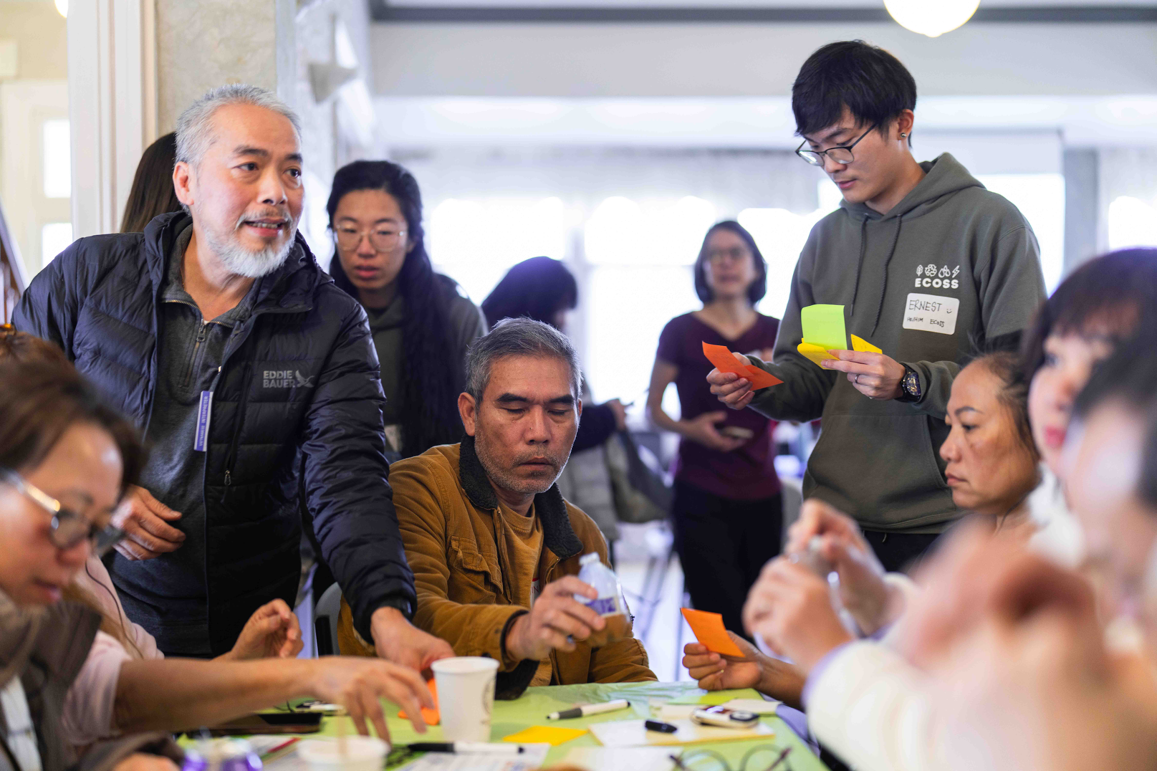
Our state must invest in everyone’s ability to participate in democracy
Washington State can revitalize democracy by creating spaces for frontline communities to develop solutions alongside government.
Image credit: ECOSS leads a Community Assembly in Beacon Hill on the effects of extreme weather events.
Notes:
Faduma
Too many people feel like their voice does not make a difference.
Community members and government officials both often feel that traditional engagement methods like listening sessions and town halls are not venues for real problem-solving.
Just Futures is a coalition of community and government who are building new ways to create policies that reflect the lived experience of frontline communities.

Slide 8
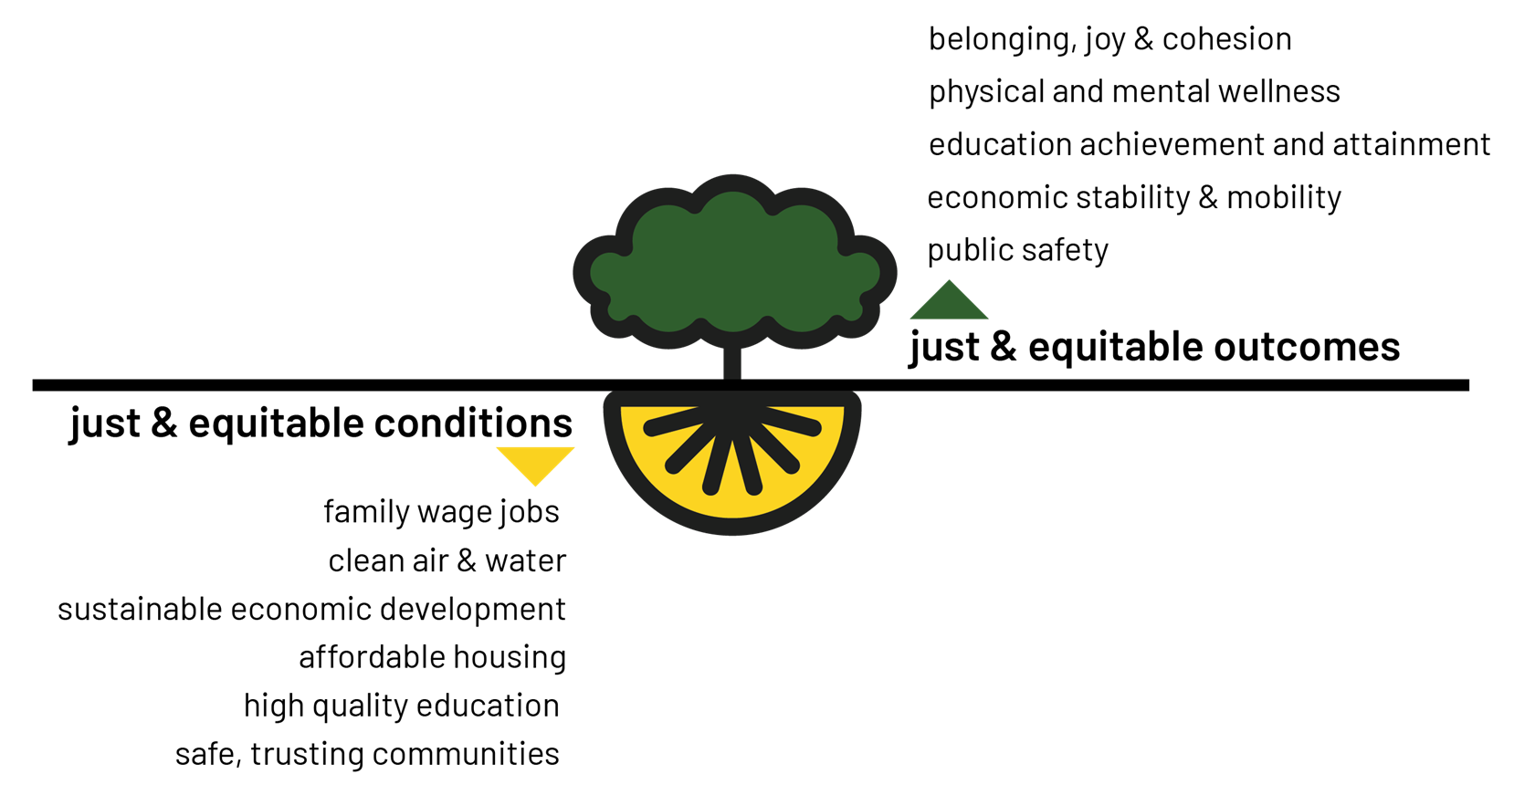
Using Community Wisdom to Solve Our Greatest Challenges
Notes:
Lindsay
North star slide
Collaborative governance empowers community members to translate their lived experiences into policy that can create more effective outcomes.
Collaborative governance happens when government and communities work together to make collective policy decisions, co-create programs to meet community needs and ensure policies and programs are implemented effectively

Slide 9
8 Strategies - Blueprint for a Just & Equitable Future: 10-Year Plan to Dismantle Poverty
Notes:
Lindsay

Slide 10
Approach : Alignment between Health, Environment & Poverty
Environmental Justice
WA State Environmental Justice Council
HEAL Act
Health
State Health Improvement Plan
Community Collaborative
Health Disparities Council
Poverty Reduction
Blueprint for a Just & Equitable Washington: The 10-Year Plan to
Reduce Poverty and Inequality
Economic Justice Alliance
Center lived expertise – those who stand to benefit the most from the programs, policies, budgets are at the tables
Similar CBOs and community members at each of our tables
Create consistent and accessible pathways for community to be meaningfully involved in government decision-making processes
Philanthropic dollars have helped us innovate to get to impact
*Sources:
WA State Blueprint for a Just & Equitable Washington
WA State Environmental Justice Task Force Final Report
WA State HEAL Act
WA State Executive Order 22-04 Implementing the WA State PEAR Plan and Playbook
Notes:
Lindsay
To complement what we shared, the two biggest existential threats to well-being are
Climate justice
Poverty – with the most egregious representation of poverty being homelessness
NOW democracy too
We have aligned approaches within our sets of work as we are both centering equity in all forms, but specifically racial equity, and incorporating human-centered design methodologies.
Centering lived expertise is cornerstone within the HEAL Act, Washington’s state Office of Equity, and the 10-Year Plan: WA State’s Blueprint for a Just & Equitable Future. Complementing this work is the Executive Order sign in December 2021 from the White House on transforming the federal customer experience and service delivery to rebuild trust in the government.

Slide 11
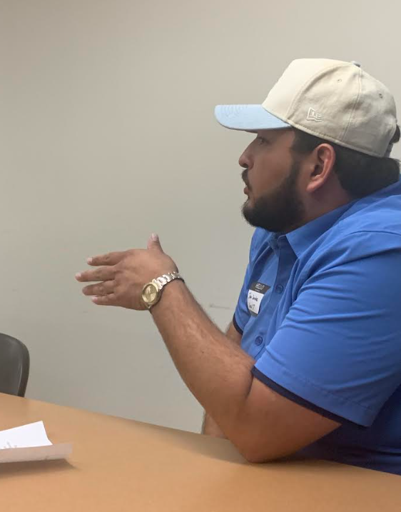
Closing the disconnect between government and the communities they serve
Participatory democracy builds trust and engagement in democracy—while also creating fairer and more effective outcomes when investing public money and making laws.
Image credit: MLK Labor leads a Community Assembly in Seattle on the effects of extreme weather events.
Notes:
Marcy
Disparities in health care, housing, and safe environments are due,
in part, to a disconnect between government policy making and community members facing
these challenges.
Collaborative governance empowers community members to translate their lived experiences into policy that can create more effective outcomes.
Collaborative governance happens when government and communities work together to make collective policy decisions, co-create programs to meet community needs and ensure policies and programs are implemented effectively

Slide 12
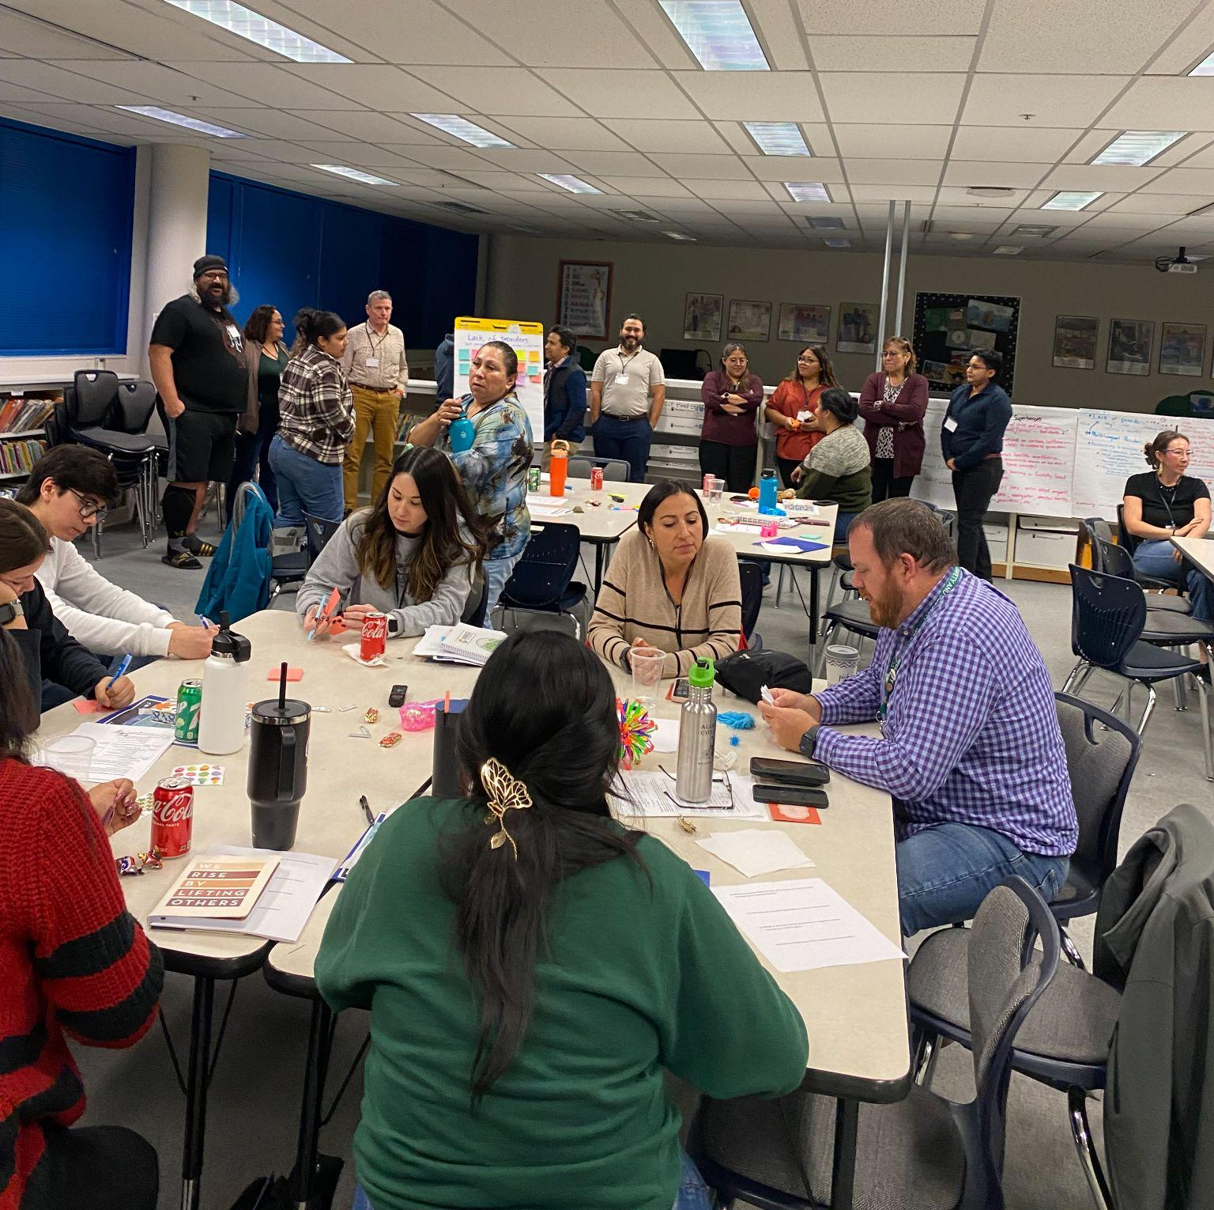
Participatory Democracy: Building a Resilient Washington State
People can’t learn to swim just by reading a how-to guide. It's the same for civic participation.
Participatory democracy creates spaces for community members to translate their lived experiences into policy.
Image credit: BMAC leads a Community Assembly in Walla Walla
Notes:
Marcy
Frontline communities have wisdom and expertise to help our state solve our biggest problems.
But right now, Washington has very few effective methods to activate community insights.
Just Futures is working to establish collaborative governance in Washington, to help people gain the skills and relationships they need to make a difference in their communities
Growing community skills will result in more effective government programs and create local leaders who are working to better their communities

Slide 13
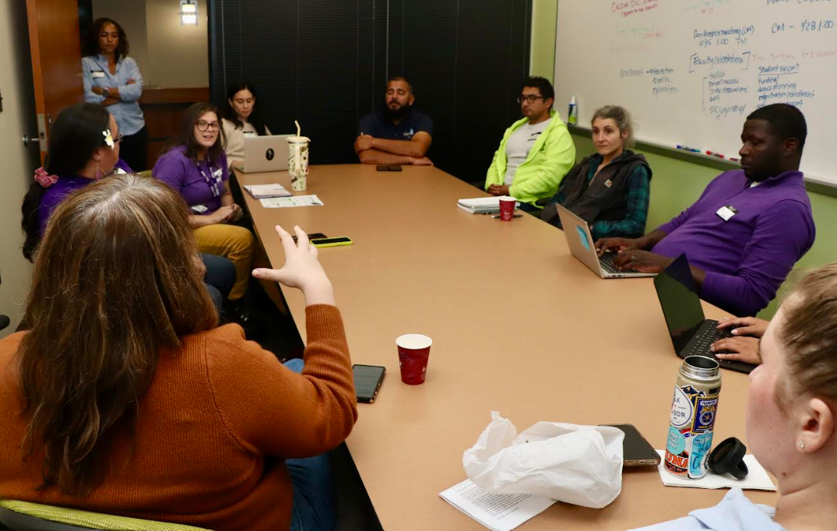
Leveraging the power of community self-determination
When communities participate in creating policy through participatory democracy, they are building skills in civic participation – and making Washington more resilient to economic and environmental challenges.
Image credit: MLK Labor leads a Community Assembly in Seattle on the effects of extreme weather events.
Notes:
Marcy

Slide 14
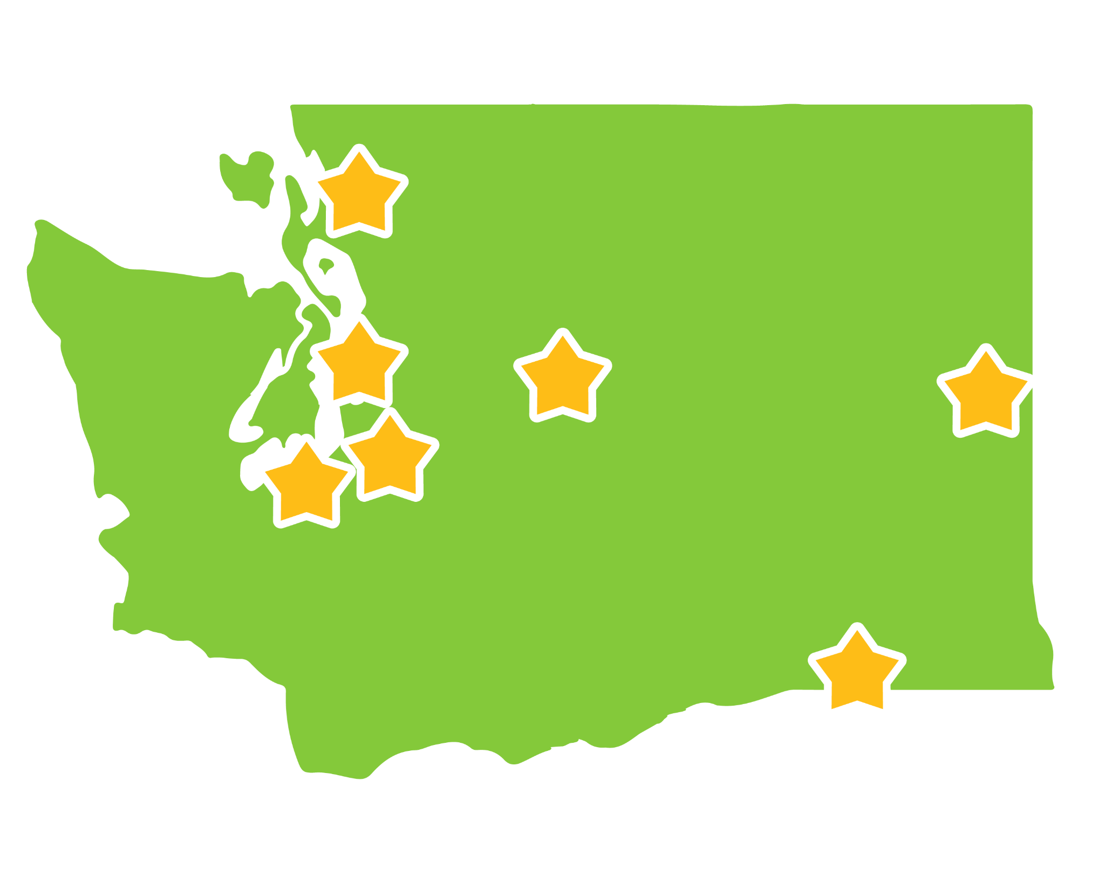
Washington State Community Assembly Pilot
A series of learning and discussion sessions led by trusted community-based organizations
Attended by community members who carry high levels of environmental and economic burdens
Community members partnered with government representatives over time, on strategy and relationship building to move outputs into outcomes.
Notes:
Faduma
Washington State both piloted assemblies which took place in Seattle, Spokane, Walla Walla, Tacoma, Sea-Tac, Sunnyside, Everson and Yakima, as well as in Skagit, Whatcom and King Counties
Assemblies are being led by trusted community organizations, including:
BMAC
ERRA
C2C
ECOSS
Utopia
Nuestra Casa

Slide 15
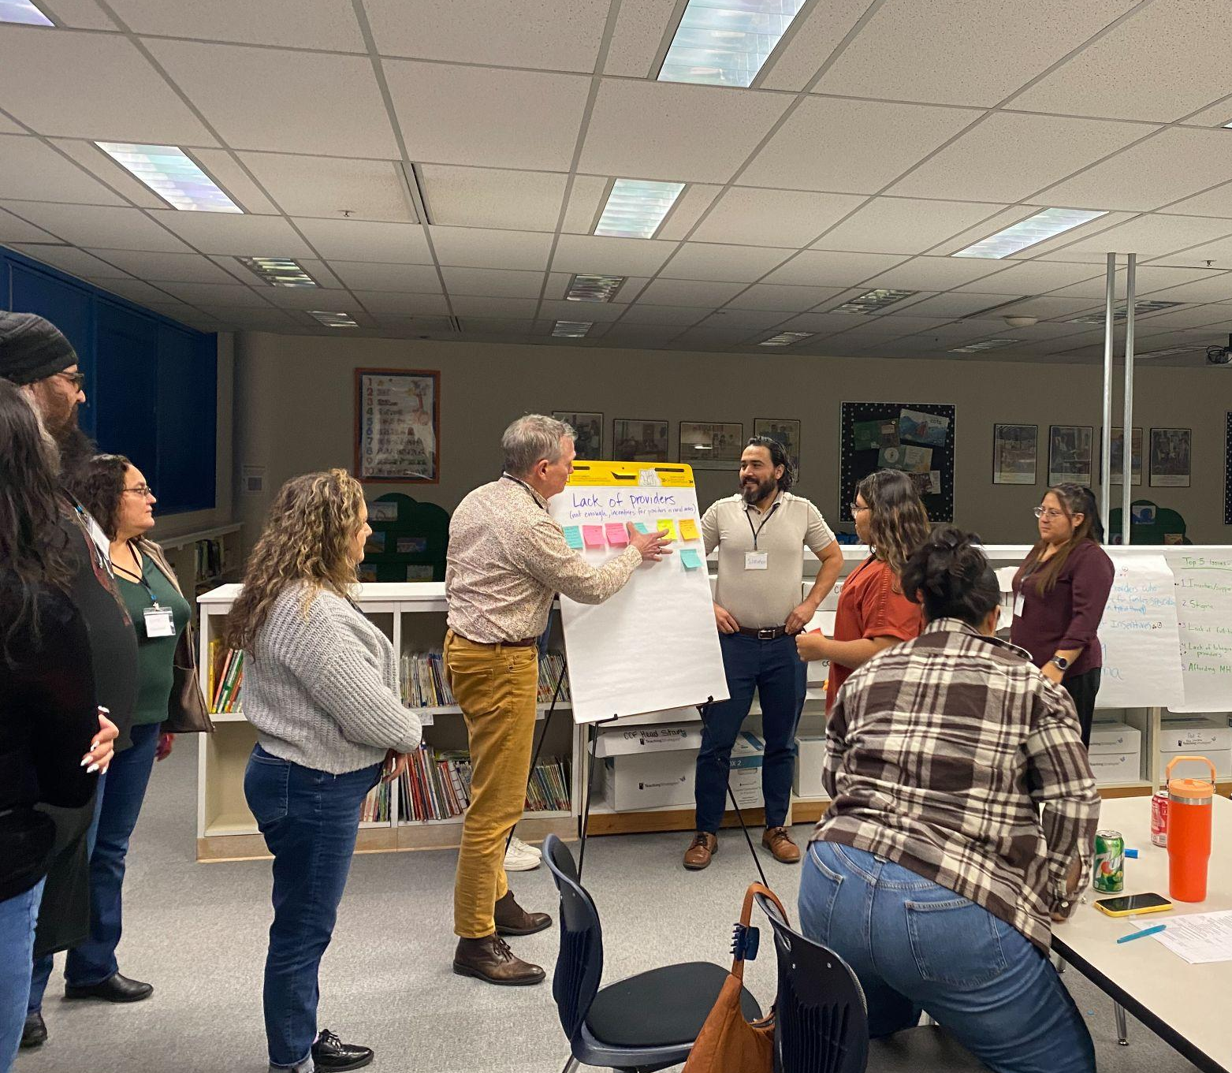
Role of Government
Community Assemblies enables community and government to collaborate and create relationships
Government gains insight into challenges and solutions building from the lived experience of frontline communities
Community members learn how to better navigate policymaking to improve their well-being
Through Assemblies, communities are able to identify priority issues to collaboratively inform programs, policies, and budgets with government agencies.
Image credit: BMAC. Community Assembly Participants discuss mental health resources in Walla Walla
Notes:
Faduma

Slide 16
Discussion
Questions?
In our current landscape, how would you build trust and collaboration between community and government?
Who holds power in our system of governance in Washington and at the local level? Who does not have power? (share some examples.)
Can you share some local and state-level examples of participatory governance in action?
If governing power were shared more broadly, what would that look like in practice? What might be the outcomes?
Notes:
Esther - some suggested discussion questions in breakout room.

Slide 17

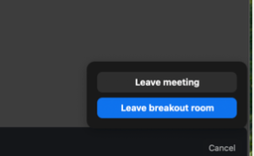
Spanish Interpretation and ASL services are only available in the main room.
To return the main rom for Spanish Interpretation or ASL services, please follow these steps:
Click the “Leave Room” button in the bottom right corner of your Zoom Interface.
Choose the “Leave breakout room” option and this will return you to the main session.
1.
Los servicios de interpretación al español y lenguaje de señas (ASL) solo están disponibles en la sala principal.
Si necesita regresar a la sala principal para recibir servicios de interpretación al español o ASL, siga estos pasos:
Haga clic en el botón “Salir de la sala” en la esquina inferior derecha de su interfaz de Zoom.
Seleccione la opción “Salir de la sala de Descanso” para regresar a la sesión principal.
2.

Slide 18
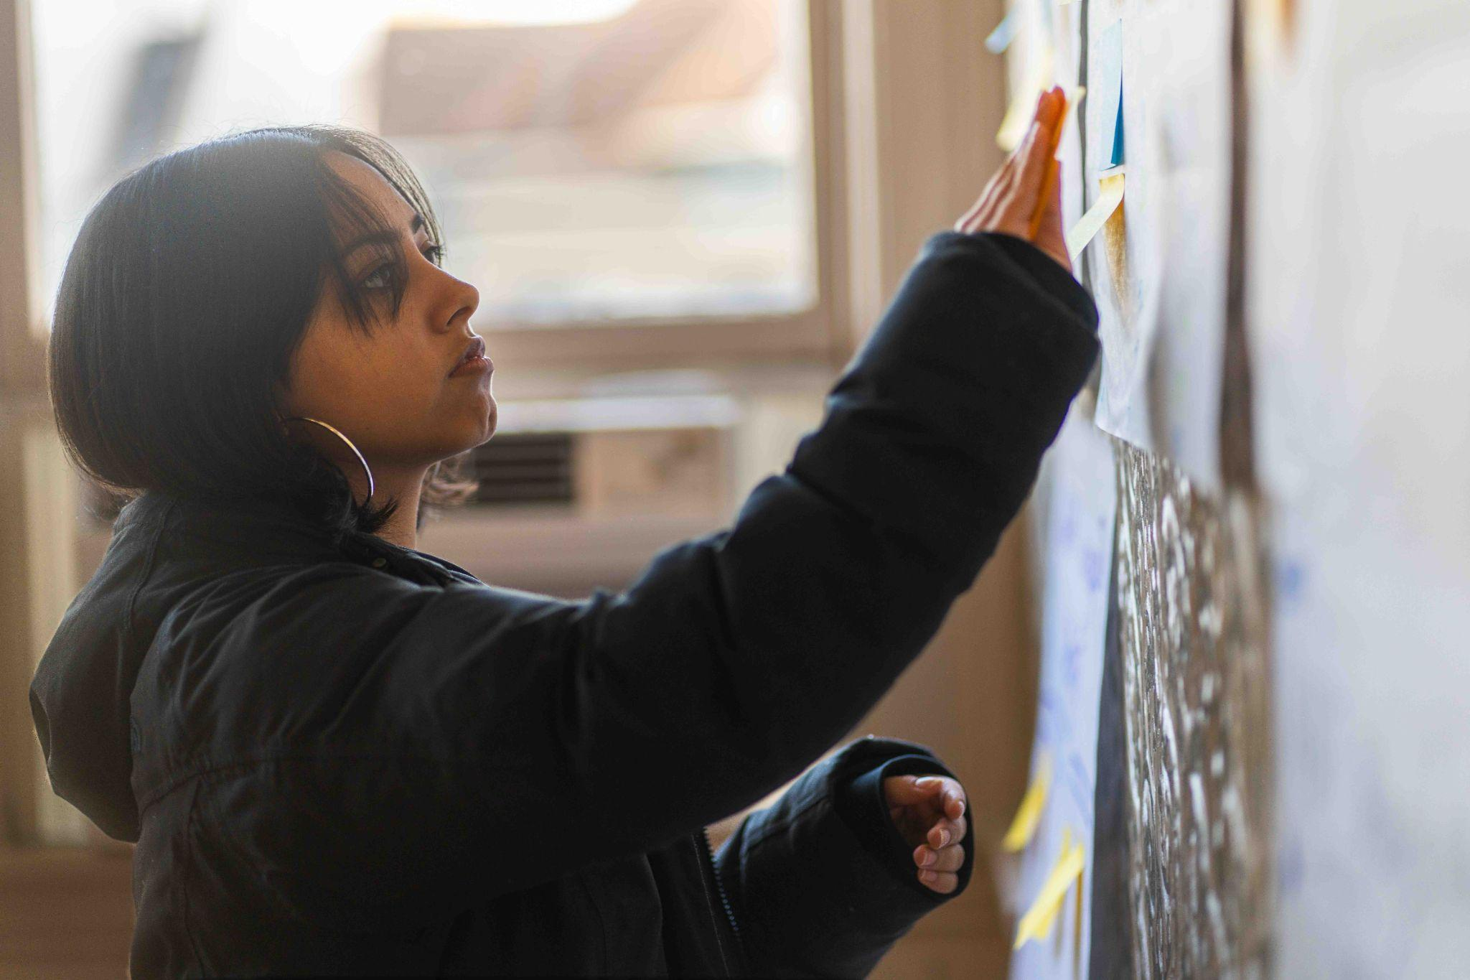
Thank you!
Image credit: ECOSS

Slide 19
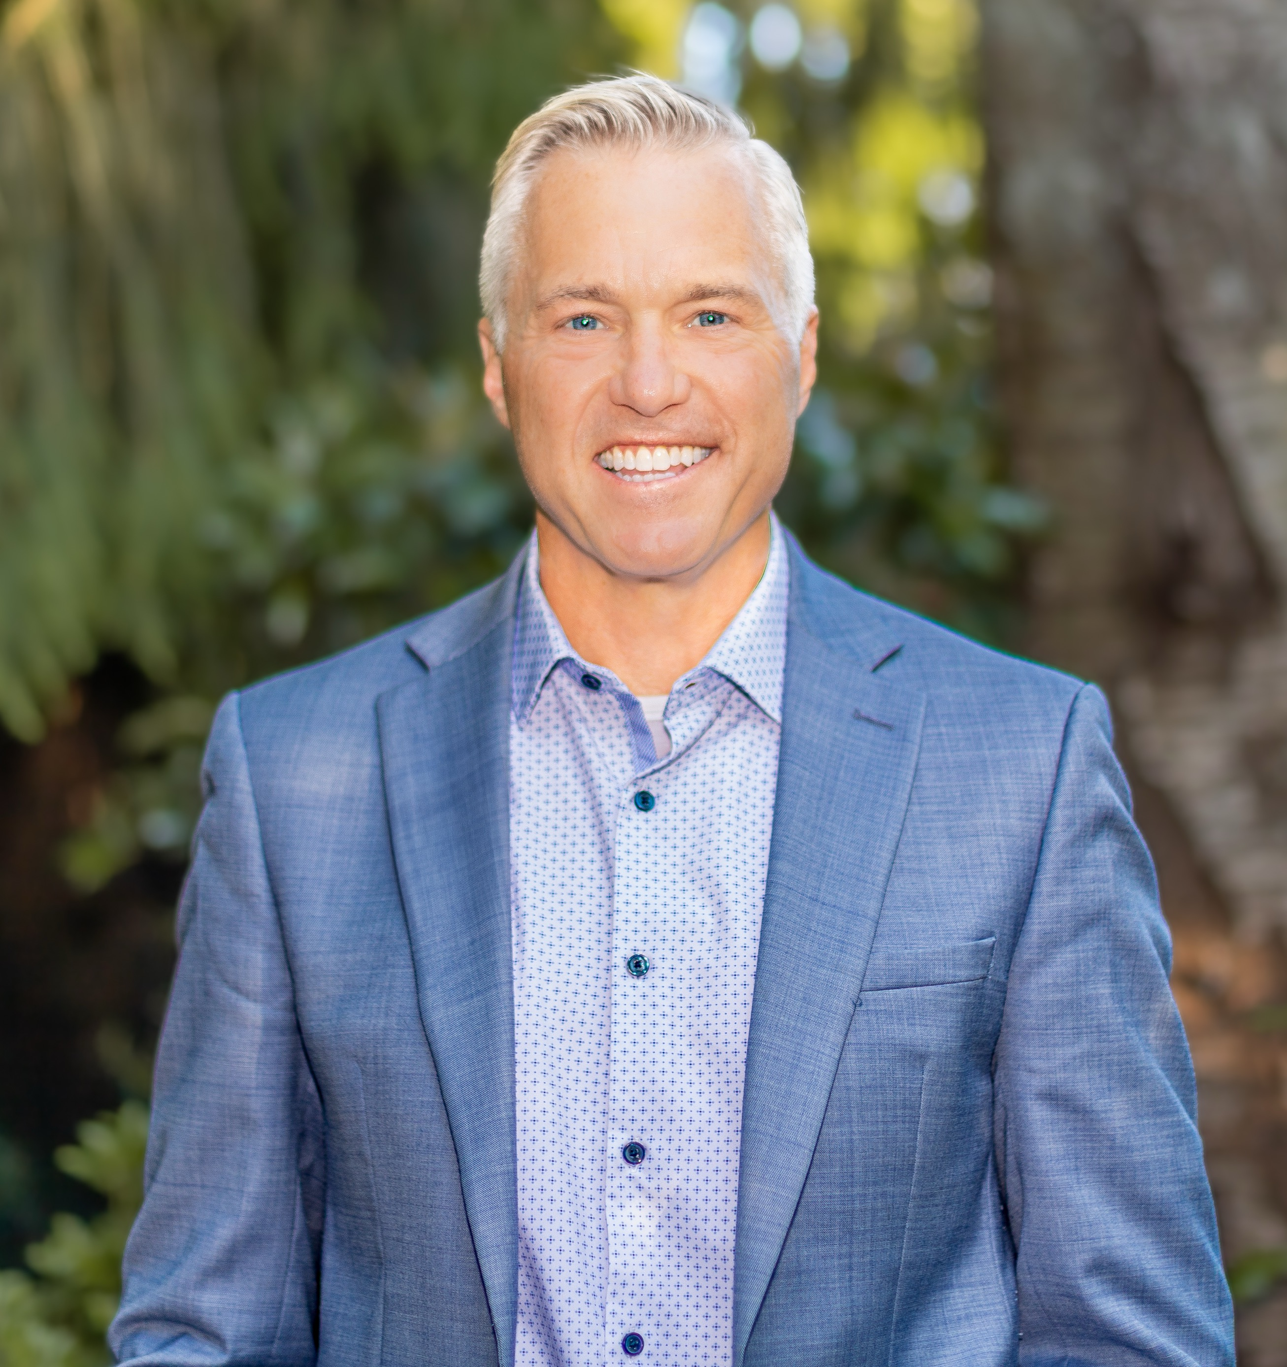
DOH Secretary of Health
Dennis Worsham
Notes:
Cyril Walrond
Davven Davenport
Grady Mitchell
Ireion Turner
Jerry Thomas
Marriam Oliver
Matthew Durham
Robb Hampton
Russell Williams
Thomas Hill
Tiana Wood-Sims

Slide 20
NEXT MEETING: FOCUS:
October 8, 2025 Immunizations
VISIT:
“As a nation, we have not yet made good on our foundational commitments to liberty, justice, and equality, or to government of, by, and for the people. But neither have we, the people, failed to achieve them.”
-- Michael McAfee, PolicyLink
https://waportal.org/partners/community-collaborative

Slide 21
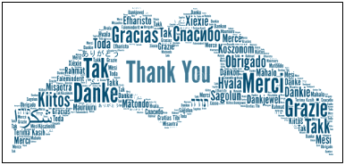
To request this document in another format, call 1-800-525-0127. Deaf or hard of
hearing customers, please call 711 (Washington Relay) or email civil.rights@doh.wa.gov.

