Slide 1


Washington State HPV Free Task Force
Annual Roundtable
Friday, October 10ᵗʰ, 2025
Notes:
Thank you for joining us. We will get started in just a moment.
Good morning, and welcome to the HPV Task Force Quarterly meeting. I’m Name, title and a member of WA HPV Free Task Force Leadership team.
Thanks for joining the meeting.
1

Slide 2

Agenda
Welcome & Housekeeping
Data Update: WA State Immunization Data
Cervical Cancer Self-Sampling Testing Presentation with Courtnee Van Ord from the National Cervical Cancer Roundtable
Immunize WA Awards Announcement
Poll Questions
Survivor Story
BREAK
HPV Vaccine Provider Survey Update
Data Update: WA State HPV-Related Cancer Burden
HPV, Oropharyngeal Cancer & How to Engage Dental Care Professional in HPV Cancer Prevention
Updates & Upcoming Events
Wrap Up
Notes:
Here is the agenda for this meeting:
2

Slide 3
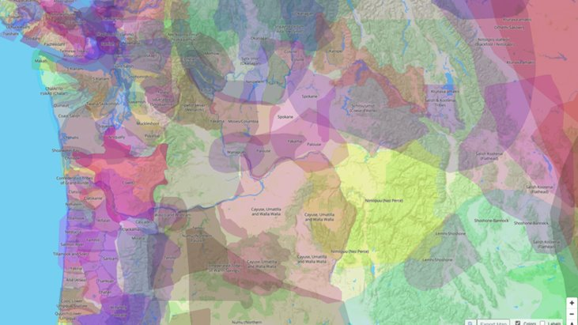
Land Acknowledgement
Notes:
Before we begin our morning, it is important that we acknowledge that although this meeting space is virtual, we are still hosting this meeting on the traditional land of the first people of Washington State. Here in WA there are 29 federally recognized native and tribal nations, 9 others in Oregon and many who still go unrecognized. In Washington, this accounts for more than 3% of our entire population. Today we want to acknowledge the land that you are on now and likely currently listening to this meeting. We are here on the land of the first people of Seattle, the Duwamish People, the Coastal Salish of the Puget Sound, the Skykomish Snoqualmie and Snohomish of Tulalip, the Skokomish Nation, the confederated tribes and bands of the Yakama nation, the Spokane Tribe of Indians, and the many tribes collectively represented by our colleagues at South Puget Intertribal Planning Agency and Northwest Portland Indian Health Board. We are privileged in occupying this space and we look to the past and present with honor and gratitude to these people, their elders, and the land itself.
3

Slide 4

Welcome & Introductions
Please introduce yourself by typing in the chat your Name, Organization and Title

Slide 5
Housekeeping
We will be recording this webinar so you can find it and all the resources referenced today on the WithinReach website. You will receive a follow up email with links to the material covered once it is available.
While the focus is absolutely on HPV vaccination – we are also looking at adolescent immunizations collectively as they are all significantly impacted by pandemic, too narrow a focus on just HPV can create missed opportunities and the actions steps we are going to be discussing can increase rates and protection against many vaccine preventable disease.
Notes:
All attendees are currently muted and will remain muted until the question-and-answer sessions. The chat is available for questions and comments. If you need technical assistance, please directly message Skye Larsen and she will support you.
Ajia McAferty will be monitoring the chat. Questions for speakers will be shared during designated question and answer time after the presentations.
This meeting is being recorded and along with the slides, they will be made available on the immunitycommunitywa.org website within the next few weeks.
This meeting will be focusing on HPV- just as a reminder here you may hear conversation about adolescent immunization, as actions steps we are going to be discussing can increase rates and protection against many vaccine preventable disease.
5

Slide 6
Code of Conduct
A friendly reminder that the HPV Taskforce invites all who attend today to help us create a safe, positive experience for everyone. Members and participants agree to support our mission and strengthen HPV prevention efforts in Washington State based on evidence-based guidance from the Advisory Committee on Immunization Practices (ACIP).
If you are subjected to an unacceptable behavior, notice that someone else is being subjected to unacceptable behavior, or have any other concerns, please notify any of the HPV Task Force planning team members as soon as possible. All reports will remain completely confidential.
See the chat for more details.
Notes:
Here is the code of conduct. We invite all those who participate today to help us create a safe, positive experience for
Everyone. Members and participants agree to support our mission and strengthen HPV prevention efforts in Washington State based on evidence-based guidance from the Advisory Committee on Immunization Practices (ACIP). See that chat message for more details
6

Slide 7
Save the Date! 2026 HPV Task Force Meeting Dates:
Spring Quarter Meeting (2.5 hrs.)
February 27, 2026
8:00 am - 10:30 am
Annual Roundtable
(4 hrs.)
May 8, 2026
8:00am- 12:00 pm
Fall Quarter Meeting (2.5 hrs.)
October 9, 2026 8:00 am – 10:30 am
Notes:
Before we start, here is the date for our 2026 meetings. More details will be available .Please save these dates to ensure your availability, and you’ll soon get calendar invites for the meeting.
7

Slide 8

Cancer Action Plan of Washington
2025 Fall Gathering
The Scott Morris Center, 12 N Sheridan St, Spokane, WA 99202
Spokane
Fred Hutch Sunnyside, 320 N. 16th Street, Sunnyside, WA
Sunnyside
Date: October 30, 2025
Time: 9:30 am – 3:00 pm
Registration Link: bit.ly/4m6Nlt0
Location: Hybrid
Join us online or at one of the in-person locations across the state ⟶
Seattle
The Panoramic Center at Pacific Tower, 1200 12th Ave South, Seattle, WA 98144
Washington State University, 240 Ott Rd, Allen Center, Room 201, Pullman, WA 99164
Pullman
Fred Hutch Peninsula Clinic, 19917 7th Ave NE Ste 100, Poulsbo, WA 98370
Can’t make it in-person? Virtual is always an option!
Poulsbo
Notes:
8

Slide 9
WA State HPV Immunization Data Update
Washington State Department of Health

Slide 10
Leigh Wallis, MPH
She/Her
Immunization Health Educator
leigh.wallis@doh.wa.gov
Health Promotion and Education (HPE)
Office of Public Affairs and Equity (OPAE)
Washington State Department of Health

Slide 11
Data: HPV Doses Administered
Note: Second quarter (April to June) data is available for 2025.
Notes:
We will look at our HPV doses administered for the second quarter of 2025 for three age groups:
Early Starters: 9-10-year-olds
On-Time: 11-12-year-olds
Catch Up: 13-17-year-olds

Slide 12
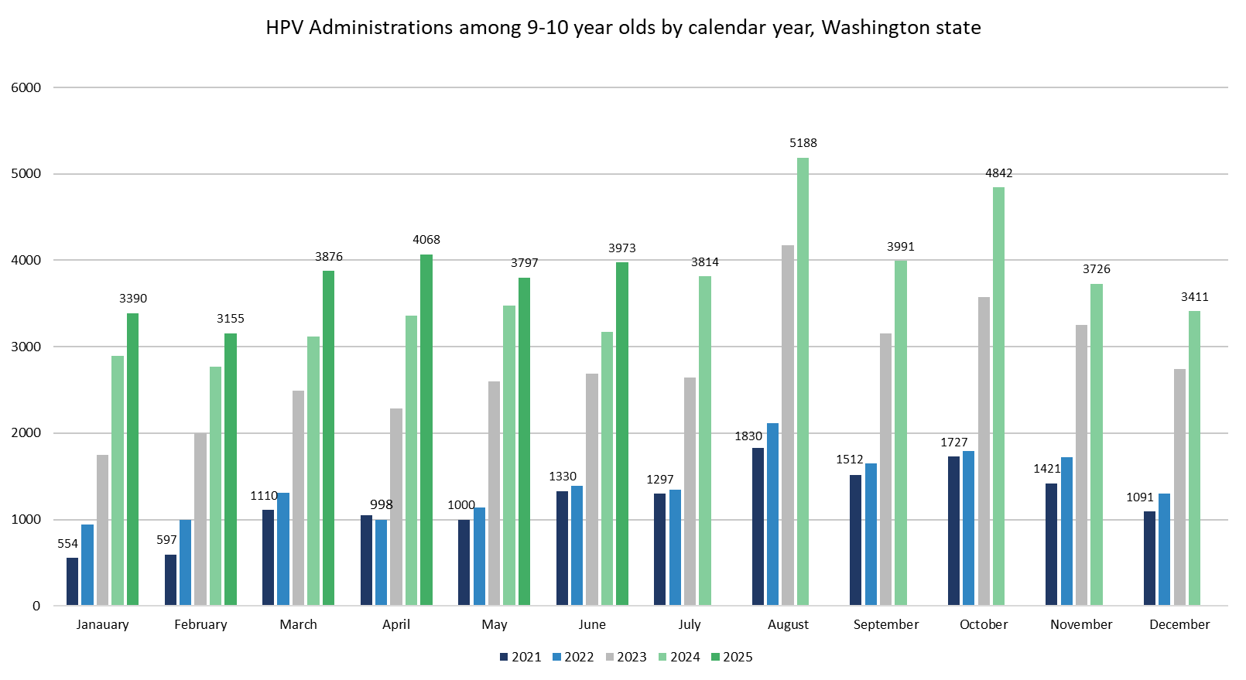
Notes:
In the second quarter of 2025, Washington state is continuing to see a rise in administrations for our early starters at age nine and 10. All of the months so far in 2025 have higher HPV administrations in this age group compared to the last four years. This is so great! The data really show that our statewide efforts to increase HPV vaccination at age 9 and 10 are working! Looking ahead to third quarter data, we expect to see higher numbers in August accounting for back to school.

Slide 13
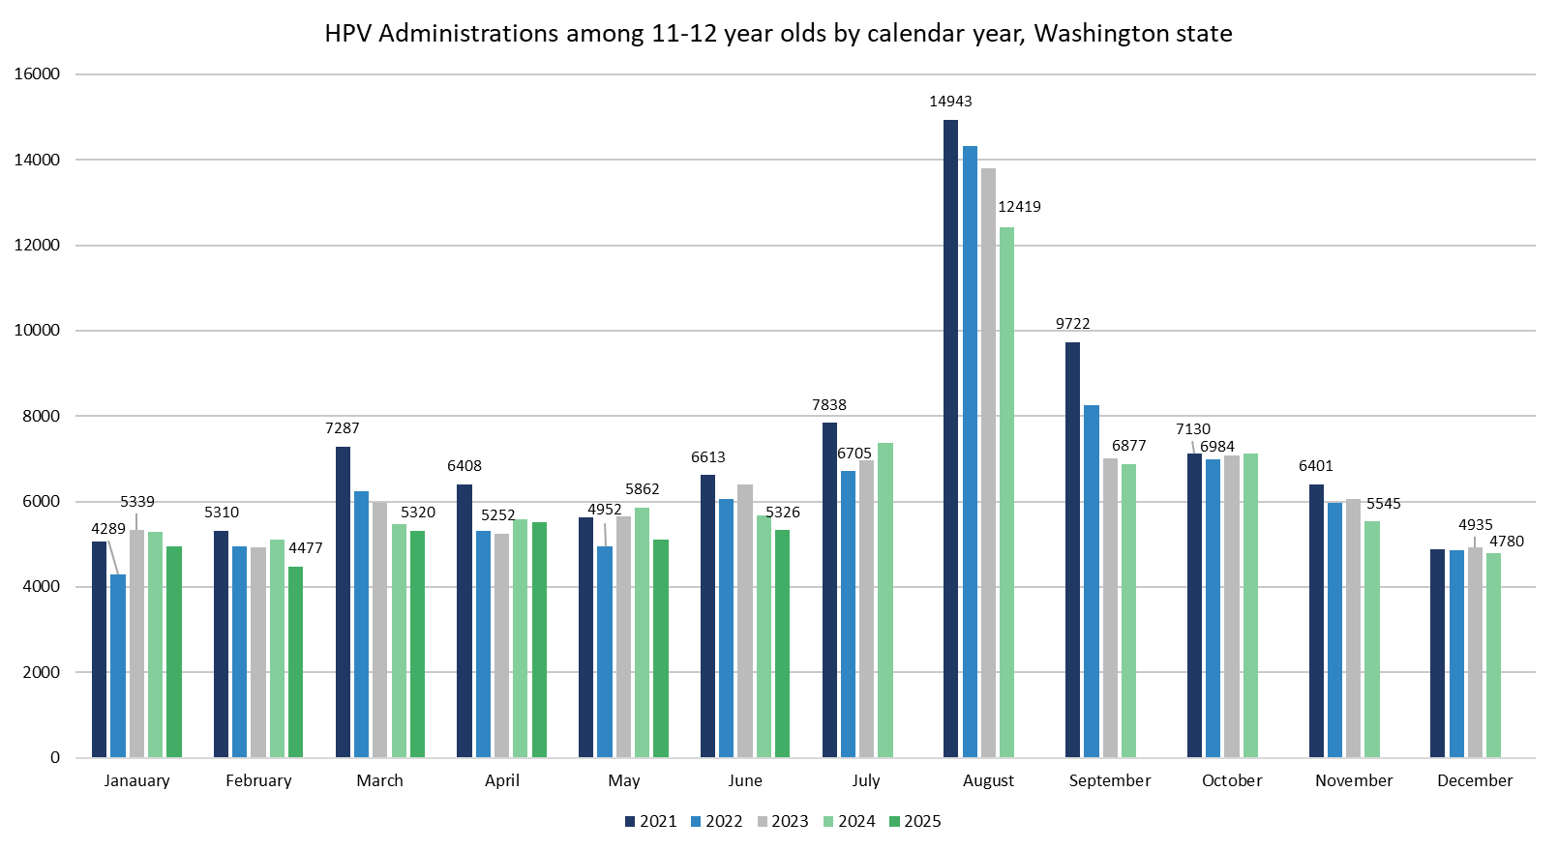
Notes:
HPV administrations for our on-time group of 11-12-year-olds are lower so far this year compared to 2024. Looking ahead to third quarter data, we expect to see a big jump in HPV administrations in August. Note the scale on this slide compared to the previous slide. Far more HPV vaccines are given to 11-12-year-olds (more than double) in August than 9-10-year-olds.

Slide 14
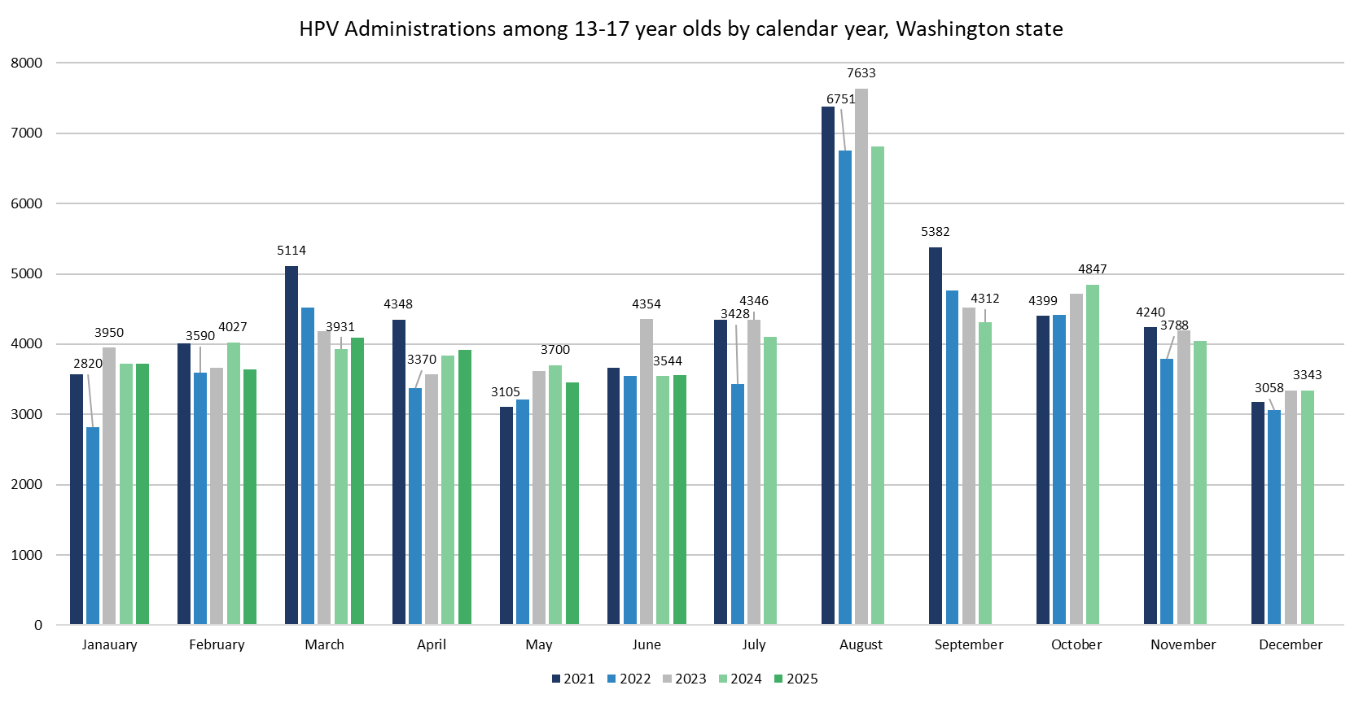
Notes:
This is our catch-up age group of kids13-17 years. HPV administrations for the second quarter of 2025 are similar to last year. Looking ahead to third quarter data, we expect a jump in August as our big kids get caught up on vaccinations just in time for back to school. We want to protect as many kids as we can before they become adults.

Slide 15
Data: HPV Coverage Rates
Notes:
Now let’s look at our HPV coverage rates for the second quarter of 2025:
HPV Initiation for 9-10-year-olds and 11-12-year-olds
Teen Vaccine Series (HPV, Tdap, and mengingococcal) for 11-12-year-olds and 13-year-olds

Slide 16
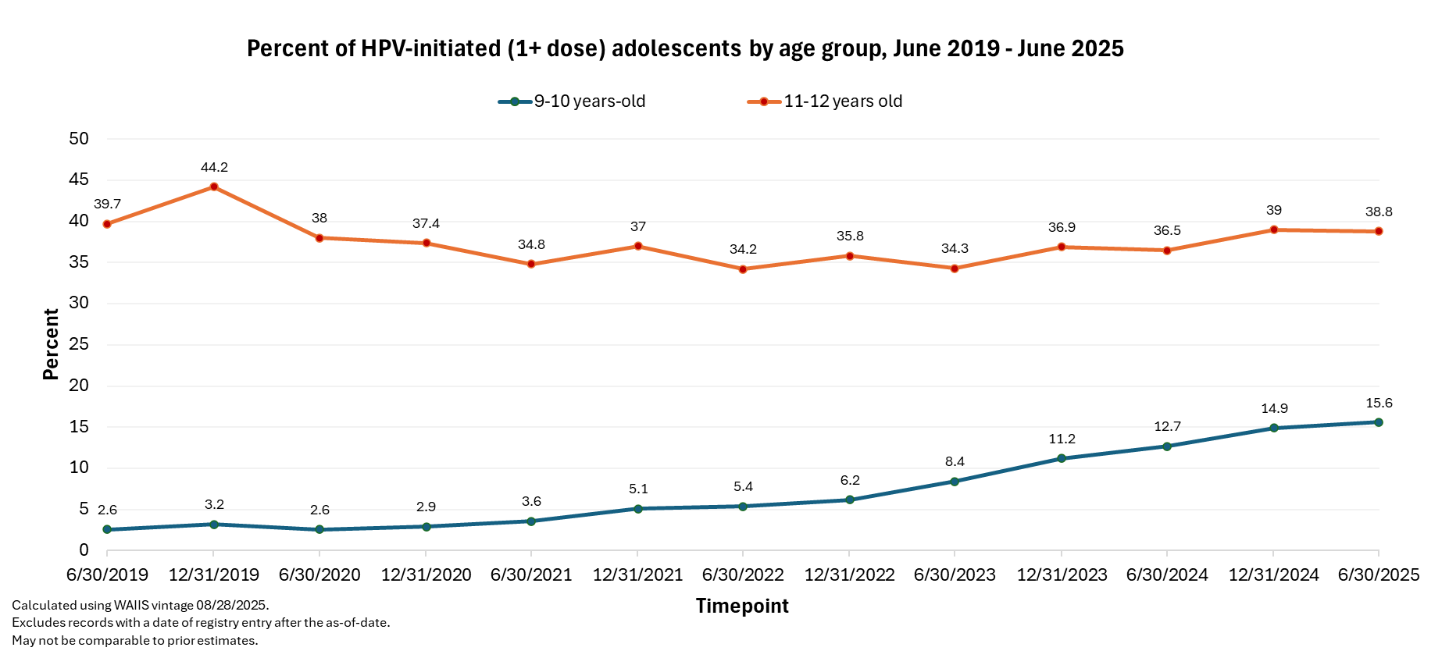
Notes:
In 2025, HPV at nine initiations continue to increase for age 9-10-year-olds (blue line). Once again, the amazing HPV work focusing on this age group is really making a difference. It is so encouraging to see this number continue to rise for six years straight! HPV at nine initiations for age 11-12-year-olds (red line) took a slight dip from the end of 2024, but not much, and is just something to keep our eye on. We should continue to do our part to support immunization efforts for this age group. We’d love to see 11-12-year-olds return to the HPV initiation coverage rate that we had at the end of 2019 (44.2%) indicated by a gold star. Looking ahead to the end of this year, we expect to see increases in both age groups due to back-to-school immunization efforts.

Slide 17
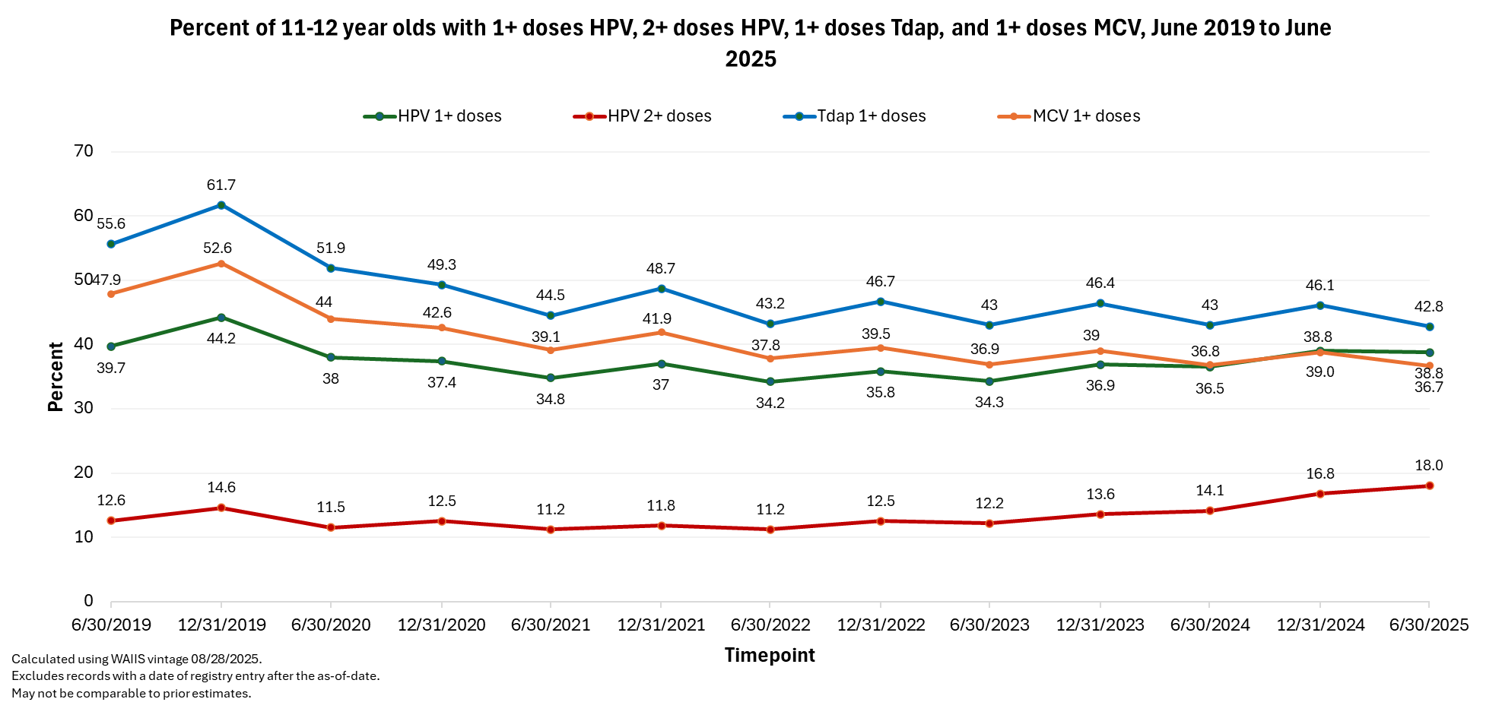
Notes:
For 11-12-year-olds, the green line is HPV initiation, and the red line is two or more doses of HPV. The green line for the first half of 2025 stayed the same at 38.8% compared to the end of 2024. The red line increased from 16.8% to 18% in the first half of 2025 compared to the end of 2024. We were expecting to see the red line (2 or more doses of HPV) continue to increase as more age 9 kids who initiated HPV vaccination age up and are protected from HPV cancers before they turn 13. I’d like to briefly mention the two other teen vaccines. There’s been a drop in meningococcal and Tdap vaccine coverage rates for the first half of 2025. This is a good reminder for health care providers of the importance of bundling the HPV vaccine recommendation with the other teen vaccines, if the child is age 11-12. For your 11-12-year-old patients, you can bundle your recommendation for all adolescent vaccines, including HPV vaccine, in the same way, on the same day. You can start the vaccine discussion with, “Now that Henry is 11 years old, he’ll need three vaccines to help protect him against meningitis, HPV cancers, and whooping cough. We’ll give these shots during today’s visit. Do you have any questions about these vaccines?”

Slide 18
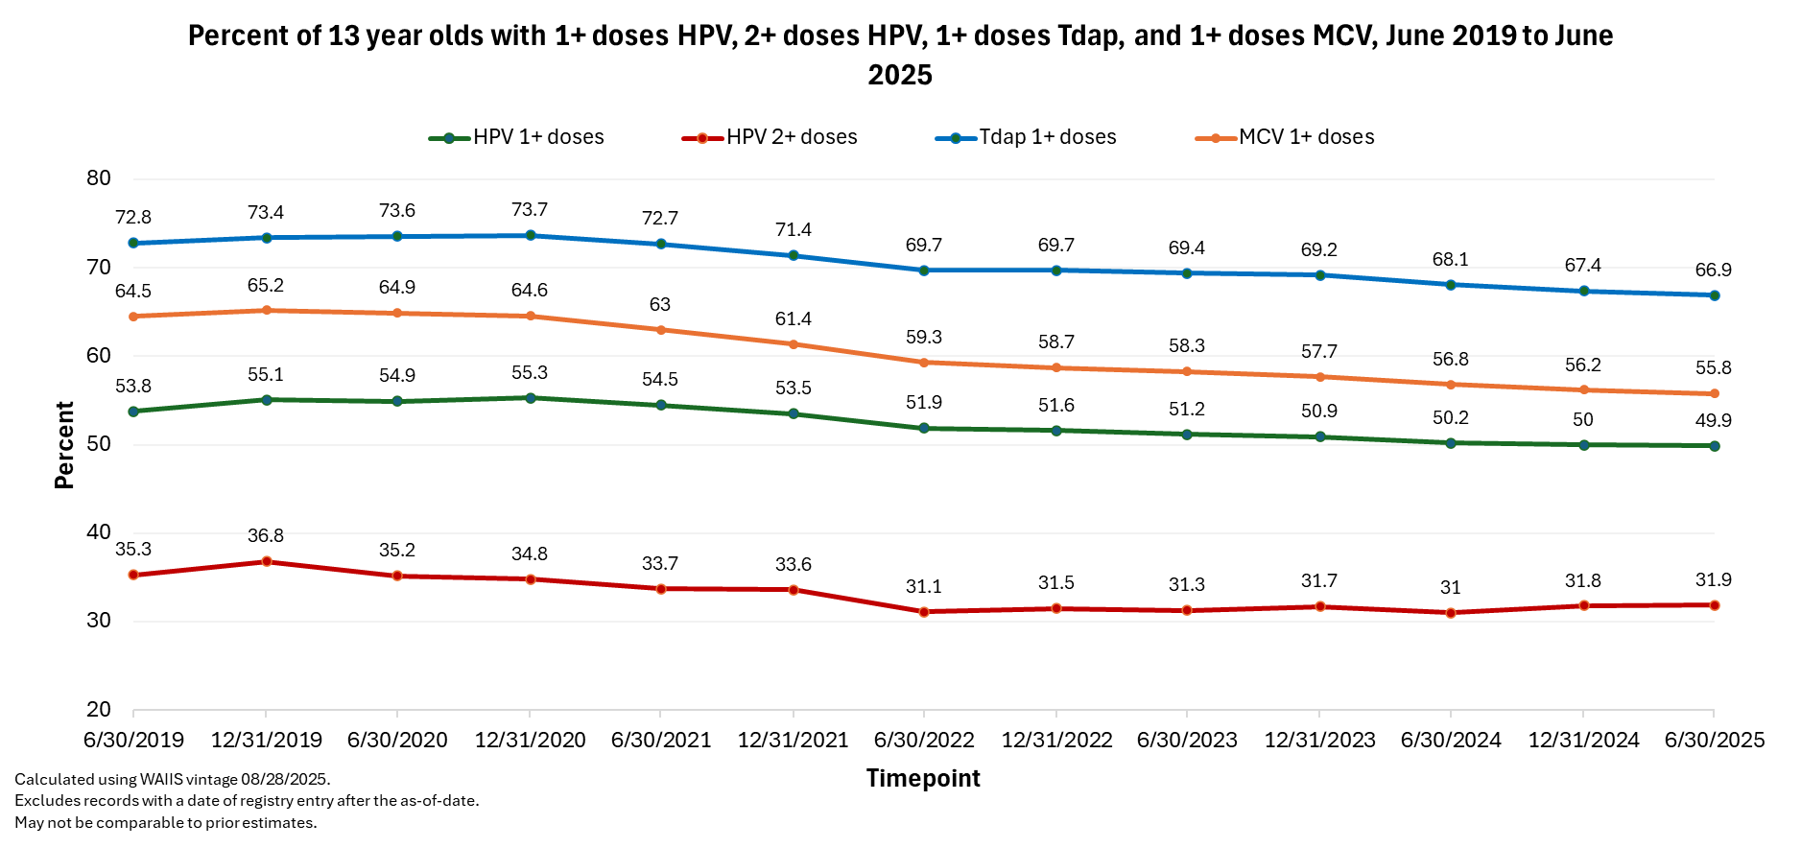
Pre-pandemic
Notes:
The 2025 data points for 13-year-olds are similar to the data points at the end of 2024. The green line is HPV initiation, and the red line is 2 or more doses of HPV. We have a ways to go to get back to pre-pandemic coverage rate levels. We really want to make sure these older kids are vaccinated against HPV.

Slide 19
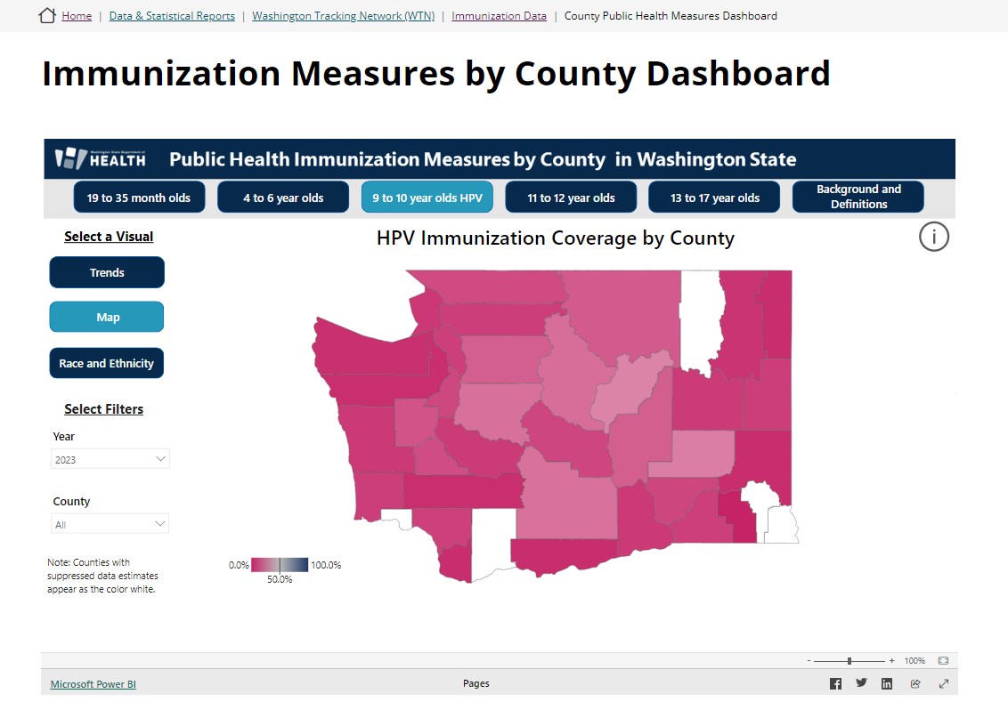
DOH HPV Immunization Data Dashboard
Source: Immunization Measures by County Dashboard | Washington State Department of Health
Notes:
Just a reminder that DOH has an immunization data dashboard with HPV coverage rates from 2016-June 2025.

Slide 20

What’s Ahead for HPV at DOH?
Four new routine mailings will begin in 2026 for ages 7 to 10. The age 9 and 10 letters will emphasize HPV vaccination.
Notes:
Watch Me Grow Washington is our state’s health promotion program that mails health and safety materials to all parents and caregivers in Washington with a child ages 0-6 years old. Four new routine mailings, including email format, in English and Spanish, will begin in 2026 for ages 7, 8, 9, and 10. Both age 9 and age 10 letters will emphasize HPV vaccination. There’s generally between 80-90k kids in each age group so, 160-180k children will have parents/caregivers that receive a letter with HPV vaccine information along with other health and safety topics. Once the letters are finalized and the new mailings have begun, we’ll be able to share web links to those letters for you look at. Currently, WMG tracks the number of mailings sent. We will be able to track emails sent once we have started the new mailings. We’d also like to track and measure HPV vaccination rates as we do this rollout, and discussions are underway to see if we can make that happen. Stay tuned!

Slide 21
DOH HPV Resources
List of DOH webpages where you can find HPV information:
Human Papillomavirus (HPV) Information Health Care Providers | Washington State Department of Health
Human Papillomavirus (HPV) Vaccine at Age Nine | Washington State Department of Health
Human Papillomavirus (HPV) | Washington State Department of Health
Plain Talk About Immunizations | Washington State Department of Health
For Preteens and Teens (7-18 Years) | Washington State Department of Health
For College Students and Administrators | Washington State Department of Health
Vaccine Stories | Washington State Department of Health
Immunization Measures by County Dashboard | Washington State Department of Health

Slide 22
doh.information@doh.wa.gov

Slide 23
HPV Self-collection Testing for Cervical Cancer Screening

Slide 24
Presentation Topics
1
Background: Cervical cancer screening and impact of social drivers of health
2
HPV Self-collection Testing: Who, what, where, when, why, and how
Putting HPV Self-collection Testing into Practice
24

Slide 25
Background
Notes:
In this section we’ll discuss
Cervical Cancer in the United States
Social Determinants of Health and cervical cancer screening
Cervical cancer Screening Guidelines
Cervical cancer Screening Tests

Slide 26



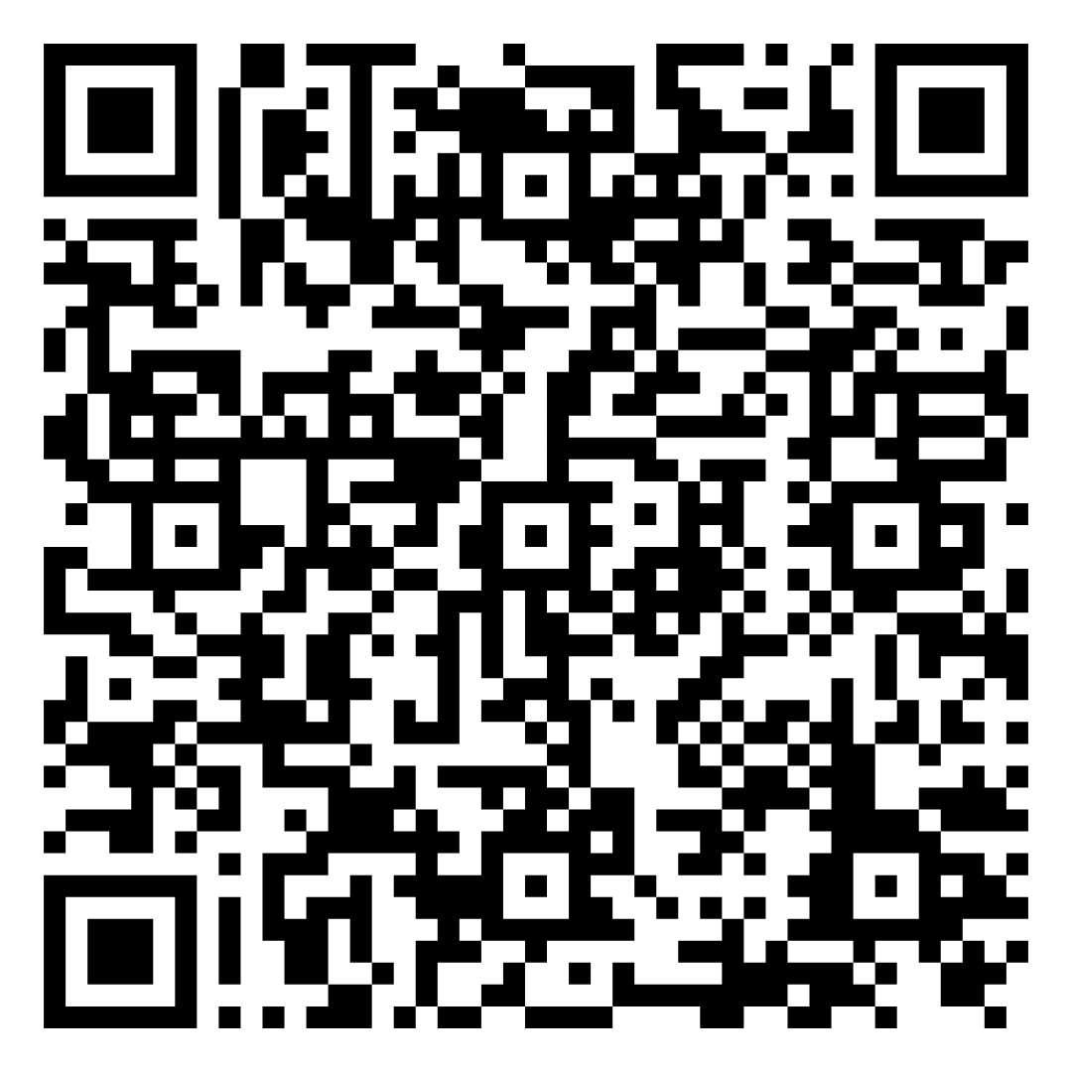
Cervical Cancer in the United States
7.6
Incidence*
Almost all cases of cervical cancer are caused by high-risk types of human papillomavirus (HPV)
2.2
Mortality*
13,360
2025 Estimates
4,320
incidence
Pulled from
Cancer Facts and Figures 2025 →
mortality
*Average annual rate per 100,000, age adjusted to the 2000 US standard population
Notes:
Speaker notes:
Although cervical cancer rates have decreased by more than half since the mid-1970’s, cervical cancer still causes a significant disease burden.
The incidence is 7.7 per 100K population, the mortality is 2.2 and
in 2024 there’s estimated to be 13,820 new cases of cervical cancer and 4,360 deaths
There are over 200 HPV types but only about 12 of them put you at risk for cancer. These are called high-risk HPV types. HPV types 16 and 18 cause about 70% of cervical cancers. Two types of HPV are associated with genital warts
Source: https://www.cancer.org/research/cancer-facts-statistics/all-cancer-facts-figures/2024-cancer-facts-figures.html

Slide 27
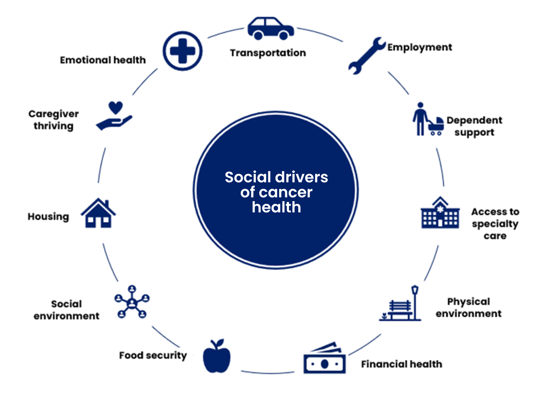

Health-related Social Needs and Social Drivers of Health (SDoH) Contribute to Health Disparities
People who do not have access to the resources that protect, improve, and maintain good quality of life can cause them to experience unfair and unjust cancer disparities.
Learn more about health equity and cancer disparities→
Notes:
Speaker notes:
Many health disparities are driven by social determinants of health, rather than biological factors.
According to the World Health Organization (WHO), the social determinants of health (SDOH) are the conditions where we live, work, learn, play, worship, and age.
They can also include the complex systemic and social structures that influence these conditions, such as policy and economic climate.
Most times, these interrelated conditions are out of someone’s personal control.
We know that SDOH have a direct impact on a person’s health. People who do not have access to the resources that protect, improve, and maintain a good quality of life can cause them to experience unfair and unjust cancer disparities.
Addressing the SDOH helps us to advance health equity so that everyone has a fair and just opportunity to be as healthy as possible.
Sources:
Advancing health equity: https://www.cancer.org/about-us/what-we-do/health-equity.html
American Cancer Society’s report on the status of cancer disparities in the United States, 2021: https://acsjournals.onlinelibrary.wiley.com/doi/epdf/10.3322/caac.21703

Slide 28
Impact of SDOH: Cervical Cancer Screening (cont.)
Cervical Cancer Screening %, United States, 2021
Family Income Level
84.2
Percent Screened
78
71.4
Source: https://acsjournals.onlinelibrary.wiley.com/doi/epdf/10.3322/caac.21703
Notes:
Speaker notes:
Here we also see that the likelihood of being up to date with screening increases with a person’s family income level
Source: https://acsjournals.onlinelibrary.wiley.com/doi/epdf/10.3322/caac.21703

Slide 29
Impact of SDOH: Cervical Cancer Screening (cont.)
Cervical Cancer Screening %, United States, 2021
Insurance Status
86.5
81
Percent Screened
64.9
Source: https://acsjournals.onlinelibrary.wiley.com/doi/epdf/10.3322/caac.21703
Notes:
Speaker notes:
Here we also see that the likelihood of being up to date with screening increases with their level of insurance coverage.
By expanding cervical cancer screening options through self-collection, we can work to mitigate some of these disparities.
Source: https://acsjournals.onlinelibrary.wiley.com/doi/epdf/10.3322/caac.21703

Slide 30
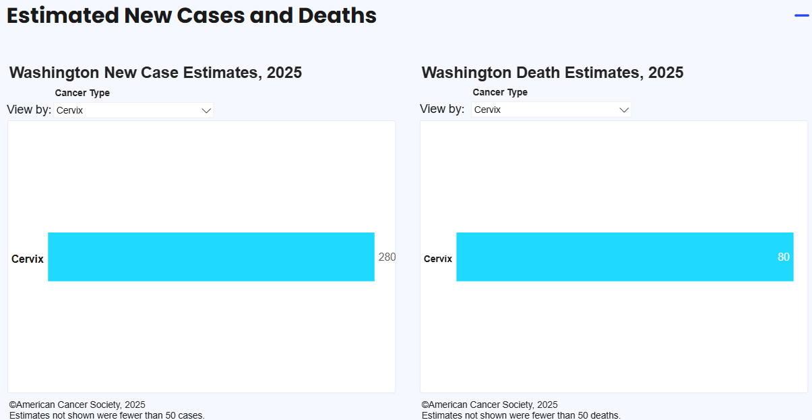
Cervical Cancer in Washington at a Glance
SOURCE: Cancer Statistics Center, 2025

Slide 31
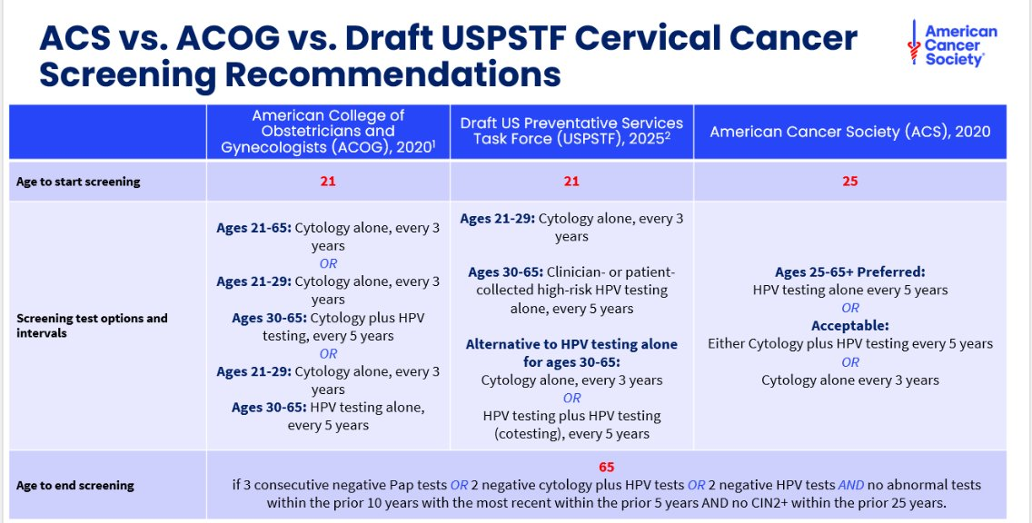

USPSTF Guidelines are currently being drafted to include self-collection testing and will be finalized in the coming months.
ACS cervical cancer screening guidelines →
Notes:
Speaker notes:
Keep in mind that these guidelines were drafted prior to the approval of self-collection HPV testing. Still, the general eligibility requirements for age remain pertinent.
Screening for cervical cancer is recommended for individuals with a cervix starting at age 25 years.
For individuals aged 25 to 65 years, screening should be done with a primary HPV test* every 5 years.
If primary HPV testing is not available, screening may be done with either co-testing that combines an HPV test with a Papanicolaou (Pap) test every 5 years or a Pap test every 3 years.
Individuals older than 65 years who have had regular screening with normal results should not be screened for cervical cancer. Once screening is stopped, it should not be started again.
Individuals who do not have a cervix (for example, because of a hysterectomy) and who do not have a history of cervical cancer or a serious precancer should not be screened.
Scan the QR code for the full ACS cervical cancer screening guidelines.
Speaker directions:
If asked about starting at 25 - Less than 1% of cervical cancer deaths are in women who were diagnosed before each 25. Disease burden was just one of many factors considered that led to the change the starting age for screening.
People who have received the HPV vaccine should still follow age-appropriate screening guidelines.
SOURCES: https://www.cancer.org/cancer/cervical-cancer/detection-diagnosis-staging/cervical-cancer-screening-guidelines.html https://acsjournals.onlinelibrary.wiley.com/doi/full/10.3322/caac.21628

Slide 32




Cervical Cancer Screening Tests
New!
If options are limited, clinicians should encourage their patients to get screened with whatever tests they have access to.
Pap Test
Cytology
Co-test
Cytology + HPV DNA test
8 tests FDA- approved with cytology
Primary HPV test
HPV DNA test
Clinician-collected sample
Self-collection HPV Testing
HPV DNA test
Patient-collected sample in clinical setting
Phasing out
ACS preferred
Learn more about HPV testing →
Notes:
Speaker notes:
These are the recommended screening tests.
Getting patients screened is the most important thing. That means clinicians should use whatever tests they have at their disposal.
HPV testing (whether clinician- or patient-collected) checks for HPV DNA in the sample and has a higher sensitivity and specificity for finding precancers than Pap testing.
Pap tests and co-tests are acceptable but not preferred. Pap tests detect abnormal cells at the time the sample was taken and the Co-test combines the two tests.
Primary HPV testing is more cost effected and streamlined than cotesting
Of note, currently there are 8 HPV tests approved for co-testing but only 3 are approved for Primary HPV testing, of which 2 are approved for self-collection (another form of primary HPV testing)—which is why primary HPV testing may not be available in every clinical setting.
When you co-test, the HPV test is doing 99% of the detection compared to the Pap test so there is far greater benefit to HPV testing alone. That’s why co-testing and Pap testing are being phased out.
We will learn more about the self-collection HPV testing in the slides to come.
Sources:
ACS Screening Guidelines: https://acsjournals.onlinelibrary.wiley.com/doi/full/10.3322/caac.21628
ACS HPV testing: HPV Testing | Diagnosing HPV | American Cancer Society
Primary HPV testing Provider needs slides: https://docs.google.com/presentation/d/10d0UaDyM7ba8KS3SzDlZJKlPFEJwFA3V/edit#slide=id.p10
BD onclarity pre-market approval: https://www.accessdata.fda.gov/scripts/cdrh/cfdocs/cfpma/pma.cfm?ID=P160037S017
Roche cobas pre-market approval: https://www.accessdata.fda.gov/scripts/cdrh/cfdocs/cfpma/pma.cfm?ID=P190028S009

Slide 33
HPV Self-Collection Testing

Slide 34
What is HPV self-collection testing?
HPV Self-collection testing is primary HPV testing.
PCR is done to evaluate the presence of HPV DNA.
Self-collection is when a patient uses a collection device to take a vaginal sample that will be tested for HPV.
This can be used as an alternative to clinician-collected cervical specimens.
Self-collection is an additional option for cervical cancer screening.
It may help increase screening in populations who have never been screened or are overdue for screening.
34
Notes:
Self-collection HPV testing is primary HPV testing
Self-collection is when a patient uses a collection kit to take a vaginal sample that will be tested for HPV. Self-collection expands options for screening.
Self-collection has been shown to be acceptable to people who have never been screened or are overdue for screening (“rarely and never screened”). This is the same group who is at highest risk for cervical cancer. Current screening rates are lower in people who are minoritized, low-income, LGBTQ+, and recent immigrants. Source:
https://www.societysource.org/Resource_Center/Self-Collection%20for%20Cervical%20Cancer%20Screening%20Communications%20Brief.pdf#search=self%2Dcollection

Slide 35
Which self-collection tests are FDA-approved for primary HPV screening?
Roche
cobas®
with Copan 522C.80 swab or Evalyn Brush
Abbott Alinity M
with simpli-Collect ™ or Evalyn Brush
BD
Onclarity™ with Copan 522C.80 swab
Teal Health
Teal Wand™
*in CA, NY, FL
35
Notes:
There are 4 tests that are approved for self-collection—cobas, Onclarity, Alinity M, and Teal Wand *in CA, NY, FL
Sources:
BD onclarity pre-market approval: https://www.accessdata.fda.gov/scripts/cdrh/cfdocs/cfpma/pma.cfm?ID=P160037S017
Roche cobas pre-market approval: https://www.accessdata.fda.gov/scripts/cdrh/cfdocs/cfpma/pma.cfm?ID=P190028S009
Teal Health product classification: https://www.accessdata.fda.gov/scripts/cdrh/cfdocs/cfpmn/denovo.cfm?id=DEN240045

Slide 36
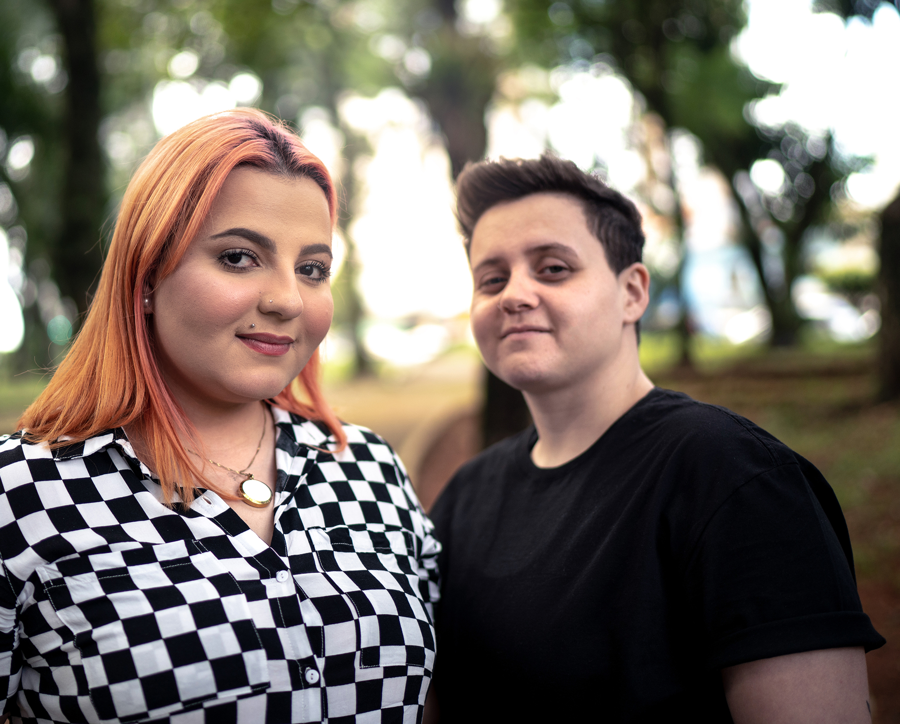
Who is eligible for HPV
self-collection testing?
Barrier to speculum exam
Must be eligible for primary HPV testing
Asymptomatic (not to be used for diagnostic testing if Abnormal bleeding, pelvic pain, vaginal discharge)
Patients should not be actively experiencing menstrual bleeding or have used a vaginal product within 2 days.
Eligible
History of cervical cancer
HIV+ or other immunosuppression
History of in utero DES exposure
If 21 to 29 years old
If the patient has Medicare insurance
Not eligible
Source: ACS NRTCC Preparing for Self-Collection: Clinician Communication Guide
36
Notes:
Eligibility requirements for self-collection are no different than they are for any type of cervical cancer screening.
Self-collection is another option for screening that may be more palatable to certain populations, including groups that are marginalized or are gender diverse.
Source: https://americancancer.sharepoint.com/sites/PatientSupport-MedicalContent/Shared%20Documents/Forms/AllItems.aspx?id=%2Fsites%2FPatientSupport%2DMedicalContent%2FShared%20Documents%2FGeneral%2FProduction%20and%20Development%2FRoundtables%2F2024%20National%20Roundtable%20for%20Cervical%20Cancer%20%28NRTCC%29%2FSelf%2DCollection%20HPV%20Testing%20for%20Cervical%20Cancer%20Screening%2FReferences%20and%20Resources%2FACS%20Clinician%20Communication%20for%20HPV%20Self%2DCollection%2Epdf&parent=%2Fsites%2FPatientSupport%2DMedicalContent%2FShared%20Documents%2FGeneral%2FProduction%20and%20Development%2FRoundtables%2F2024%20National%20Roundtable%20for%20Cervical%20Cancer%20%28NRTCC%29%2FSelf%2DCollection%20HPV%20Testing%20for%20Cervical%20Cancer%20Screening%2FReferences%20and%20Resources

Slide 37



What are potential benefits of HPV self-collection testing?
HPV self-collected screening is more sensitive and accurate than the Pap test alone and about as accurate as clinician-collected HPV testing.
It may be more appealing to patients with limited mobility, history of sexual trauma, gender diversity, medical mistrust, or discomfort with speculum exams.
Clinicians who offer in-clinic self-collection do not need to do a speculum exam, freeing up time to address other patient concerns.
Source: American Cancer Society National Roundtable on Cervical Cancer Preparing for Self-collection: Clinician Communication Guide
37
Notes:
Self-collected HPV screening is primary HPV testing—or a PCR test for HPV DNA
Some studies show that self-collection is as accurate as clinician-collection while other studies show self-collection has a slightly lower rate of detection of precancers. Self-collection for HPV testing is still far more accurate than clinician-collected Pap tests. Small differences in accuracy in other screening tests for cancer are common.
Self-collection is used as part of the screening program in 17 other countries including Australia and the Netherlands. Data from these and other countries indicate that self-collection can extend the reach of screening to those who do not participate in traditional provider-based screening.
Self-collection is a tool to that may help mitigate health disparities linked to social determinants of health
Source: https://www.societysource.org/Resource_Center/Self-Collection%20for%20Cervical%20Cancer%20Screening%20Communications%20Brief.pdf#search=self%2Dcollection https://americancancer.sharepoint.com/sites/PatientSupport-MedicalContent/Shared%20Documents/Forms/AllItems.aspx?id=%2Fsites%2FPatientSupport%2DMedicalContent%2FShared%20Documents%2FGeneral%2FProduction%20and%20Development%2FRoundtables%2F2024%20National%20Roundtable%20for%20Cervical%20Cancer%20%28NRTCC%29%2FSelf%2DCollection%20HPV%20Testing%20for%20Cervical%20Cancer%20Screening%2FReferences%20and%20Resources%2FACS%20Clinician%20Communication%20for%20HPV%20Self%2DCollection%2Epdf&parent=%2Fsites%2FPatientSupport%2DMedicalContent%2FShared%20Documents%2FGeneral%2FProduction%20and%20Development%2FRoundtables%2F2024%20National%20Roundtable%20for%20Cervical%20Cancer%20%28NRTCC%29%2FSelf%2DCollection%20HPV%20Testing%20for%20Cervical%20Cancer%20Screening%2FReferences%20and%20Resources

Slide 38



What should patients know before choosing self-collection?
About 1 in 10 patients will receive a positive result.
If patient receives a positive result for HPV 16 or HPV 18, they must be referred for colposcopy (speculum exam included).
Learn more about HPV testing
If the patient receives a positive result for other HPV (not 16 or 18) using Roche, or if they have HPV types grouped as 45, 33/58, 31, 52/35/39/68, or 51 using BD, the patient must return for a speculum exam for dual-stain or cytology testing.
38
Notes:
Self-collected HPV screening is primary HPV testing—or a PCR test for HPV DNA.
Approved self-collection tests do not allow for cytological assessment of the sample, while clinician-collected tests do. Source: https://www.societysource.org/Resource_Center/Self-Collection%20for%20Cervical%20Cancer%20Screening%20Communications%20Brief.pdf#search=self%2Dcollection https://americancancer.sharepoint.com/sites/PatientSupport-MedicalContent/Shared%20Documents/Forms/AllItems.aspx?id=%2Fsites%2FPatientSupport%2DMedicalContent%2FShared%20Documents%2FGeneral%2FProduction%20and%20Development%2FRoundtables%2F2024%20National%20Roundtable%20for%20Cervical%20Cancer%20%28NRTCC%29%2FSelf%2DCollection%20HPV%20Testing%20for%20Cervical%20Cancer%20Screening%2FReferences%20and%20Resources%2FACS%20Clinician%20Communication%20for%20HPV%20Self%2DCollection%2Epdf&parent=%2Fsites%2FPatientSupport%2DMedicalContent%2FShared%20Documents%2FGeneral%2FProduction%20and%20Development%2FRoundtables%2F2024%20National%20Roundtable%20for%20Cervical%20Cancer%20%28NRTCC%29%2FSelf%2DCollection%20HPV%20Testing%20for%20Cervical%20Cancer%20Screening%2FReferences%20and%20Resources

Slide 39
How does self-collection compare to clinician collection?
 | Clinician-collected | Self-collection
Who takes the sample? | Clinician | Patient (in-clinic)
Where is the sample taken from? | Cervix | Vagina
Is a speculum used? | Yes | No
What lab test is run? | PCR to detect HPV DNA/HPV genotyping | PCR to detect HPV DNA/ HPV genotyping
What other tests can be run on the sample? | Pap/cytology, dual stain | None
Next steps if HPV+? | Patient will need to return only if colposcopy is required | Patient will need to return. If HPV16/18+, for colposcopy. If positive for other HPV+, for Pap or dual stain
How often should screening occur if HPV-? | Every 5 years | Every 3-5 years
Is it more accurate than Pap testing alone? | Yes | Yes
39
Notes:
Primary HPV testing and self-collection HPV testing have key similarities and differences
Primary HPV testing uses a clinician-collected sample from the cervix and self-collection uses a patient collected sample from the vagina
Primary HPV testing allows for cytological assessment of the sample whereas self-collected samples do not. This means that HPV positive results (about every 1 in 10) will require patients to return to the clinic for follow-up with a speculum exam. The hope is that one day self-collected samples will one day be able to be cytologically assessed as well.
Both tests use PCR to check for high-risk HPV types and can provide genotyping results. They are both taken in a healthcare setting and they are both more accurate than Pap testing alone.
Primary HPV testing is recommended to be repeated every 5 years, whereas self-collection testing is recommended every 3 years—although it is expected to change to 5 years once more research is done.
Source: https://www.societysource.org/Resource_Center/Self-Collection%20for%20Cervical%20Cancer%20Screening%20Communications%20Brief.pdf#search=self%2Dcollection https://americancancer.sharepoint.com/sites/PatientSupport-MedicalContent/Shared%20Documents/Forms/AllItems.aspx?id=%2Fsites%2FPatientSupport%2DMedicalContent%2FShared%20Documents%2FGeneral%2FProduction%20and%20Development%2FRoundtables%2F2024%20National%20Roundtable%20for%20Cervical%20Cancer%20%28NRTCC%29%2FSelf%2DCollection%20HPV%20Testing%20for%20Cervical%20Cancer%20Screening%2FReferences%20and%20Resources%2FACS%20Clinician%20Communication%20for%20HPV%20Self%2DCollection%2Epdf&parent=%2Fsites%2FPatientSupport%2DMedicalContent%2FShared%20Documents%2FGeneral%2FProduction%20and%20Development%2FRoundtables%2F2024%20National%20Roundtable%20for%20Cervical%20Cancer%20%28NRTCC%29%2FSelf%2DCollection%20HPV%20Testing%20for%20Cervical%20Cancer%20Screening%2FReferences%20and%20Resources
https://docs.google.com/presentation/d/10d0UaDyM7ba8KS3SzDlZJKlPFEJwFA3V/edit#slide=id.p21

Slide 40
Key Takeaways
1
SDOH impact cervical cancer screening uptake.
Current screening rates are lower in people who are minoritized, low-income, LGBTQ+, and recent immigrants. Members of these groups are at the highest risk for cervical cancer.
2
HPV Self-collection testing is a new screening option.
An advantage of self-collection is that it may be more acceptable to patients with limited mobility, history of sexual trauma, gender diversity, medical mistrust, or discomfort with speculum exams.
3
HPV Self-collection testing should be repeated after 3 years if result is negative.
This is expected to increase to five years after more research is done.*
4
Patients must return for follow-up if the HPV self-collection testing result is positive.
About 1 in 10 results is expected to be positive.
5
HPV Self-collection testing is primary HPV testing.
It is expected to be covered by insurance and the CPT codes and ICD-10 codes are not expected to change.
*USPSTF draft recommends five years for women aged 30-65.
40

Slide 41
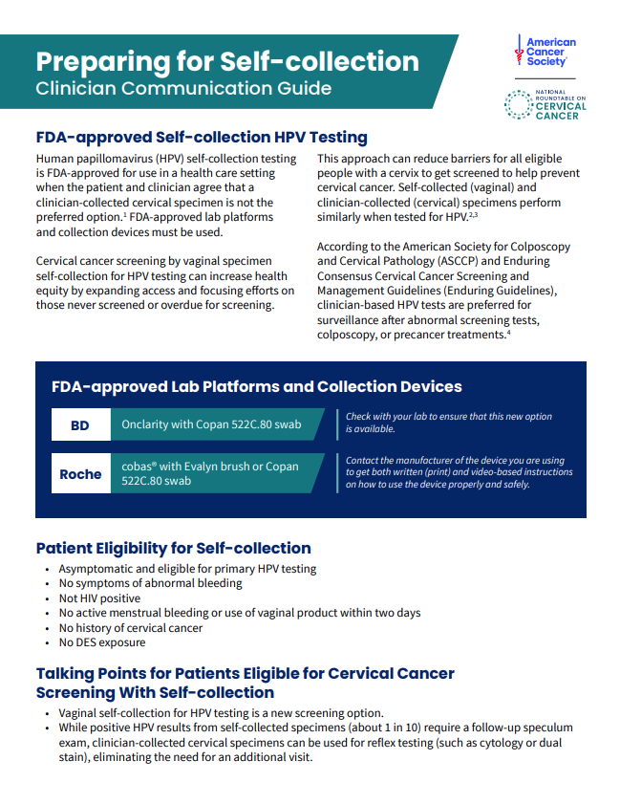

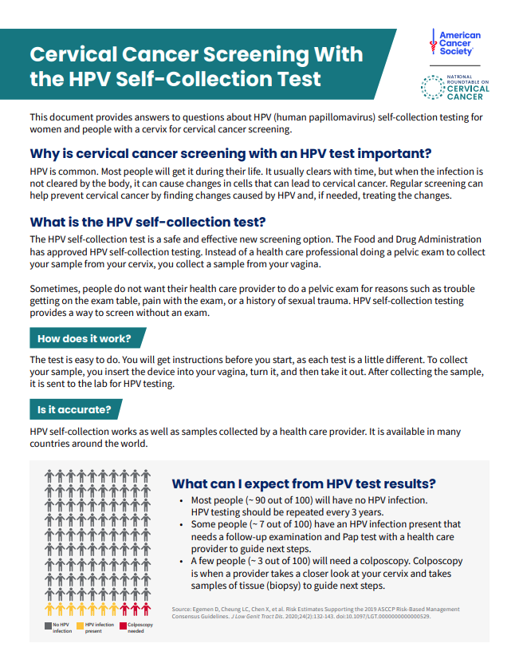
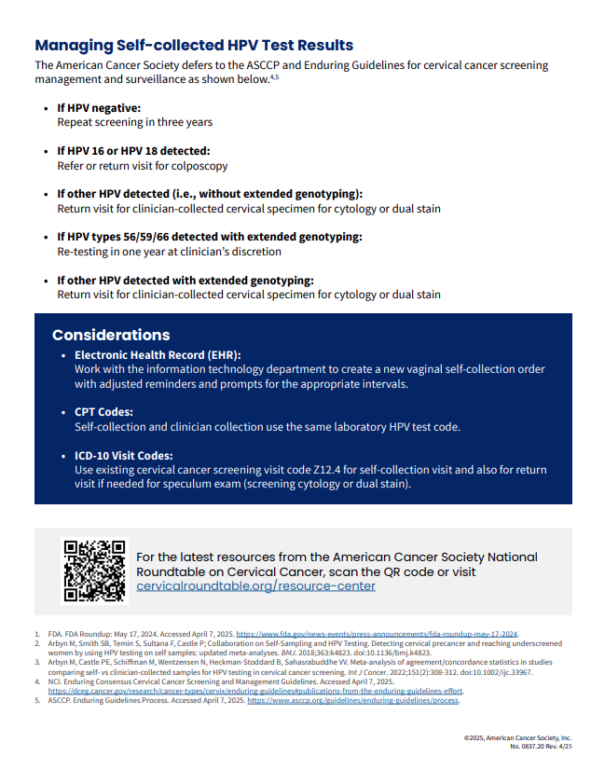
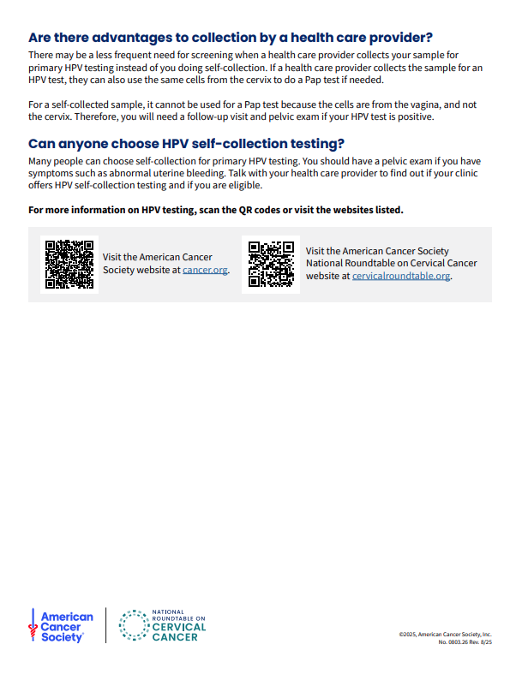

ACS National Roundtable on Cervical Cancer Self-collection Resources
Cervical Cancer Screening with the HPV Self-collection Test
Preparing for Self-collection: Clinician Communication Guide
Check out Resource Center
41

Slide 42
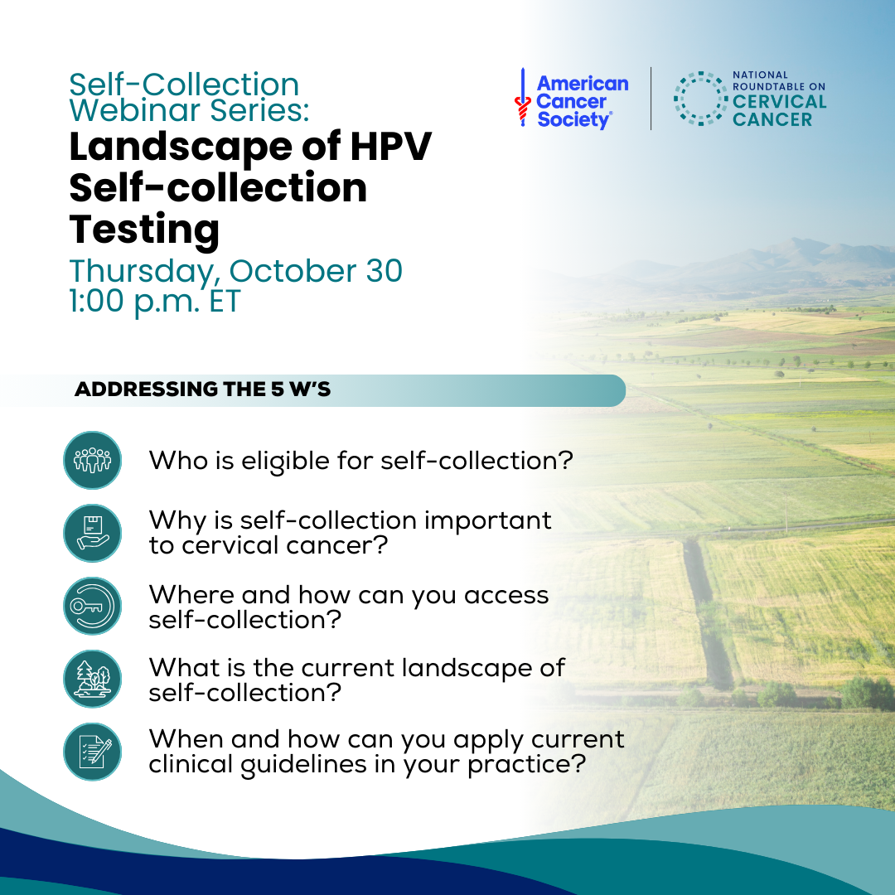

Self-collection Webinar Series
Target: FQHCs and Safety Net Health Systems
Session 1 | Thursday, October 30:
Landscape of HPV Self-collection Testing
Session 2 | Thursday, December 4:
System Readiness & Tracking
Session 3 | Thursday, January 15:
Implementation
Scan the QR or visit the Upcoming Webinar Page at cervicalroundtable.org
42
Notes:
On October 30 at 1pm ET, the ACS NRTCC will be kicking off their three-part educational webinar series on self-collection for cervical cancer screening. Learn more about self-collection with a foundational overview, including available testing options and devices and current clinical guidelines. Also, save the dates for webinars 2 and 3 where they will follow how FQHCs and safety-net health systems have implemented self-collection testing in their clinics. Registration will be available in early October for webinar 2 and 3.
Chat:
Calling all FQHCs and safety-net health systems! Join us for the first session in our three-part educational series on self-collection for cervical cancer screening. We’ll cover who is eligible for self-collection, why it matters, how it works, and what the current guidelines say. Learn how to assess your eligible population and start conversations about implementing self-collection in your clinic. Register today: https://cervicalroundtable.org/upcomingwebinars/

Slide 43

Questions

Slide 44
Thank You
©2024, American Cancer Society, Inc. Rev. 08/24 Models used for illustrative purposes only

Slide 45
References
Siegel RL, Giaquinto AN, Jemal A. Cancer statistics, 2024. CA Cancer J Clin. 2024;74(1):12-49. doi:10.3322/caac.21820
Islami F, Guerra CE, Minihan A, et al. American Cancer Society's report on the status of cancer disparities in the United States, 2021. CA Cancer J Clin. 2022;72(2):112-143. doi:10.3322/caac.21703
Fontham ETH, Wolf AMD, Church TR, et al. Cervical cancer screening for individuals at average risk: 2020 guideline update from the American Cancer Society. CA Cancer J Clin. 2020;70(5):321-346. doi:10.3322/caac.21628
FDA. BD Onclarity HPV Assay. Premarket approval. Accessed August 14, 2024. https://www.accessdata.fda.gov/scripts/cdrh/cfdocs/cfpma/pma.cfm?ID=P160037S017
FDA. cobas HPV. Premarket approval. Accessed August 14, 2024. https://www.accessdata.fda.gov/scripts/cdrh/cfdocs/cfpma/pma.cfm?ID=P190028S009
Cuzick J, Clavel C, Petry KU, et al. Overview of the European and North American studies on HPV testing in primary cervical cancer screening. International journal of cancer. 2006 Sep 1;119(5):1095-101.
Arbyn M, Smith SB, Temin S, Sultana F, Castle P; Collaboration on Self-Sampling and HPV Testing. Detecting cervical precancer and reaching underscreened women by using HPV testing on self samples: Updated meta-analyses. BMJ. 2018;363:k4823. doi:10.1136/bmj.k4823.
Arbyn M, Verdoodt F, Snijders PJ, et al. Accuracy of human papillomavirus testing on self-collected versus clinician-collected samples: a meta-analysis. Lancet Oncol. 2014;15(2):172-83. doi:10.1016/S1470-2045(13)70570-9
Arbyn M, Castle PE, Schiffman M, Wentzensen N, Heckman-Stoddard B, Sahasrabuddhe VV. Meta-analysis of agreement/concordance statistics in studies comparing self- vs clinician-collected samples for HPV testing in cervical cancer screening. Int J Cancer. 2022;151(2):308-312. doi:10.1002/ijc.33967.
American Cancer Society. HPV testing. Updated June 3, 2024. Accessed August 14, 2024. https://www.cancer.org/cancer/risk-prevention/hpv/hpv-and-hpv-testing.html
National Cancer Institute Division of Cancer Prevention. NCI Cervical Cancer ‘Last Mile’ Initiative. Accessed August 14, 2024. https://prevention.cancer.gov/major-programs/nci-cervical-cancer-last-mile-initiative#about
Becton, Dickinson and Company. Self-Collection with the BD Onclarity™ HPV Assay. Accessed August 14, 2024. https://static.bd.com/documents/eifu/ZMG_500077590_EN_A_01.pdf
Provider Workgroup 2024. American Cancer Society National Roundtable on Cervical Cancer. Primary HPV Screening Provider Needs. Accessed August 14, 2024. https://docs.google.com/presentation/d/10d0UaDyM7ba8KS3SzDlZJKlPFEJwFA3V/edit#slide=id.p1
Polman NJ, Ebisch RMF, Heideman DAM, et al. Performance of human papillomavirus testing on self-collected versus clinician-collected samples for the detection of cervical intraepithelial neoplasia of grade 2 or worse: A randomised, paired screen-positive, non-inferiority trial. Lancet Oncol. 2019;20(2):229-238. doi:10.1016/S1470-2045(18)30763-0
American Cancer Society National Roundtable on Cervical Cancer. Preparing for Self-collection: Clinician Communication Guide. Available soon.
American Cancer Society National Roundtable on Cervical Cancer. Primary HPV Screening for Cervical Cancer Screening: Technical Guide for Coding and Billing. November 2023.
45

Slide 46


Immunize Washington and Immunization Quality Improvement for Providers (IQIP)
Office of Immunization Child Profile
Notes:
GENERAL PRESENTATION TITLE SLIDE
Quick Help Tips
Presentation Title Box:
just add text
Office/Program Box:
just add program/office name
If titles/text are lengthy, boxes can be adjusted by dragging/stretching them for best visual appeal

Slide 47



Immunize WA Awards 2025

Slide 48
Immunize WA Goals
Increase
Increase immunization rates at the clinic level by using best practice tools and the Washington State Immunization Information System (IIS).
Support
Support activities to provide on time vaccination to children and adolescents
Encourage
Encourage clinics to measure their immunization rates so they know where they are doing well and areas to improve.
Engage in
Engage in immunization quality improvement activities
Help
Help Washington meet national goals for child and teen vaccines

Slide 49
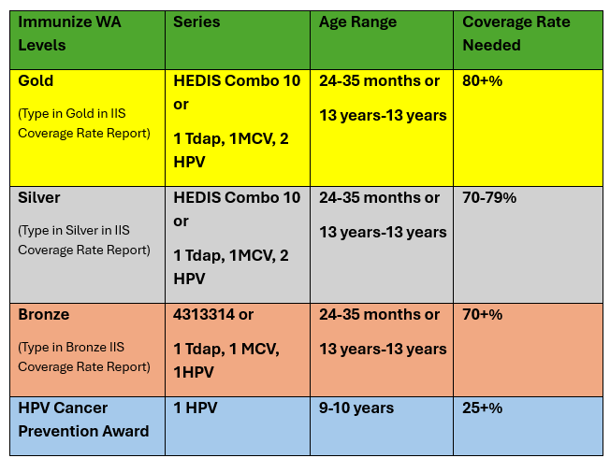
IQIP/ Immunize WA Coverage Levels

Slide 51
Childhood Series 2021-2025
2021 awards moved from the 4313314 series to HEDIS Combo 10 measure
2022 Bronze Award measure introduced

Slide 52
Adolescent Series 2021-2025

Slide 53
HPV Cancer Prevention Immunize WA 2025

Slide 54

Washington State IQIP Program Immunization Quality Improvement for Providers
Benefits
Evidence-based strategies
Facilitate return for vaccination
Leverage WAIIS to improve workflows
Give strong vaccine recommendations
Strengthen vaccine communications
HPV vaccination at age 9
Tailored support
Increase vaccine uptake
Improve vaccination workflow
Individualized training (IIS)
Technical assistance
CE, CNE, CME available for HPV Vax @ 9 Strategy
Flexibility!
You choose the strategies, goals, and pace*
2 visits & 2 brief check-ins over 12 months

Slide 55

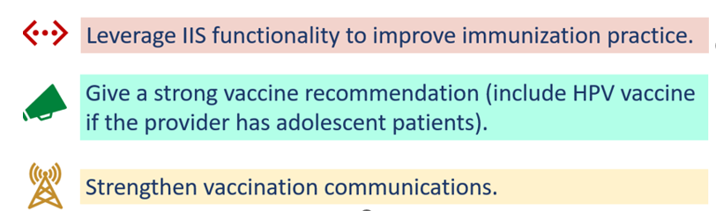

Strategies and Action Items
IQIP Core Strategies
Facilitate return to clinic for vaccination.
Recommend HPV vaccination series starting at age 9.

Slide 56
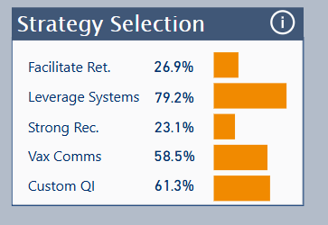
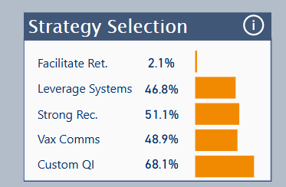
2025 Award Period
Oct 1, 2025

Slide 57

Alternate QI Credit

Slide 58
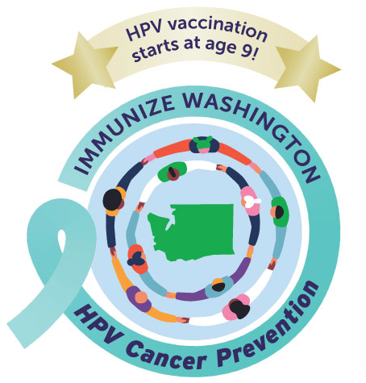
2026 Award Timeline
June 1, 2026 - Clinic nomination opens
July 15, 2026 - Nominations Close
3rd Week in August Award Announced in recognition of NIAM (Date TBD)

Slide 59


Slide 60
Poll #1
“What speakers or topics would you find most valuable or engaging for our 2026 programming?”
Notes:
12

Slide 61
Poll#2
“What have you used, or what do you think we should use to help increase awareness for parents and patients around HPV vaccination, particularly HPV at 9?”
A. Posters for exam rooms, school nurse rooms
B. School nurse letters
C. Radio spots
D. TikTok/social media posts or videos
E. TV ads
F. Podcasts
G. MyChart messages from provider
H. DOH mailings
I. Other
Notes:
13

Slide 62

Survivor Story
Pam Akers
Cervivor
Notes:
14

Slide 63

We'll be back at: 9:45 AM
Notes:
We will now take a 15-minute break before transitioning on to our next agenda item!
15

Slide 64
HPV@9 Provider Survey
Office of Immunization

Slide 65
Hello
Trevor Christensen
Dr. Sherri Zorn
Epidemiologist
Pediatrician
Office of Immunization
WCAAP

Slide 66
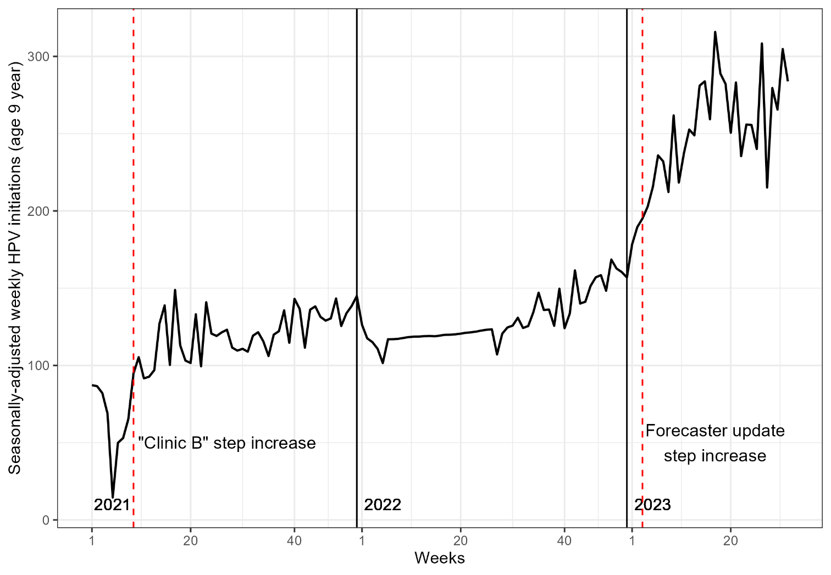
Background
Encouraging HPV vaccine initiation at 9
Many efforts since at least 2017
Past and present quality improvement programs
WAIIS forecast updated to recommend HPV vaccine at age 9 in January, 2023
Published evaluation indicates forecaster update doubled initiation, but still lower than initiation at age 11
Christensen, T., Zorn, S., Bay, K., Treend, K., Averette, C., & Rhodes, N. (2023). Effect of immunization registry-based provider reminder to initiate HPV vaccination at age 9, Washington state. Human Vaccines & Immunotherapeutics, 19(3). https://doi.org/10.1080/21645515.2023.2274723
Notes:
Encouraging HPV initiation at 9 years old has been an activity of several organizations across the state since at least 2017. Strategies have included communications to providers, clinic quality improvement programs and, in 2023, the state immunization registry updated its forecasting program to recommend HPV vaccine to everyone starting at age 9.

Slide 67
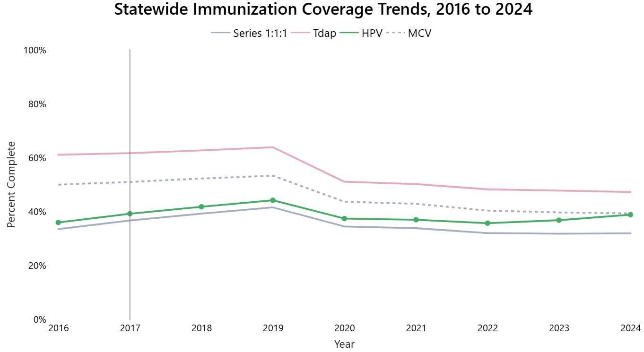
Ages 11-12 years old
Notes:
This work has contributed to HPV vaccine initiation being the only routine childhood immunization to increase in recent years. As of June 2025, the precent of kids 11-12 years old who have had one HPV vaccine has surpassed the percent who have received their scheduled meningococcal conjugate vaccine.

Slide 68
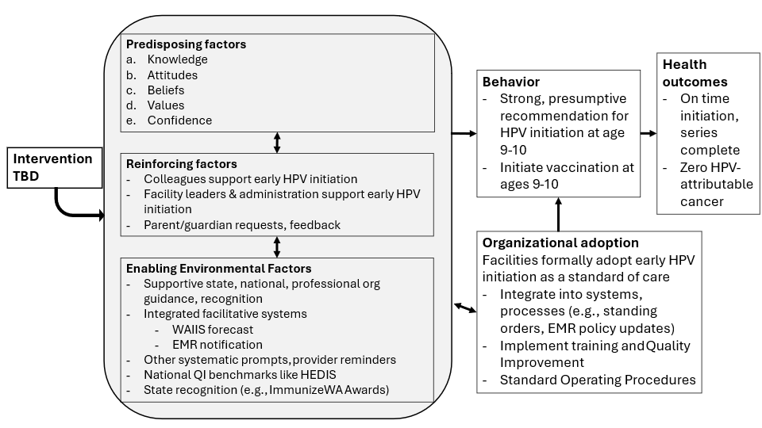
Project logic model
Notes:
Quality improvement efforts to increase HPV initiation at ages 9-10 are ongoing, but what else should we be doing?
We resolved to conduct a survey of providers to answer this question, but this proved difficult without some kind of guiding framework. We adopted the Precede-Proceed framework to organize our thoughts and the survey. The survey fit into Phase 3 of the framework, which is about assessing the Predisposing, Reinforcing and Enabling factors that drive the behavior (providers recommending HPV at 9) that result in the outcome we are concerned about (HPV vaccine initiation) and, ultimately, the prevention of HPV-attributable cancer.
The survey was organized based on the above logic model which is based on the Precede-Proceed framework.
Predisposing factors are intrinsic to the respondent: knowledge, attitudes and beliefs. Reinforcing factors can be thought of as the expressed attitudes and beliefs of the people around the respondent: what do colleagues or managers think? What do parents say? Enabling factors are policy, systems and environmental supports or barriers. We also added an intermediate outcome about Organization Adoption to our logic model as our experience with quality improvement programs has demonstrated how important this is for driving provider behavior.

Slide 69
Research Questions
What are the most important predisposing, reinforcing and enabling factors to providers for recommending HPV at 9-10 years old?
What does organizational adoption of early HPV initiation look like in Washington State?
To what extent do EMR and immunization registry forecasting predict the preferred age at which providers recommend HPV initiation?
Of the identified predictive factors, which are amenable to public health intervention?
Notes:
To further define the scope of the survey, we drafted these questions which align with the Precede-Proceed framework and our logic model. Ultimately, we wanted to understand the experience of health care providers well enough that we could identify promising public health interventions to further HPV vaccine initiation at 9.

Slide 70
Methods
Online survey
Convenience sample health care professionals
Recruitment conducted through government and professional organization listservs and newsletters
Inclusion criteria
Be a currently licensed, practicing health care professional
Serve a pediatric population that includes children 9 to 12 years old
Practice is in Washington state
Practice usually carries (has in stock) the HPV vaccine
Notes:
The survey was offered via SurveyMonkey and included a mix of quantitative and some qualitative questions. Some of the questions were based on a prior national study by Kong et al (2022).

Slide 71
Results
162 responses → 131 met inclusion criteria
Primarily physicians, medical assistants and registered nurses
55% pediatrics, 39% family medicine
91% primary care
Responses from 25 counties, mostly population centers (King, Pierce, etc.)

Slide 72
Results: WAIIS and EMR
Electronic medical record software
63% EPIC
13% Athena
How does your practice usually check which vaccines children are due for?
WAIIS: 91%
EMR: 82%
~80% have EMR that forecasts HPV initiation age
60% forecast starting age 9
33% forecast starting age 11
Notes:
More than half of users were on EPIC and 9-out-of-10 reported using WAIIS to determine patient vaccine eligibility. About 4-in-5 reported that their electronic medical record forecasts the age HPV vaccine should be initiated. More than half of these reported that age was 9 years old and about a third reported it was 11 years old.

Slide 73
Results
84% usually recommend HPV to 9-10 year olds
Easiest age group to recommend HPV vaccine to:
9-10 year olds – 30%
11-12 year olds – 38%
No difference – 32%
Pediatric healthcare professionals had a higher prevalence of reporting it was easier to recommend HPV vaccine to 9-10 year olds than family medicine.
Notes:
Reported early HPV vaccine recommendation was high, but only about one third of respondents felt it was easier to recommend HPV vaccine to 9-10 year-olds than 11-12 year-olds and another third felt there was no difference.

Slide 74
Advantages and Disadvantages
Most reported advantages of recommending HPV vaccine to 9-10 year-olds
Ensure protection well before exposure (63%)
Fewer vaccines given at the same visit (62%)
Better chance to complete the series on time (61%)
Better immune response (46%)
Most reported disadvantages of recommending HPV vaccine to 9-10 year-olds
Parents are not ready to talk about it (61%)
Children not expecting a shot, not ready (47%)
It’s uncomfortable to talk about sex with parents of younger children (18%)
I see no disadvantages (17%)
Notes:
Respondents were asked to select all the advantages and disadvantages they thought applied to recommending HPV vaccination to 9-10-year-olds versus families of older children. The most frequently listed advantages include:
Ensure protection well before exposure (63%)
Fewer vaccines given at the same visit (62%)
Better chance to complete the series on time (61%)
Better immune response (46%)
The most frequently cited disadvantages to recommending HPV vaccination to 9-10-year-olds versus families of older children were:
Parents are not ready to talk about it (61%)
Children not expecting a shot, not ready (47%)
It’s uncomfortable to talk about sex with parents of younger children (18%)
17% of respondents reported NO disadvantages

Slide 75
Challenges
Challenges reported by those who plan to recommend HPV vaccine to 9-10 year-olds
Parental resistance (77%)
Lack of electronic medical record prompt (21%)
No challenges (14%)
Insufficient time during visit (9%)

Slide 76
Willingness
Among those who DO NOT plan to recommend HPV vaccine to 9-10 year-olds…
Factors that would make them more willing to recommend HPV vaccine at 9-10 years old
Requests from parents (69%)
More research demonstrating benefits of starting at age 9 years (53%)

Slide 77
Impact of DOH Resources
Respondents were asked what DOH resources have been helpful at increasing vaccination at their organization. The most frequently supported things were:
WAIIS forecast (52%)
Immunization schedule posters (37%)
Educational materials for parents (35%)
Training sessions and webinars (28%)
HPV-at-nine website (19%)
Newsletter and updates (17%)
Quality improvement support (17%)
Immunize WA Awards (14%)

Slide 78
Discussion
Sampling bias important factor to consider
Respondents probably more informed about and positive toward HPV@9
Parents, parents, parents, parents
“Parents more readily say yes” LEAST frequently cited advantage
“Parents are not ready to talk about it” MOST cited disadvantage
Among HPV@9 vaccinators, “Parental resistance” most cited challenge
Among non-HPV@9 vaccinators, “Requests from parents” most cited factor that would making them more willing to recommend at 9
Notes:
The responses seem more supportive of recommending HPV at 9 years old than we expected. In general, respondents were probably more informed about and invested in HPV vaccination at age 9 than the overall population. Rather than using the survey to make inferences about all eligible Washington state health care providers, it is better to think about the relatively small subset of people who were likely to see the advertisement for the survey and to take the time to respond.
The missing link for most healthcare professionals seems to be parental knowledge and attitudes about HPV vaccination at 9. Parents were the least frequently cited advantage and most frequently cited disadvantage of recommending HPV vaccine at 9 years old. Among those who do recommend HPV at 9, parental resistance was the most cited challenge while, among those who do not usually recommend HPV at 9 years old, parental request was the most frequently cited factor that would make them more willing to do so.
One of the qualitative responses spoke to the role parents play in the exam room. They stated recommending at 9 is much easier because parents do not feel the provider is judging their child to be sexually active and because, typically, a “no” stems from being unprepared for the conversation rather than just not wanting to proceed at all. So, it isn’t that parents are necessarily against HPV vaccination at 9, but rather that they are unprepared for the conversation at that visit. So, public health interventions aimed at increasing parental knowledge and awareness could have a major impact on HPV initiation rates by priming parents for the conversation in advance of the visit at 9 years old.

Slide 79


Next steps?
Notes:
So, where do we go from here? How do we reach parents? There are some existing channels that could be leveraged.
Watch Me Grow Washington sends health and safety information to all parents and caregivers of children from birth to 6 years in Washington state, but a pilot Watch Me Grow mailing at 9 years old was recently completed and it found the mailing caused a small increase HPV vaccine initiation. This and other communications to parents could build parental knowledge and awareness in advance of their child’s 9-year well child visit.
The MyIR app includes forecast vaccinations and is another option for reaching parents.

Slide 80
Questions?

Slide 81
To request this document in another format, call 1-800-525-0127. Deaf or hard of
hearing customers, please call 711 (Washington Relay) or email doh.information@doh.wa.gov.

Slide 82
HPV-Related Cancers in Washington State
Cancer Prevention and Control Unit/Cancer Registry Program

Slide 83
Presenter
October 10, 2025
Mahesh Keitheri Cheteri, PhD
Epidemiologist
Cancer Registry Program

Slide 84
Definition - Data Type
Incidence: New cases of cancer

Slide 85
Definition - Age Adjusted Rate
Two or more populations can be compared (if age distribution differs).
How age adjusted rates are calculated?
Calculate age specific rates (19 age groups) for two or more populations.
Weight the age specific rates (2000 standard population proportion is used).
Add the weighted age specific rates (19 age groups).

Slide 86
Definition – 95% Confidence Intervals
The confidence intervals describe variation around the rate due to chance alone

Slide 87
HPV Related Cancers Definition
Orpharyngeal squamous cell carcinoma definition:
{Site and Morphology.Primary Site - labeled} = 'C01.9-Base of tongue, NOS','C02.4-Lingual tonsil','C02.8-Overlapping lesion of tongue','C05.1-Soft palate, NOS','C05.2-Uvula','C09.0-Tonsillar fossa','C09.1-Tonsillar pillar','C09.8-Overlapping lesion of tonsil','C09.9-Tonsil, NOS','C10.0-Vallecula','C10.1-Anterior surface of epiglottis','C10.2-Lateral wall of oropharynx','C10.3-Posterior wall of oropharynx','C10.4-Branchial cleft','C10.8-Overlapping lesion of oropharynx','C10.9-Oropharynx, NOS','C14.0-Pharynx, NOS','C14.2-Waldeyers ring','C14.8-Overlapping lesion of lip, oral cavity & pharynx'
AND {Site and Morphology.Histologic Type ICD-O-3} = 8050-8086,8120-8131
AND {Site and Morphology.Diagnostic Confirmation} = 'Microscopically confirmed'
Anal and rectal squamous cell carcinoma definition:
{Site and Morphology.Primary Site - labeled} = 'C20.9-Rectum, NOS','C21.0-Anus, NOS','C21.1-Anal canal','C21.2-Cloacogenic zone','C21.8-Overlapping lesion of rectum, anus, and anal canal'
AND {Site and Morphology.Histologic Type ICD-O-3} = 8050-8086,8120-8131
AND {Site and Morphology.Diagnostic Confirmation} = 'Microscopically confirmed'

Slide 88
HPV Related Cancers Definition
Vulvar squamous cell carcinoma definition:
{Site and Morphology.Primary Site - labeled} = 'C51.0-Labium majus','C51.1-Labium minus','C51.2-Clitoris','C51.8-Overlapping lesion of vulva','C51.9-Vulva, NOS'
AND {Site and Morphology.Histologic Type ICD-O-3} = 8050-8086,8120-8131
AND {Race, Sex, Year Dx, Registry, County.Sex} = ' Female'
AND {Site and Morphology.Diagnostic Confirmation} = 'Microscopically confirmed'
Vaginal squamous cell carcinoma definition:
{Site and Morphology.Primary Site - labeled} = 'C52.9-Vagina, NOS'
AND {Site and Morphology.Histologic Type ICD-O-3} = 8050-8086,8120-8131
AND {Race, Sex, Year Dx, Registry, County.Sex} = ' Female'
AND {Site and Morphology.Diagnostic Confirmation} = 'Microscopically confirmed'

Slide 89
HPV Related Cancers Definition
Penile squamous cell carcinoma definition:
{Site and Morphology.Primary Site - labeled} = 'C60.0-Prepuce','C60.1-Glans penis','C60.2-Body of penis','C60.8-Overlapping lesion of penis','C60.9-Penis, NOS'
AND {Site and Morphology.Histologic Type ICD-O-3} = 8050-8086,8120-8131
AND {Race, Sex, Year Dx, Registry, County.Sex} = ' Male'
AND {Site and Morphology.Diagnostic Confirmation} = 'Microscopically confirmed'
Cervical carcinoma definition:
{Site and Morphology.Primary Site - labeled} = 'C53.0-Endocervix','C53.1-Exocervix','C53.8-Overlapping lesion of cervix uteri','C53.9-Cervix uteri'
AND {Site and Morphology.Histologic Type ICD-O-3} = 8010-8671,8940-8941
AND {Race, Sex, Year Dx, Registry, County.Sex} = ' Female'
AND {Site and Morphology.Diagnostic Confirmation} = 'Microscopically confirmed'

Slide 90
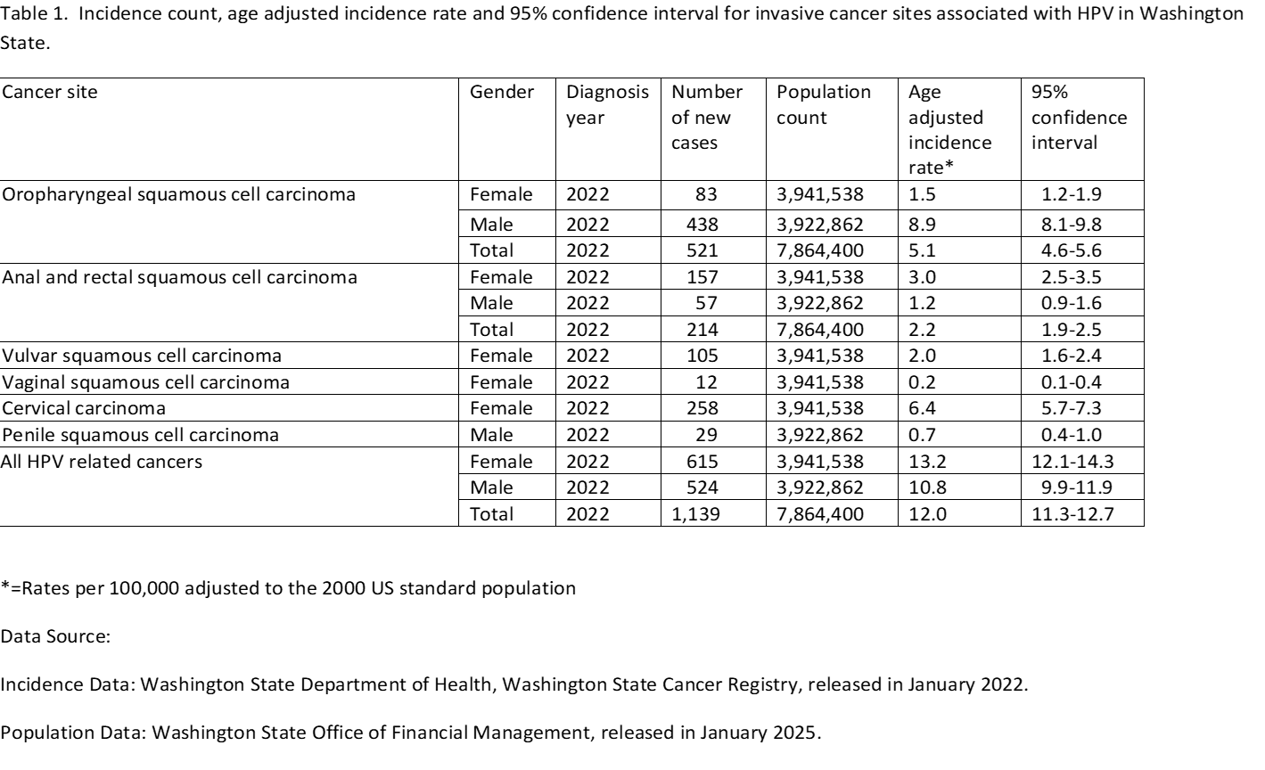
Incidence Data for the HPV Related Cancer Sites

Slide 91
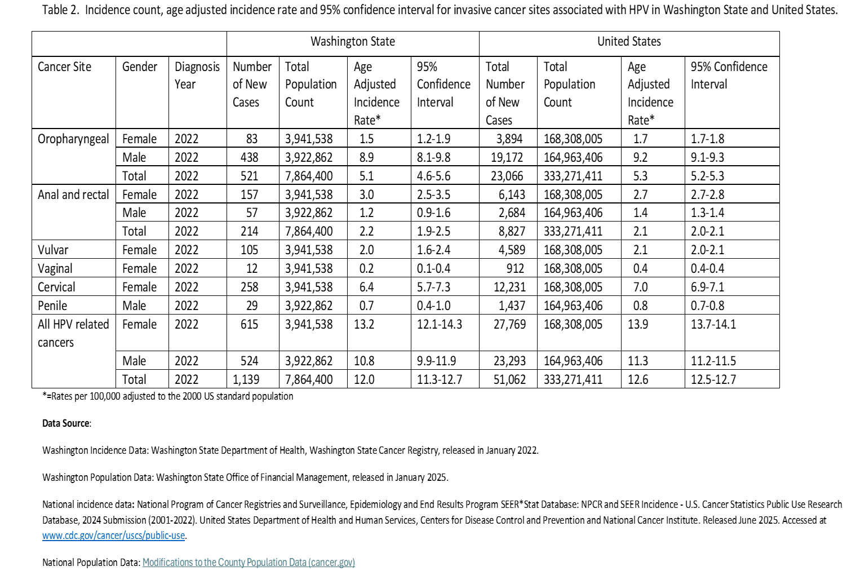
Incidence Data for the HPV Related Cancer Sites

Slide 92
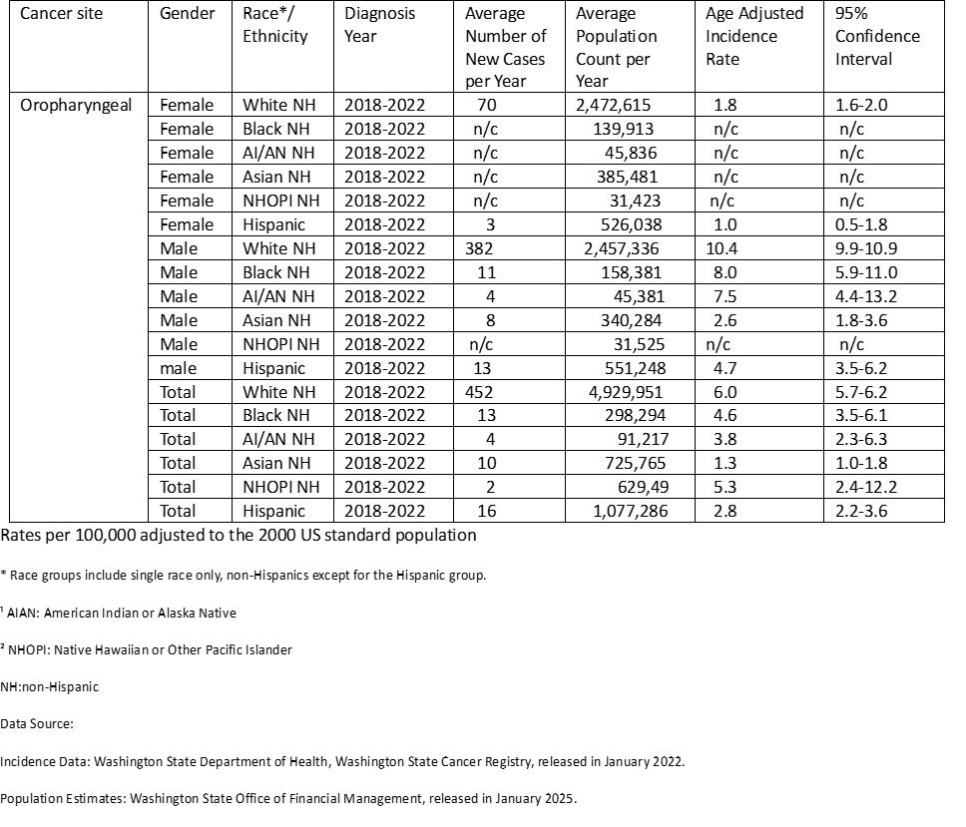
Oropharyngeal Squamous Cell Carcinoma by Race and Ethnicity

Slide 93
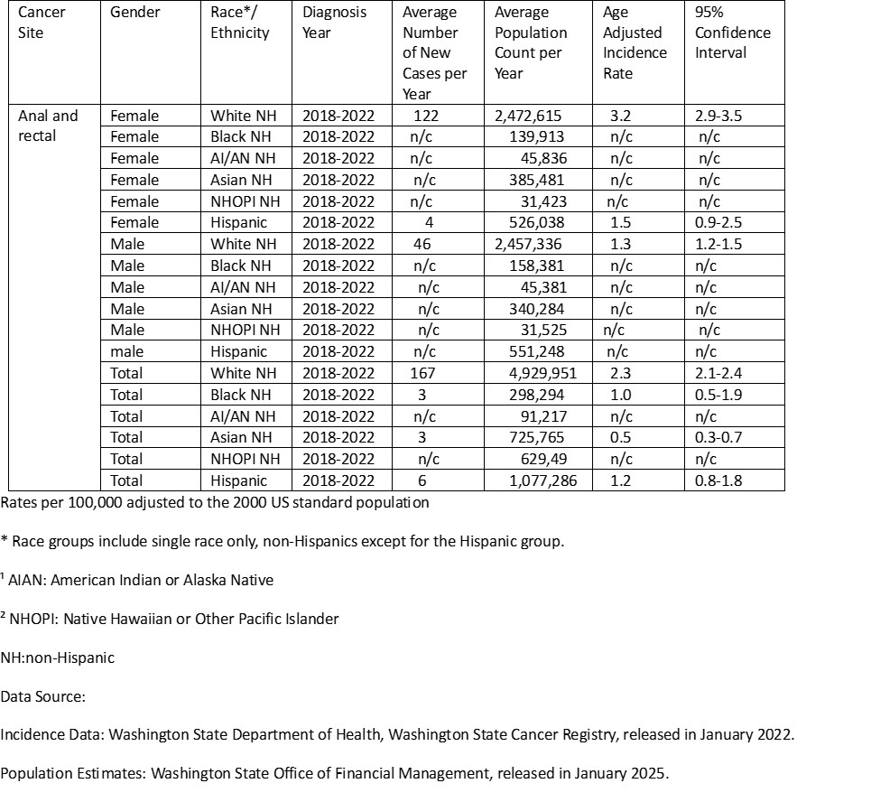
Anal and Rectal Squamous Cell Carcinoma by Race and Ethnicity

Slide 94
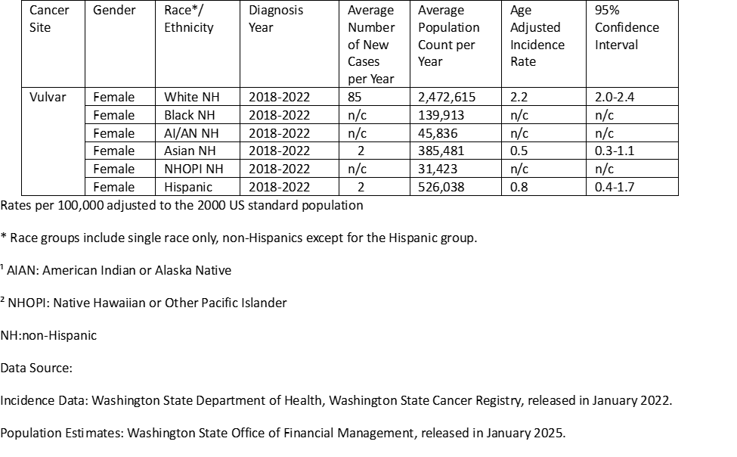
Vulvar Squamous Cell Carcinoma by Race and Ethnicity

Slide 95
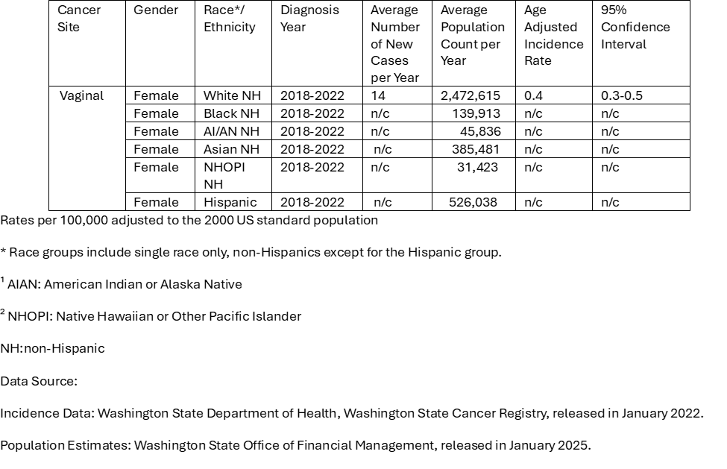
Vaginal Squamous Cell Carcinoma by Race and Ethnicity

Slide 96
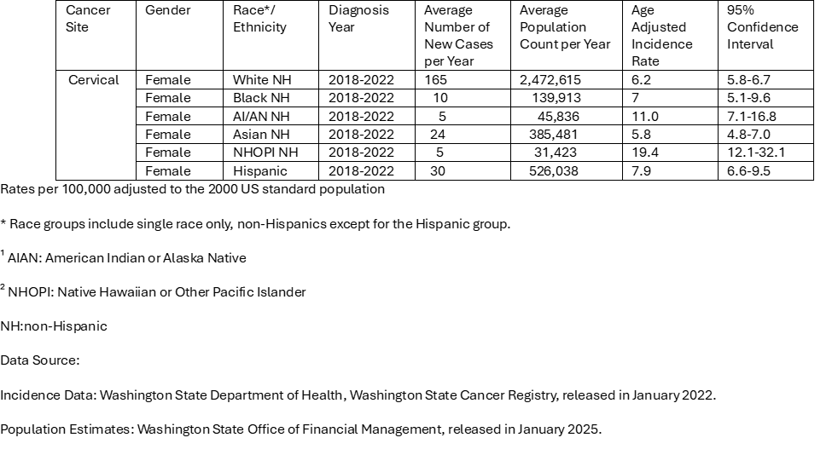
Cervical Carcinoma by Race and Ethnicity

Slide 97
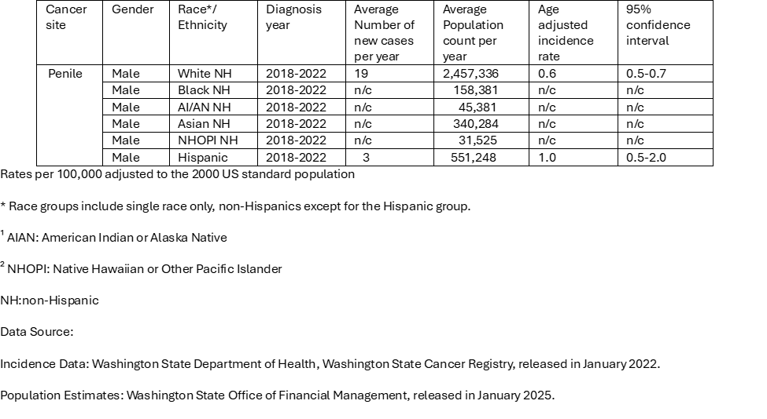
Penile Squamous Cell Carcinoma by Race and Ethnicity

Slide 98
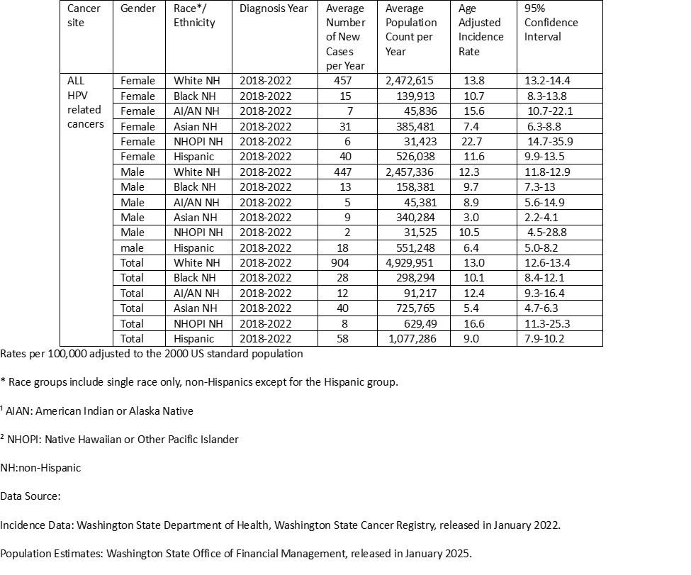
All HPV Related Cancers by Race and Ethnicity

Slide 99
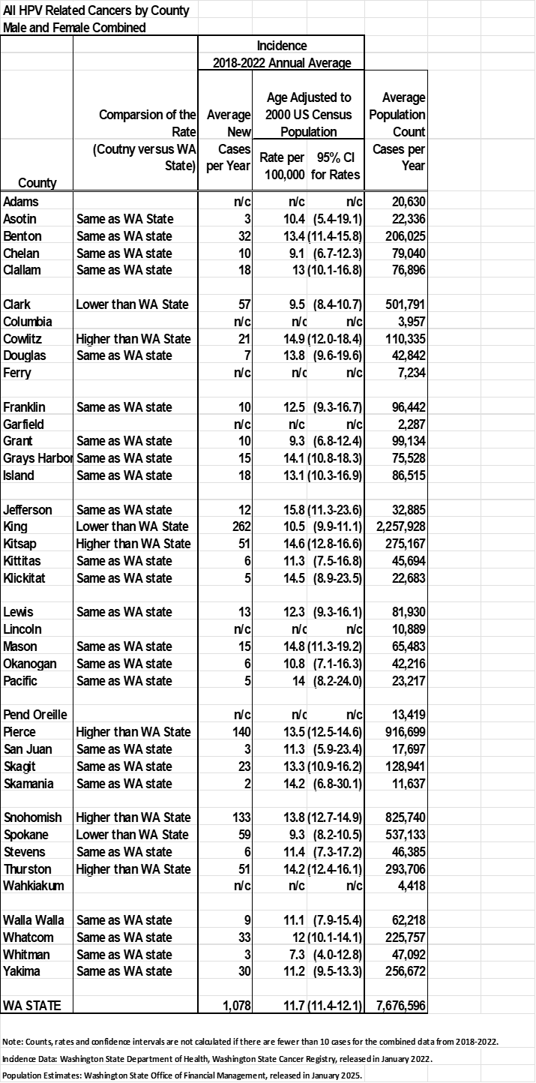
All HPV Related Cancers by County

Slide 100
Trends in Age Adjusted Incidence Rates
Used Joinpoint software (National Cancer Institute Software).
Tested for changes over time.
Calculated the annual percent change (APC).

Slide 101
Interpreting Joinpoint Analyses for the WSCR Report
Rates are level over time when the APC is not statistically significantly different from zero (p≥0.05).
Rates are increasing or decreasing when the APC is statistically significantly different from zero (p<0.05).
Increasing and Decreasing trends are described as:
Slight = APC is less than 1 percent
Steady = APC is between 1-3.9 percent
Sharp = APC is greater than or equal to 4 percent
Reference: Ries LAG, Wingo PA, Miller BF, Miller DS, Howe Hl et al. The annual report to the nation on the status of cancer, 1973-1997, with a special section on colorectal cancer. Cancer, 2000, 88:2398-2424.

Slide 102
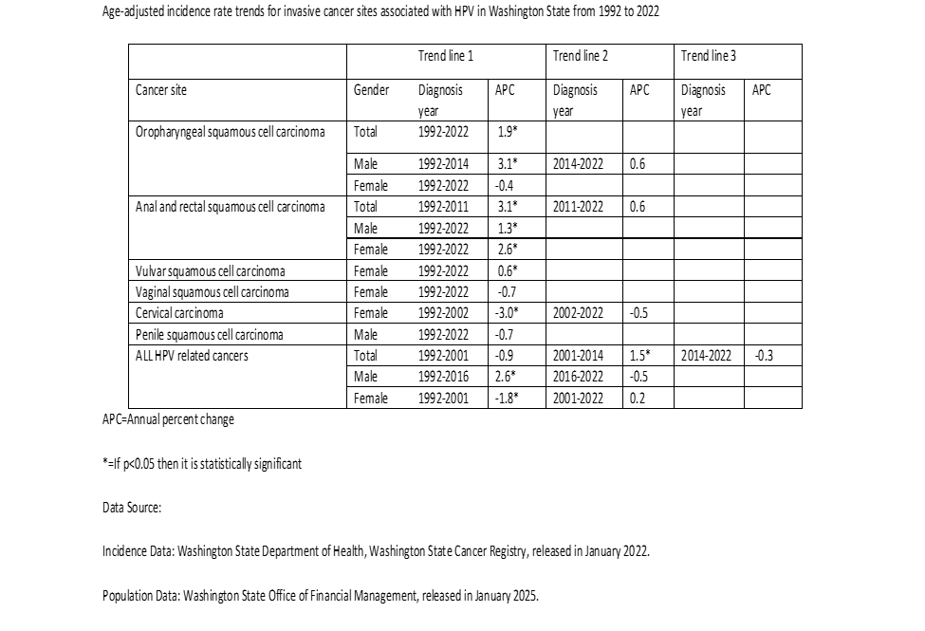
Incidence Rate Time Trends

Slide 103
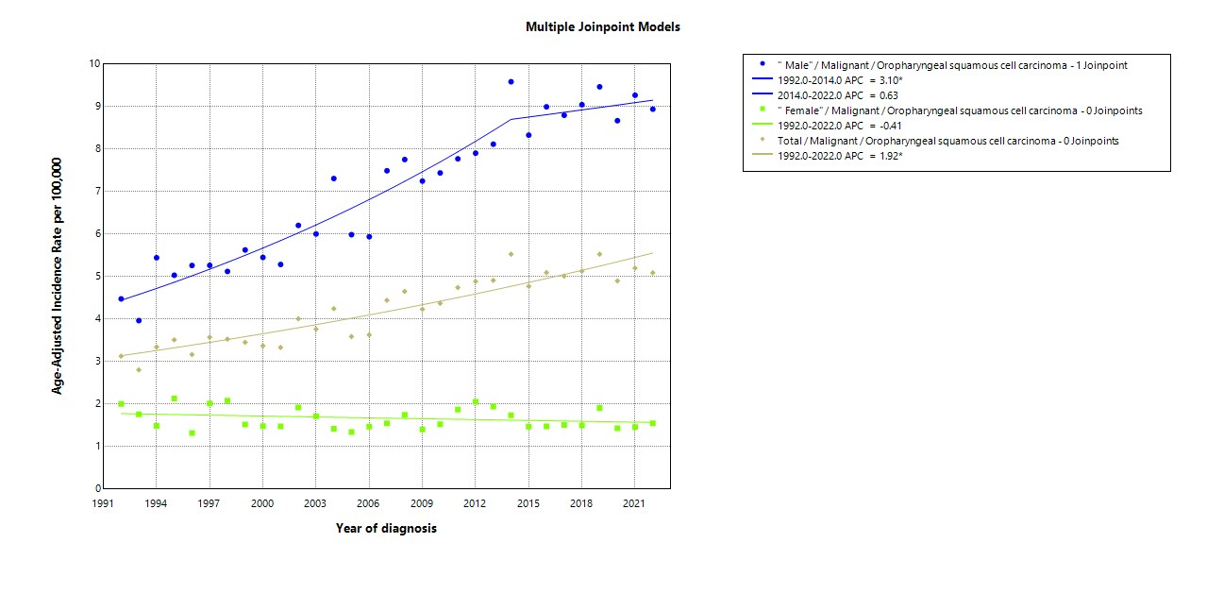
Incidence Rate Time Trends for Oropharyngeal Squamous Cell Carcinoma

Slide 104
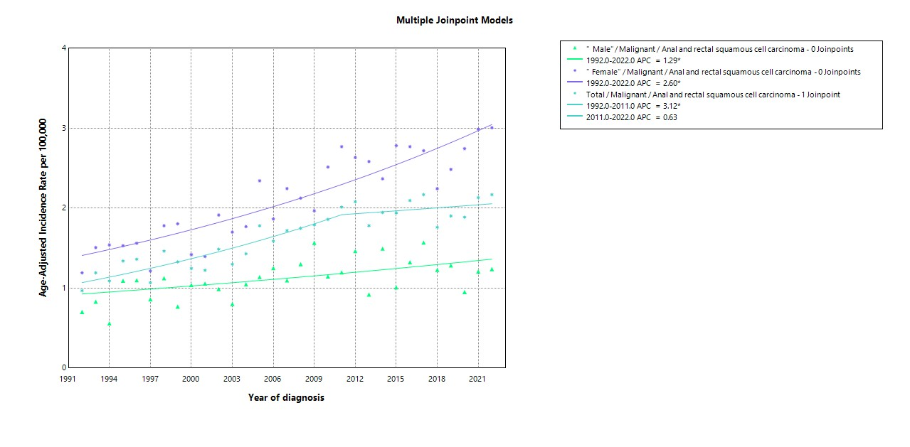
Incidence Rate Time Trends for Anal and Rectal Squamous Cell Carcinoma

Slide 105
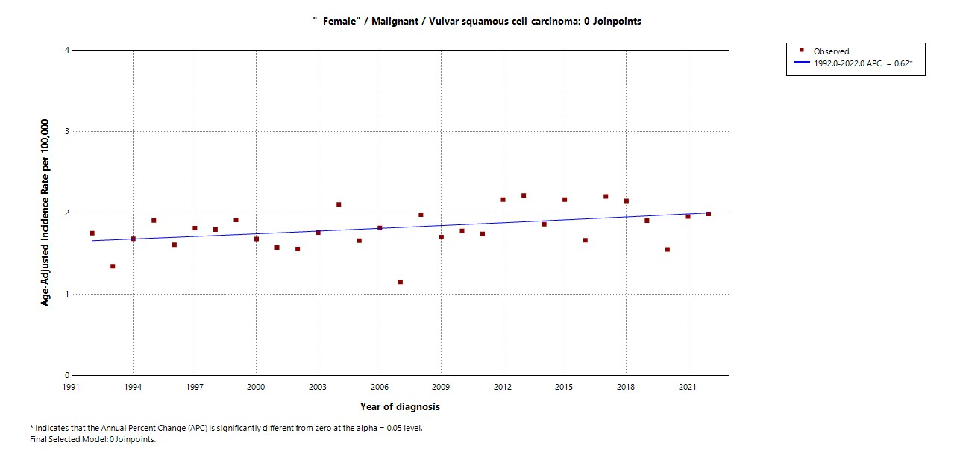
Incidence Rate Time Trends for Vulvar Squamous Cell Carcinoma

Slide 106
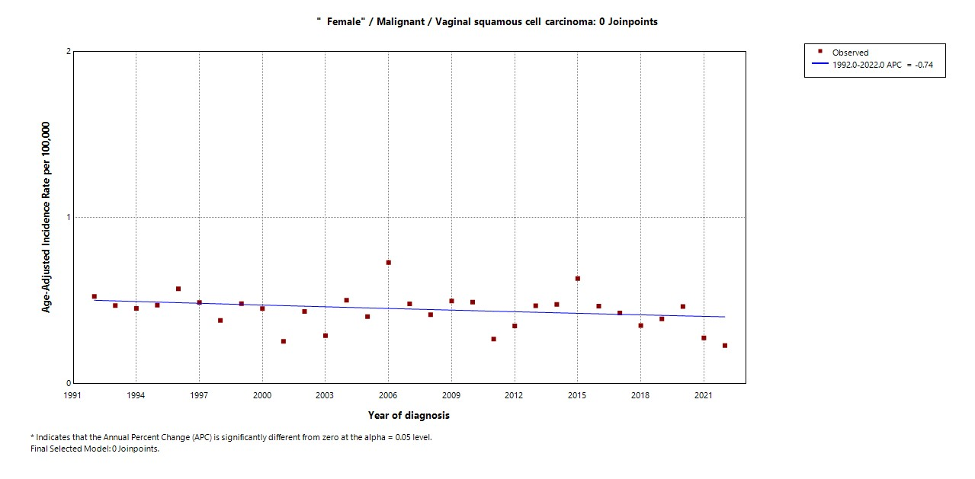
Incidence Rate Time Trends for Vaginal Squamous Cell Carcinoma

Slide 107
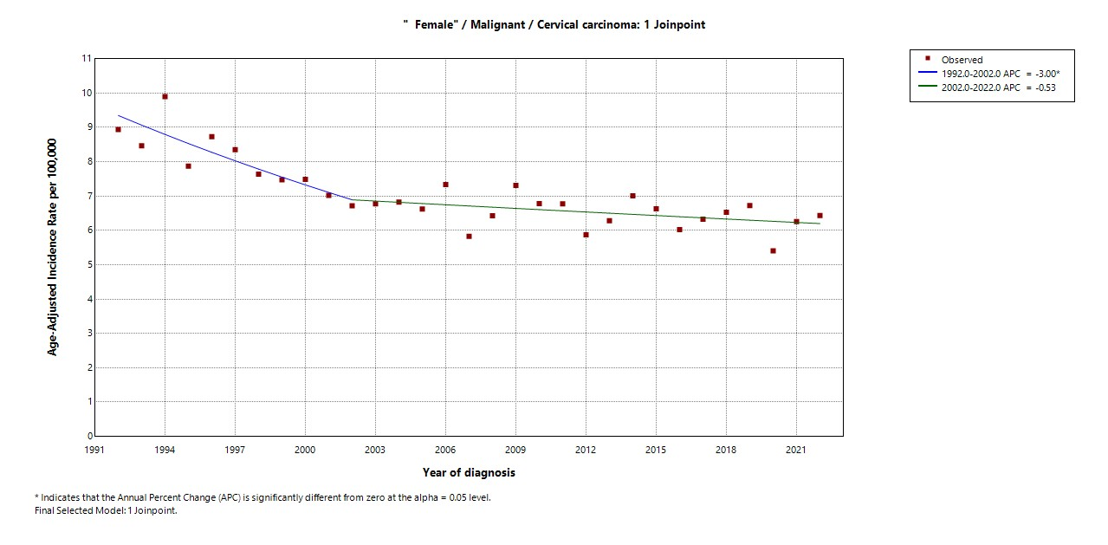
Incidence Rate Time Trends for Cervical Carcinoma

Slide 108
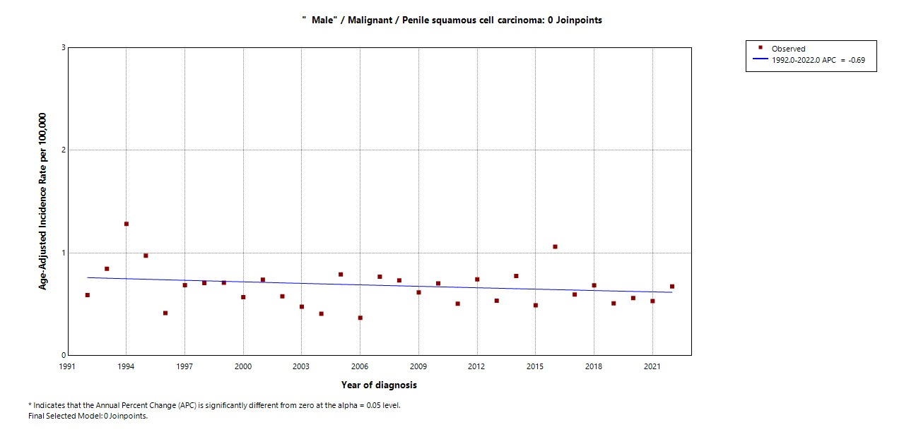
Incidence Rate Time Trends for Penile Squamous cell Carcinoma

Slide 109
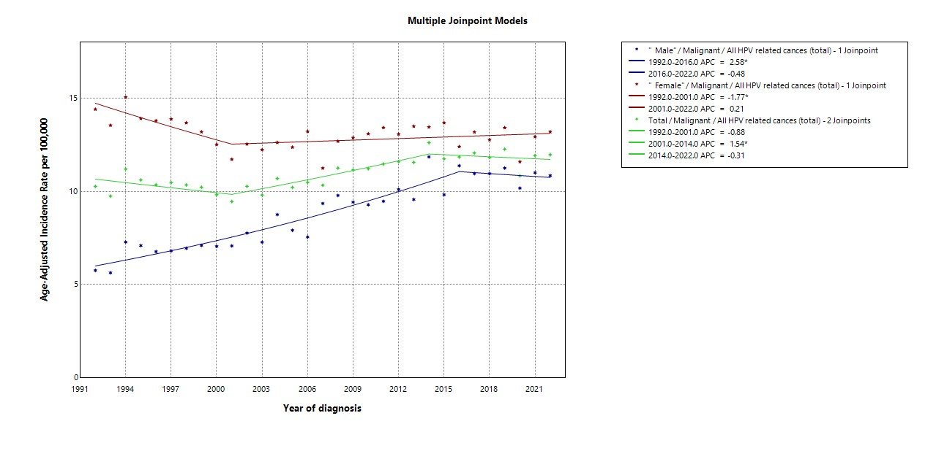
Incidence Rate Time Trends for all HPV related Cancers

Slide 110
Thank You
Any Questions or Comments are Welcome
Email: Mahesh.KeitheriCheteri@doh.wa.gov

Slide 111
HPV, Oropharyngeal Cancer & How to Engage Dental Care Professional in this HPV Cancer Prevention
Gary Heyamoto, DDS
Notes:
18

Slide 112

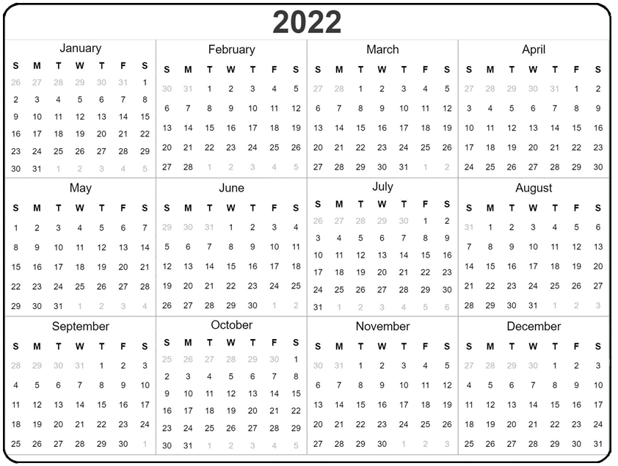
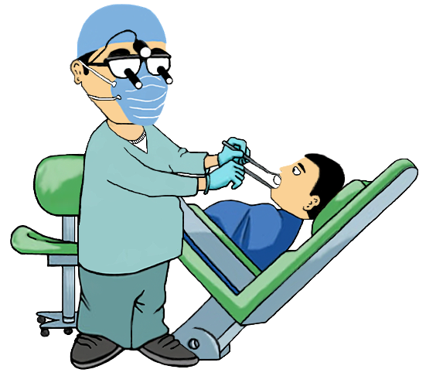



Notes:
Know your unique role. Dental providers play a unique role in HPV cancer prevention.
*Adolescent patients often come in twice a year for dental visits, more than they may go to their pediatrician or primary care provider. *Their time in your chair may be one of the few opportunities for parents or guardians to learn about the HPV vaccination, but only if your office is educated.

Slide 113
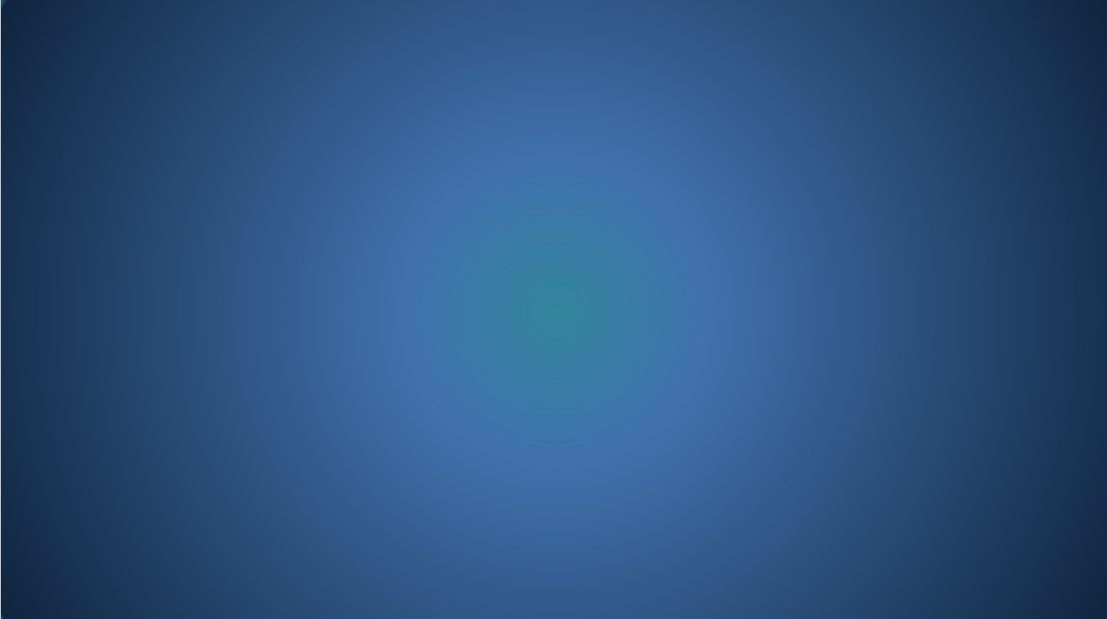
What Can Dentists Do For HPV Awareness?
EDUCATE YOURSELF on HPV/Vaccine.
ENGAGE YOUR TEAM Educate your entire team about the link between HPV infection and oropharyngeal cancer.
PROVIDE INFORMATION via office posters and patient brochures.
HEALTH HISTORY FORM : Add HPV questions to your office forms.
COLLABORATE Partner with pediatricians and primary care providers as well as ENT’s for ease of referral.
CONDUCT YEARLY ORAL CANCER screenings which include oropharyngeal cancer screening questions.
Notes:
What can dentists do for HPV Awareness?
Educate yourself on the HP virus and the vaccine so you may answer questions and feel comfortable talking to patients regarding the sexual nature of the disease’s transmission. Remember to emphasize cancer prevention. There is a vaccine …Gardasil 9.
* Engage your team. Educate your entire team about the link between HPV infection and oropharyngeal cancer.
* Have information pamphlets available for patients to take home.
* Dentists can add a question or two regarding the HPV Vaccine on their Health History Questionnaire.
By placing it here, patients may ask “why?” This gives you an opportunity to discuss what HPV infections are and the cancer preventing vaccine.
Collaborate. Consider partnering with pediatricians and primary care providers to ensure the continuum of care. Together you can develop and share examples of clear concise messages.
* Conduct yearly oral cancer screenings which include oropharyngeal cancer screening questions.

Slide 114





Notes:
Educate yourself
on the HP virus and the vaccine so you may answer questions and feel comfortable talking to patients regarding the potential sexual nature of the disease’s transmission. Remember to emphasize cancer prevention when taking advantage of administration beginning at age 9.. Learn how to make changes in your office to support HP awareness.

Slide 115
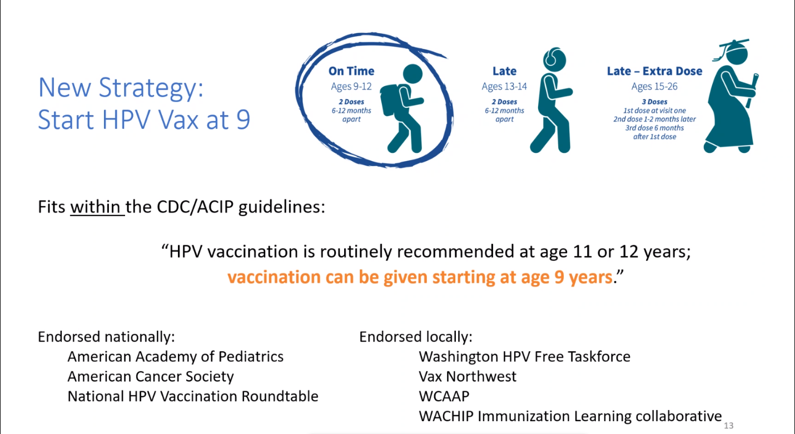

6 things dentists can do to bring awarenes: posters, Hhistory, pamphlets etc.
Biancarelli, The Journal of Pediatrics (2021)
Casey, Journal of Lower Genital Tract Disease (2021)
Notes:
Make sure you emphasize the vaccination can be given starting at age 9 !
Studies have shown the best immune response is achieved around this age, plus it helps all but insure the series is completed by age 13 for the strongest and longest lasting effectiveness. This also takes the sexual nature out of the discussion and puts emphasis on the efficacy of the vaccine. It is cancer prevention!

Slide 116
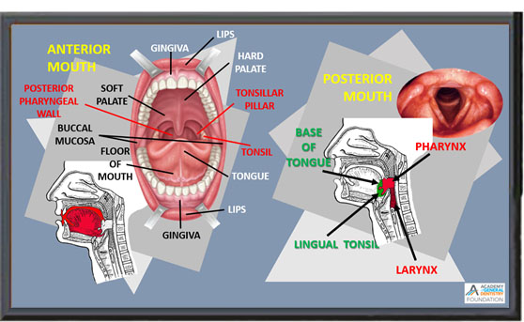
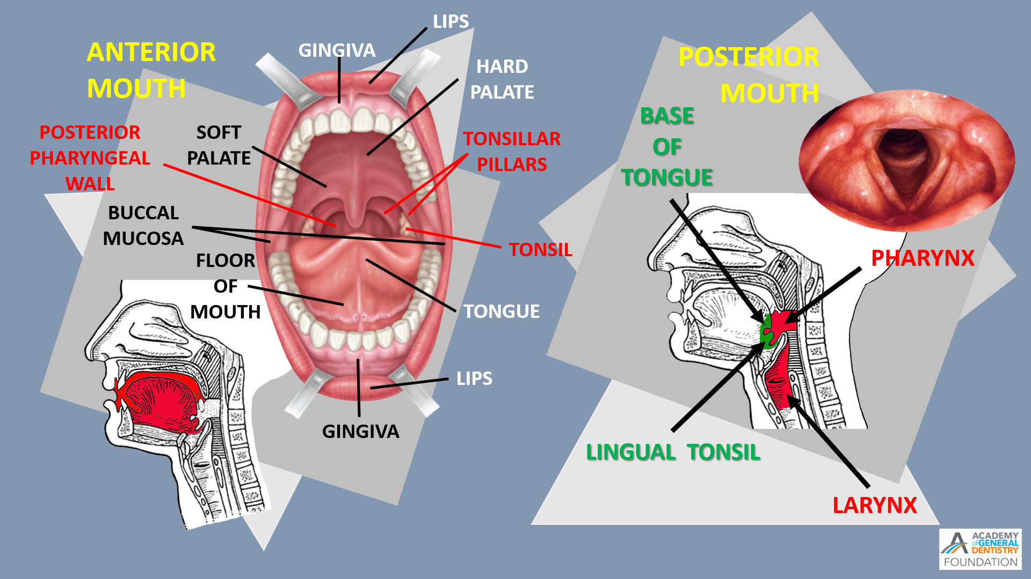
Notes:
Engage your team. Educate your entire team about the link between HPV infection and oropharyngeal cancer.
Educate your entire team about the HPV virus, modes of transmission and about the cancer preventing potential of the vaccine.
Create a culture of cancer prevention by arming staff with language to speak professionally and confidently about the vaccine to your patients.

Slide 117







Notes:
Practice cancer prevention. Parents may be unaware of the link between HPV and oropharyngeal cancer.
*Educate parents of your pediatric patients (starting around age 2 to 7) about the risks of HPV and the *importance of getting the HPV vaccine for their adolescent children starting at age 9..
*Make sure you begin talking about the vaccine before the child reaches age 8, before they become sexual active. Consider an office brochure.
*or office posters
*Emphasize that the inoculation is an anti-cancer vaccine. Have HPV brochures available to hand out.

Slide 118



How can I lower my risk of giving or getting oral HPV?
Are HPV vaccines safe?
How long are HPV vaccines effective?
How can I lower my risk of giving or getting oral HPV?
How do people contract HPV?
What is Human Papillomavirus (HPV) and Oropharyngeal Cancer?
What are the signs and symptoms of oropharyngeal cancer?
How effective are HPV vaccines?
Notes:
Another action dentists can take is to create a brochure for patients to take home containing information/answers to questions such as:
What is Human Papillomavirus Cancer?
How can I lower my risk of giving or getting oral HPV?
How do people contract HPV?
What are the signs and symptoms of oropharyngeal cancer?
How long are HPV vaccines effective?
How effective are HPV vaccines?
Are HPV vaccines safe?
*This brochure should contain answers to these commonly asked questions plus contain contact information for further resources.

Slide 119


PUT HPV VACCINE QUESTIONS ON YOUR MEDICAL
HISTORY FORMS
Are you current in your well-care physician visits?
Notes:
In addition, dentists can add a question or two regarding the HPV Vaccine on their Health History Questionnaire.
By placing it here, patients may ask “why?” This gives you an opportunity to discuss what HPV infections are and the cancer preventing vaccine.

Slide 120






“BE A HPV VACCINATION ADVOCATE"
THE HPV VACCINE IS CANCER PREVENTION
Call your doctor to make an appointment for the cancer prevention vaccine.
WRITE A PRESCRIPTION FOR
A VACCINE APPOINTMENT
Notes:
Refer patients for vaccinations.
*"Be a HPV vaccination advocate" Parents may be ready to get their child vaccinated after speaking with you about the HPV vaccine. Remember, a recommendation from you is a strong, effective and trusted advice.
*Give them a simulated prescription as a reminder.
*Emphasize The HPV Vaccination is Cancer Prevention.

Slide 121




Notes:
Collaborate.
Meet and select an Eye, Ear, Nose and Throat specialist to refer your patients to for a “second opinion”.
*Better yet, have a listing, complete with phone numbers and addresses, of several ENT’s to give to your patients for follow up.
Have prescription pads for referrals handy.

Slide 122

Notes:
When conducting our oral cancer exam, these 11 questions should be asked that reflect the health of the Pharynx/Larynx
Eleven Critical Questions to access “Posterior Mouth” health and potential early cancers in Pharynx/Larynx.
1. Do you have any white or red patches on your tongue or tonsils that have been there over two weeks?
2. Do you have excessive phlegm buildup causing you to constantly clear your throat?
3. Do you have persistent coughing?
4. Have you noticed your voice changing or do you have bouts of hoarseness?
5. Do you have a persistent sore throat or a feeling that something is caught in your throat?
6. Do you have difficulty swallowing or chewing?
7. Do you have difficulty moving your jaw or tongue?
8. Do you have numbness of your tongue or any other areas of your mouth?
9. Do you have a lump in your neck that may or may not be tender or painful?
10. Are your cervical lymph glands sore or tender?
11. Do you have unexplained weight loss or persistent bad breath?

Slide 123



Here is the link to the Original HPV Awareness Video I made:
https://www.youtube.com/watch?v=gthLwHV_DHc
Here is the link to the full HPV video:
https://www.youtube.com/watch?v=fQUd-ZsIrX4
Here is the video for the exam portion only:
https://www.youtube.com/watch?v=xsEuRqMkGhg
Notes:
In 2020 I made a video to explain and demonstrate what I believe is dentistry’s obligation to protect our patients.
The full length video is 20 minutes long and contains a narrated complete oral cancer exam at the end.
* I had a friend who teaches at the University of Arizona’s pathology department demonstrate the version they teach.
* She demonstrates the extra and intra oral complete exam in less than 5 minutes.
The 11 questions can easily be asked when doing this exam, thus completing the anterior and posterior exams.

Slide 124
Updates, Upcoming Events, & Wrap-Up
Notes:
Cancer Action Plan of Washington Meeting & Registration Link
Date: October 30, 2025
Time: 9:30 am- 3:00 pm
19

Slide 125
Cancer Action Plan of Washington - October 30, 2025
Upcoming Events
The Scott Morris Center, 12 N Sheridan St, Spokane, WA 99202
Spokane
Fred Hutch Sunnyside, 320 N. 16th Street, Sunnyside, WA
Sunnyside
Seattle
The Panoramic Center at Pacific Tower, 1200 12th Ave South, Seattle, WA 98144
Washington State University, 240 Ott Rd, Allen Center, Room 201, Pullman, WA 99164
Pullman
Fred Hutch Peninsula Clinic, 19917 7th Ave NE Ste 100, Poulsbo, WA 98370
Can’t make it in-person? Virtual is always an option!
Poulsbo
Notes:
20

Slide 126
2026 Meetings
Wrap Up
Spring Quarter Meeting (2.5 hrs.)
February 27, 2026, 8:00 am - 10:30 am
Annual Roundtable (4 hrs.)
May 8, 2026, 8:00am- 12:00 pm
Fall Quarter Meeting (2.5 hrs.)
October 9, 2026, 8:00 am – 10:30 am
Notes:
21

Slide 127

Thank you for doing your part to prevent HPV Cancers!
Notes:
All the materials shared today will be soon posted on WithinReach Website. Thank you!
22

