Slide 1

Responding to youth loneliness: a strengths-based approach
DOH 910-931 April 2026
A mini skill session developed by young people for
youth-serving health professionals, providers, and adults
Notes:
“Today, we’ll focus on how to provide strengths-based, time-realistic support for youth who may be feeling lonely or isolated, especially when social media plays a role. The goal is not to ‘fix’ loneliness, but to help you feel more confident starting conversations that feel human, supportive, and doable in real clinical or school settings. This session will include practical tools, realistic scenarios, and examples of language you can actually use. By the end, we hope you’ll walk away with responses you can draw from the next time a teen opens up about feeling alone.”

Slide 2
How to use this mini skill session
This skill session is designed to be facilitated over 20–30-minutes, for example, during a staff meeting or a lunch-and-learn activity.
The session offers insight from young people on the topic, three scenarios to practice what you learned, discussion questions and time to reflect, and resources for more information or help.
Anyone can participate in this session. It is designed for providers, professionals, and caring adults who work with adolescents and/or young adults around 12-24 years old.
Anyone can facilitate the session. A facilitator’s script is included in the “notes” section of the power point slides. The facilitator leads the group through the session by reading the script for each slide, posing pre-defined questions to the group, and creating space for group discussion.
Notes:
See slide for facilitator guidance. You can skip this slide during your presentation.

Slide 3
Young people want adults to understand how they experience loneliness and provide appropriate support
“Similar to physical health: while its generally a good idea to eat healthy, ‘eating healthy’ can vary greatly. For example a healthy diet for person A can consist of making sure they get enough grains and such, but for person B, they have celiac and that would be detrimental.
[…] Same goes for social connection needs and styles. So finding what works for YOU is VITAL. […] Just making sure that social connection, like everything else, is framed by equity, diversity/inclusion, and empathy/education.”
- Youth Advisory Council member, 2025
Notes:
“To begin, let’s talk about why we’re doing this training.
There have been many discussions at the state and national level in recent years about improving the quality of young people’s social connections and social media’s role in youth loneliness. The Washington State Department of Health wanted to know what young people themselves think about this issue, and spoke to their Youth Advisory Council about their thoughts on youth loneliness and social media use. They said they want adults to understand how they experience loneliness and how to provide appropriate support. One member framed the conversation by sharing this quote: [read quote box on slide]
This training responds to young people’s need for understanding. It focuses on how youth-serving providers and professionals can respond to youth in ways that reduce stigma, increase connection, and meet their unique needs.”
References:
Social Connection | HHS.gov
Social Media and Youth Mental Health | HHS.gov

Slide 4
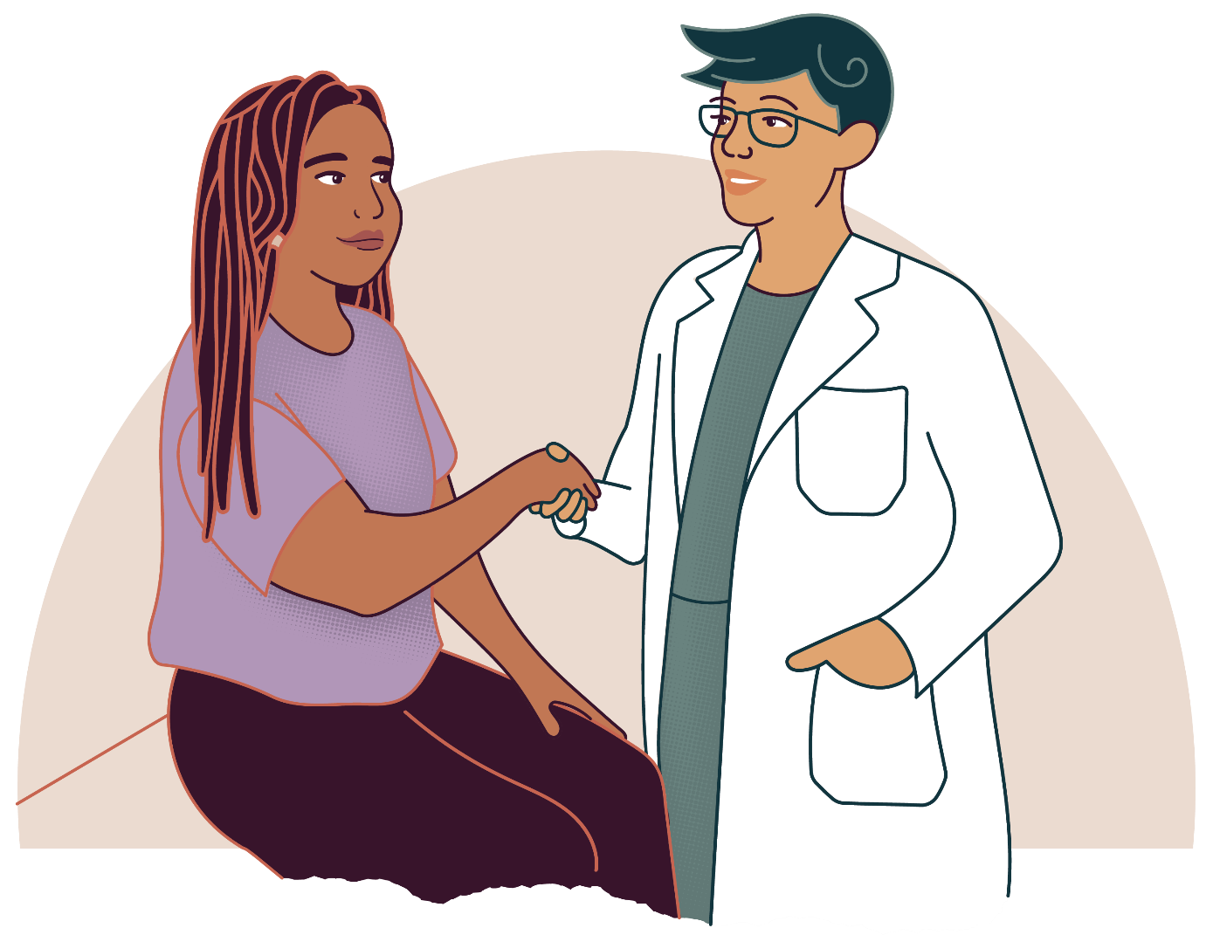
What this session will help you do
This session will help you:
This session will not:
Recognize how loneliness can show up in youth.
Understand how social media may impact a young person’s sense of self.
Practice using empathy and strengths-based language.
Replace training on mental health treatment.
Provide one-size-fits-all solutions.
Notes:
“We have three main objectives today. First, to recognize how loneliness can show up in youth. Second, to understand that teens use social media in very different ways. While it can contribute to comparison and isolation, it is also a critical tool for connection, identity exploration, and belonging. Finally, to respond with empathy and curiosity—focusing on the young person, not just the problem—especially within the limits of real-world time constraints.”
This skill session was inspired by the Adolescent Health Initiative’s Spark Training Series, and developed by the Washington State Department of Health's Youth Advisory Council (YAC) Intern, Lorenzo Beltran. He created it with support from subject matter experts in the Department of Health's Adolescent & Young Adult Health Unit, and in partnership with the Youth Advisory Council. This group identified the most important things they wanted adults to know about supporting youth experiencing loneliness.

Slide 5
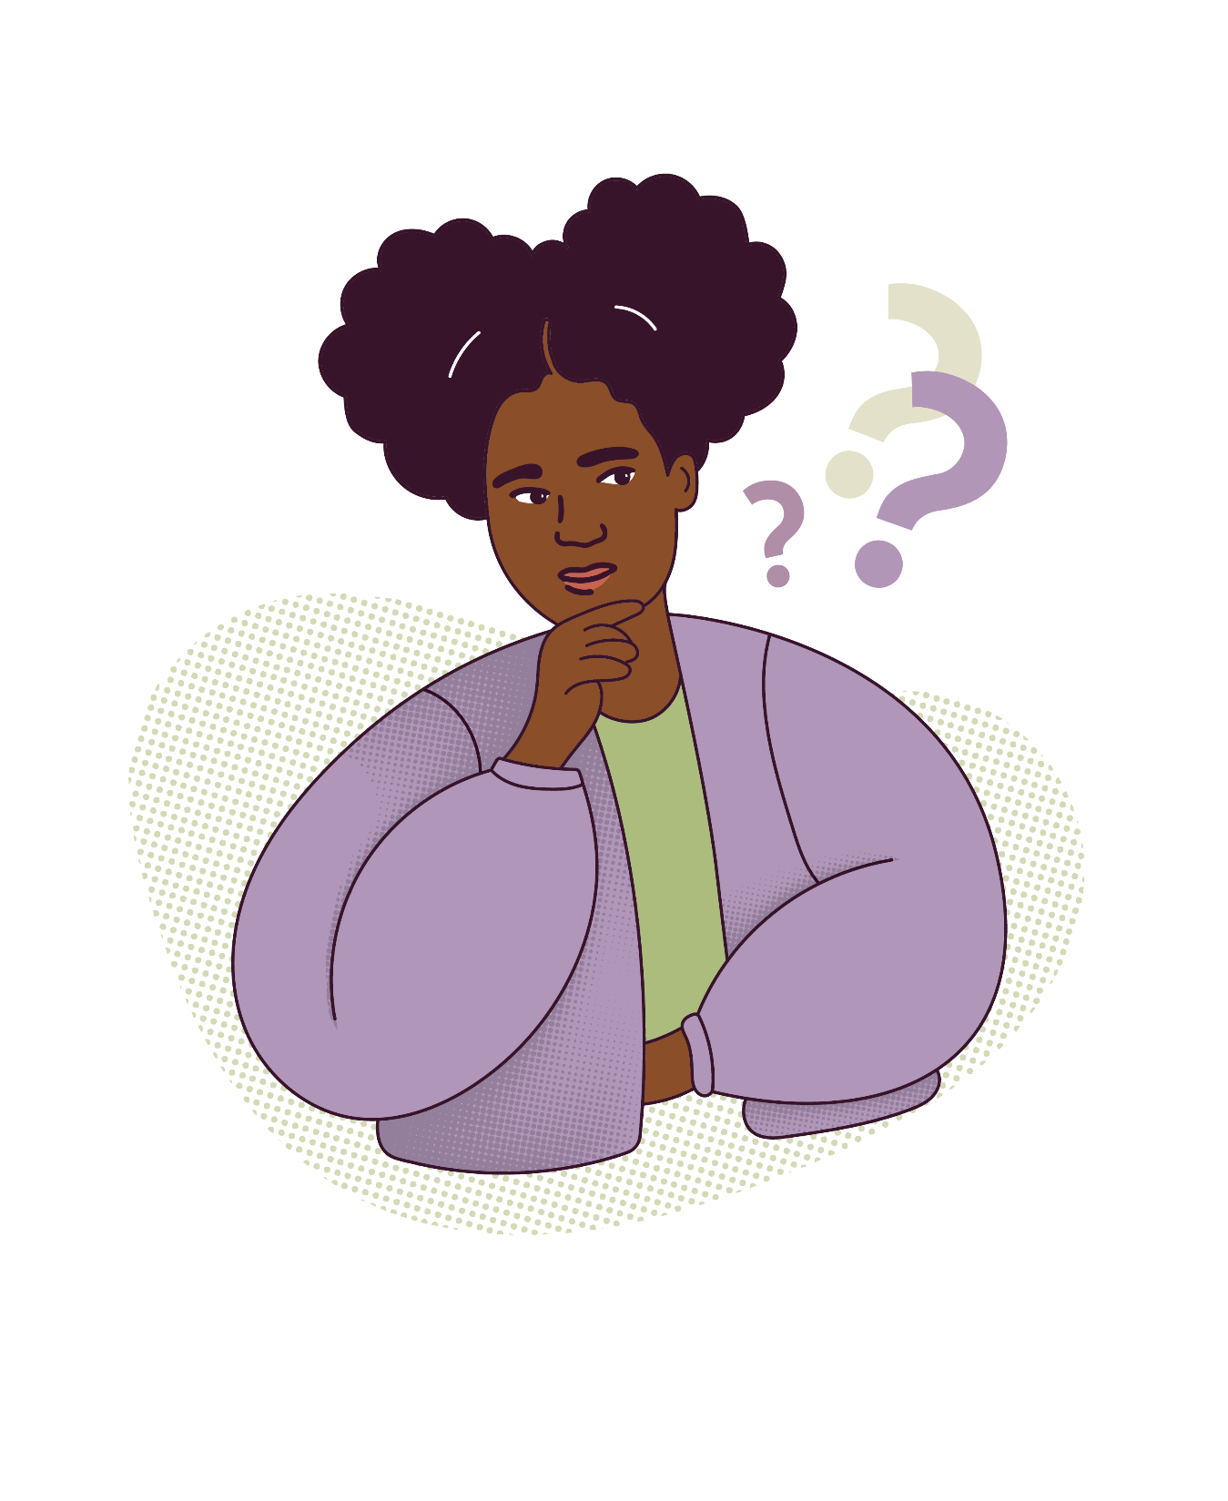
Recall a time when you felt lonely
Think about a time in your childhood when felt lonely:
Did you reach out for support?
What did it feel like to ask for help?
Or what did it feel like to handle it on your own?
Notes:
"Take a minute to think about a time in your childhood or teenage years when you felt lonely. Imagine how your teenage self felt. Did you reach out for support? What did it feel like to ask for help? Or, what did it feel like to handle it on your own? Let's have one or two people share with the group."
Thank participants for their responses, and let them know that we will continue to imagine situations from a young person's point of view throughout the training.
"The purpose of this question is to practice empathy with youth experiencing loneliness. Participants might feel vulnerable, scared, nervous, hopeful, or a variety of other emotions when reaching out for support. The experience is also different for everyone."

Slide 6
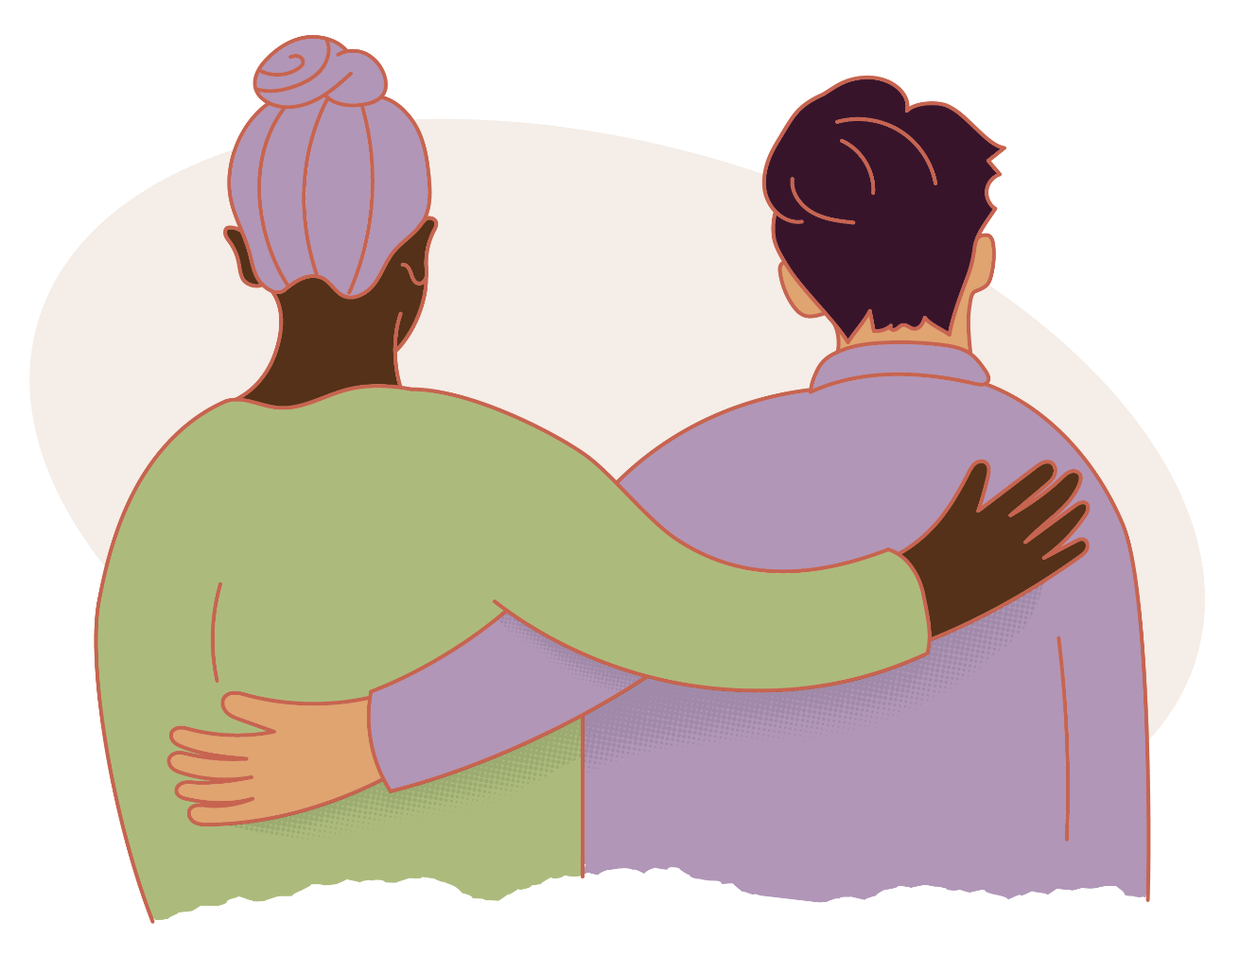
Why this topic matters
According to the young people...
Loneliness looks different for everyone​
There is no single cause or solution​
Comparison often increases pressure for adolescents​
Social media amplifies comparison and isolation
Notes:
“Let’s talk about why this topic matters to young people. Loneliness can manifest in different ways, and as such people often have different experiences with it. Many times, it’s not about being physically alone. So many young people today face digital isolation, where they are constantly surrounded by online interactions but feel emotionally disconnected. Understanding this helps us meet young people where they are, without judgement.”​

Slide 7
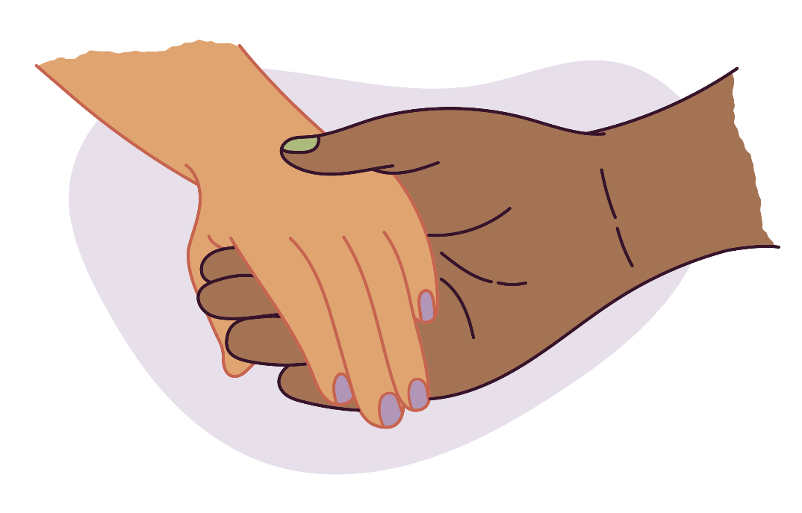
Common youth experiences navigating loneliness
Young people often experience:
Feeling dismissed when they reach out for help.
Having their emotions minimized, especially when told to “just stay positive,” is not helpful.
Comparing themselves to idealized online lives.
Not having their barriers to seeking support recognized.
Notes:
“Young people share many similar experiences navigating loneliness. Many young people describe feeling dismissed when they try to open up, often because adults move quickly to reassurance or advice. Social media comparisons can intensify those feelings, even when teens know posts aren’t the full picture. At the same time, it’s important to name that social media also offers real benefits: connection, creativity, identity exploration, and community. When we only focus on the harm, youth may feel misunderstood. Recognizing both sides helps us meet them where they are.”

Slide 8
What youth want you to understand
Listen without judgment
Validate rather than minimize​
Lead with empathy and curiosity​
Recognize how identity and stigma shape youth experiences (e.g., LGBTQIA2S+, youth, immigrant/first-generation)​
Social media can be used to connect, and can be isolating as well​
Build trust and confidentiality​
Loneliness can occur even in crowds​
Identify and build on existing strengths for support
Notes:
“Loneliness is something that almost every young person experiences in some form, but it rarely looks the same from one person to the next. A teenager may look fine on the outside but they can simultaneously feel invisible on the inside. Some might feel lonely even when surrounded by people. Others might use social media constantly but still feel unseen. In today’s culture, emotional openness is often discouraged. Social media encourages us to ‘curate’ our lives, which means young people may feel pressure to appear happy or confident, even when they aren’t. That makes loneliness even more isolating because it can feel like everyone else is doing fine.”​
​
“For young people, loneliness can be heightened by feeling misunderstood or unseen. As providers, teachers, or mentors, we might not always relate to their experiences. Maybe we didn’t grow up online, or maybe our cultural background shapes how we talk about emotions. But the key is to approach these moments with curiosity rather than assumption. When teenagers share their experiences with us, it is important to meet them where they’re at. Instead of trying to fix the feeling, we can validate it. For example: ‘That sounds really hard. It makes sense that you’d feel that way.’ We also have to build trust by keeping confidentiality. When youth sense they can’t speak freely, that isolation deepens. Simply saying, ‘This is a safe space—you don’t have to have it all figured out,’ can be a huge relief.”​
​

Slide 9
Reminder:
Persistent loneliness that impacts a young person’s day-to-day life may require additional
support and intervention.
Notes:
"Remember that persistent loneliness that impacts a young person's day-to-day life may require additional support and intervention. If you're worried about someone and need guidance, there are resources for youth and adults at the end of this presentation."

Slide 10

Activity
Let’s go through 3 scenarios written by young people about times they might feel isolated or disconnected.​
We’ll read a quote from a young person, then go through a series of questions to reflect on how you might respond as a supportive adult.​
Notes:
"Now, we'll go through 3 scenarios written by young people about times they might feel isolated or disconnected. We'll read a quote from a young person, then go through a series of questions to reflect on how you might respond as a supportive adult. Each scenario is designed to practice listening first, validating feelings, identifying strengths, and asking questions that keep the youth (not the problem) at the center."

Slide 11
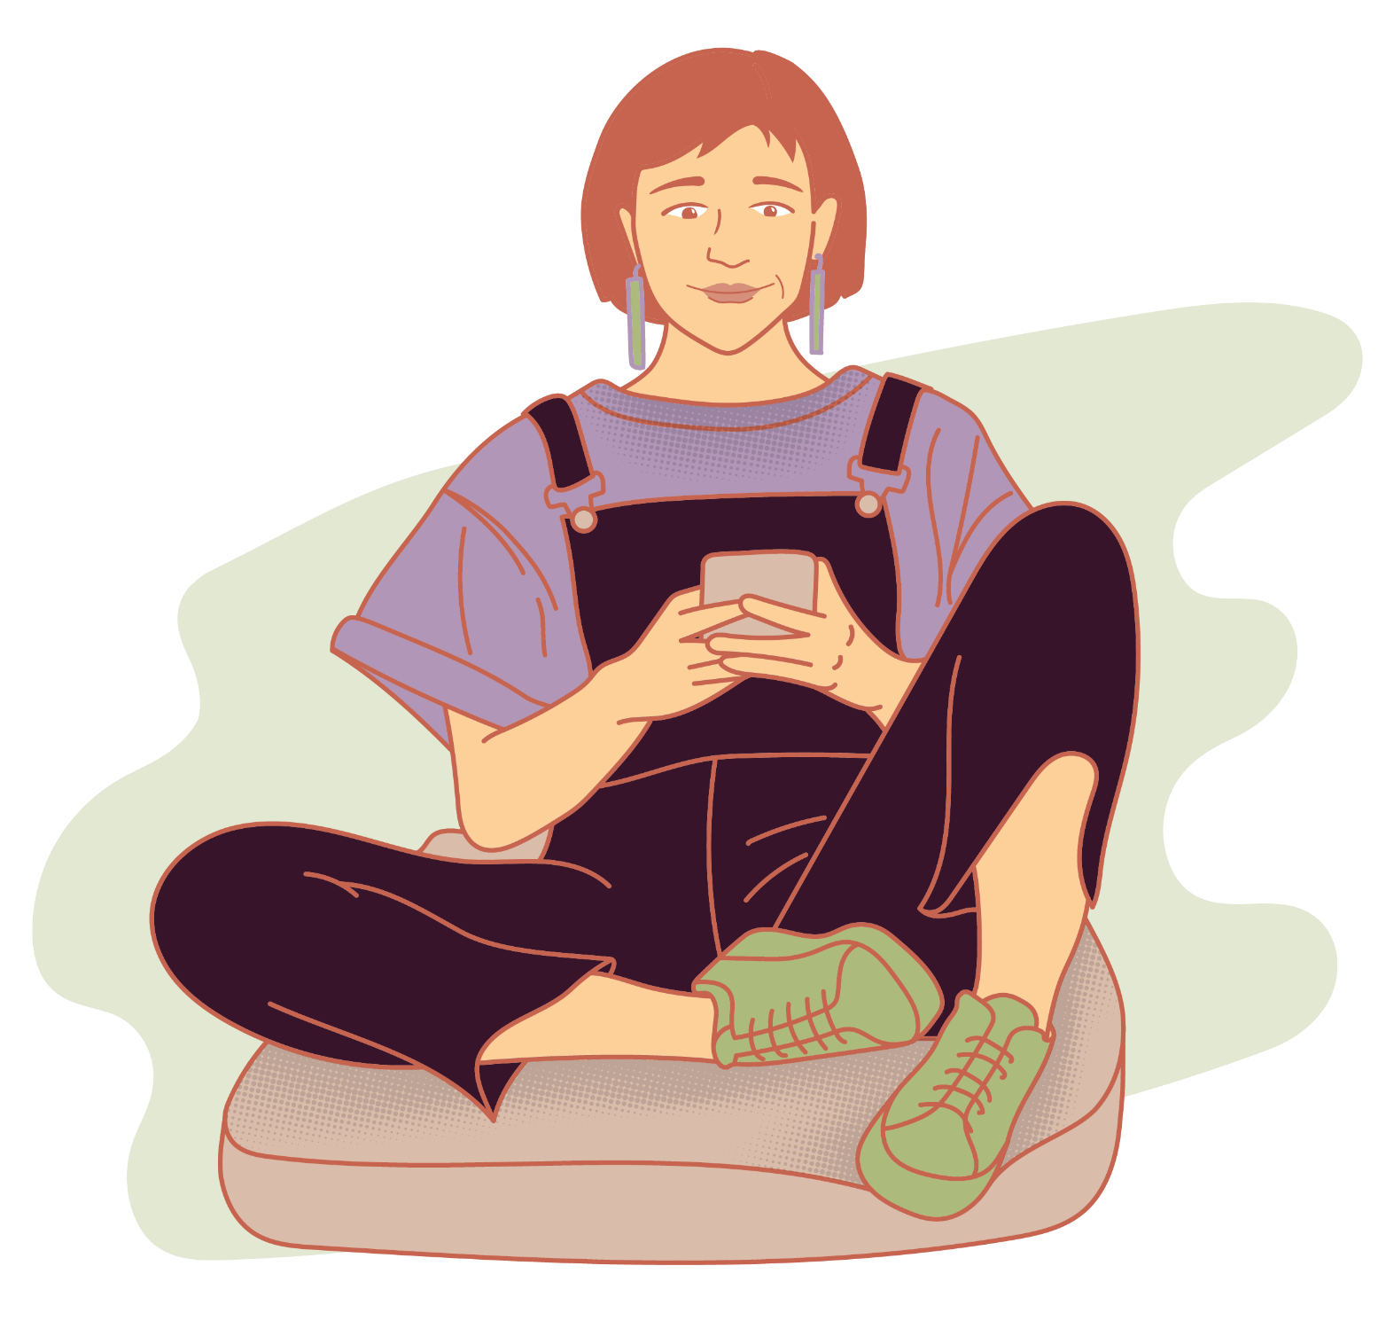
Scenario 1: Isolation on social media​
Alicia (age 17) is at a well visit with her provider. When asked about coping with stress, she shared:
    “I like to go on social media to relax, but I don’t know what’s wrong with me. Every time I go on social media, I feel worse about my life.”
Which of the following responses would be best to use?
“Social media is terrible for mental health. You should delete your accounts.”
“Most of the stuff you see online is fake, anyway. I wouldn’t worry about it.”
“I’m hearing how difficult it is to feel bad about yourself. That sounds really tough.”
Notes:
Read the slide aloud to the group, or ask a participant to do so. Ask the group to agree on a response to the multiple-choice question before going to the next slide.

Slide 12
Scenario 1: Isolation on social media​
The best response is C.
  “I’m hearing how difficult it is to feel like you're not enough. That sounds really tough.”
Alicia continues:
  “Everyone else my age is doing something huge. They have awards, perfect friend groups, vacations, everything. I feel stuck.
  I keep telling myself to ignore it, but I can’t.
  It just makes me feel like I’m not enough.”
Reflection questions:
  What feeling is Alicia expressing?
  What phrase could validate her stress without minimizing it?
Notes:
Read the slide aloud to the group, or ask a participant to do so. Ask the group to agree on a response to the multiple-choice question before going to the next slide.
You are welcome to replace the reflection questions with other options that feel more relevant. Here are a few to choose from:
What would you say FIRST to show you hear Alicia?
What open question could help you understand this person’s motivations for using social media?
What strength do you notice in the way they described their situation?
What small steps could you suggest with them, not for them? How would you remind them they aren’t the only one who feels this way?
Here are some example answers to the reflection questions you could share with your group:
What emotion or feeling is this young person trying to share?
This young person is describing feelings of isolation, inadequacy, and jealousy.
The person expressed a desire to stop making comparisons.
She feels bad or guilty.
She is comparing herself to others and it’s negatively impacting her.
They seem to have low self esteem.
She feels like she isn’t good enough.
She’s not able to move on.
What would you say FIRST to show you hear them?
“I’m hearing how difficult it is to feel like you’re not enough.”
“It sounds exhausting to feel compared all the time.”
“It’s hard not to compare yourself to what you see on social media.”
“Social media does make it seem like others’ are doing more than you.”
What open question could help you understand this person’s motivations for using social media?
“What keeps you coming back to social media, even when it’s hard?”
“What do you like about using social media?”
“When was a time you felt included on social media, and what was different about those times?”
“Maybe we could talk about why you use social media and how we can make it work better for you.”
What strength do you notice in the way they described their situation?
“You’re already noticing patterns and that tells me you’re paying attention to your needs.”
“You’re in tune with yourself and you recognize that social media is making you feel bad.”
“It sounds like you’re ready for a change, but maybe aren’t sure how”
What small steps could you suggest with them, not for them? How would you remind them they aren't the only one who feels this way?
“You are not alone. Many young people feel this way about what they see on social media. What do you think about setting aside scheduled time each day to check social media”
“It is a normal experience to compare yourself to your friends and it’s hard not to when you see what they are doing right as they are doing it. On a scale of one to ten, how confident are you that you can make a change”
“Is there an activity you have always wanted to try? What is one step you could take to work towards that? Or do you know someone who does that? How do you feel about connecting with them?”
“Social media shows just a small part of people’s lives. It’s hard for most of us to remember that.”
What phrase could validate the stress without minimizing it?
Being a young person is really stressful these days, especially with social media, and especially when you feel like you aren’t doing enough.
It can be stressful when you think you should be doing more.

Slide 13
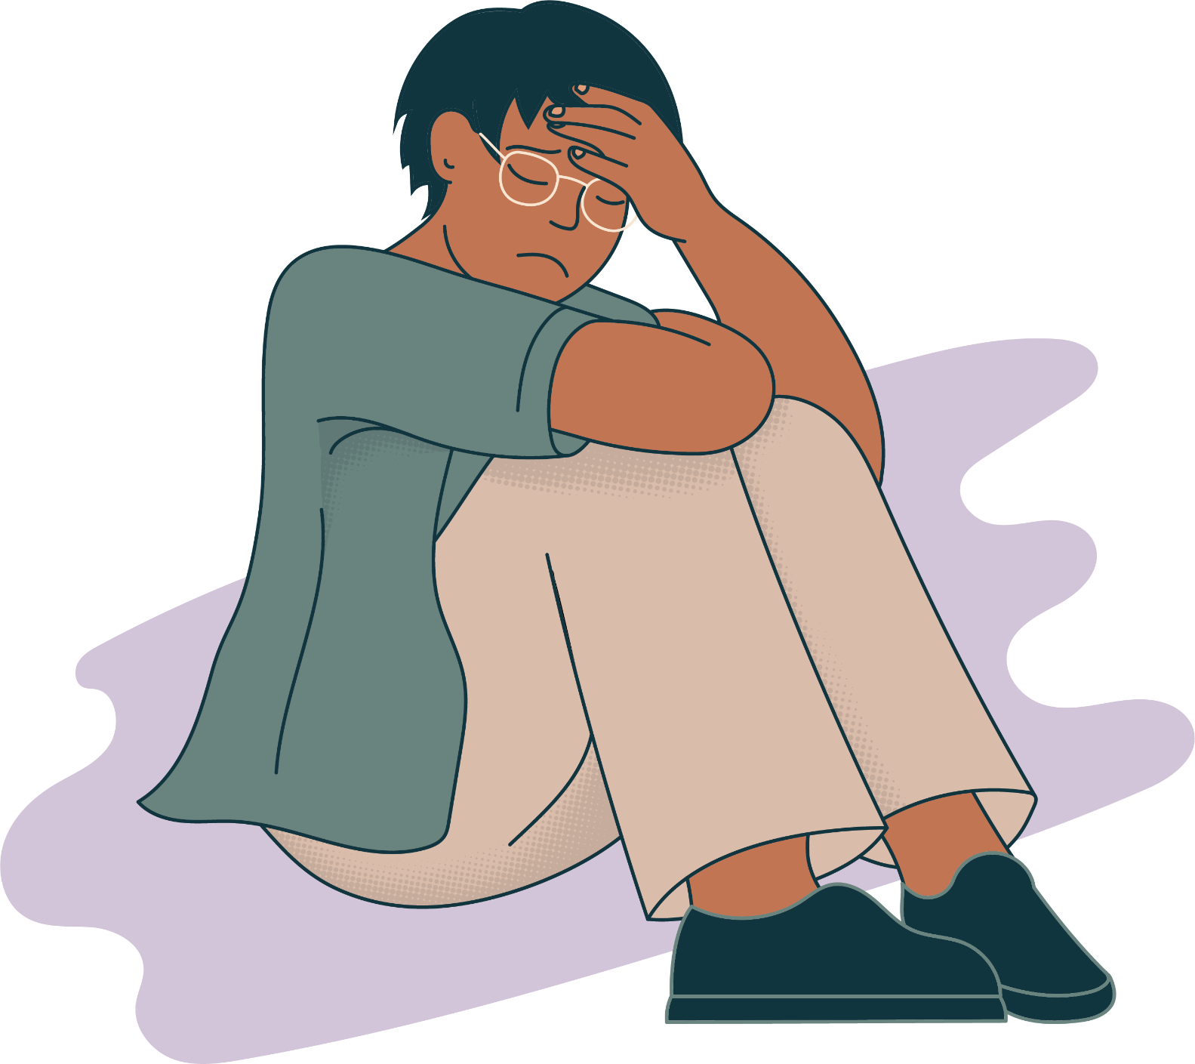
Scenario 2: Isolation at home
Ash (age 15) is checking in with their youth group leader about an upcoming project. When asked how things are at home, they say:
  “At home, no one asks how I’m doing. I stay in my room most of the time because it feels like no one notices I'm even there.”
Which of the following responses would be best to use?
“It can be so painful to feel unnoticed.”
“Maybe you should go sit in the living room with your family instead of being cooped up in your room.”
“That’s hard to believe. I always see your family supporting you at your basketball games.”
Notes:
Read the slide aloud to the group, or ask a participant to do so. Ask the group to agree on a response to the multiple-choice question before going to the next slide.

Slide 14
Scenario 2: Isolation at home
The best response is A.
  “It can be so painful to feel unnoticed.”
Ash continues:
  “I feel completely shut out. My friends hang out without me now, and I only find out when I see their posts.
  I feel like I’m trying to reach out, and no one cares. I don't want to be alone all the time, but I don't know what to do anymore.”
Reflection questions:
What strength do you hear in the way they talked about their situation?
What question could you ask that helps them explore sources of support?
Notes:
"The best response is A. Option B skips ahead to problem-solving before demonstrating empathy for Ash's situation, while option C dismisses what Ash shared and makes an assumption about their relationship with their family. Option A validates how Ash is feeling and shows empathy. This allows Ash to feel safe, and they continue talking."
Read the rest of the slide aloud, or invite a participant to do so.
You are welcome to replace the reflection questions with other options that feel more relevant. Here are a few to choose from:
What emotion or feeling is the youth describing most strongly?
How would you show them you understand how heavy this feels?
What question could you ask that helps them explore sources of support?
What might help the teen feel seen, even in small ways?
What strength do you hear in the way they talked about their situation?
What support options could you explore together?
What phrase could help them feel less invisible?
Here are some example answers to the reflection questions you could share with your group:
What emotion or feeling is the youth describing most strongly?
They feel left out, invisible and uncared for.
They feel frustrated with their friends, and with not knowing what to do.
They feel helpless and unsure of what to do.
How would you show them you understand how heavy this feels?
“It is really painful to feel unnoticed.”
“It can feel really heart breaking to be left out”
“It is frustrating when you aren’t sure what to do”
“People can be really focused on themselves.”
“Friendships can be really wonderful sometimes, and really frustrating at other times”
What question could you ask that helps them explore sources of support?
“If support looked the way you wanted it to, what would be different?”
“Have you felt like this before? What helped then?”
“If a friend of yours felt like this, what would you say to them to help?”
What might help the teen feel seen, even in small ways?
Asking about how this situation makes them feel and validating their feelings.
Listening without interrupting or trying to make it better.
Letting them know they aren’t alone and that it’s normal to feel yucky when you are left out or feel unnoticed.
It’s normal to feel bad when you’re being left out, but it is not a reflection of their worth.
What strength do you hear in the way they talked about their situation?
“The fact that you’re talking about this tells me that connection matters to you.”
“I can tell that you’re in tune with what you need to protect your mental health”
“It sounds like you’ve tried to make some connections but maybe haven’t found your people”
What support options could you explore together?
“Are there any groups or activities at school that you’re interested in? Maybe we could look at one together”
“How comfortable would you be setting up a weekly activity with your family? Like Friday movie nights or Sunday game nights?”
“Do you want to explore options for connecting with others who are experiencing the same thing? Let’s look at some peer support groups”
“Who is one person you know you can rely on? How do you feel about making a connection with them?”
“Who in your life always includes you? How do you feel about spending more time with them?”
What phrase could help them feel less invisible?
“I can tell your health really matters to you. What are some things you are interested in that make you feel good?”
“Reciprocal friendships are really important. I can tell you want something more.”

Slide 15
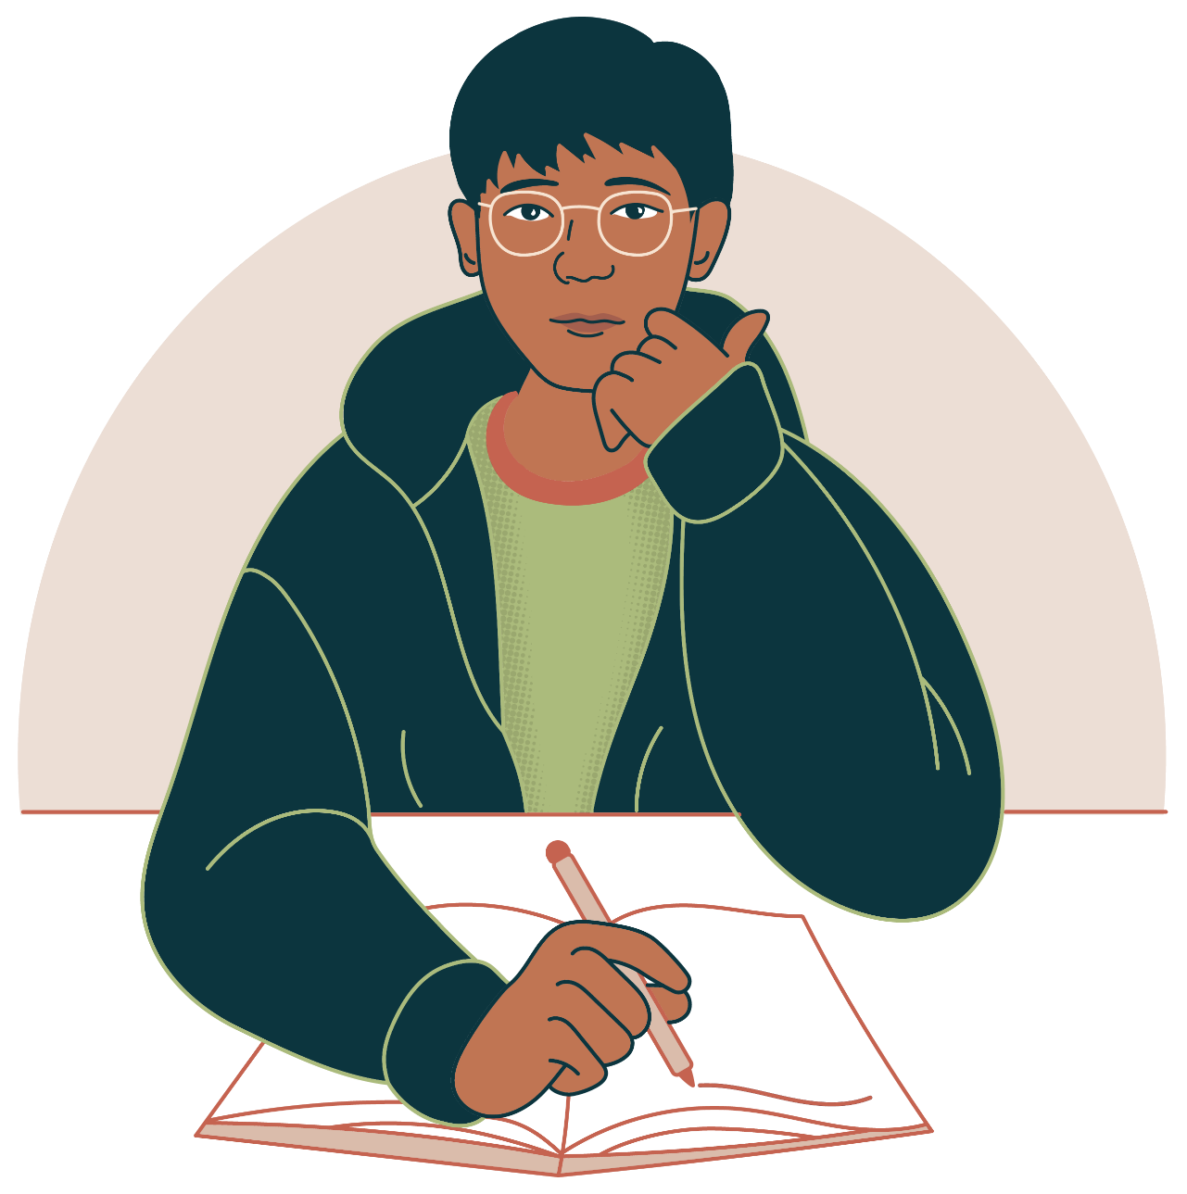
Scenario 3: Student of color
Alok (age 18) is meeting with his school’s guidance counselor. When asked about his interest in joining extra curriculars, he says:
“I haven’t signed up for any extra curriculars. I feel out of place at school most of the time. I’m one of the only people who looks like me, and it feels like everyone notices even when they don't say anything.”
Which of the following responses would be best to use?
“It's important for colleges to see that you’re well-rounded outside of academics. You should join an extracurricular activity today.”
“That sounds so heavy to carry every day. Want to explore what belonging might feel like for you?”
“I bet that feels hard, but you might be overreacting. This school is very inclusive.”
Notes:
Read the slide aloud to the group, or ask a participant to do so. Ask the group to agree on a response to the multiple-choice question before going to the next slide.

Slide 16
Scenario 3: Student of color
The best response is B.
  “That sounds so heavy to carry every day. Want to explore what belonging might feel like for you?”
Alok continues:
  “Sometimes people make little comments that aren’t outright mean, but they still stick with me. I want to join clubs or try out for things, but I worry I’ll just stand out even more.
  I want to make friends and feel included, but it’s tiring feeling so different all the time. It makes me feel like I don't fully belong anywhere.”
Reflection questions:
What open question could help you explore this youth’s strengths?
What phrase could help them feel seen without making assumptions about Alok's identity or experience?
Notes:
"The best response is B. Option A dismissed Alok's feelings and experiences. Option C minimizes what Alok shared and implies that there may be something wrong with Alok's point of view. Option B validates how Alok is feeling and prompts him to explore what kind of support he might need. This makes Alok feel like he can trust the guidance counselor, and they continue talking."
Read the rest of the slide aloud, or invite a participant to do so.
You are welcome to replace the reflection questions with other options that feel more relevant. Here are a few to choose from:
What emotion or feeling is the youth naming most clearly?
How can you show you hear the weight of being one of the few?
How can you acknowledge bias or microaggressions without brushing past them?
What small step toward connection could you explore with them?
Here are some example answers to the reflection questions you could share with your group:
What emotion or feeling is the youth naming most clearly?
Feeling like an outcast.
Feeling like they don’t belong anywhere and are unwanted.
How can you show you hear the weight of being one of the few?
“That sounds really heavy to carry every day.”
“You’re right, it is hard to ignore comments, even when they are little or people don’t know they’re mean”
“It sounds like you feel like you don’t really fit in anywhere”
What open question could help you explore this youth’s strengths?
“You’ve found ways to get through this before—what helped then?”
“I can tell it’s important to you to be true to yourself”
How can you acknowledge bias or microaggressions without brushing past them?
“You shouldn’t have to explain or justify how that feels.”
“It’s not okay for people to talk to you like that”
“It’s important that everyone feels included, no matter where they’re from or how they look”
What small step toward connection could you explore with them?
“What do you wish your life looked like? What is one step you could take to work towards that?”
“Are there other places outside of school that you’d be interested in learning more about? Like volunteering with an organization or joining a club.”
What phrase could help them feel seen without making assumptions about their identity or experience?
“I can tell being part of the community is really important to you”
“It sounds like you want to be part of the group and feel like you belong here, too”
“We all want to feel like we belong, it’s an important part of our well being”
“Thank you for sharing this with me. I am always here for support”

Slide 17
Try connecting over offering solutions
Key Takeaways
Helpful Phrases
Listen before offering solutions​
Focus on strengths, not deficits​
Offer support and involve youth in action steps
“Thank you for being honest.”
“You’re not alone in feeling that way.”​
“I hear you. It can be hard to remember posts are highlights, not the full story.”​
“Let's think about things that make you feel confident.”
Notes:
“The biggest takeaway is that young people often don’t need instant solutions—rather, they need connection. When we respond with empathy, we help them feel seen and understood. When we highlight their strengths, we remind them that they already have tools within them to heal and grow.
To summarize: listen before offering solutions, focus on strengths instead of deficits, and offer support and involve youth in action steps. If you’re not sure what to say, you can use some of these example phrases.”

Slide 18
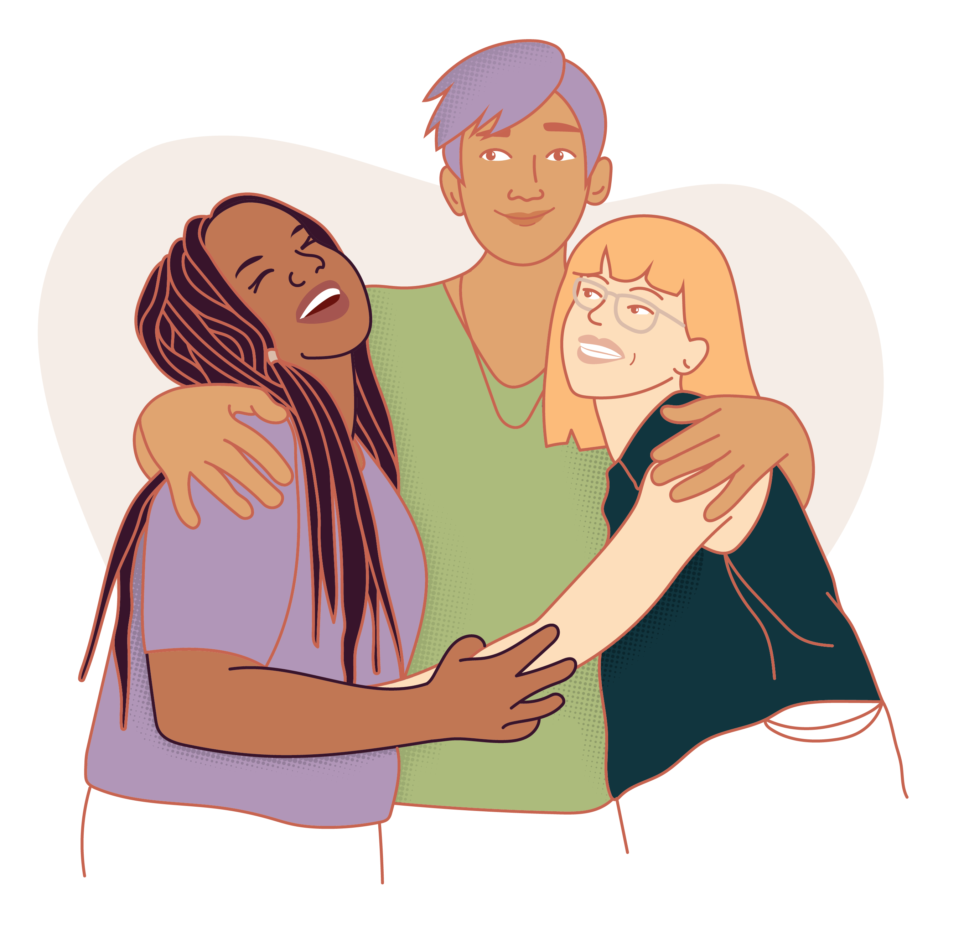
Final reflections
What word describes how you want youth to feel when they come to you?​
Notes:
“[intro reflection prompt]
Before we wrap up, I want to invite a quick reflection. Think back to what resonated with you today. Maybe it was the reminder to pause before giving advice, or maybe it was recognizing how powerful simple validation can be. Now, take a moment to think of one word that captures how you want young people to feel when they talk to you—maybe heard, safe, valued, or understood. Hold onto that word. Let it guide how you show up in those future conversations.”​
You are welcome to use a different reflection question if you like. Here are some additional options:
What is one thing you learned today that will change how you talk with youth?
What is one phrase you want to use more when a young person shares something hard?
How will you pause before giving advice in future conversations?
What is one change you want to make in how you respond to social media stress?

Slide 19
When you feel worried about someone, consider a referral.
If you are a provider and concerned that more intervention may be necessary, you should take the appropriate steps.
If you are not a provider and you are concerned for a young person's wellbeing, there are resources available:
  Mental health: Know when to get help - Mayo Clinic
  988 | Suicide & Crisis Lifeline
  Home - Washington Teen Link
Teens and young adults can find mental and behavioral health resources on Teen Health Hub WA.

Slide 20
More resources and information for adults
Adolescent connectedness: cornerstone for health and wellbeing - PMC
Building Social Connection With Youth | Communities4Youth
Center of Excellence on Social Media and Youth Mental Health
Media Use Guidelines: Teens | Nemours KidsHealth
Teens and social media use: What's the impact? - Mayo Clinic
Loneliness in adolescence: prevalence, developmental contexts, and interventions - PMC
Teen Mental Health: How to Know When Your Child Needs Help - HealthyChildren.org
Mental health: Know when to get help - Mayo Clinic

Slide 21
More resources and information for youth
How Can I Feel Less Lonely? (for Teens) | Nemours KidsHealth
How Can Social Connection Reduce Loneliness? (for Teens) | Nemours KidsHealth
Loneliness Resources - Text CONNECT to 741741
Loneliness - National Alliance on Mental Illness
How Can Social Connection Reduce Loneliness? (for Teens) -Seattle Children’s Hospital
How Can I Feel Less Lonely? (for Teens) - Seattle Children's Hospital

Slide 22


This skill session was co-created by the Washington State Department of Health’s Youth Advisory Council (YAC) and inspired by the Adolescent Health Initiative’s Spark Training series.

Slide 23
To request this document in another format, call 1-800-525-0127. Deaf or hard of
hearing customers, please call 711 (Washington Relay) or email doh.information@doh.wa.gov.

