Slide 1

Add a logo here. Use the Crop tool to adjust the size, as needed.
Remember to delete this text box!
Add a photo or image of an event flyer here. Use the Crop tool to adjust the size, as needed.
Remember to delete this text box!
Notes:
Customize this slide to introduce your trainer(s) and/or your organization. See examples on slides 2 and 3 for formatting ideas. You can also choose to hide slides 1-3 and start with slide 4 which introduces the workshop.
Need some help? Find some tips and tutorials for how to edit Microsoft PowerPoint slides here: https://support.microsoft.com/en-us/office/slides-and-text-6c206169-2b17-48c5-8bd9-df38fa6049d1
Note: No other slides in this deck are modifiable.

Slide 2
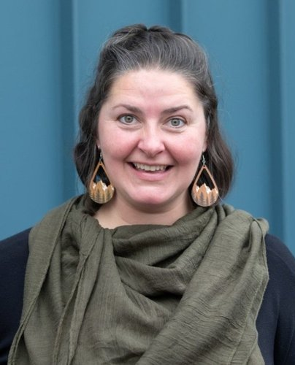

EXAMPLE
Erika Behrends
Erika brings more than 15 years of experience in curriculum design, facilitation, content development, event management, and training delivery across countries and languages.
Erika is fluent in English and Spanish.
Notes:
BDAC Trainer introduction slide

Slide 3

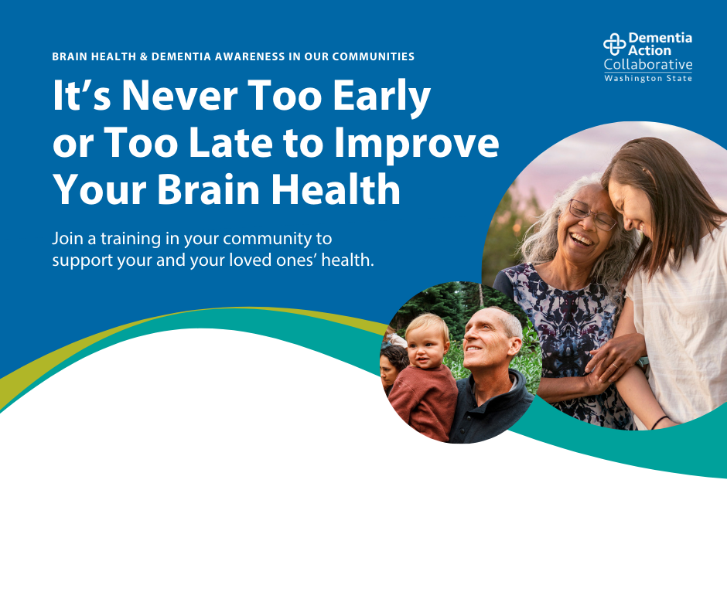
EXAMPLE
Improve Your and Your Loved Ones’ Brain Health
Dementia
Awareness Training
Thursday, January 1, 2026 | 5:30 PM
Community Center | Training Room
1235 Community Center Way, City, State, 98765
Join us at the community center to learn more about how you can improve your and your loved ones’ brain health.
Notes:
Event promotion example slide

Slide 4
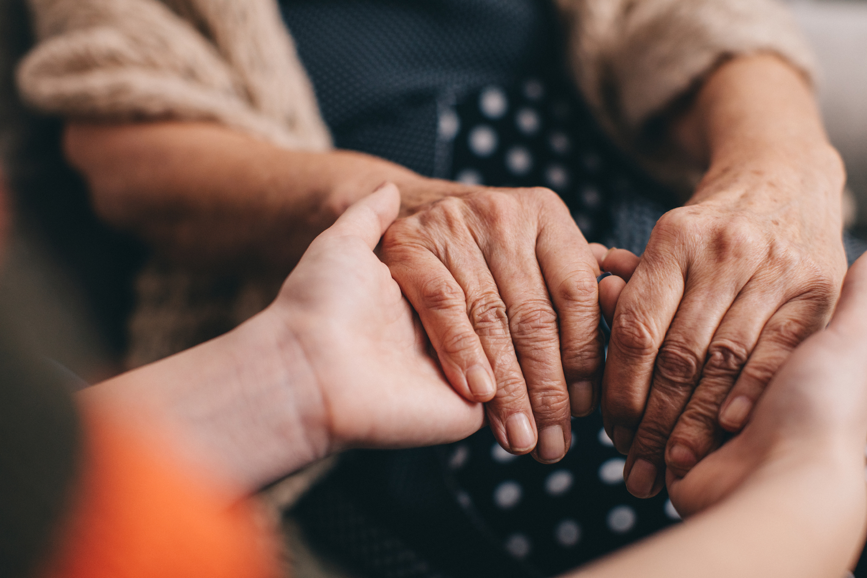
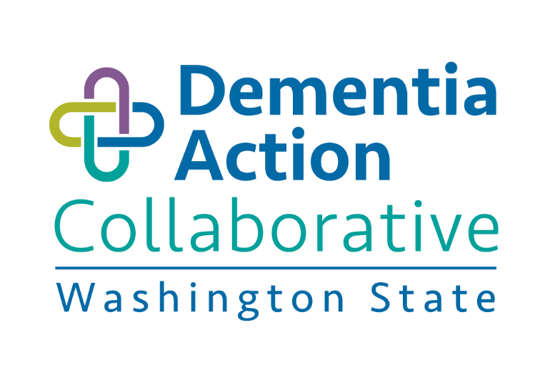
Brain Health
& Dementia Awareness in
Our Communities
Benefits of Early Dementia Detection, Potentially Modifiable Risk Factors, and Available Resources for People Living with Dementia
This publication was made possible by BOLD Public Health Grant Award #5NU58DPO07508-03 from Centers for Disease Control. Its contents are solely the responsibility of the authors and do not necessarily represent the official views of Centers for Disease Control.
VERSION 2.0 | FEBRUARY 2026
Notes:
Welcome/Framing (2 Min)
Welcome participants to workshop and thank them for coming.
Explain why we are here. You might say: “We are here to increase awareness around brain health and dementia in our communities.”
Clarify this training is not counseling or a medical consultation. You might say: “During this workshop, you are going to hear about brain health and dementia. It might bring up questions about your own health and experiences. Any medical, mental health, legal, or financial questions are best answered by your own provider. What I can do is direct you to support and resources about brain health and dementia.”
Orient participants to their materials. You might say: “A lot of the information we will go over today is on the handout you received when you arrived. Throughout the workshop, we will give you other handouts that are yours to keep, and we encourage you to write on them to reinforce your learning.”

Slide 5

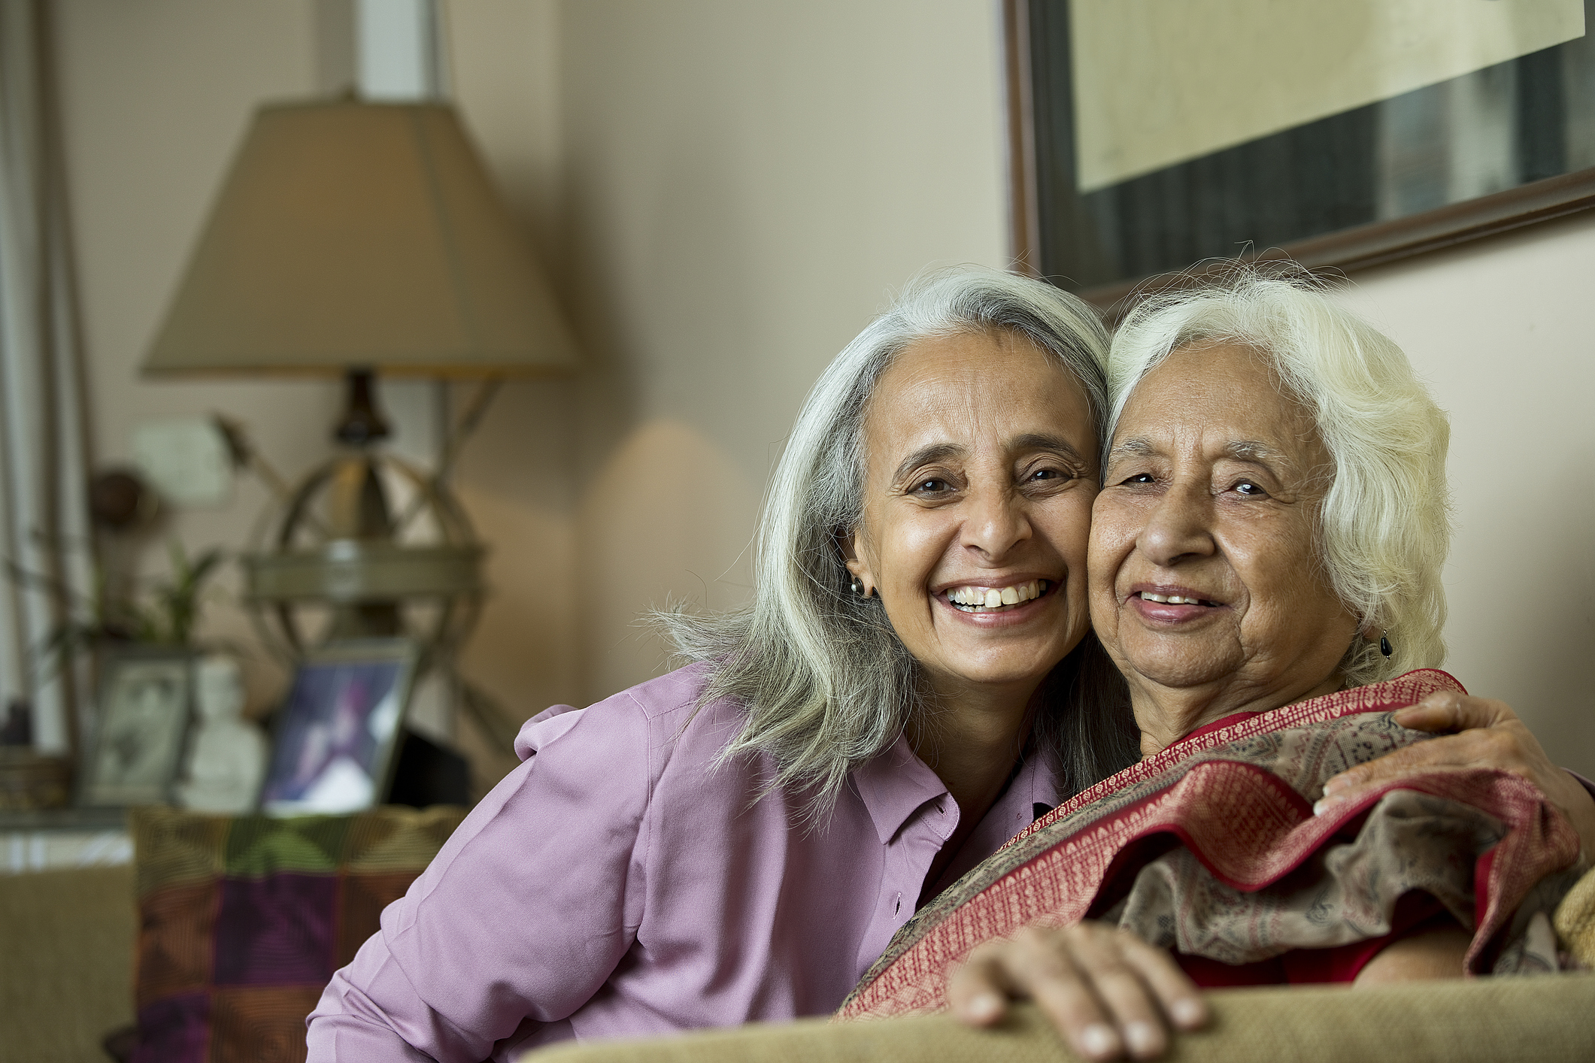
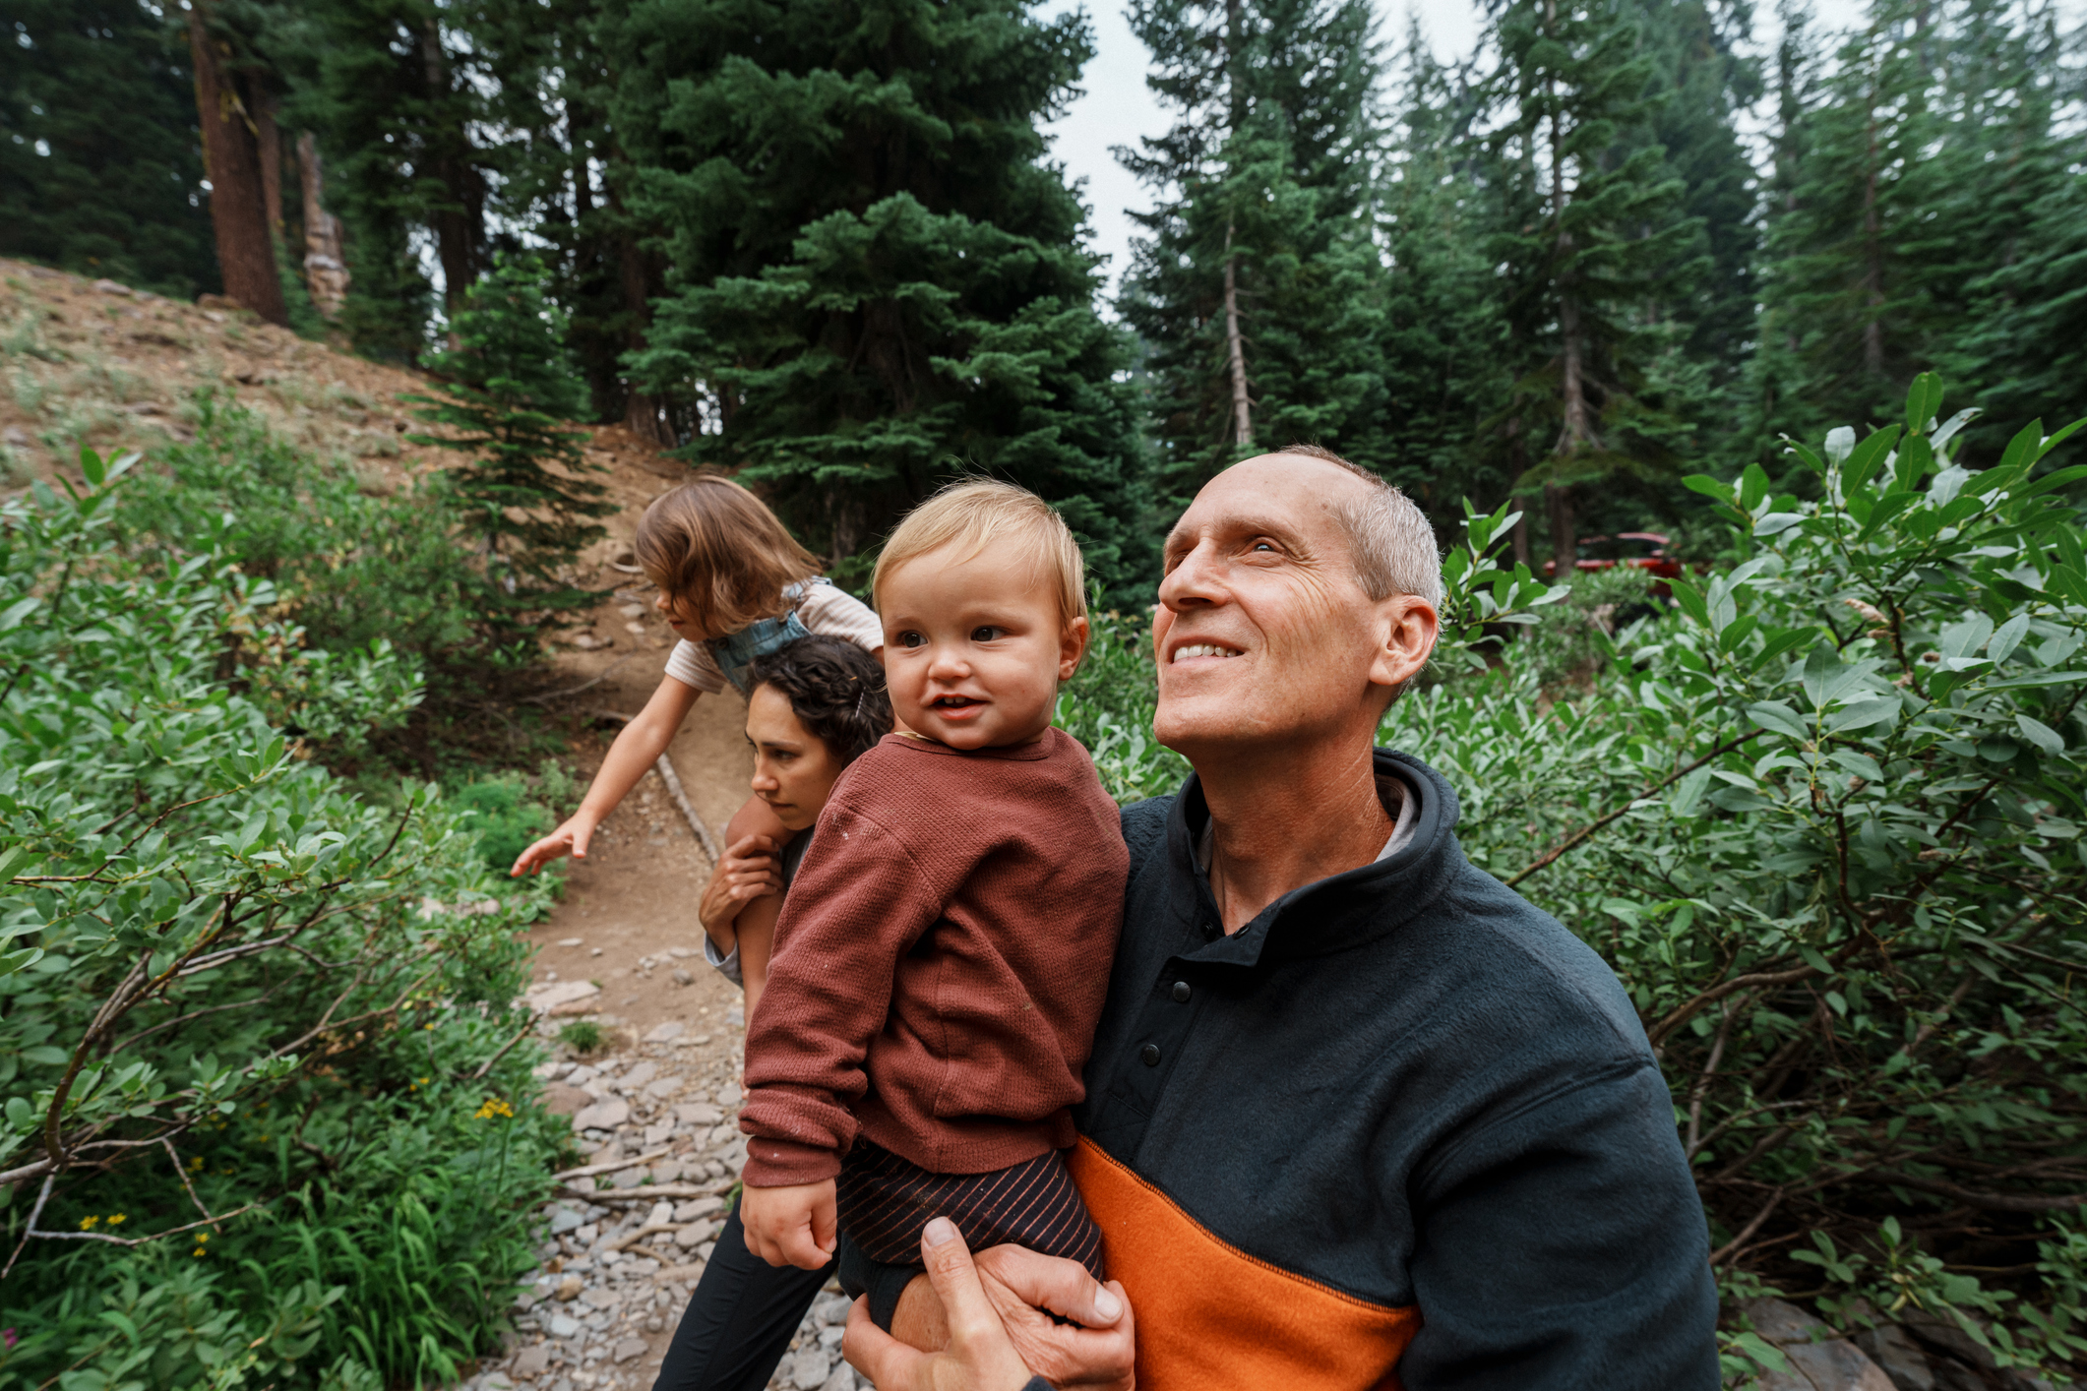
Welcome & Introductions
Introduce Yourself
Say your name, and why you’re attending this workshop
Please Do Not Change Presentation Language
Brain Health & Dementia Awareness in Our Communities | 5
Notes:
Introductions: Trusted Messenger & Participants (5 MIN)
Introduce yourself and explain why increasing brain health and dementia awareness is important to you.
Explain why you are here. Share your role as a BDAC trainer and why you’re leading this session.
Ask participants to share their names and why they are attending.
Note: For groups larger than 12, ask participants to introduce themselves to the person next to them.

Slide 6
Learn about and reflect on
brain health and dementia in
our communities
Understand potentially modifiable risk factors and the benefits of early detection for dementia
Explore resources for further learning, action, and support around brain health and dementia
1
Learning Objectives
2
3
Please Do Not Change Presentation Language
Brain Health & Dementia Awareness in Our Communities | 6
Notes:
Learning Objectives (1 Min)
Read aloud the learning objectives:
Learn about and reflect on brain health and dementia in our communities
Understand potentially modifiable risk factors and the benefits of early detection for dementia
Explore resources for further learning, action, and support around brain health and dementia

Slide 7
Living with dementia has its challenges, and supportive community can help
Early dementia diagnosis can
increase quality of life
It’s never too early or too late
to improve brain health
Small lifestyle changes can
make a big difference
We are committed to connecting with you and connecting you with resources
Core
Messages
Please Do Not Change Presentation Language
Brain Health & Dementia Awareness in Our Communities | 7
Notes:
Core Messages (1 Min)
Preview the core messages:
Living with dementia has challenges, supportive community can help
Early dementia diagnosis can increase quality of life
It’s never too early or too late to improve brain health
Small lifestyle changes can make a big difference
We are committed to connecting with you and connecting you with resources

Slide 8
Expectations
1
2
3
Take Care of Yourself
Stay Present for
the Full Workshop
Take Care of Each Other
Assume Positive Intent and Acknowledge Impact
Take Care of this Space
Leave This Place Better
Than You Found It
Please Do Not Change Presentation Language
Brain Health & Dementia Awareness in Our Communities | 8
Notes:
Expectations (1 Min)
Discuss expectations for participants, and request agreement.
Take Care of Yourself: Stay Present for the Full Workshop
Take Care of Each Other: Assume Positive Intent, Acknowledge Impact
Take Care of this Space: Leave This Place Better than You Found It

Slide 9
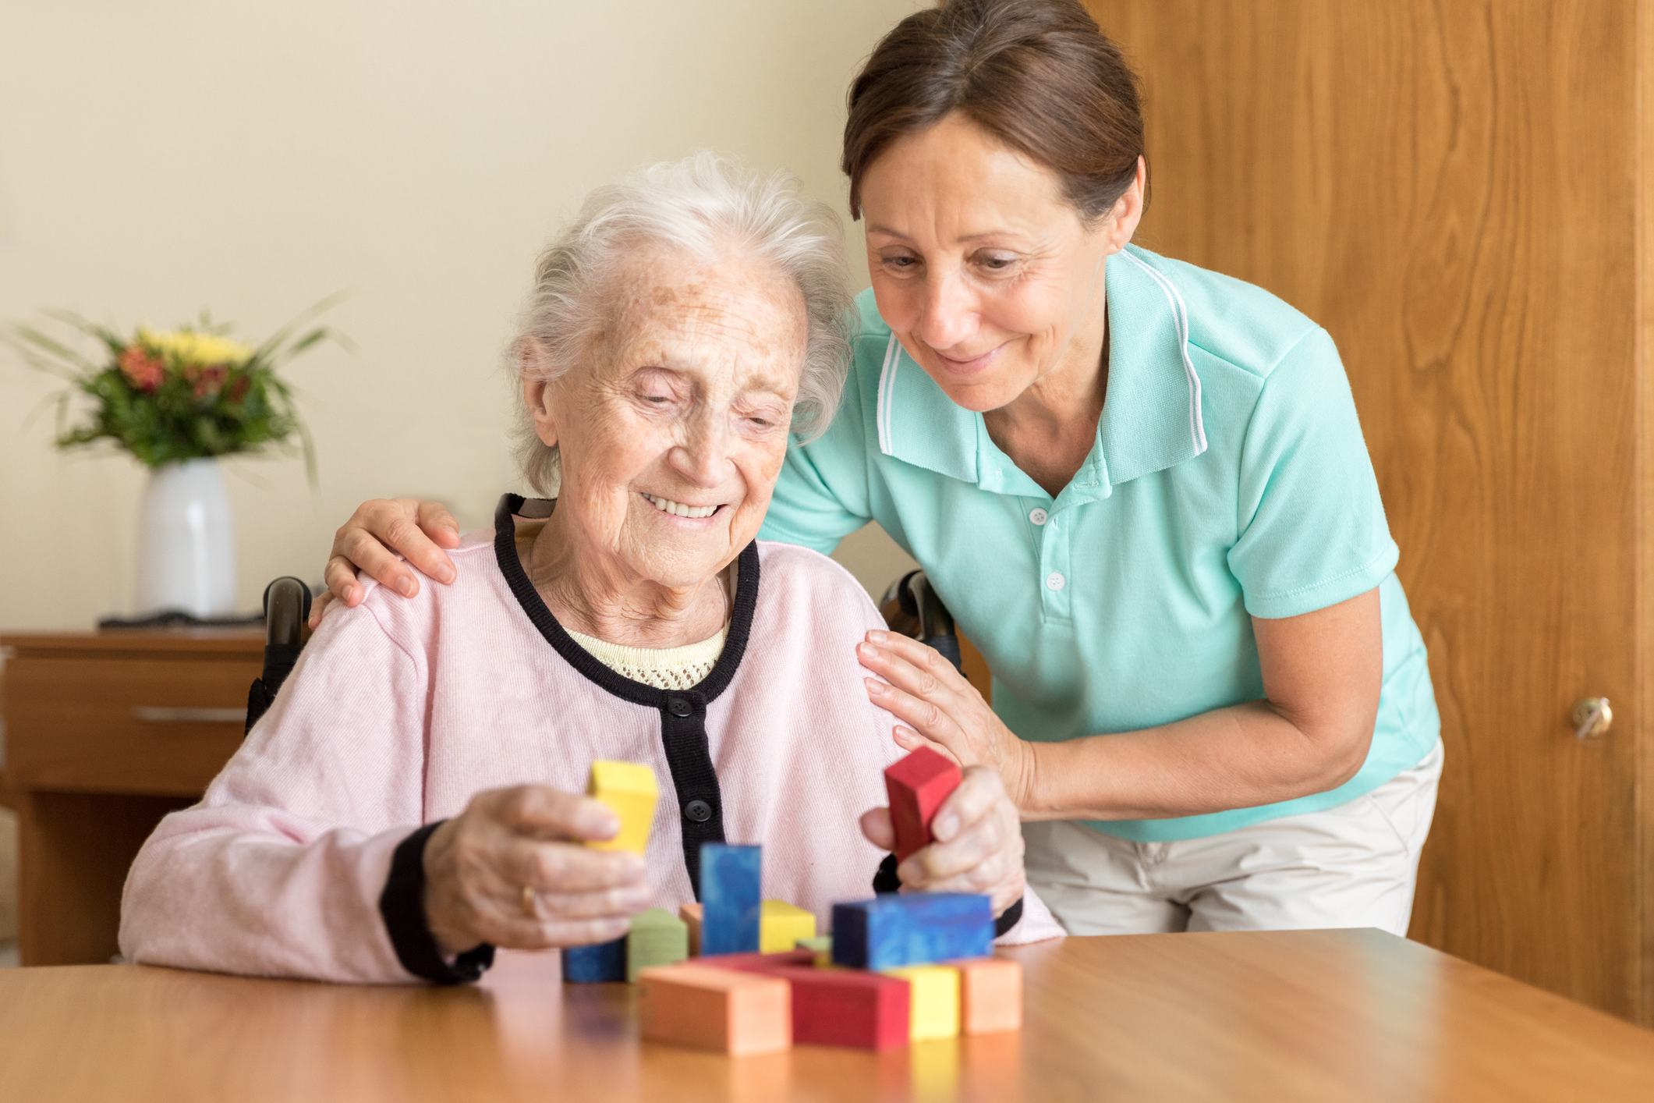

Dementia in
Our Communities
Living with dementia has its challenges, and supportive community can help.
Please Do Not Change Presentation Language
Brain Health & Dementia Awareness in Our Communities | 9
Notes:
Core message #1 (1 Min)
Transition by sharing the first core message:
“Let’s start by defining dementia. As we do, it is important to remember our first core message: Living with dementia has its challenges, and supportive community can help.”

Slide 10
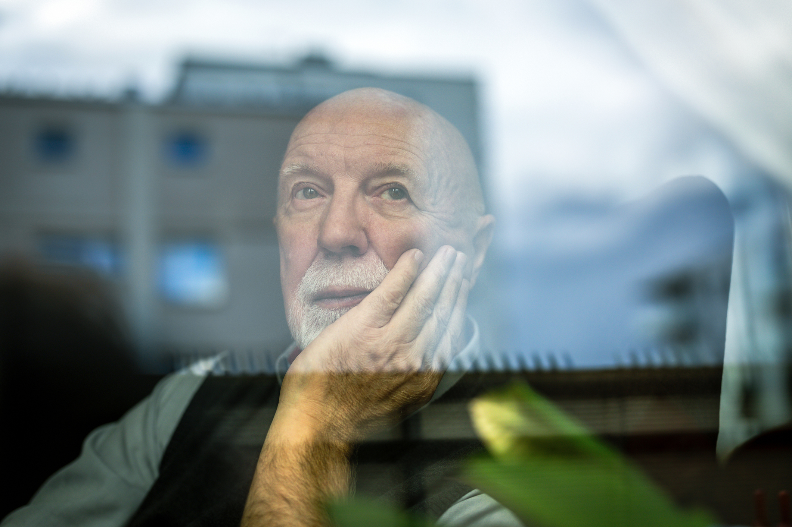
Dementia in Our Communities
What is Dementia?
Dementia is not a disease itself –
it is a set of symptoms caused by a variety of conditions that damage the brain. These changes result in decline in memory and thinking abilities that interfere with daily life.
Please Do Not Change Presentation Language
Brain Health & Dementia Awareness in Our Communities | 10
Notes:
what is dementia (1 Min)
Define Dementia. You might say: “Dementia is not a typical part of aging, but the risk of dementia does increase with age.”
Dementia is not a disease itself – it is a set of symptoms caused by a variety of conditions that damage the brain. These changes result in decline of memory and thinking abilities that interfere with daily life.

Slide 11
Dementia in Our Communities
Risk of Dementia Increases With Age
Please Do Not Change Presentation Language
Brain Health & Dementia Awareness in Our Communities | 11
Notes:
Dementia Risk & Age (1 Min)
Explain that dementia risk increases with age. You might say: “While dementia is not a typical part of aging, it is not uncommon. Dementia happens to people who did nothing wrong, and risk increases with age.”

Slide 12
Dementia in Our Communities
Alzheimer’s is a Type of Dementia
ALZHEIMER’S
DEMENTIA
Alzheimer’s is a specific
brain disease and is the most common type of dementia.
In fact, Alzheimer's accounts for 60-80% of dementia cases.
Dementia is a general term for symptoms like decline in memory, reasoning, or other thinking skills.
VS
Please Do Not Change Presentation Language
Brain Health & Dementia Awareness in Our Communities | 12
Notes:
alzheimer’s v. dementia (1 Min)
Differentiate Alzheimer’s from Dementia. You might say: “Alzheimer’s is different from dementia. Alzheimer’s is a specific brain disease and is the most common cause of dementia. In fact. Alzheimer’s accounts for 60-80% of dementia cases.”

Slide 13
Dementia in Our Communities
How Dementia is Experienced in the US
10%
2x
1.5x
Around 10% – or 1 in every 10 adults over 65 – in the United States have Alzheimer’s disease (a type of dementia).
Blacks/African Americans are 2 times more likely to have Alzheimer’s disease than the non-Hispanic white population.
Hispanic/Latino adults are 1.5 times more likely to develop Alzheimer’s disease than the non-Hispanic white population.
Please Do Not Change Presentation Language
Brain Health & Dementia Awareness in Our Communities | 13
Notes:
How Dementia Is Experienced in This Community (1 Min)
Share health disparities. You might say: “Let’s explore how dementia shows up in our communities.”
National Statistics
Starting at 65, the risk of dementia increases significantly with age.
Around 10% – or 1 in every 10 adults over 65 – in the US have Alzheimer’s disease, a form of dementia.
Black/African Americans are 2 times more likely to have Alzheimer’s disease than non-Hispanic whites.
Hispanic/Latino adults are 1.5 times more likely to develop Alzheimer’s disease.

Slide 14
Dementia in Our Communities
How Dementia is Experienced in Washington
125k
20
Around 125,000 people in Washington are currently living with dementia
In Washington, Blacks/African American, Hispanic/Latino, and American Indian/Alaska Native communities experience dementia at higher rates than the White/Caucasian population
The number of people experiencing dementia in Washington is expected to double in the next 20 years
Please Do Not Change Presentation Language
Brain Health & Dementia Awareness in Our Communities | 14
Notes:
How Dementia Is Experienced in This Community (1 Min)
Share health disparities. You might say: “Let’s explore how dementia shows up in our communities here in Washington.”
Washington Statistics
In WA, around 125,000 people are living with dementia. That number is expected to double in the next twenty years.
Black/African American, Hispanic/Latino, & American Indian/Alaska Native communities experience dementia at higher rates.

Slide 15

Dementia in Our Communities
Activity: Think-Pair-Share
INSTRUCTIONS:
QUESTION:
1
Think for one minute
Share with the person next to you for two minutes
Share out with the group
How has dementia touched my life and/or the lives of those I know?
2
3
Please Do Not Change Presentation Language
Brain Health & Dementia Awareness in Our Communities | 15
Notes:
Activity: Group Discussion (Think-Pair-Share) (8 MIN)
Explain the activity. You might say: “You will think for one minute, share with a partner for two minutes, then share out with the group. Here is the question we will be thinking and talking about: How has dementia touched my life and/or the lives of those I know?”
Debrief the activity. Say: Please raise your hand if:
…you have ever known someone who is living with dementia.
…someone in your family or community is living with dementia now.
…based on your family history, you are concerned you might develop dementia.

Slide 16
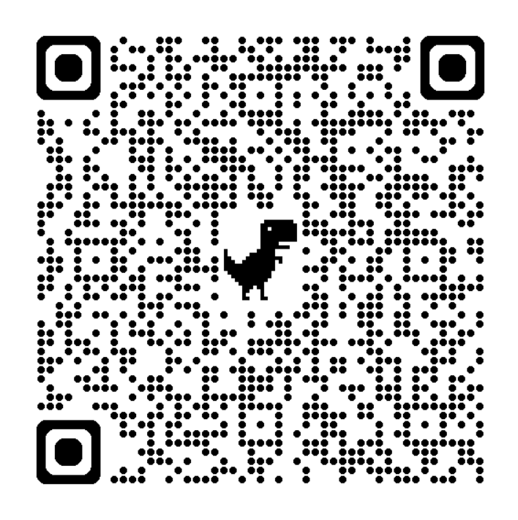
Resources
Learn more through the link below or using the QR code by pointing your phone camera at the QR code, then touching the prompt on the screen to open the website.
doh.wa.gov/brain-health-resources
Email Brain-Health@DOH.WA.Gov for further assistance.
Please Do Not Change Presentation Language
Brain Health & Dementia Awareness in Our Communities | 16
Notes:
Resources & Support: WHAT is Dementia (2 MIN)
Highlight Dementia Resources & Support. You might say: “This QR code and URL lead to a page of digital resources that is organized to make it easy for you to find what you need to learn more about brain health and dementia. There are three resources we recommend:”
CDC | About Dementia
WA State Department of Health | Dementia
WA State Department of Social & Health Services |
‘Let’s Talk Dementia’ Mini Videos

Slide 17
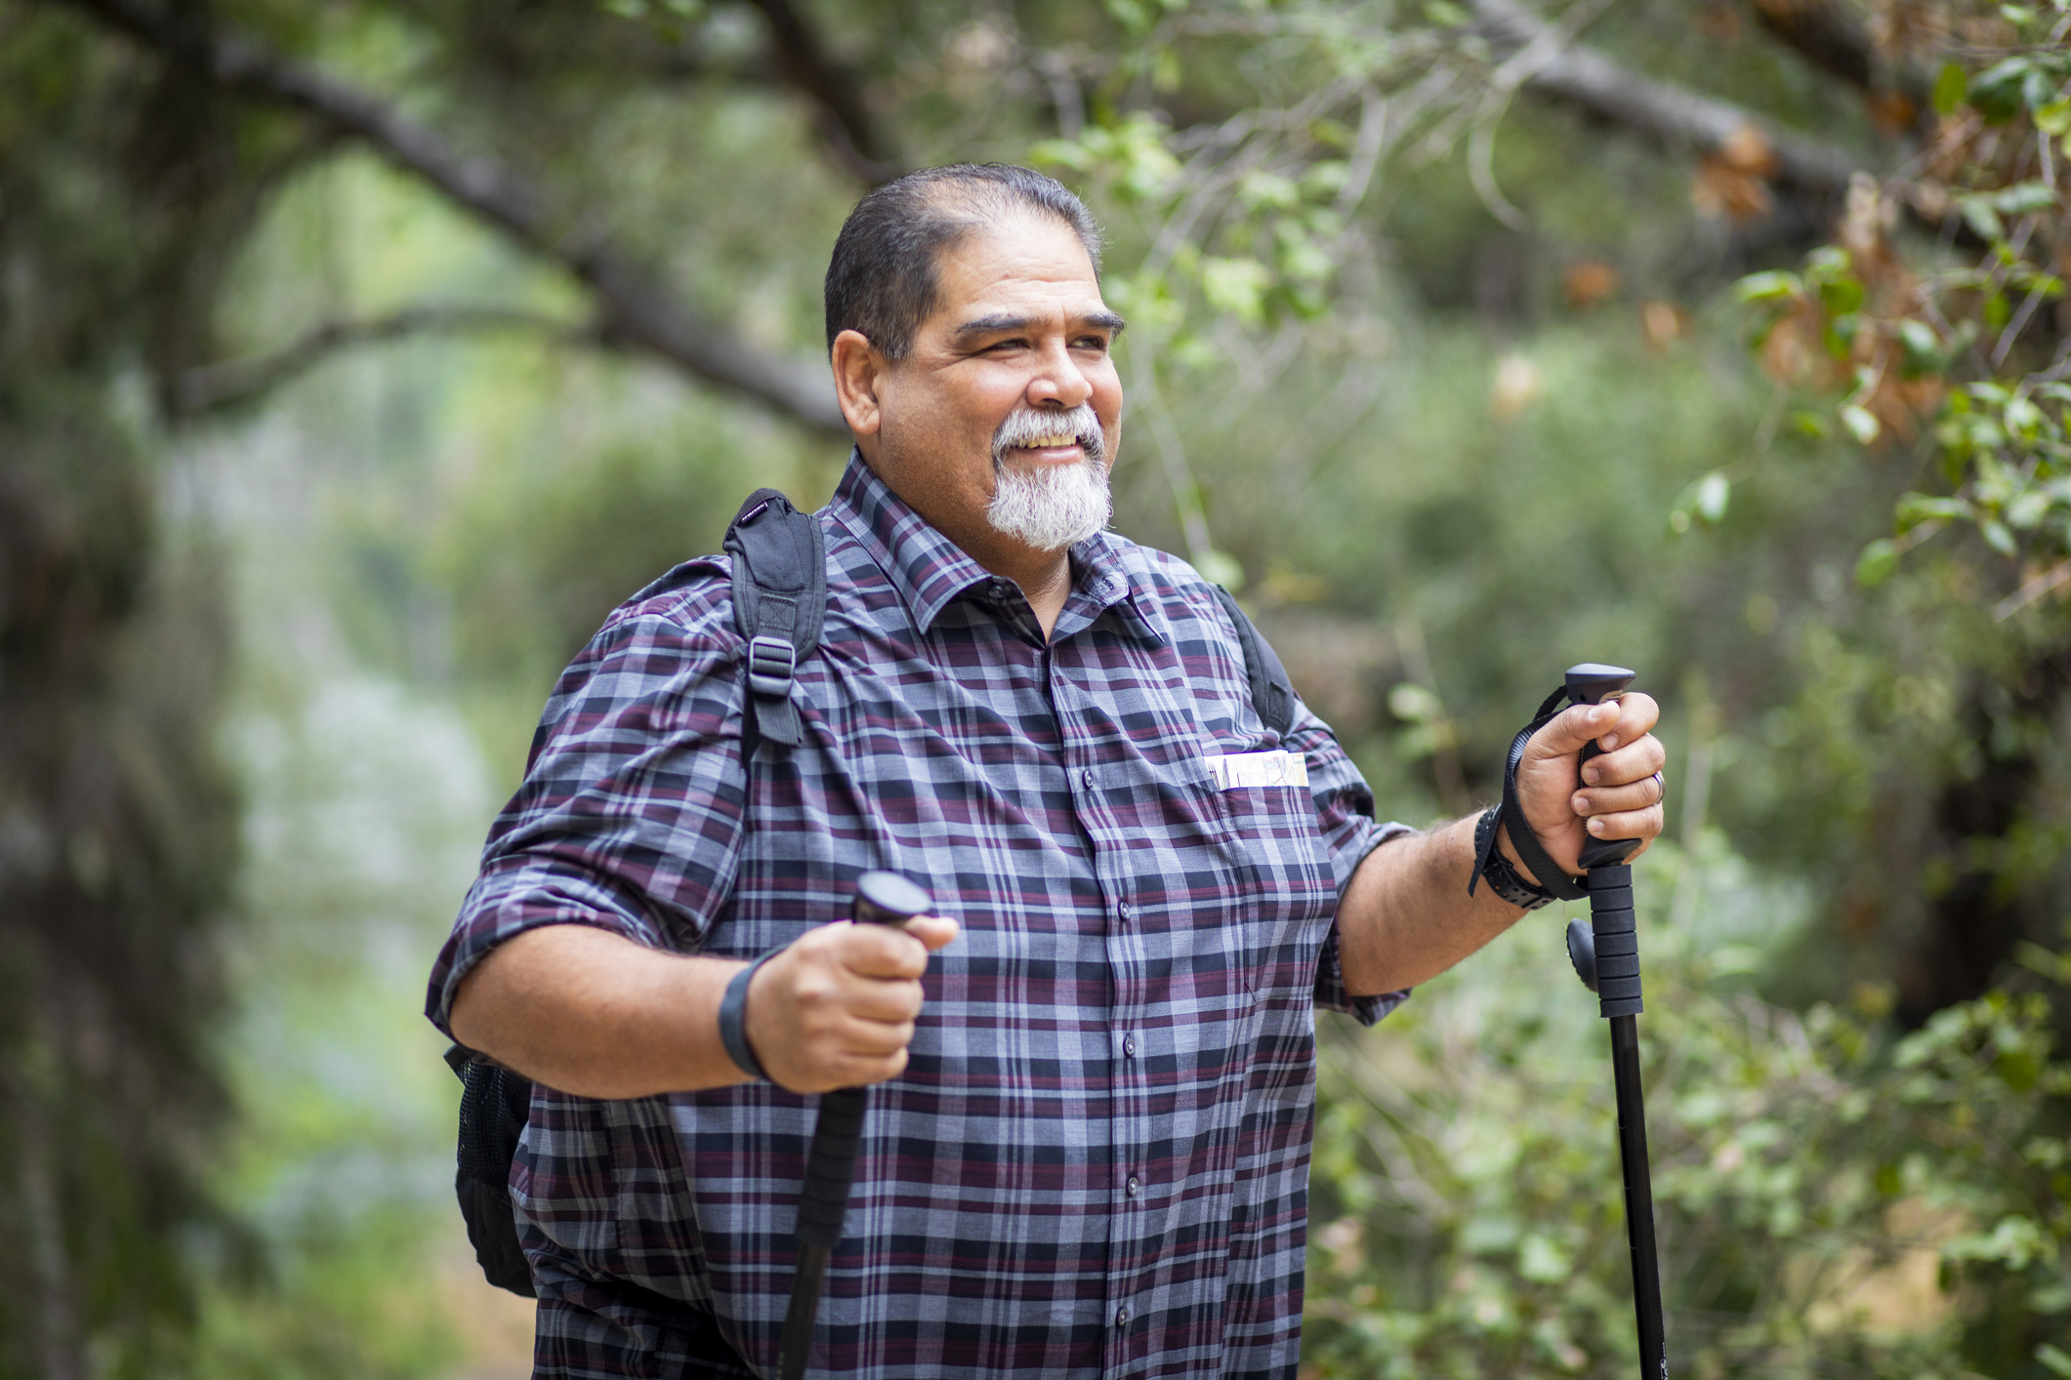

Benefits of
Early Detection
Early dementia diagnosis can improve quality of life.
Please Do Not Change Presentation Language
Brain Health & Dementia Awareness in Our Communities | 17
Notes:
Core message #2 (1 MIN)
Transition by sharing the second core message: “The good news is: Early dementia diagnosis can improve quality of life. For example, it can allow people who may be living with dementia to participate in their own legal and healthcare planning. It also gives individuals and their families time to find resources and build a strong support network.”

Slide 18

Benefits of Early Detection
How Can I Recognize Dementia?
Ten Signs of Dementia
Please Do Not Change Presentation Language
Brain Health & Dementia Awareness in Our Communities 18
Notes:
How Do I Know If I Or Someone Close to Me May Be Experiencing Dementia? (1 MIN)
Frame the conversation. You might say: “If you are wondering if you or someone in your life is experiencing dementia, we encourage you to look for signs of change in behavior or ability to do things. For example, if your mom was amazing at math and all of the sudden can’t do math anymore, that might be a sign of dementia. However, if you were never good at math and still can’t do math, that would not be a sign of dementia. Now, let’s look at ten possible signs of dementia. Remember, they are not in any particular order, and any one of the signs could mean you or someone close to you may be experiencing dementia. It is also important to keep in mind that these signs do not always mean you have dementia. Changes in memory or thinking may be due to another condition that could be addressed. Getting a dementia diagnosis takes time and multiple visits to a medical provider.”
Review the Ten Signs of Dementia

Slide 19
Benefits of Early Detection
Ten Signs of Dementia
1
Possible Sign of Dementia:
Asking for the same information over and over.
Not able to recall recently learned information.
Memory Loss that Disrupts Daily Life
­Typical Aging:
Temporarily forgetting names or appointments.
Please Do Not Change Presentation Language
Brain Health & Dementia Awareness in Our Communities | 19
Notes:
Memory Loss that Disrupts Daily Life (1 MIN)
Possible Sign of Dementia: Asking for the same information over and over. Not able to recall recently learned information.
Typical Aging: Temporarily forgetting names or appointments.

Slide 20
Benefits of Early Detection
Ten Signs of Dementia
2
Possible Sign of Dementia:
It’s harder to work with numbers, follow a recipe or keep track of bills.
Difficulty concentrating.
Challenges in Planning or Solving Problems
­Typical Aging:
Making mistakes managing bills once in a while.
Please Do Not Change Presentation Language
Brain Health & Dementia Awareness in Our Communities | 20
Notes:
Challenges in Planning or Solving Problems (1 MIN)
Possible Sign of Dementia: It’s harder to work with numbers, follow a recipe or keep track of bills. Difficulty concentrating.
Typical Aging: Making mistakes managing bills once in a while.

Slide 21
Benefits of Early Detection
Ten Signs of Dementia
3
­Possible Sign of Dementia:
Trouble driving to a familiar location, making a grocery list or remembering rules to a game you have played many times before.
Difficulty Completing Familiar Tasks
Typical Aging:
Needing help recording a TV show once in a while.
Please Do Not Change Presentation Language
Brain Health & Dementia Awareness in Our Communities | 21
Notes:
Difficulty Completing Familiar Tasks (1 MIN)
Possible Sign of Dementia: Trouble driving to a familiar location, making a grocery list or remembering rules to a game you have played many times before.
Typical Aging: Needing help recording a TV show once in a while.

Slide 22
Benefits of Early Detection
Ten Signs of Dementia
4
­Possible Sign of Dementia:
Losing track of dates and seasons.
Forgetting where you are or
how you got there.
Confusion
with Time
or Place
Typical Aging:
Forgetting the day of the week but figuring it out later.
Please Do Not Change Presentation Language
Brain Health & Dementia Awareness in Our Communities | 22
Notes:
Confusion with Time or Place (1 MIN)
Possible Sign of Dementia: Losing track of dates and seasons. Forgetting where you are or how you got there.
Typical Aging: Forgetting the day of the week but figuring it out later.

Slide 23
Benefits of Early Detection
Ten Signs of Dementia
5
­Possible Sign of Dementia:
Trouble judging distance or determining color.
Vision issues may cause balance or reading problems.
Trouble Understanding
Visual Images and Spatial Relationships
Typical Aging:
Vision changes related to cataracts or to typical aging.
Please Do Not Change Presentation Language
Brain Health & Dementia Awareness in Our Communities | 23
Notes:
Trouble Understanding Visual Images and Spatial Relationships (1 MIN)
Possible Sign of Dementia: Trouble judging distance or determining color. Vision issues may cause balance or reading problems.
Typical Aging: Vision changes related to cataracts or to typical aging.

Slide 24
Benefits of Early Detection
Ten Signs of Dementia
6
­Possible Sign of Dementia:
Trouble following or joining a conversation or naming familiar objects.
Stopping mid-conversation and being unable to continue or repeating yourself.
New Problems with Words in Speaking or Writing
Typical Aging:
Sometimes having trouble finding the right word.
Please Do Not Change Presentation Language
Brain Health & Dementia Awareness in Our Communities | 24
Notes:
New Problems with Words in Speaking or Writing (1 MIN)
Possible Sign of Dementia: Trouble following or joining a conversation or naming familiar objects. Stopping mid-conversation and being unable to continue or repeating yourself.
Typical Aging: Sometimes having trouble finding the right word.

Slide 25
Benefits of Early Detection
Ten Signs of Dementia
7
­Possible Sign of Dementia:
Putting objects in unusual places.
Losing Things Without Being Able to Retrace Steps to Find Them
Typical Aging:
Misplacing things, but retracing steps to find them.
Please Do Not Change Presentation Language
Brain Health & Dementia Awareness in Our Communities | 25
Notes:
Losing Things Without Being Able to Retrace Steps to Find Them
(1 MIN)
Possible Sign of Dementia: Putting objects in unusual places.
Typical Aging: Misplacing things, but retracing steps to find them.

Slide 26
Benefits of Early Detection
Ten Signs of Dementia
8
­Possible Sign of Dementia:
Changes in decision-making.
Paying less attention to hygiene.
Decreased or Poor Judgment
Typical Aging:
Making a bad decision or mistake once in a while.
Please Do Not Change Presentation Language
Brain Health & Dementia Awareness in Our Communities | 26
Notes:
Decreased or Poor Judgment (1 MIN)
Possible Sign of Dementia: Changes in decision-making. Paying less attention to personal hygiene.
Typical Aging: Making a bad decision or mistake once in a while.

Slide 27
Benefits of Early Detection
Ten Signs of Dementia
9
­Possible Sign of Dementia:
Changes in participating in previously enjoyed events.
Withdrawal from Work or Social Activities
Typical Aging:
Sometimes feeling uninterested in family or social obligations.
Please Do Not Change Presentation Language
Brain Health & Dementia Awareness in Our Communities | 27
Notes:
Withdrawal from Work or Social Activities (1 MIN)
Possible Sign of Dementia: Changes in participation in previously enjoyed events.
Typical Aging: Sometimes feeling uninterested in family or social obligations.

Slide 28
Benefits of Early Detection
Ten Signs of Dementia
­Possible Sign of Dementia:
Confusion, suspicion, depression, fear or anxiety.
Easily upset at home, with friends or outside comfort zone.
10
Changes in Mood or Personality
Typical Aging:
Developing ways of doing things, becoming irritable when a routine is disrupted.
Please Do Not Change Presentation Language
Brain Health & Dementia Awareness in Our Communities | 28
Notes:
Changes in Mood or Personality (1 MIN)
Possible Sign of Dementia: Confusion, suspicion, depression, fear or anxiety. Easily upset at home, with friends or outside comfort zone.
Typical Aging: Developing ways of doing things, becoming irritable when a routine is disrupted.

Slide 29

Benefits of Early Detection
Talking to My Medical Provider About Dementia Concerns
Talking about dementia can be hard and can feel scary. However, getting the advice of a trusted medical provider can help you and your loved ones respond with care and resources.
Please Do Not Change Presentation Language
Brain Health & Dementia Awareness in Our Communities 29
Notes:
Activity: TALKING to my medical provider about dementia concerns (1 MIN)
Explain the activity. You might say: “It can be hard to talk about our concerns about dementia. With our families. With our medical providers. We are going to learn how to have courageous conversations about dementia so we are prepared.”

Slide 30

Talking to My Medical Provider About Dementia Concerns
Before Your Visit
1
Write down your signs
List medications, including over the counter and vitamins
2
3
Plan to bring a friend
4
Choose your questions
Please Do Not Change Presentation Language
Brain Health & Dementia Awareness in Our Communities | 30
Notes:
Activity: TALKING to my medical provider about dementia concerns (1 MIN)
Discuss what to do before a dementia-related visit to a medical provider.
Before: Write down your signs. List your medications. Plan to bring a friend. Choose your questions.

Slide 31
Talking to My Medical Provider About Dementia Concerns
During Your Visit
1
Share health concerns
2
Be completely open
3
Ask for a diagnosis
4
Talk about next steps
Please Do Not Change Presentation Language
Brain Health & Dementia Awareness in Our Communities | 31
Notes:
Activity: TALKING to my medical provider about dementia concerns (1 MIN)
Discuss what to do during a dementia-related visit to a medical provider.
During: Share health concerns. Be completely open. Ask for a diagnosis. Talk about next steps.
Note: Remind participants that while it is important to ask for a dementia diagnosis, getting a clear diagnosis should take multiple visits to a healthcare provider.

Slide 32

Talking to My Medical Provider About Dementia Concerns
After Your Visit
1
Acknowledge your feelings
2
Review your notes
3
Write down new questions
4
Identify your resources
Please Do Not Change Presentation Language
Brain Health & Dementia Awareness in Our Communities | 32
Notes:
Activity: TALKING to my medical provider about dementia concerns (1 MIN)
Discuss what to do after a dementia-related visit to a medical provider.
After: Acknowledge your feelings. Review your notes. Write down new questions. Identify your resources.

Slide 33

Benefits of Early Detection
Activity: Courageous Conversations
PROMPT:
INSTRUCTIONS:
Talking to My Medical Provider About Dementia Concerns
1
Review handout and helpful questions to ask
2
Practice asking questions with a partner
Please Do Not Change Presentation Language
Brain Health & Dementia Awareness in Our Communities | 33
Notes:
Activity: TALKING to my medical provider about dementia concerns (3 min)
Hand out the activity sheet.
Request each participant choose one question they plan to ask their medical provider, and practice saying it aloud to a partner.
Explain that the person listening to the question should not try to answer it. They can either stay silent or acknowledge by saying something like: “Thank you for asking that question.”
Model the activity by asking one participant to ask you a question. Respond as outlined above.

Slide 34

Benefits of Early Detection
Debrief
You can get assistance early, right when you need it
You can help your community
help you better
You have time to make changes that can influence your quality of life
Fear of diagnosis is typical and reasonable; and there are benefits to knowing more about how to cope with dementia.
Please Do Not Change Presentation Language
Brain Health & Dementia Awareness in Our Communities | 34
Notes:
Debrief – OPTIONAL, IF TIME ALLOWS
Debrief the activity. You might say: “Fear of diagnosis is typical and reasonable; there are benefits to knowing more about how to cope with dementia. Here are a few things to remember:”
You can get assistance early, right when you need it.
You can help your family and community help you better.
You have time to make changes that can influence your quality of life.
It is important to write down your questions so you don’t forget them.
It is okay to ask your medical provider to read a list of questions if you prefer not to ask them out loud.
Remember, getting a dementia diagnosis is a process and should take more than one visit to a medical provider.

Slide 35
Resources
Learn more through the link below or using the QR code by pointing your phone camera at the QR code, then touching the prompt on the screen to open the website.
doh.wa.gov/brain-health-resources
Email Brain-Health@DOH.WA.Gov for further assistance.
Please Do Not Change Presentation Language
Brain Health & Dementia Awareness in Our Communities | 35
Notes:
Resources & Support: Early Detection (1 MIN)
Highlight Early Detection Resources & Support. You might say: “There are three resources we really recommend if you would like to know more about signs of dementia and the benefits of early detection. They are:”
WA State Department of Health | Community Dementia Education Resources
Aging Disability Services (ADS) | Self-Management Flags & Plans
Alzheimer’s Association | Why Get Checked?

Slide 36


Potentially Modifiable
Risk Factors
It's never too early or too late to improve brain health. Small lifestyle changes can make a big difference.
What small means will be different for each person.
Please Do Not Change Presentation Language
Brain Health & Dementia Awareness in Our Communities | 36
Notes:
Core message #3 (1 MIN)
Transition by sharing the third and fourth core messages: “It is never too early or too late to improve brain health. Small lifestyle changes can make a big difference. Remember, what “small” means is different for every person.”

Slide 37

Potentially Modifiable Risk Factors
Potentially Modifiable
Risk Factors
Means things in your life that you can choose to change.
Please Do Not Change Presentation Language
Brain Health & Dementia Awareness in Our Communities | 37
Notes:
Introduce Potentially Modifiable Risk Factors (1 MIN)
Define terms. You might say: “Potentially modifiable means things in your life you can choose to change, either as individuals or as a community. We will start by defining each of ten factors, then we will discuss some changes you can make for each one to improve your brain health.”
Discuss the value of small changes. You might say: “Small changes to the way we live our lives can improve our brain health. Some changes will be harder to make than others; any change in these areas can make a big difference. Some lifestyle changes are good for more than one reason. For example, what is good for your brain is also good for your heart, your gut, and your muscles.”

Slide 38
Potentially Modifiable Risk Factors
Potentially Modifiable Risk Factors
Making any change in these areas will make a big difference:
Depression
Diabetes
Excessive Alcohol Use
Hearing Loss
High Blood Pressure
Physical Inactivity
Poor Diet Quality
Poor Sleep Quality and Sleep Disorders
Tobacco Use
Traumatic Brain Injury (TBI)
Please Do Not Change Presentation Language
Brain Health & Dementia Awareness in Our Communities | 38
Notes:
Potentially Modifiable Risk Factors (1 MIN)
Review the entire list of Potentially Modifiable Risk Factors. You might say: “There are many risk factors for dementia, and today we will take a look at ten and consider how hard each one would be to change in our own lives.”

Slide 39
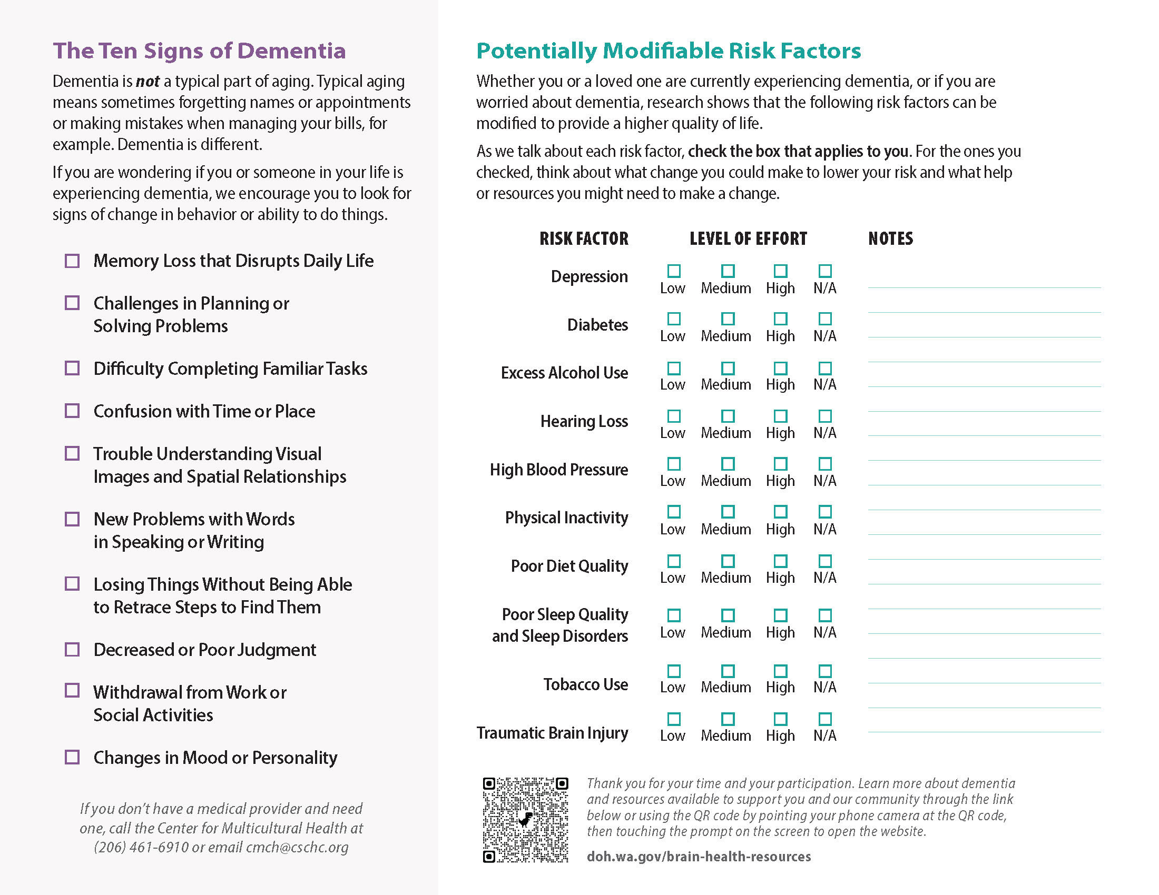
Potentially Modifiable Risk Factors
Activity
Choose to Make Change
INSTRUCTIONS:
Check the box that applies to you on your Participant Handout
Use your Participant Handout to rate each risk factor relative to how hard it might be to modify in your life.
Please Do Not Change Presentation Language
Brain Health & Dementia Awareness in Our Communities | 39
Notes:
Activity: Choose to Make Change (3 MIN)
Explain the activity. You might say: “After we define each potentially modifiable risk factor, we will ask you to use your participant handout to rate how hard each one of them would be for you to change, then talk about some strategies you might use.”
Frame the activity. You might say: “Some factors will be easier to change than others. Changing any of them can make your life and brain health better, so we encourage you to focus on the ones that are easiest for you. You do not need to share your answers with anyone else.”

Slide 40
Potentially Modifiable Risk Factors
Potentially Modifiable Risk Factor
Depression
Definition:
A low mood or loss of pleasure or interest in activities for long periods of time.
Please Do Not Change Presentation Language
Brain Health & Dementia Awareness in Our Communities | 40
Notes:
Potentially Modifiable Risk Factor: Depression (1 MIN)
Depression: A low mood or loss of pleasure or interest in activities for long periods of time.
Read the definition: Depression is a common mental health condition that can happen to anyone. It is different from regular mood changes and feelings about everyday life. Depressive episodes last most of the day, nearly every day, for at least two weeks.
Ask participants to check the box on their Participant Handout that reflects how hard it would be to change this risk factor in their life.

Slide 41
Potentially Modifiable Risk Factors
Risk Factor: Depression
Changes That Can Make a Big Difference
Talk to a Professional
Find a counselor or support group and talk to your medical provider.
Stay involved, even when you don’t feel like it.
Ask for help participating in activities you enjoy.
Check the box that applies to you on your Participant Handout
Please Do Not Change Presentation Language
Brain Health & Dementia Awareness in Our Communities | 41
Notes:
Strategies to Make Change: Depression (1 MIN)
Depression: Talk To a Professional – Medical Provider, Counselor, Minister
Find a counselor or support group. Stay involved, even when you don’t feel like it. Ask for help participating in enjoyable activities.

Slide 42
Potentially Modifiable Risk Factors
Potentially Modifiable Risk Factor
Diabetes
Definition:
A disease that occurs when your blood sugar is too high or too low.
Please Do Not Change Presentation Language
Brain Health & Dementia Awareness in Our Communities | 42
Notes:
Potentially Modifiable Risk Factor: Diabetes (1 MIN)
Diabetes: A disease that occurs when your blood sugar is too high or too low.
Read the definition: Diabetes happens when your body either cannot produce or cannot use insulin, the hormone that helps glucose get into cells to be used as energy. Over time diabetes can damage your brain, heart, kidneys, feet, and eyes.
Ask participants to check the box on their Participant Handout that reflects how hard it would be to change this risk factor in their life.

Slide 43
Potentially Modifiable Risk Factors
Risk Factor: Diabetes
Changes That Can Make a Big Difference
Monitor Blood Sugar
Get tested for diabetes.
Limit processed foods and sugars in the home.
Keep healthy snacks available and easy to access.
Check the box that applies to you on your Participant Handout
Please Do Not Change Presentation Language
Brain Health & Dementia Awareness in Our Communities | 43
Notes:
Strategies to Make Change: Diabetes (1 MIN)
Diabetes: Monitor Blood Sugar
Get tested for diabetes. Limit processed foods and sugars in the home. Keep healthy snacks available and easy to access.

Slide 44
Potentially Modifiable Risk Factors
Potentially Modifiable Risk Factor
Excessive Alcohol Use
Definition:
Drinking more than the recommended amount of alcohol.
Please Do Not Change Presentation Language
Brain Health & Dementia Awareness in Our Communities | 44
Notes:
Potentially Modifiable Risk Factor: Excess Alcohol Use (1 MIN)
Excess Alcohol Use: Drinking more than the recommended amount of alcohol.
Read the definition: Drinking alcohol, even in small amounts, can have immediate and lasting impacts on your brain’s ability to think clearly, remember, and function.
Ask participants to check the box on their Participant Handout that reflects how hard it would be to change this risk factor in their life.

Slide 45
Potentially Modifiable Risk Factors
Risk Factor: Excessive Alcohol Use
Changes That Can Make a Big Difference
Limit or Avoid Drinking Alcohol
Self limit the number of drinks you consume.
Keep less alcohol in the home.
Plan social events without alcohol.
Check the box that applies to you on your Participant Handout
Please Do Not Change Presentation Language
Brain Health & Dementia Awareness in Our Communities | 45
Notes:
Strategies to Make Change: Excess Alcohol Use (1 MIN)
Excess Alcohol Use: Limit or Avoid Drinking Alcohol
Limit the number of drinks you consume. Keep less alcohol in the home. Plan social events without alcohol.

Slide 46
Potentially Modifiable Risk Factors
Potentially Modifiable Risk Factor
Hearing Loss
Definition:
Having trouble hearing due to a problem in your ears.
Please Do Not Change Presentation Language
Brain Health & Dementia Awareness in Our Communities | 46
Notes:
Potentially Modifiable Risk Factor: Hearing Loss (1 MIN)
Hearing Loss: Having trouble hearing due to a problem in your ears.
Read the definition: Hearing loss can be mild or severe, and the worse it gets the louder sounds need to be for you to hear them. Many people lose their hearing as they get older, which can keep them from engaging with others and lead to isolation. Hearing aids can help people hear better and improve brain health.
Ask participants to check the box on their Participant Handout that reflects how hard it would be to change this risk factor in their life.

Slide 47
Potentially Modifiable Risk Factors
Risk Factor: Hearing Loss
Changes That Can Make a Big Difference
Get & Use Hearing Aids
Check your hearing regularly.
Ask people to speak up if you cannot hear them.
Seek out state/community hearing aid resources.
Note: There is no standard recommended age at which to get a hearing test. If symptoms arise, get checked out.
Check the box that applies to you on your Participant Handout
Please Do Not Change Presentation Language
Brain Health & Dementia Awareness in Our Communities | 47
Notes:
Strategies to Make Change: Hearing Loss (1 MIN)
Hearing Loss: Get & Use Hearing Aids
Check your hearing regularly. Ask people to speak up if you cannot hear them. Seek out state/community hearing aid resources.
Note: There is no standard recommended age at which to get a hearing test. If symptoms arise, get checked out.

Slide 48
Potentially Modifiable Risk Factors
Potentially Modifiable Risk Factor
High Blood Pressure
Definition:
The force of your blood pushing against the walls of your blood vessels is too high.
Please Do Not Change Presentation Language
Brain Health & Dementia Awareness in Our Communities | 48
Notes:
Potentially Modifiable Risk Factor: High Blood Pressure (1 MIN)
High Blood Pressure: The force of your blood pushing against the walls of your blood vessels is too high.
Read the definition: People with high blood pressure at midlife have a greater decline in key thinking skills later in life than those with typical blood pressure. People with high blood pressure may not feel symptoms. The only way to know for sure if your blood pressure is high is to get it checked.
Ask participants to check the box on their Participant Handout that reflects how hard it would be to change this risk factor in their life.

Slide 49
Potentially Modifiable Risk Factors
Risk Factor: High Blood Pressure
Ask a Medical Provider about Blood Pressure Medication
Changes That Can Make a Big Difference
Get your blood pressure tested regularly.
Make healthier food choices at gatherings.
Ask your medical provider about medication.
Check the box that applies to you on your Participant Handout
Please Do Not Change Presentation Language
Brain Health & Dementia Awareness in Our Communities | 49
Notes:
Strategies to Make Change: High Blood Pressure (1 MIN)
High Blood Pressure: Talk To Your Medical Provider, Take Prescribed Medications
Get a blood pressure test. Ask your medical provider about medication. Make healthier food choices at family gatherings.

Slide 50
Potentially Modifiable Risk Factors
Potentially Modifiable Risk Factor
Physical Inactivity
Definition:
Not moving your body for long periods of time.
Please Do Not Change Presentation Language
Brain Health & Dementia Awareness in Our Communities | 50
Notes:
Potentially Modifiable Risk Factor: Physical Inactivity (1 MIN)
Physical Inactivity: Not moving your body for long periods of time.
Read the definition: Regular exercise strengthens the body and changes the brain to improve memory and thinking skills. The opposite is also true: Not moving our bodies for long periods of time can harm your body and your brain. There are lots of ways to move our bodies more, including walking, gardening, golfing, pickle ball, running, swimming, hiking, biking, and dancing. Consistency is key.
Ask participants to check the box on their Participant Handout that reflects how hard it would be to change this risk factor in their life.

Slide 51
Potentially Modifiable Risk Factors
Risk Factor: Physical Inactivity
Changes That Can Make a Big Difference
Move Your Body More
Move your body at least 15 minutes/day.
Do chair exercises/chair yoga.
Use a walker or cane for safer movement.
Check the box that applies to you on your Participant Handout
Please Do Not Change Presentation Language
Brain Health & Dementia Awareness in Our Communities | 51
Notes:
Strategies to Make Change: Physical Inactivity (1 MIN)
Physical Inactivity: Move Your Body More
Move your body at least 15 minutes per day. Do chair exercises/chair yoga. Use a walker or cane for safer movement.

Slide 52
Potentially Modifiable Risk Factors
Potentially Modifiable Risk Factor
Poor Diet Quality
Definition:
Not eating healthy foods.
Please Do Not Change Presentation Language
Brain Health & Dementia Awareness in Our Communities | 52
Notes:
Potentially Modifiable Risk Factor: Poor Diet Quality (1 MIN)
Poor Diet Quality: Not eating healthy foods.
Read the definition: A good diet varies by culture, locally available foods, and individual needs. Consistently eating lots of fruit, vegetables, legumes, nuts, and whole grains; and limiting sugar and salt can help keep your body and brain healthy.
Ask participants to check the box on their Participant Handout that reflects how hard it would be to change this risk factor in their life.

Slide 53
Potentially Modifiable Risk Factors
Risk Factor: Poor Diet Quality
Changes That Can Make a Big Difference
Improve
Diet Quality
Talk with your medical provider about your diet.
Use single serving containers for portion control.
Buy and freeze seasonal fruits and vegetables.
Check the box that applies to you on your Participant Handout
Please Do Not Change Presentation Language
Brain Health & Dementia Awareness in Our Communities | 53
Notes:
Strategies to Make Change: Poor Diet Quality (1 MIN)
Poor Diet Quality: Improve Diet Quality
Talk with your medical provider about your diet. Use single-serving containers for portion control. Buy and freeze seasonal fruits.

Slide 54
Potentially Modifiable Risk Factors
Potentially Modifiable Risk Factor
Poor Sleep Quality and Sleep Disorders
Definition:
You are having a lot of trouble sleeping, or when you get up in the morning, you still feel tired.
Please Do Not Change Presentation Language
Brain Health & Dementia Awareness in Our Communities | 54
Notes:
Potentially Modifiable Risk Factor: Poor Sleep Quality and Sleep Disorders (1 MIN)
Poor Sleep Quality and Sleep Disorders: You are having a lot of trouble sleeping.
Read the definition: Not sleeping can affect your health and safety. Having trouble falling asleep at night, staying asleep, or being very sleepy during the daytime could be due to sleep disorders like insomnia or sleep apnea. Many sleep disorders can be treated if they are diagnosed. Better sleep means better brain health, so talk with your medical provider.
Ask participants to check the box on their Participant Handout that reflects how hard it would be to change this risk factor in their life.

Slide 55
Potentially Modifiable Risk Factors
Risk Factor: Poor Sleep Quality and Sleep Disorders
Changes That Can Make a Big Difference
Diagnose & Treat Sleep Disorders
Consult a sleep professional.
Set and keep a defined bedtime routine.
Remove distractions from sleeping area.
Check the box that applies to you on your Participant Handout
Please Do Not Change Presentation Language
Brain Health & Dementia Awareness in Our Communities | 55
Notes:
Strategies to Make Change: Poor Sleep Quality and Sleep Disorders (1 MIN)
Poor Sleep Quality and Sleep Disorders: Diagnose & Treat Sleep Disorders
Consult a sleep professional. Set and keep a defined bedtime routine. Remove distractions from the sleeping area.

Slide 56
Potentially Modifiable Risk Factors
Potentially Modifiable Risk Factor
Tobacco Use
Definition:
Smoking cigarettes, cigars, pipes or using other products like chewing tobacco or snuff.
Please Do Not Change Presentation Language
Brain Health & Dementia Awareness in Our Communities | 56
Notes:
Potentially Modifiable Risk Factor: Tobacco Use (1 MIN)
Tobacco Use: Smoking cigarettes, cigars, pipes or using other products like chewing tobacco or snuff.
Read the definition: Smoking tobacco can make it harder to process information, remember things, and concentrate. People who smoke are also 30% more likely to develop dementia than people who do not smoke. Even if you cannot stop smoking, smoking less can help your brain work better.
Ask participants to check the box on their Participant Handout that reflects how hard it would be to change this risk factor in their life.

Slide 57
Potentially Modifiable Risk Factors
Risk Factor: Tobacco Use
Changes That Can Make a Big Difference
Stop or Reduce Smoking and/or Tobacco Use
Find an achievable stop-smoking program.
Talk with your medical provider about options.
Ask for help limiting tobacco use.
Check the box that applies to you on your Participant Handout
Please Do Not Change Presentation Language
Brain Health & Dementia Awareness in Our Communities | 57
Notes:
Strategies to Make Change: Tobacco Use (1 MIN)
Tobacco Use: Stop or Reduce Smoking/Tobacco Use
Find an achievable stop-smoking program. Talk with your medical provider about options. Ask for help limiting tobacco use.

Slide 58
Potentially Modifiable Risk Factors
Potentially Modifiable Risk Factor
Traumatic Brain Injury
Definition:
Traumatic brain injury can happen in many ways, such as a fall, a car or biking accident, or when you hit your head during a sporting activity.
Please Do Not Change Presentation Language
Brain Health & Dementia Awareness in Our Communities | 58
Notes:
Potentially Modifiable Risk Factor: Traumatic Brain Injury (1 MIN)
Traumatic Brain Injury: Traumatic brain injury can happen in many ways, such as a fall, a car or biking accident, or when you hit your head during a sporting activity.
Read the definition: Traumatic brain injury can cause temporary or long-term problems with how you think, understand, move, communicate, and act, and can contribute to risk for dementia. While many causes of traumatic brain injury are outside of your control, there are some strategies like wearing a helmet or using a walking aid that will lessen your risk.
Ask participants to check the box on their Participant Handout that reflects how hard it would be to change this risk factor in their life.

Slide 59
Potentially Modifiable Risk Factors
Risk Factor: Traumatic Brain Injury
Changes That Can Make a Big Difference
Take Precautions
Plan your space to avoid trip and fall hazards.
Place items you use regularly on low shelves.
Wear your seatbelt and/or helmet.
Check the box that applies to you on your Participant Handout
Please Do Not Change Presentation Language
Brain Health & Dementia Awareness in Our Communities | 59
Notes:
Strategies to Make Change: Traumatic Brain Injury (1 MIN)
Traumatic Brain Injury: Take Precautions to Avoid Injury
Plan your space to avoid trip and fall hazards. Place items you use regularly on low shelves. Wear your seatbelt and/or helmet.

Slide 60
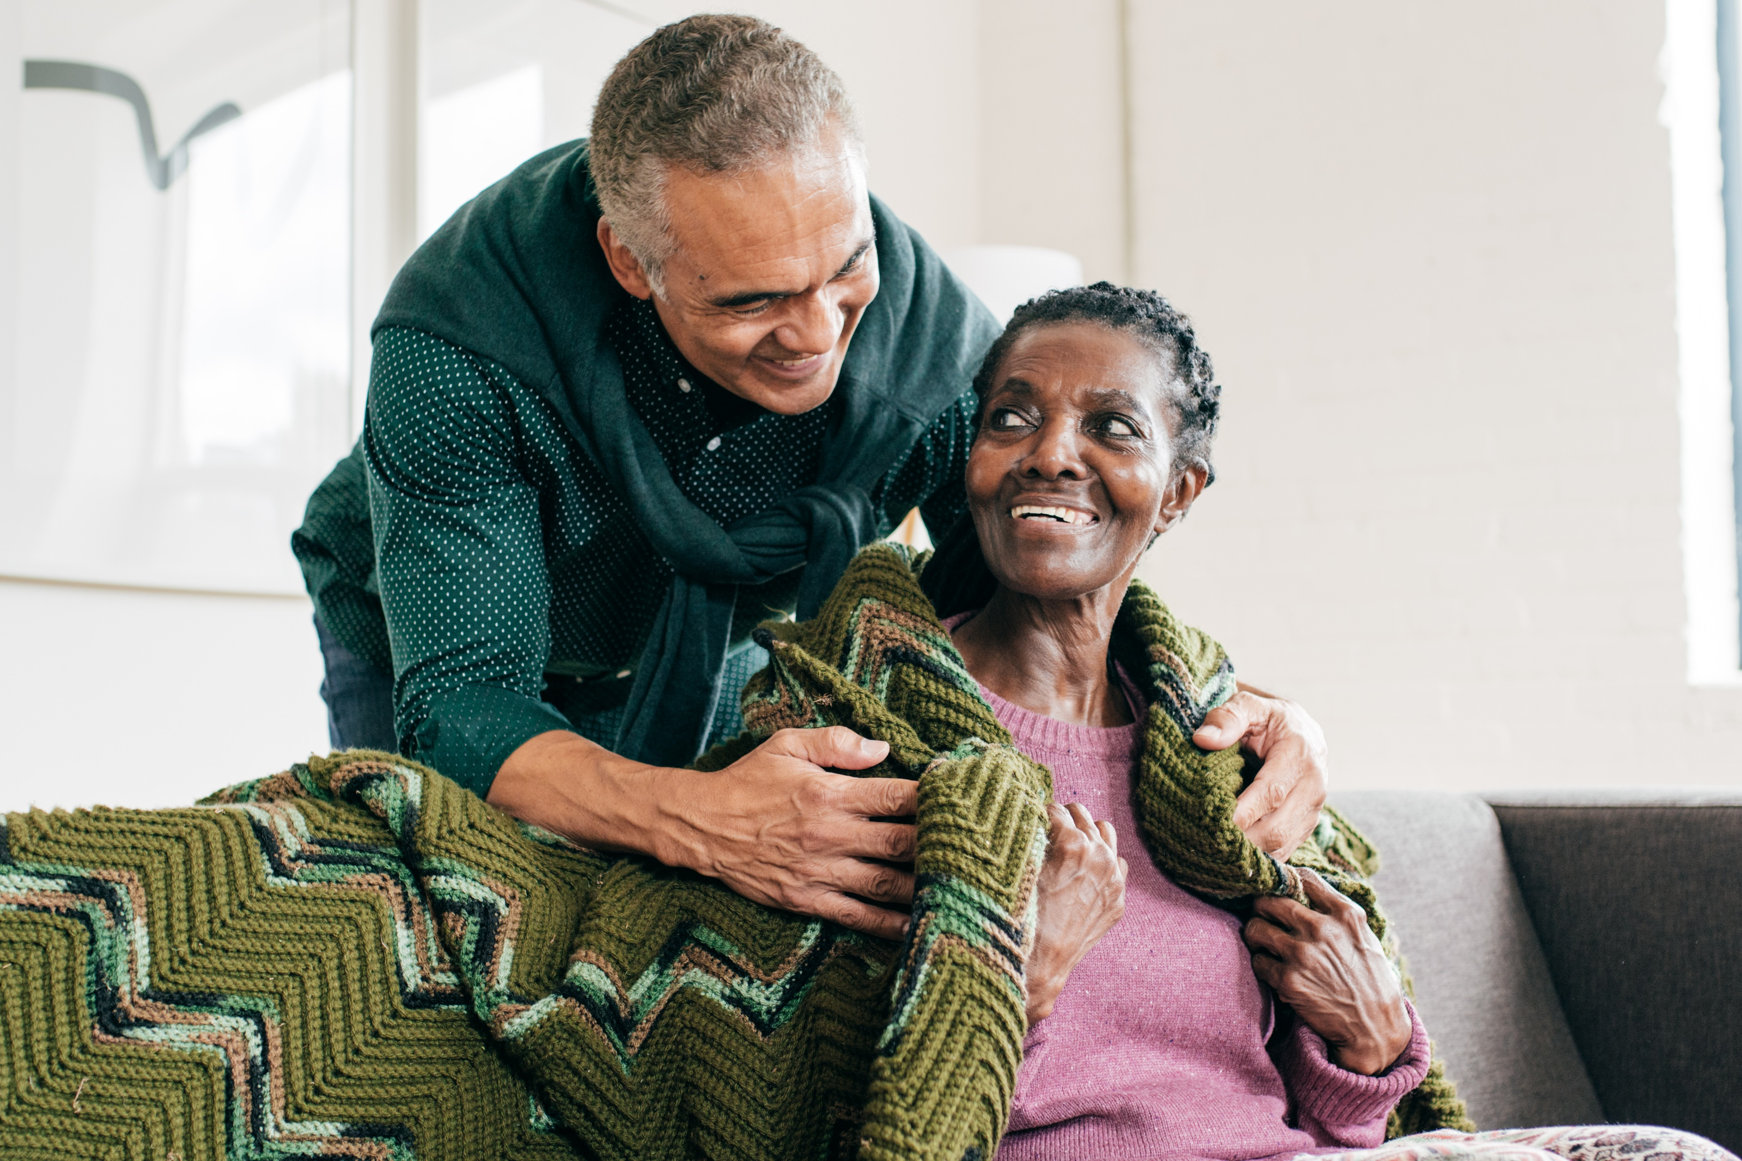
Potentially Modifiable Risk Factors
Activity: Choose to Make Change
Which Strategies Might Work For You?
Increasing Dementia Awareness in Our Communities | 2026
Please Do Not Change Presentation Language
Brain Health & Dementia Awareness in Our Communities | 60
Notes:
Debrief (5 MIN)
Ask:
Which small change would be easiest for you to make?
What are the barriers to making changes?
How will you make this change?
When will you make this change?
What supports would you need?

Slide 61

Potentially Modifiable Risk Factors
Debrief
Which change would be easiest for you to make?
What are the barriers to making that change?
When will you commit to make that change?
How will you make that change?
What supports would you need?
Please Do Not Change Presentation Language
Brain Health & Dementia Awareness in Our Communities | 61
Notes:
Debrief, Part 2 (3 MIN)
Discuss what it would take to make some of these changes in your life.
If you do not have a medical provider to consult about changing one or more of these risk factors, you can reach out to the Center for Multicultural Health.

Slide 62
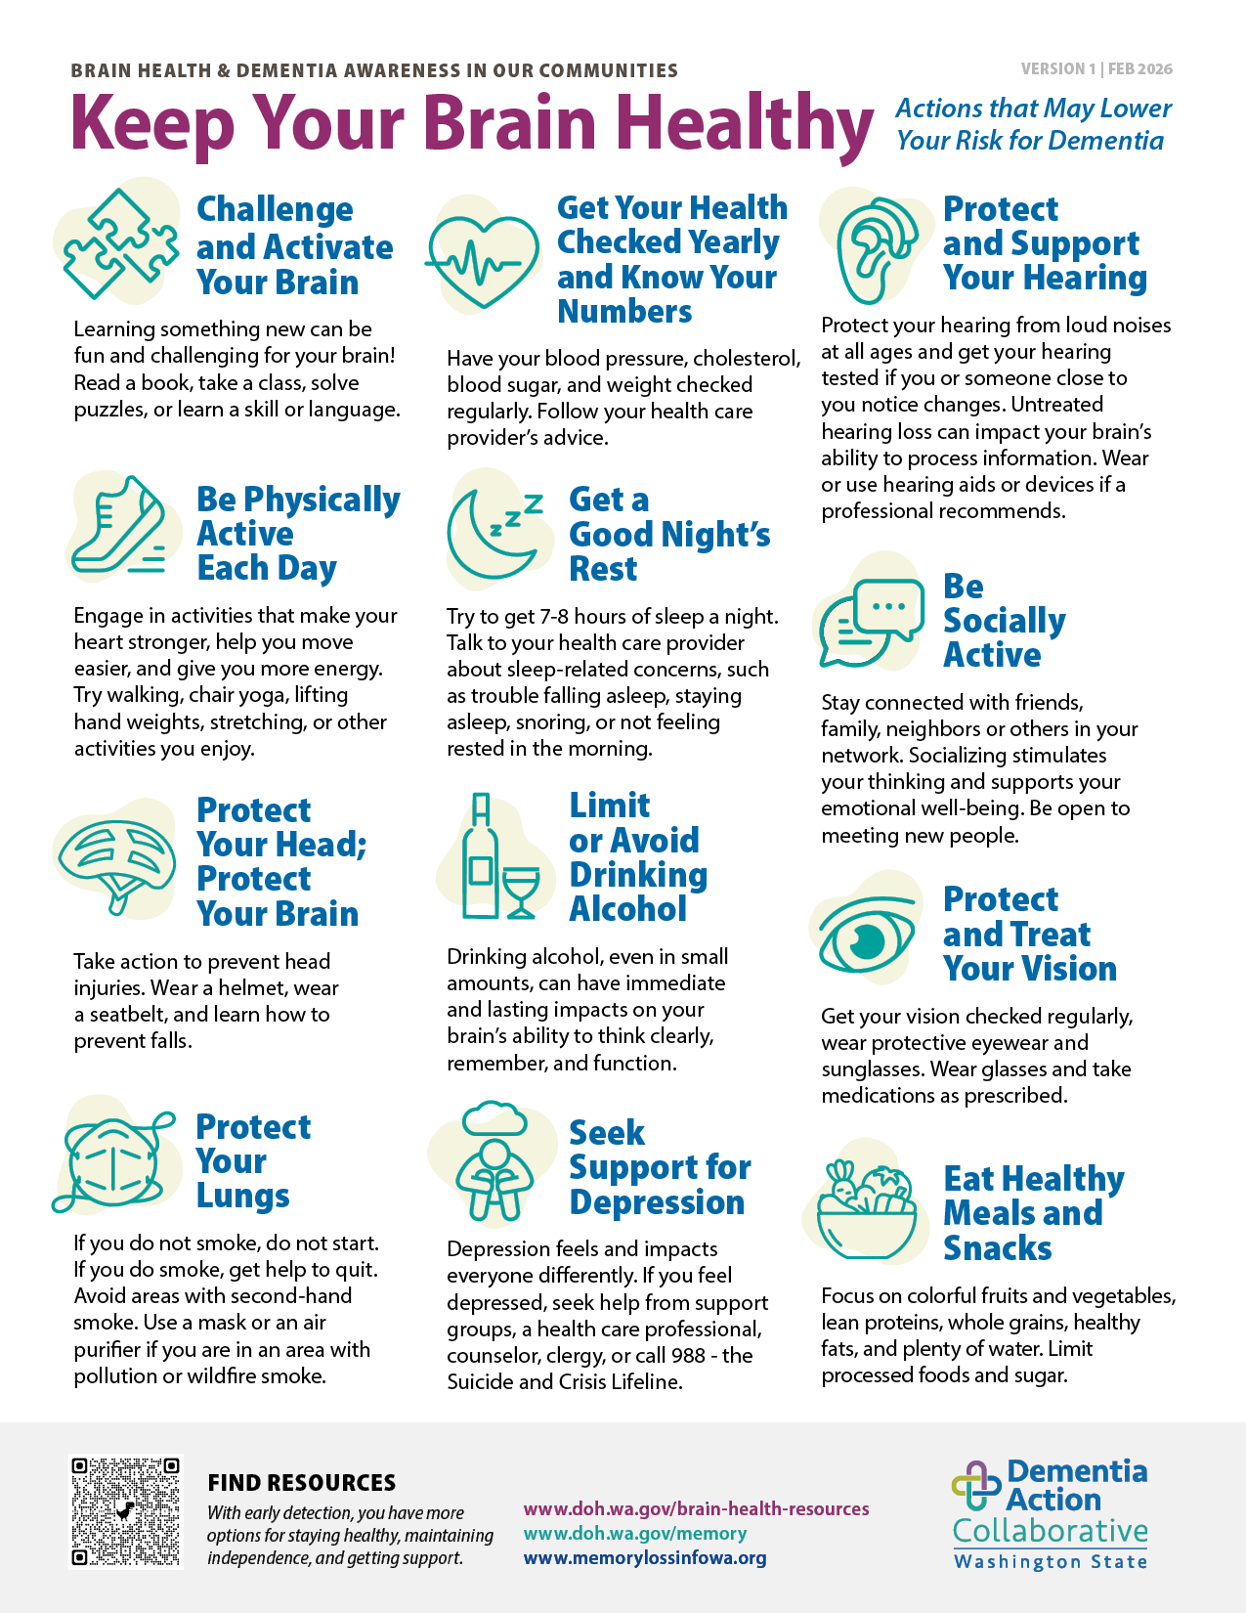
Potentially Modifiable Risk Factors
Learn More About Risk Factors
There are more potentially modifiable risk factors.
Check out the Keep Your Brain Healthy handout to learn more.
Please Do Not Change Presentation Language
Brain Health & Dementia Awareness in Our Communities | 62
Notes:
LEARN MORE ABOUT RISK FACTORS (1 MIN)
Explain there are more potentially modifiable risk factors. Encourage participants to check out the Brain Health Messages handout to learn more.

Slide 63
Resources
Learn more through the link below or using the QR code by pointing your phone camera at the QR code, then touching the prompt on the screen to open the website.
doh.wa.gov/brain-health-resources
Email Brain-Health@DOH.WA.Gov for further assistance.
Please Do Not Change Presentation Language
Brain Health & Dementia Awareness in Our Communities | 63
Notes:
Resources & Support: Potentially Modifiable Risk Factors
Debrief (1 MIN)
Highlight Risk-Factor-Related Resources and Support. You might say: “As we mentioned before, this QR code and URL lead to a page of digital resources that is organized to make it easy for you to find what you need to learn more about brain health and dementia. There are three resources we really recommend if you would like to know more about potentially modifiable risk factors. They are:”
CDC | Dementia Risk Reduction
Alzheimer’s Association | Promote Brain Health
Lancet Commission | Modifiable Risk Factors for Dementia Infographic

Slide 64


Wrap-Up
We are committed to connecting with you and to connecting you with resources.
Please Do Not Change Presentation Language
Brain Health & Dementia Awareness in Our Communities | 64
Notes:
Core message #4 (1 MIN)
Transition by sharing the fourth and final core message: “As we wrap up our workshop, we want to share our fifth and final core message. We are committed to connecting with you and to connecting you with resources.”

Slide 65

Final Reflection
What is one change I will make
or action I will take based on our learning together today?
Use the provided handout to write down your commitment to change.
Please Do Not Change Presentation Language
Brain Health & Dementia Awareness in Our Communities | 65
Notes:
Final Reflection (2 MIN)
Ask participants to write down a commitment as an exit ticket:
What is one change I will make or action I will take based on our learning together today?

Slide 66
Living with dementia has its challenges, and supportive community can help
Early dementia diagnosis can
increase quality of life
It’s never too early or too late
to improve brain health
Small lifestyle changes can
make a big difference
We are committed to connecting with you and connecting you with resources
Core
Messages
Please Do Not Change Presentation Language
Brain Health & Dementia Awareness in Our Communities | 66
Notes:
Reinforce Core Messages (1 MIN)
Review the core messages:
Living with dementia has challenges; supportive community can help
Early dementia diagnosis can increase quality of life
It is never too early or too late to improve brain health
Small lifestyle changes can make a big difference
We are committed to connecting with you and connecting you with resources

Slide 67

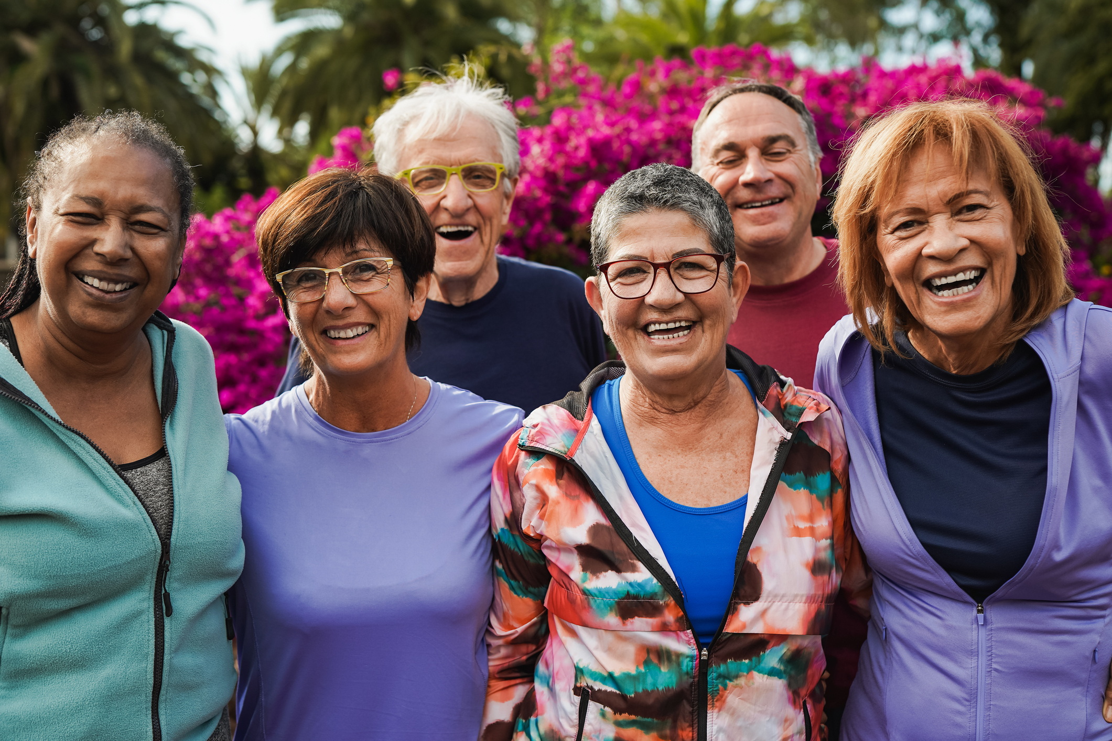
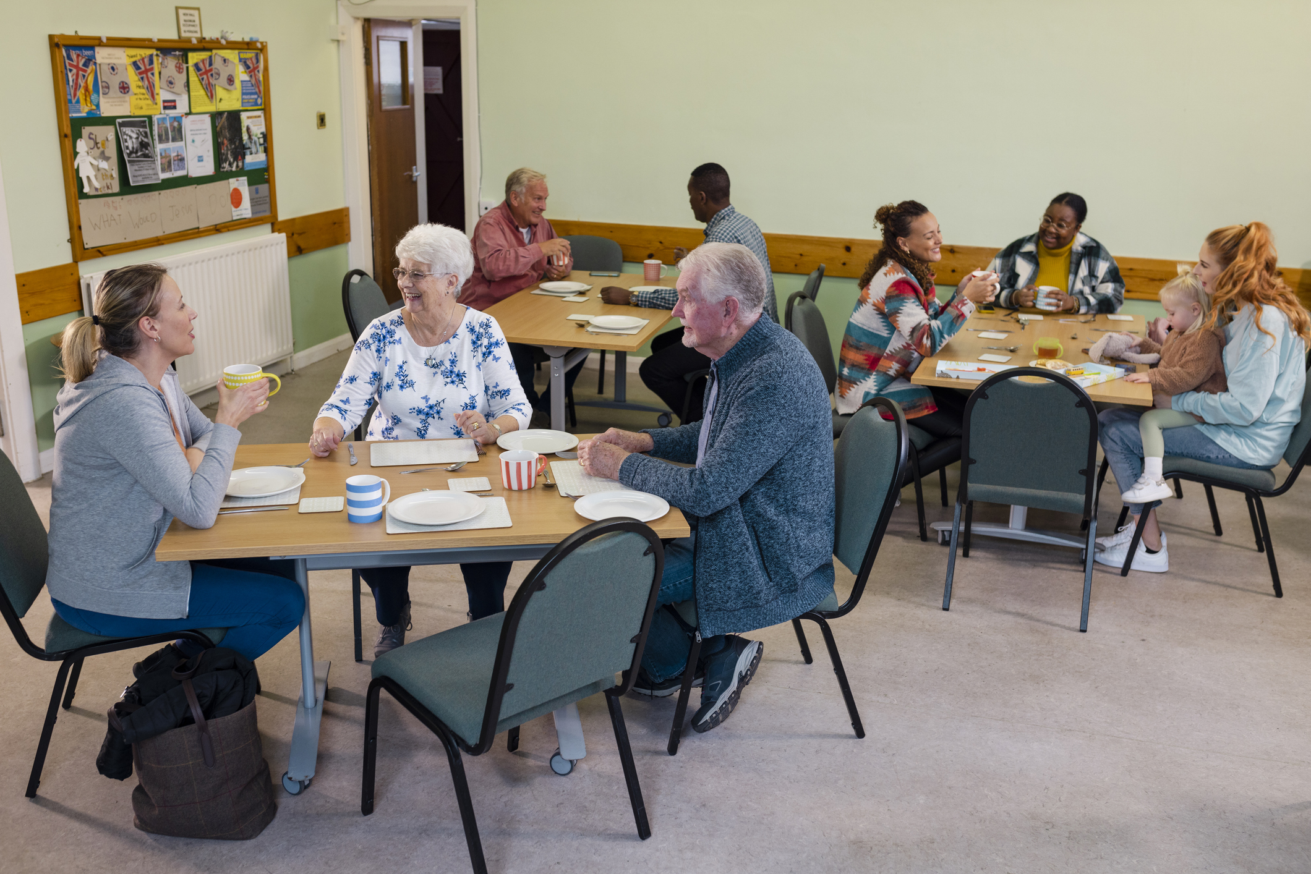
Discover Community
Events & Resources
Find additional resources, opportunities, and upcoming events offered by your host organization. Ask your trainer for more information.
Brain Health & Dementia Awareness in Our Communities | 67
Notes:
Additional Dementia-Awareness Resources and Support (1 MIN)
Highlight Dementia-Awareness Resources & Support. You might say: “There are more digital resources that are organized to make it easy for you to find what you need to learn more about brain health and dementia.”
Washington Community Living Connections | Dementia Road Map
Dementia Legal Planning Project Toolkit | Get Connected to a Legal Professional
Memory & Brain Wellness Center | Dementia Friends Washington
Us Against Alzheimer’s | Prevention, Early Detection & Diagnosis, Access to Treatments
Balm of Gilead | Culturally Tailored Brain Health Resources
Direct participants to other resources, events, or opportunities available in your own community.

Slide 68
Learn about and reflect on
brain health and dementia in
our communities
Understand potentially modifiable risk factors and the benefits of early detection for dementia
Explore resources for further learning, action, and support around brain health and dementia
1
Learning Objectives
2
3
Please Do Not Change Presentation Language
Brain Health & Dementia Awareness in Our Communities | 68
Notes:
Revisit Learning Objectives (1 MIN)
Ask participants if they feel we have met each learning objective:
Learn about and reflect on brain health and dementia in our communities
Understand potentially modifiable risk factors and the benefits of early detection for dementia
Explore resources for further learning, action, and support around brain health and dementia

Slide 69
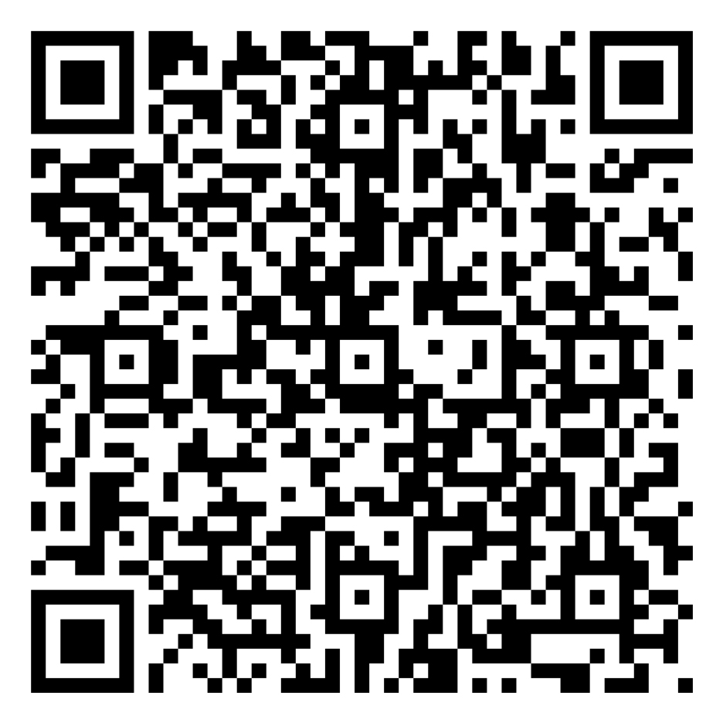
Training
Evaluation
Please complete the training evaluation.
forms.office.com/g/AJYbJGczWD
Brain Health & Dementia Awareness in Our Communities | 69
Notes:
Training evaluation (3 MIN)
Ask participants to scan the QR code or follow the URL to complete the digital workshop evaluation. If needed, hand out paper copies of the workshop evaluation for participants to complete. You might say: “BDAC is a new program. Completing the evaluation is really important to help us improve and continue to offer this to your community. We appreciate your time and input.”

Slide 70

Thank You
for Attending
And for caring enough to grow brain health and dementia awareness in our communities.
Questions?
Please Do Not Change Presentation Language
Brain Health & Dementia Awareness in Our Communities | 70
Notes:
Thank You & Question/Answer Session (1 MIN)
Thank each participant for attending.
Offer to stay a few extra minutes to answer any questions.
Optional: Hand out or send out digital Certificates of Completion.

