Slide 1
Protecting our families against measles

Slide 2
Measles is serious and spreading.
Notes:
Some of you might have heard that measles cases and outbreaks are rising in Washington state. That is a problem we all should be aware of, because measles can be very serious, especially for some of the most vulnerable people in our families and community. It is also a problem because measles spreads very easily from person to person.

Slide 3

We can protect our kids, families and community.
Here is the situation and what we can do about it.
Notes:
However, there are steps we can take to protect ourselves. To start, the Washington State Department of Health and our own doctors and leaders are encouraging everyone to make sure their families are up to date on their measles vaccination. We will talk today about measles and what we can do to avoid it in our own families and community.

Slide 4
What is measles?
Measles is a serious illness caused by a virus
It is highly contagious
It spreads when people talk, cough or sneeze
The virus stays after people leave
Notes:
What is measles? Measles is a serious illness caused by a virus. The virus is highly contagious, so it is very easy for measles to spread from one person to the next to the next. It spreads in the air when people talk, cough or sneeze, for example. The virus also can stay on surfaces in a room for two hours after an infected person leaves that room. So you might not know you are in a room where the virus is present.

Slide 5
What is measles?
Some people get ear infections, pneumonia or brain swelling.
Measles is most dangerous for:
Babies
Kids 5 and younger
Pregnant people
People with weaker immune systems
Notes:
Most people who get measles recover. But some people get very sick. They can get ear infections, pneumonia and brain swelling. Sometimes people with measles have to be hospitalized. Anyone can get measles, but this illness is usually most dangerous for babies; little kids; pregnant people; and anyone else who has a weaker immune system.

Slide 6
Measles disrupts life.
If you have been close to someone with the virus and you are unvaccinated, you should:
If you get sick with measles:
Stay home for 21 days
Stay apart from other people, including family
You still can get vaccinated within 72 hours
The illness will last a week or longer
Stay home and separate from family
Notes:
Measles can make life hard if you get exposed to the virus, especially if you are not vaccinated or if you get sick. If you have been close to someone with the virus and you are unvaccinated, you should stay away from other people to avoid spreading the virus to them. Most unvaccinated people who are exposed do get sick, and they can spread the virus before they notice symptoms. If you are exposed, you should stay home for 21 days. You also should stay apart from other people, including people you live with. This is difficult and inconvenient, but it’s important to help prevent more and more people from getting sick. It’s important to know you can still get vaccinated within 72 hours of the exposure, which can help prevent you from getting sick. If you get sick with measles, you can expect your illness to last a week or longer. You will miss work, and you should stay home and separate from family.

Slide 7
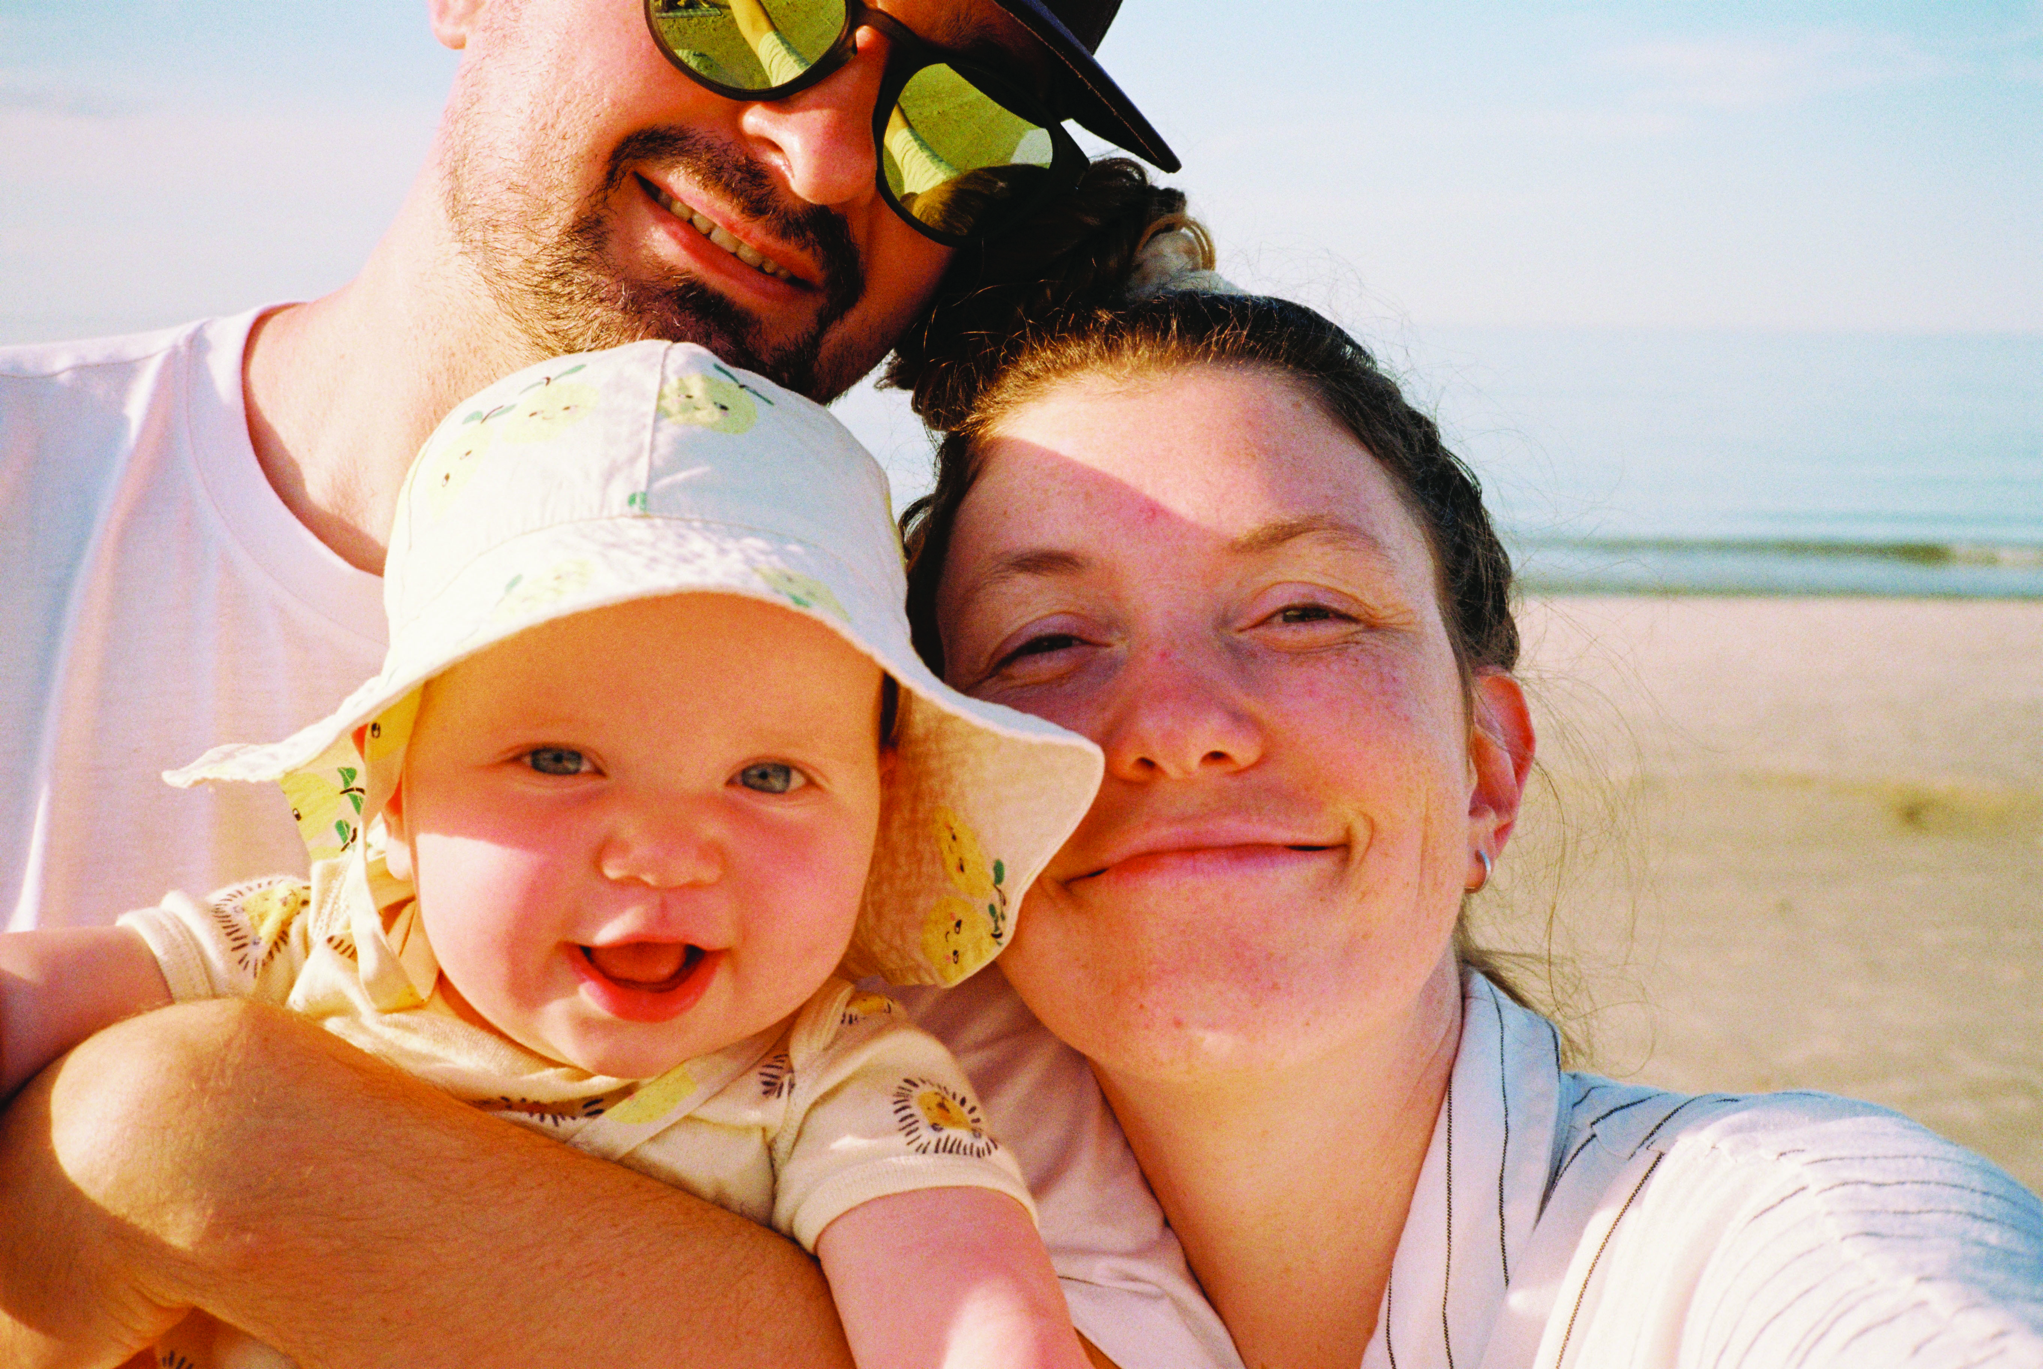
What can we do?
Get vaccinated!
Measles shots are the strongest protection.
Babies, kids and adults can get the vaccine.
The measles vaccine is also called the MMR vaccine.
Notes:
The good news is that we can avoid measles and protect ourselves and our families and other people in our community. The most important thing is to get your kids and the adults in your family vaccinated. If you don’t know whether you have been vaccinated, there is a website you can use to find out. We will share that at the end of this presentation.
Measles shots are the strongest protection. They are very effective. Just one dose prevents 93% of people from getting measles, and two doses protect 97% of people.
The measles vaccine is also called the MMR vaccine. Besides measles, it also protects against mumps and rubella.

Slide 8
How does the vaccine work? Is it safe?
It is given as two shots
The vaccine teaches your body to fight off measles
It has been proven to be safe over many decades
Some people have mild side effects for a day or two
If you have questions, ask your doctor, pharmacists
or health care provider
Notes:
The measles vaccine is given as two shots at separate times. The shots contain a weakened virus that teaches your body to fight off the illness. It is safe. It has been proven to be safe over many decades of research, and it is still always being monitored for safety. Some people have mild side effects, such as a sore arm or a fever. They last a day or two, and they are much less serious than measles. You also can ask your own doctor or pharmacist if you have any questions or concerns.

Slide 9
How to get the vaccine.
Call your clinic, pharmacist, doctor’s office
or health care provider
Vaccines are available free for kids
Vaccines are available free for adults without insurance
Washington State Department of Health vaccine finder
Notes:
The measles vaccine is not difficult or expensive to get. If you have a clinic or pharmacist or doctor, call them. It often is available for free or at a low cost. The state makes the measles vaccine, and other vaccines, available free for all children younger than 19. There also are free vaccines available for adults who do not have insurance. The Washington State Department of Health has a map showing many locations where these free vaccines are available. We will share a link to that at the end of this presentation as well.

Slide 10
What else can we do?
We all have a part
Stay apart to prevent the spread
Know the symptoms
Get medical care
Notes:
Besides vaccination, there are other ways we can prevent the spread of measles. Each of us has a role in this. We can stay apart when sick or exposed to prevent the spread, know the symptoms of measles to watch for, and get medical care if we need it.

Slide 11
Staying apart to prevent measles from spreading
If you’re exposed to measles and unvaccinated:
Stay home for 21 days
Stay apart from other people
You still can get vaccinated within 72 hours
This can protect you from getting sick or reduce
your symptoms
Notes:
Again, it’s very important to stay away from other people if you have been near someone who has been infected with the measles virus. You should stay home for 21 days and stay apart from other people during that time. However, some people who get exposed can still get vaccinated if they do so within 72 hours of the exposure. This can prevent them from getting sick or from getting very sick. You can ask your clinic or doctor about this if you get exposed and you are not vaccinated yet.

Slide 12
Measles symptoms
They don’t start all at the same time
If you have a fever, cough and red eyes, stay
home and apart from other people
Watch for a rash
Call a clinic or doctor
Notes:
We should all be watching out for the signs of measles. They don’t start all at the same time. They often start with a fever, cough and red eyes. If you have those symptoms, stay home and apart from other people and watch to see if you get a rash within a few days. If you see a rash, first call a clinic or doctor. You need to visit them to get diagnosed and find out what to do next. They will make a plan for you to visit without exposing other people to the virus.

Slide 13
Resources
Scan to find your vaccine records. You also can go to myirmobile.com.
Scan for a map showing free measles vaccine locations for adults without insurance and for children 18 and younger.
Notes:
Thank you! Here are two tools to help you protect your family against measles. You can use your phone to scan the codes or go to these websites. You can use My IR Mobile to find out whether you or your kids have been vaccinated for measles. You can use the map to find free vaccination locations for kids and adults.

