Slide 1

Add a logo here. Use the Crop tool to adjust the size, as needed.
Remember to delete this text box!
Add a photo or image of an event flyer here. Use the Crop tool to adjust the size, as needed.
Remember to delete this text box!
Notes:
Customize this slide to introduce your trainer(s) and/or your organization. See examples on slides 2 and 3 for formatting ideas. You can also choose to hide slides 1-3 and start with slide 4 which introduces the workshop.
Need some help? Find some tips and tutorials for how to edit Microsoft PowerPoint slides here: https://support.microsoft.com/en-us/office/slides-and-text-6c206169-2b17-48c5-8bd9-df38fa6049d1
Note: No other slides in this deck are modifiable.

Slide 2
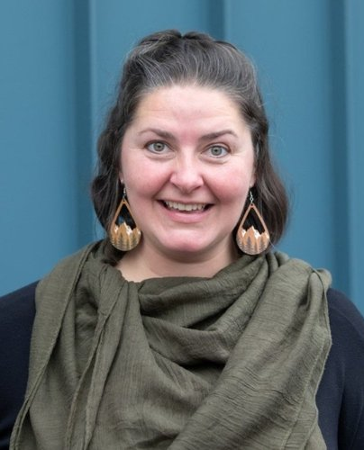

EXAMPLE
Erika Behrends
Erika brings more than 15 years of experience in curriculum design, facilitation, content development, event management, and training delivery across countries and languages.
Erika is fluent in English and Spanish.
Notes:
BDAC Trainer introduction slide

Slide 3

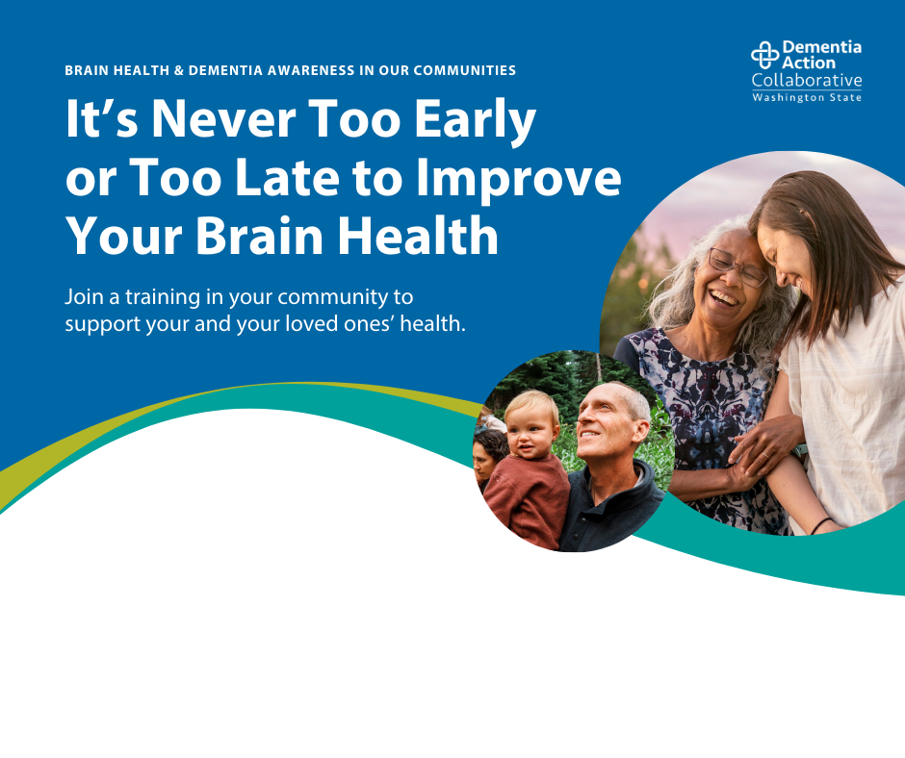
EXAMPLE
Improve Your and Your Loved Ones’ Brain Health
Dementia
Awareness Training
Thursday, January 1, 2026 | 5:30 PM
Community Center | Training Room
1235 Community Center Way, City, State, 98765
Join us at the community center to learn more about how you can improve your and your loved ones’ brain health.
Notes:
Event promotion example slide

Slide 4
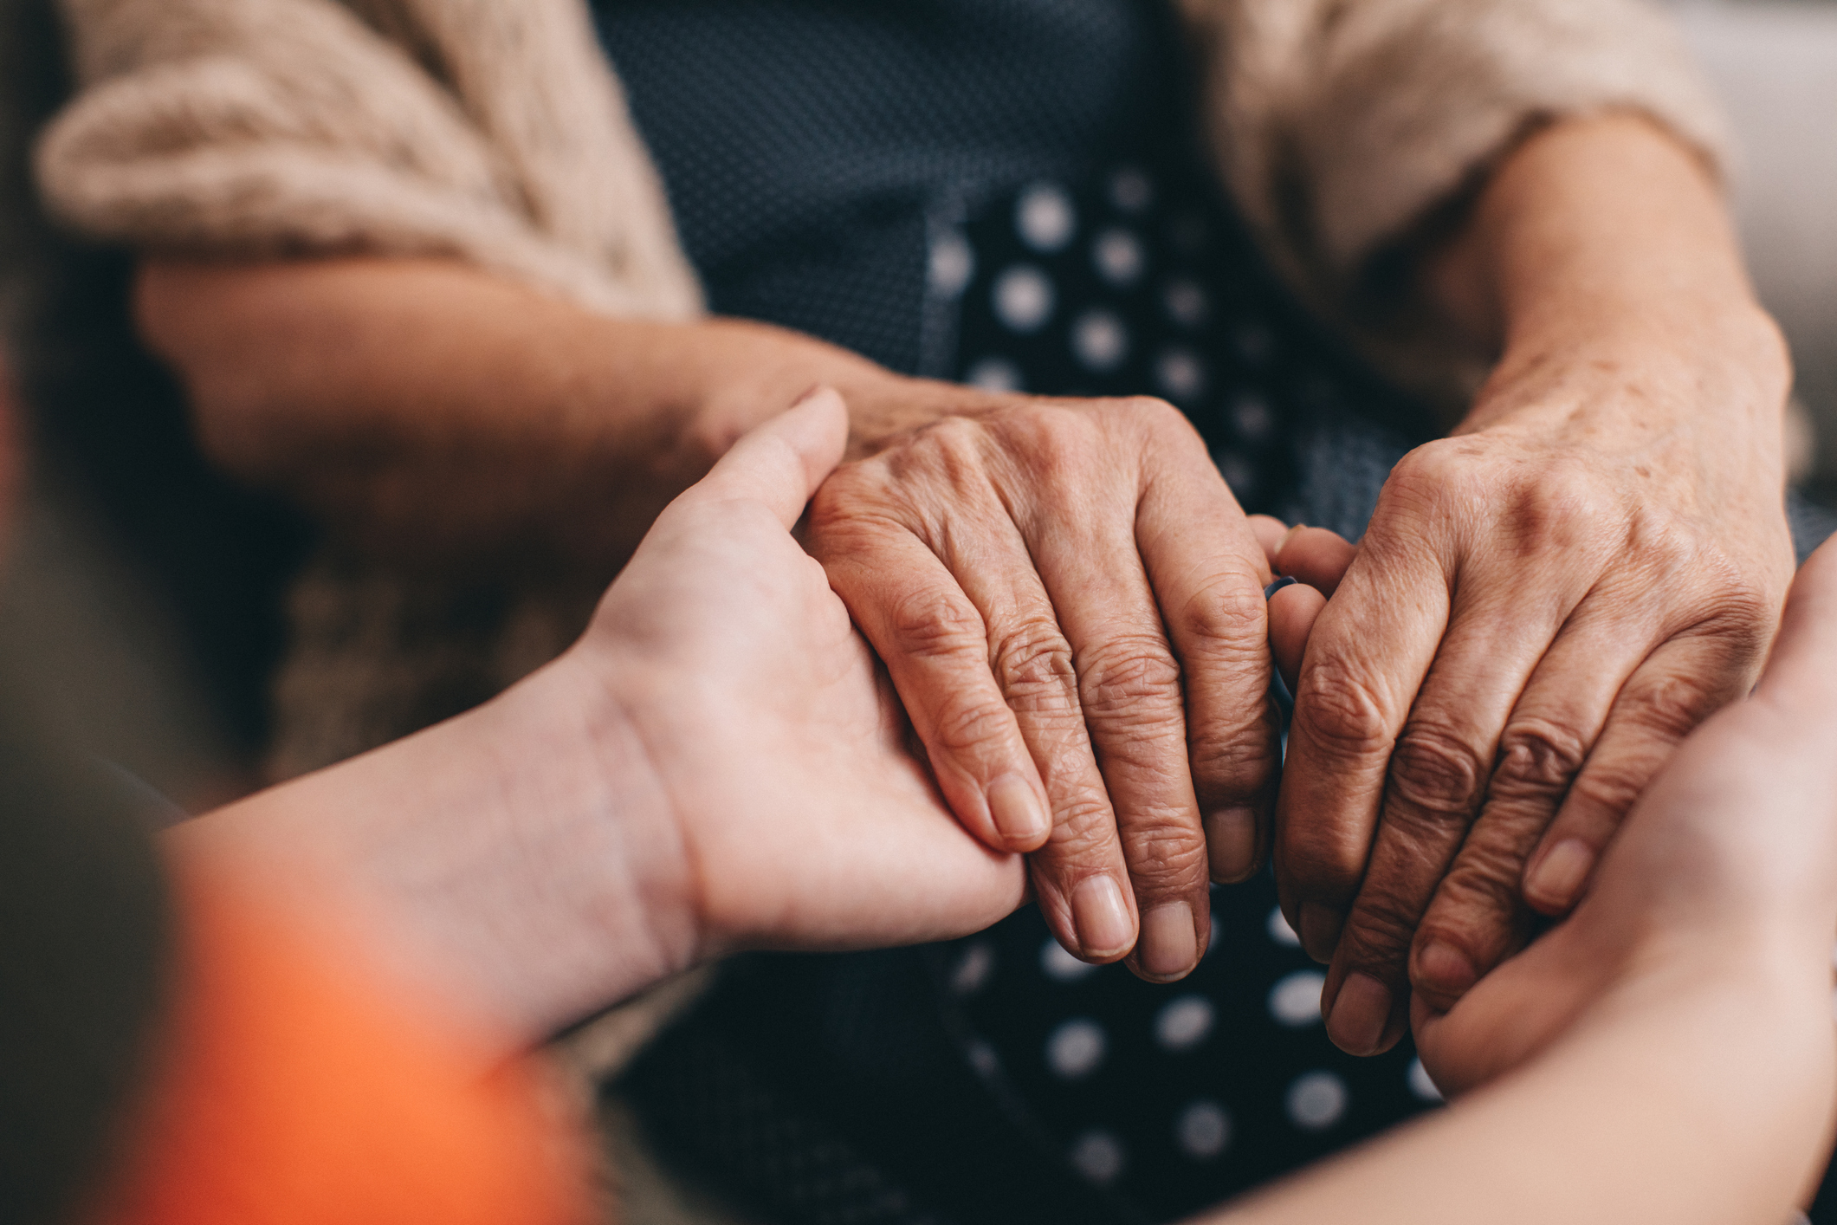
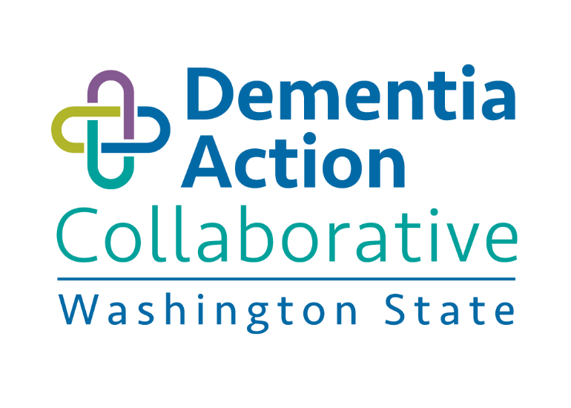
Brain Health
& Dementia Awareness in
Our Communities
Benefits of Early Dementia Detection, Potentially Modifiable Risk Factors, and Available Resources for People Living with Dementia
This publication was made possible by BOLD Public Health Grant Award #5NU58DPO07508-03 from Centers for Disease Control.
Its contents are solely the responsibility of the authors and do not necessarily represent the official views of Centers for Disease Control.

Slide 5

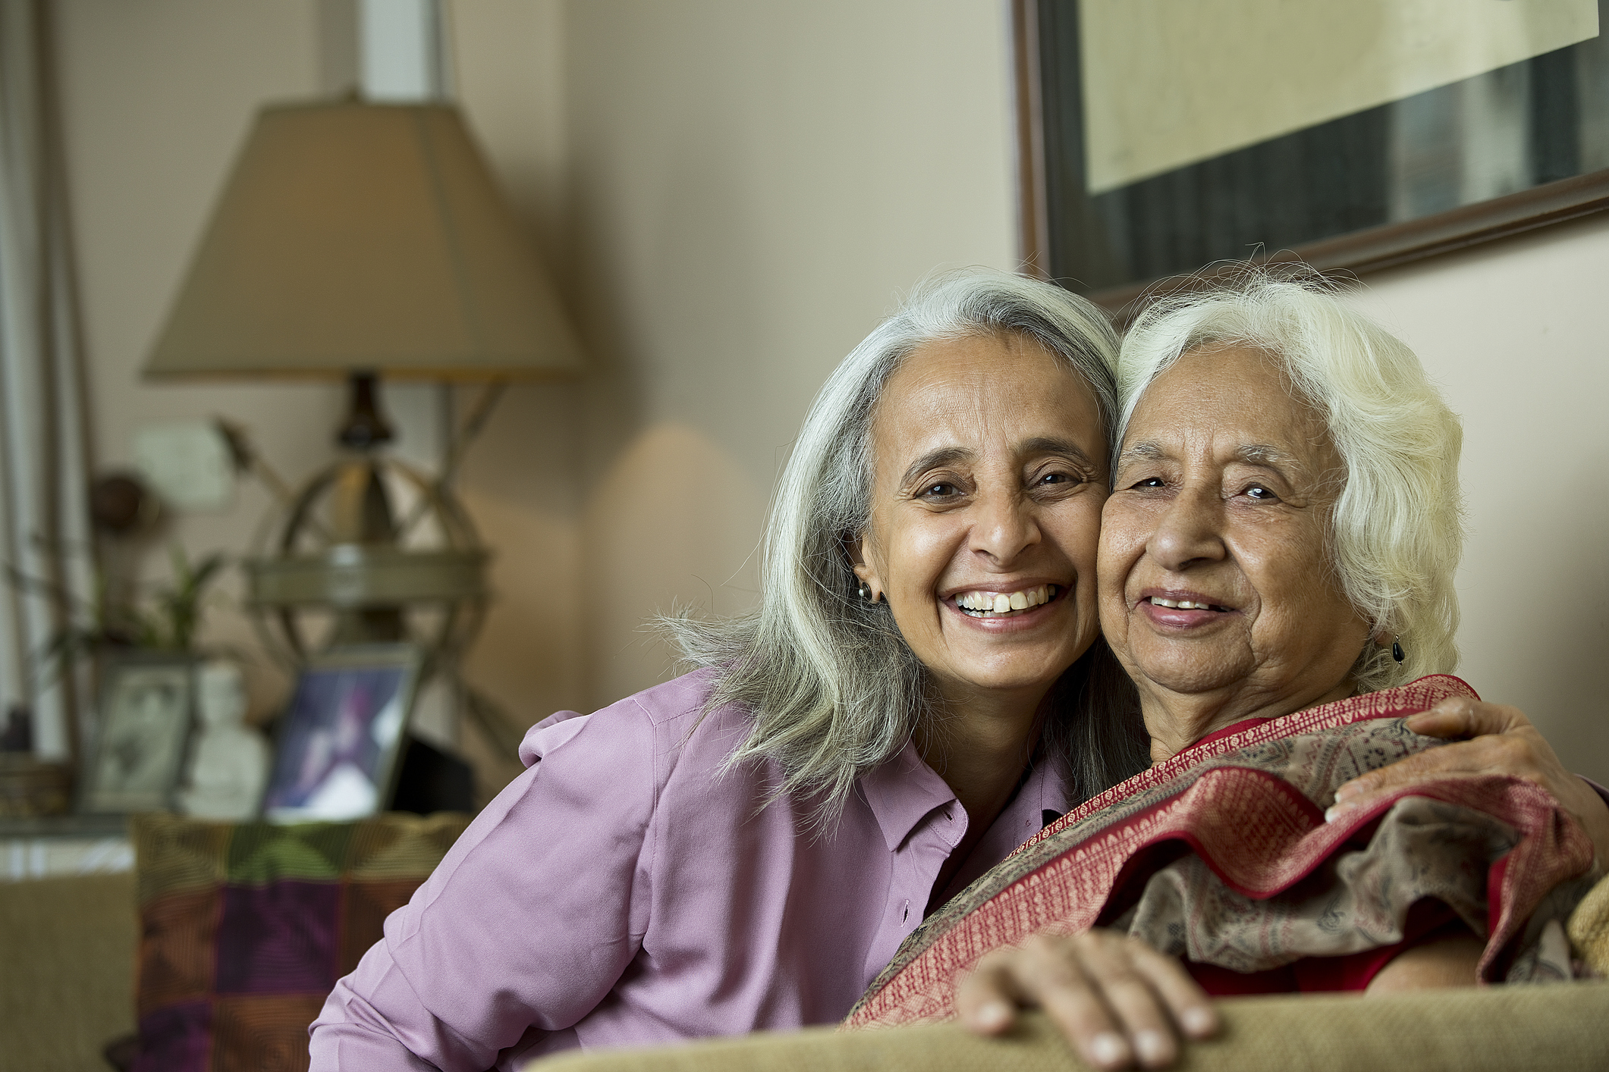
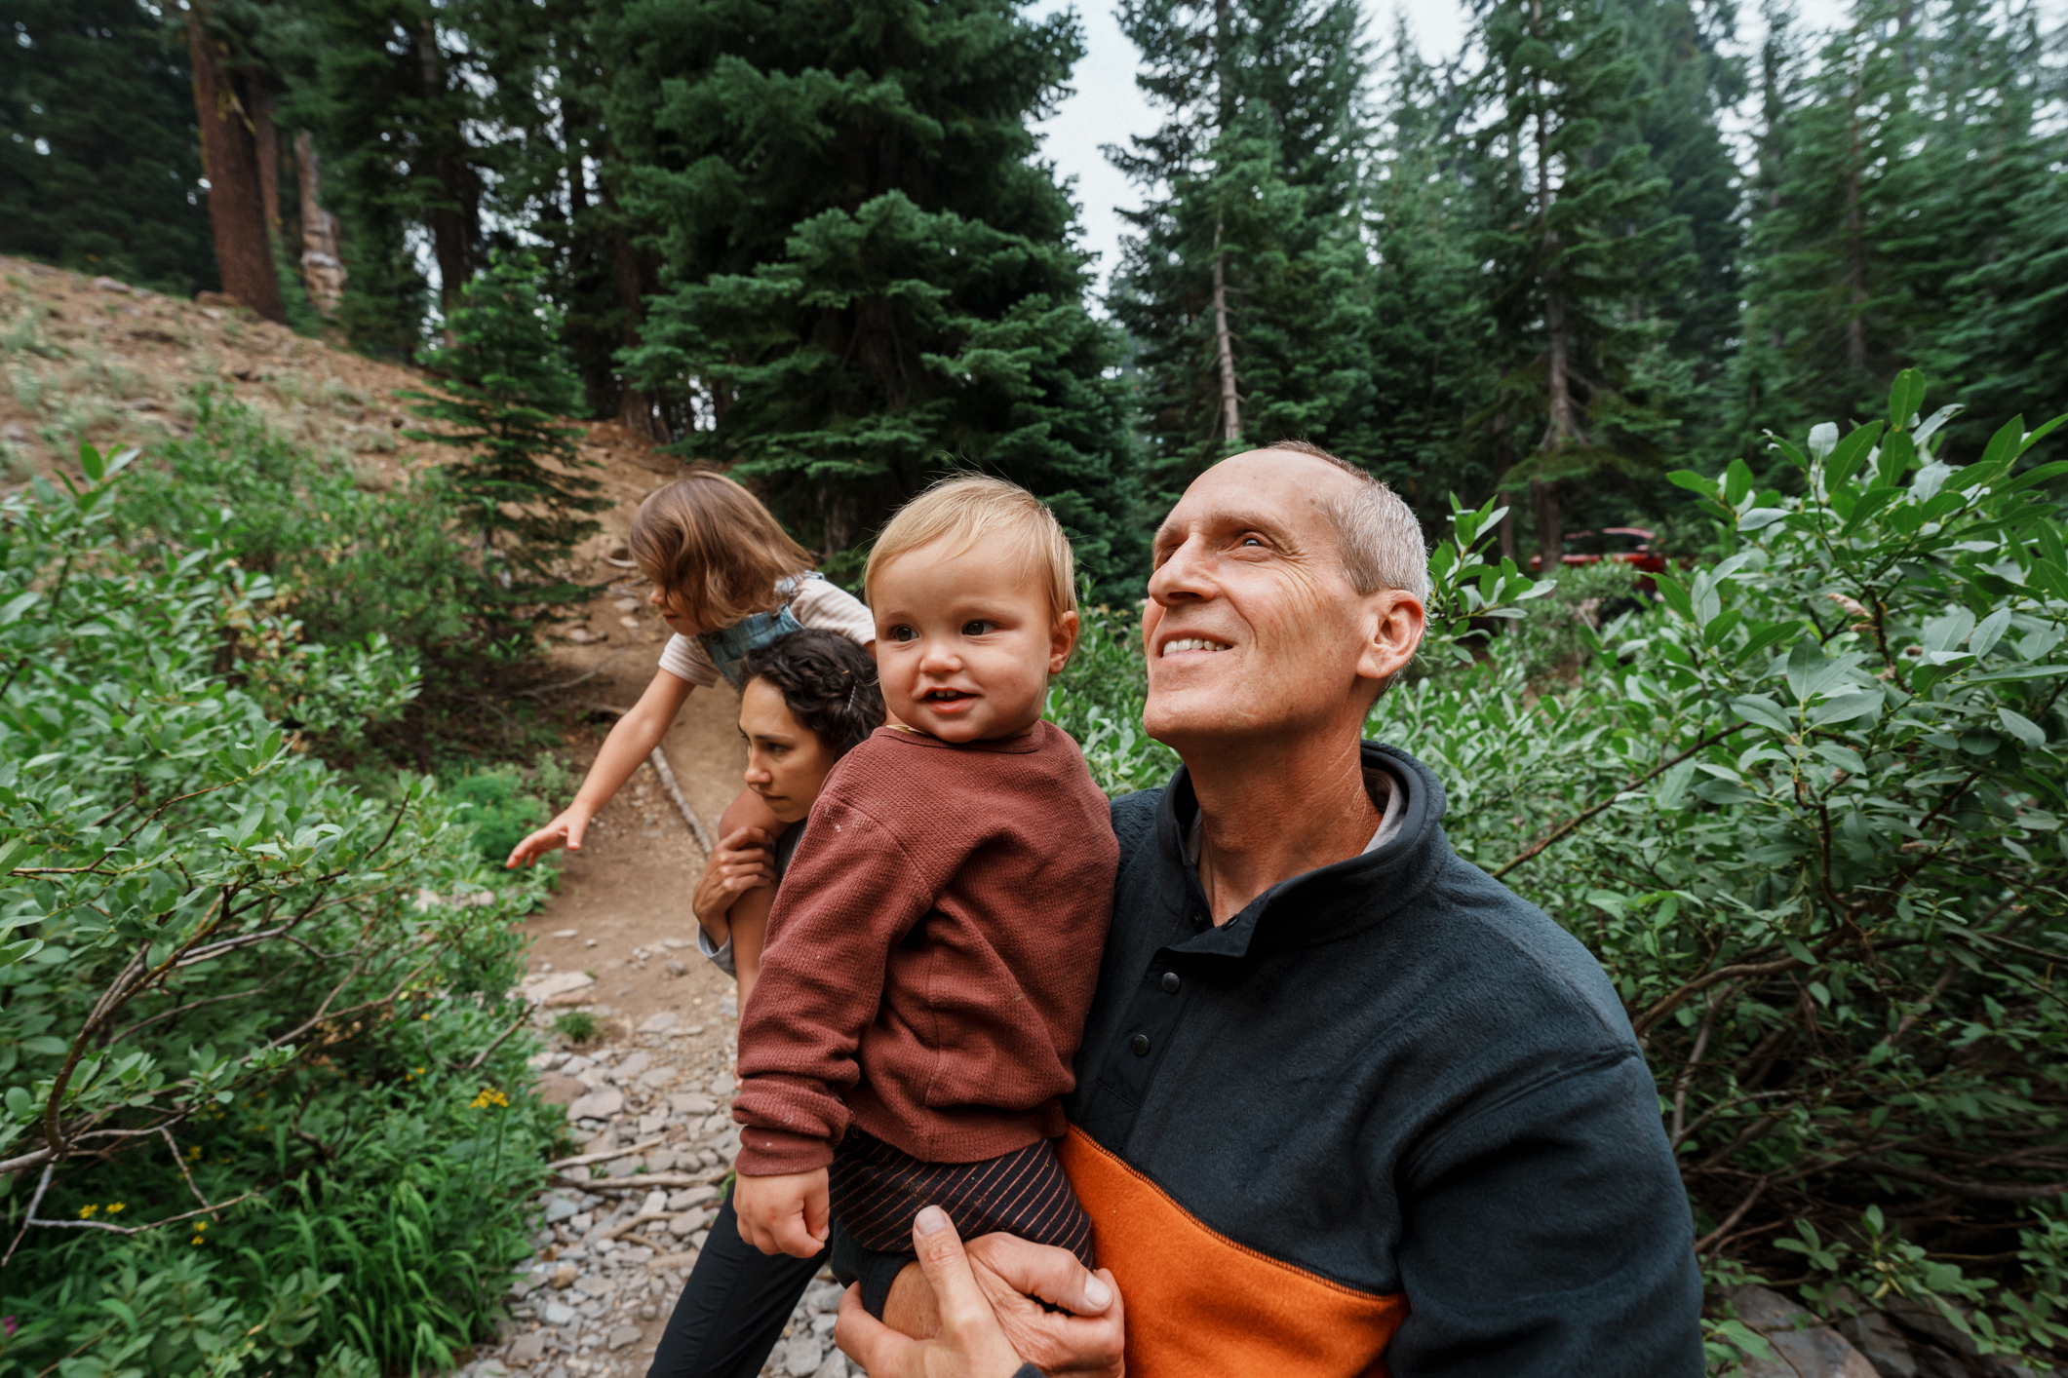
Welcome & Introductions
Introduce Yourself
Say your name, and why you’re attending this workshop
Please Do Not Change Presentation Language
Brain Health & Dementia Awareness in Our Communities | 5

Slide 6
Learn about and reflect on
brain health and dementia in
our communities
Understand potentially modifiable risk factors and the benefits of early detection for dementia
Explore resources for further learning, action, and support around brain health and dementia
1
Learning Objectives
2
3
Please Do Not Change Presentation Language
Brain Health & Dementia Awareness in Our Communities | 6

Slide 7
Living with dementia has its challenges, and supportive community can help
Early dementia diagnosis can
increase quality of life
It’s never too early or too late
to improve brain health
Small lifestyle changes can
make a big difference
We are committed to connecting with you and connecting you with resources
Core
Messages
Please Do Not Change Presentation Language
Brain Health & Dementia Awareness in Our Communities | 7

Slide 8
Expectations
1
2
3
Take Care of Yourself
Stay Present for
the Full Workshop
Take Care of Each Other
Assume Positive Intent and Acknowledge Impact
Take Care of this Space
Leave This Place Better
Than You Found It
Please Do Not Change Presentation Language
Brain Health & Dementia Awareness in Our Communities | 8

Slide 9
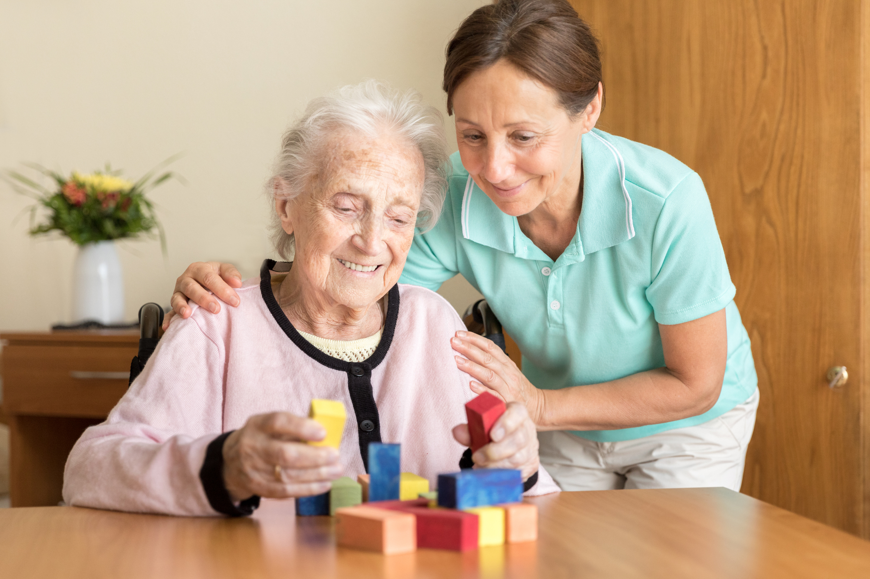

Dementia in
Our Communities
Living with dementia has its challenges, and supportive community can help.
Please Do Not Change Presentation Language
Brain Health & Dementia Awareness in Our Communities | 9

Slide 10
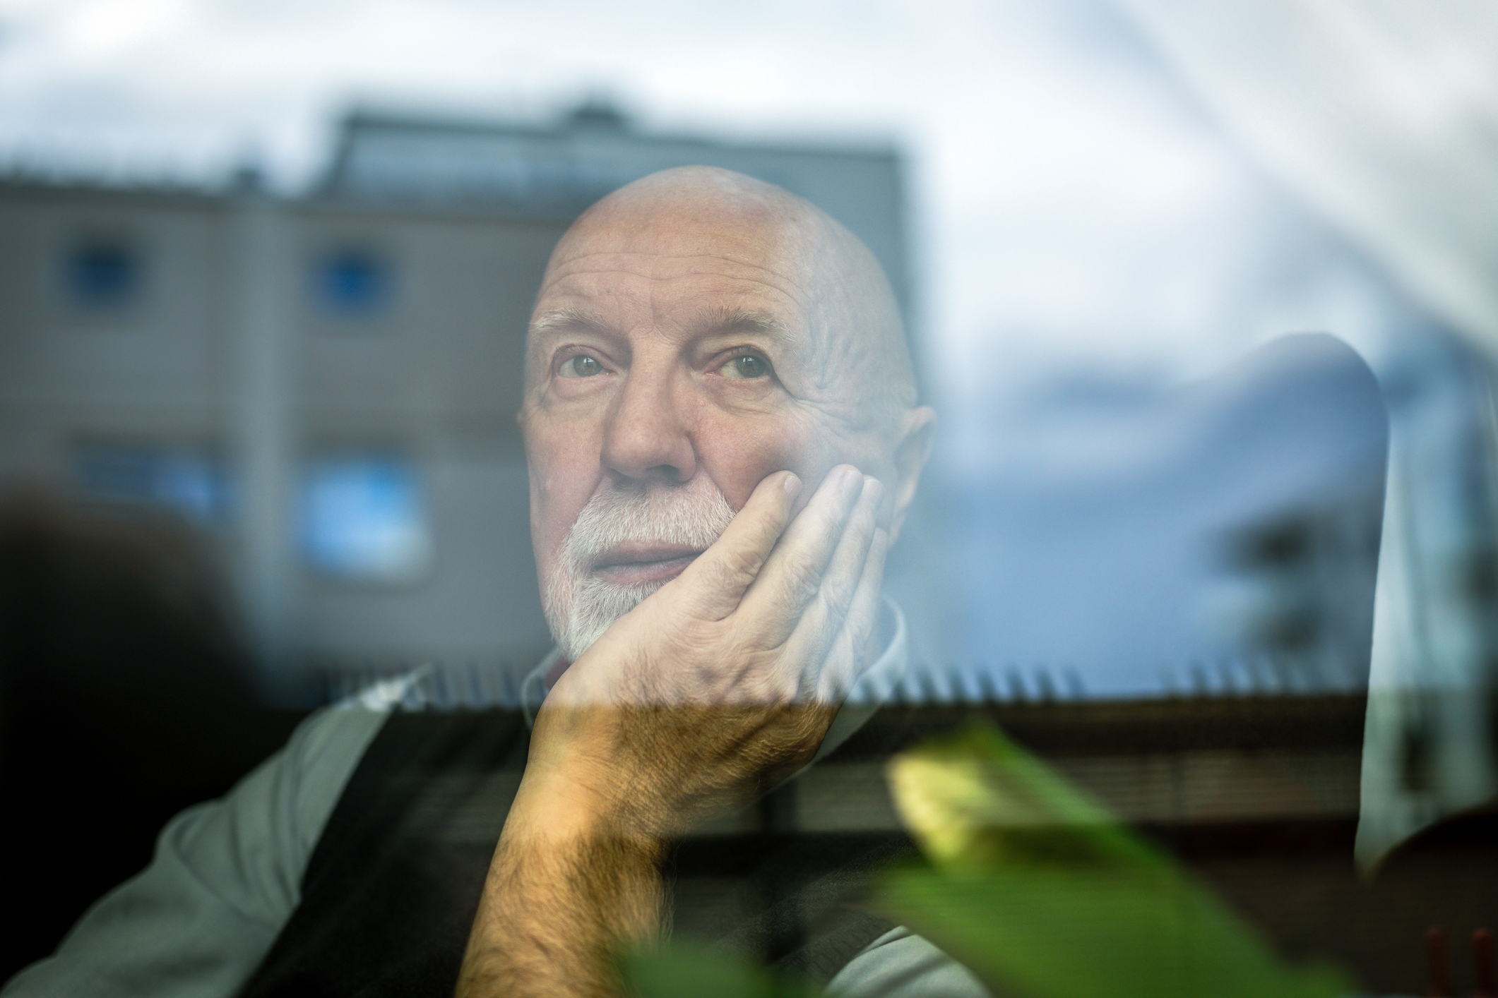
Dementia in Our Communities
What is Dementia?
Dementia is not a disease itself –
it is a set of symptoms caused by a variety of conditions that damage the brain. These changes result in decline in memory and thinking abilities that interfere with daily life.
Please Do Not Change Presentation Language
Brain Health & Dementia Awareness in Our Communities | 10

Slide 11
Dementia in Our Communities
Risk of Dementia Increases With Age
Please Do Not Change Presentation Language
Brain Health & Dementia Awareness in Our Communities | 11

Slide 12
Dementia in Our Communities
Alzheimer’s is a Type of Dementia
ALZHEIMER’S
DEMENTIA
Alzheimer’s is a specific
brain disease and is the most common type of dementia.
In fact, Alzheimer's accounts for 60-80% of dementia cases.
Dementia is a general term for symptoms like decline in memory, reasoning, or other thinking skills.
VS
Please Do Not Change Presentation Language
Brain Health & Dementia Awareness in Our Communities | 12

Slide 13
Dementia in Our Communities
How Dementia is Experienced in the US
10%
2x
1.5x
Around 10% – or 1 in every 10 adults over 65 – in the United States have Alzheimer’s disease (a type of dementia).
Blacks/African Americans are 2 times more likely to have Alzheimer’s disease than the non-Hispanic white population.
Hispanic/Latino adults are 1.5 times more likely to develop Alzheimer’s disease than the non-Hispanic white population.
Please Do Not Change Presentation Language
Brain Health & Dementia Awareness in Our Communities | 13

Slide 14
Dementia in Our Communities
How Dementia is Experienced in Washington
125k
20
Around 125,000 people in Washington are currently living with dementia
In Washington, Blacks/African American, Hispanic/Latino, and American Indian/Alaska Native communities experience dementia at higher rates than the White/Caucasian population
The number of people experiencing dementia in Washington is expected to double in the next 20 years
Please Do Not Change Presentation Language
Brain Health & Dementia Awareness in Our Communities | 14

Slide 15

Dementia in Our Communities
Activity: Virtual Discussion
INSTRUCTIONS:
QUESTION:
1
Think for one minute
Share your answer
in the chat
Debrief together
How has dementia touched my life and/or the lives of those I know?
2
3
Please Do Not Change Presentation Language
Brain Health & Dementia Awareness in Our Communities | 15

Slide 16
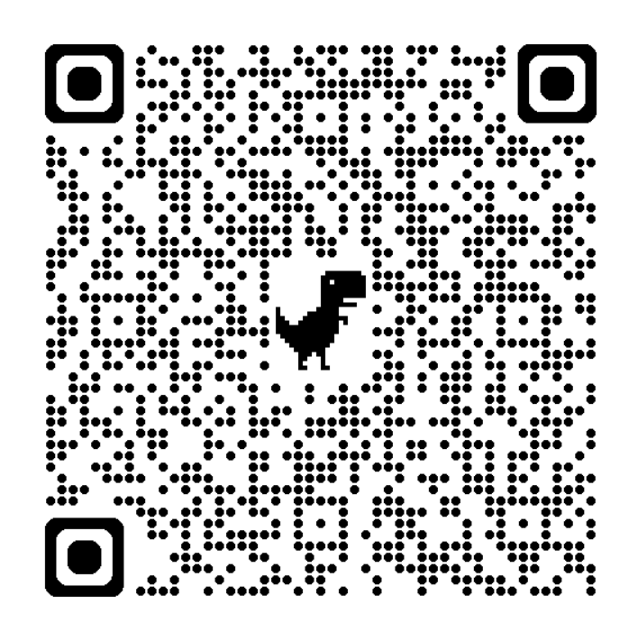
Resources
Learn more through the link below or using the QR code by pointing your phone camera at the QR code, then touching the prompt on the screen to open the website.
doh.wa.gov/brain-health-resources
Email Brain-Health@DOH.WA.Gov for further assistance.
Please Do Not Change Presentation Language
Brain Health & Dementia Awareness in Our Communities | 16

Slide 17
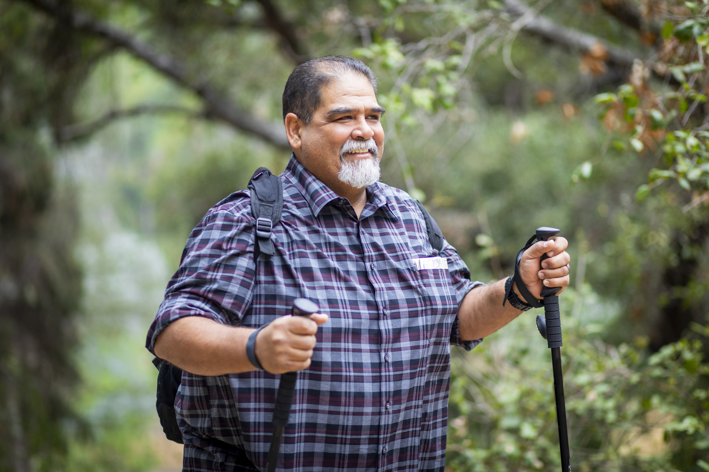

Benefits of
Early Detection
Early dementia diagnosis can improve quality of life.
Please Do Not Change Presentation Language
Brain Health & Dementia Awareness in Our Communities | 17

Slide 18

Benefits of Early Detection
How Can I Recognize Dementia?
Ten Signs of Dementia
Please Do Not Change Presentation Language
Brain Health & Dementia Awareness in Our Communities 18

Slide 19
Benefits of Early Detection
Ten Signs of Dementia
1
Possible Sign of Dementia:
Asking for the same information over and over.
Not able to recall recently learned information.
Memory Loss that Disrupts Daily Life
­Typical Aging:
Temporarily forgetting names or appointments.
Please Do Not Change Presentation Language
Brain Health & Dementia Awareness in Our Communities | 19

Slide 20
Benefits of Early Detection
Ten Signs of Dementia
2
Possible Sign of Dementia:
It’s harder to work with numbers, follow a recipe or keep track of bills.
Difficulty concentrating.
Challenges in Planning or Solving Problems
­Typical Aging:
Making mistakes managing bills once in a while.
Please Do Not Change Presentation Language
Brain Health & Dementia Awareness in Our Communities | 20

Slide 21
Benefits of Early Detection
Ten Signs of Dementia
3
­Possible Sign of Dementia:
Trouble driving to a familiar location, making a grocery list or remembering rules to a game you have played many times before.
Difficulty Completing Familiar Tasks
Typical Aging:
Needing help recording a TV show once in a while.
Please Do Not Change Presentation Language
Brain Health & Dementia Awareness in Our Communities | 21

Slide 22
Benefits of Early Detection
Ten Signs of Dementia
4
­Possible Sign of Dementia:
Losing track of dates and seasons.
Forgetting where you are or
how you got there.
Confusion
with Time
or Place
Typical Aging:
Forgetting the day of the week but figuring it out later.
Please Do Not Change Presentation Language
Brain Health & Dementia Awareness in Our Communities | 22

Slide 23
Benefits of Early Detection
Ten Signs of Dementia
5
­Possible Sign of Dementia:
Trouble judging distance or determining color.
Vision issues may cause balance or reading problems.
Trouble Understanding
Visual Images and Spatial Relationships
Typical Aging:
Vision changes related to cataracts or to typical aging.
Please Do Not Change Presentation Language
Brain Health & Dementia Awareness in Our Communities | 23

Slide 24
Benefits of Early Detection
Ten Signs of Dementia
6
­Possible Sign of Dementia:
Trouble following or joining a conversation or naming familiar objects.
Stopping mid-conversation and being unable to continue or repeating yourself.
New Problems with Words in Speaking or Writing
Typical Aging:
Sometimes having trouble finding the right word.
Please Do Not Change Presentation Language
Brain Health & Dementia Awareness in Our Communities | 24

Slide 25
Benefits of Early Detection
Ten Signs of Dementia
7
­Possible Sign of Dementia:
Putting objects in unusual places.
Losing Things Without Being Able to Retrace Steps to Find Them
Typical Aging:
Misplacing things, but retracing steps to find them.
Please Do Not Change Presentation Language
Brain Health & Dementia Awareness in Our Communities | 25

Slide 26
Benefits of Early Detection
Ten Signs of Dementia
8
­Possible Sign of Dementia:
Changes in decision-making.
Paying less attention to hygiene.
Decreased or Poor Judgment
Typical Aging:
Making a bad decision or mistake once in a while.
Please Do Not Change Presentation Language
Brain Health & Dementia Awareness in Our Communities | 26

Slide 27
Benefits of Early Detection
Ten Signs of Dementia
9
­Possible Sign of Dementia:
Changes in participating in previously enjoyed events.
Withdrawal from Work or Social Activities
Typical Aging:
Sometimes feeling uninterested in family or social obligations.
Please Do Not Change Presentation Language
Brain Health & Dementia Awareness in Our Communities | 27

Slide 28
Benefits of Early Detection
Ten Signs of Dementia
­Possible Sign of Dementia:
Confusion, suspicion, depression, fear or anxiety.
Easily upset at home, with friends or outside comfort zone.
10
Changes in Mood or Personality
Typical Aging:
Developing ways of doing things, becoming irritable when a routine is disrupted.
Please Do Not Change Presentation Language
Brain Health & Dementia Awareness in Our Communities | 28

Slide 29

Benefits of Early Detection
Talking to My Medical Provider About Dementia Concerns
Talking about dementia can be hard and can feel scary. However, getting the advice of a trusted medical provider can help you and your loved ones respond with care and resources.
Please Do Not Change Presentation Language
Brain Health & Dementia Awareness in Our Communities 29

Slide 30

Talking to My Medical Provider About Dementia Concerns
Before Your Visit
1
Write down your signs
List medications, including over the counter and vitamins
2
3
Plan to bring a friend
4
Choose your questions
Please Do Not Change Presentation Language
Brain Health & Dementia Awareness in Our Communities | 30

Slide 31
Talking to My Medical Provider About Dementia Concerns
During Your Visit
1
Share health concerns
2
Be completely open
3
Ask for a diagnosis
4
Talk about next steps
Please Do Not Change Presentation Language
Brain Health & Dementia Awareness in Our Communities | 31

Slide 32
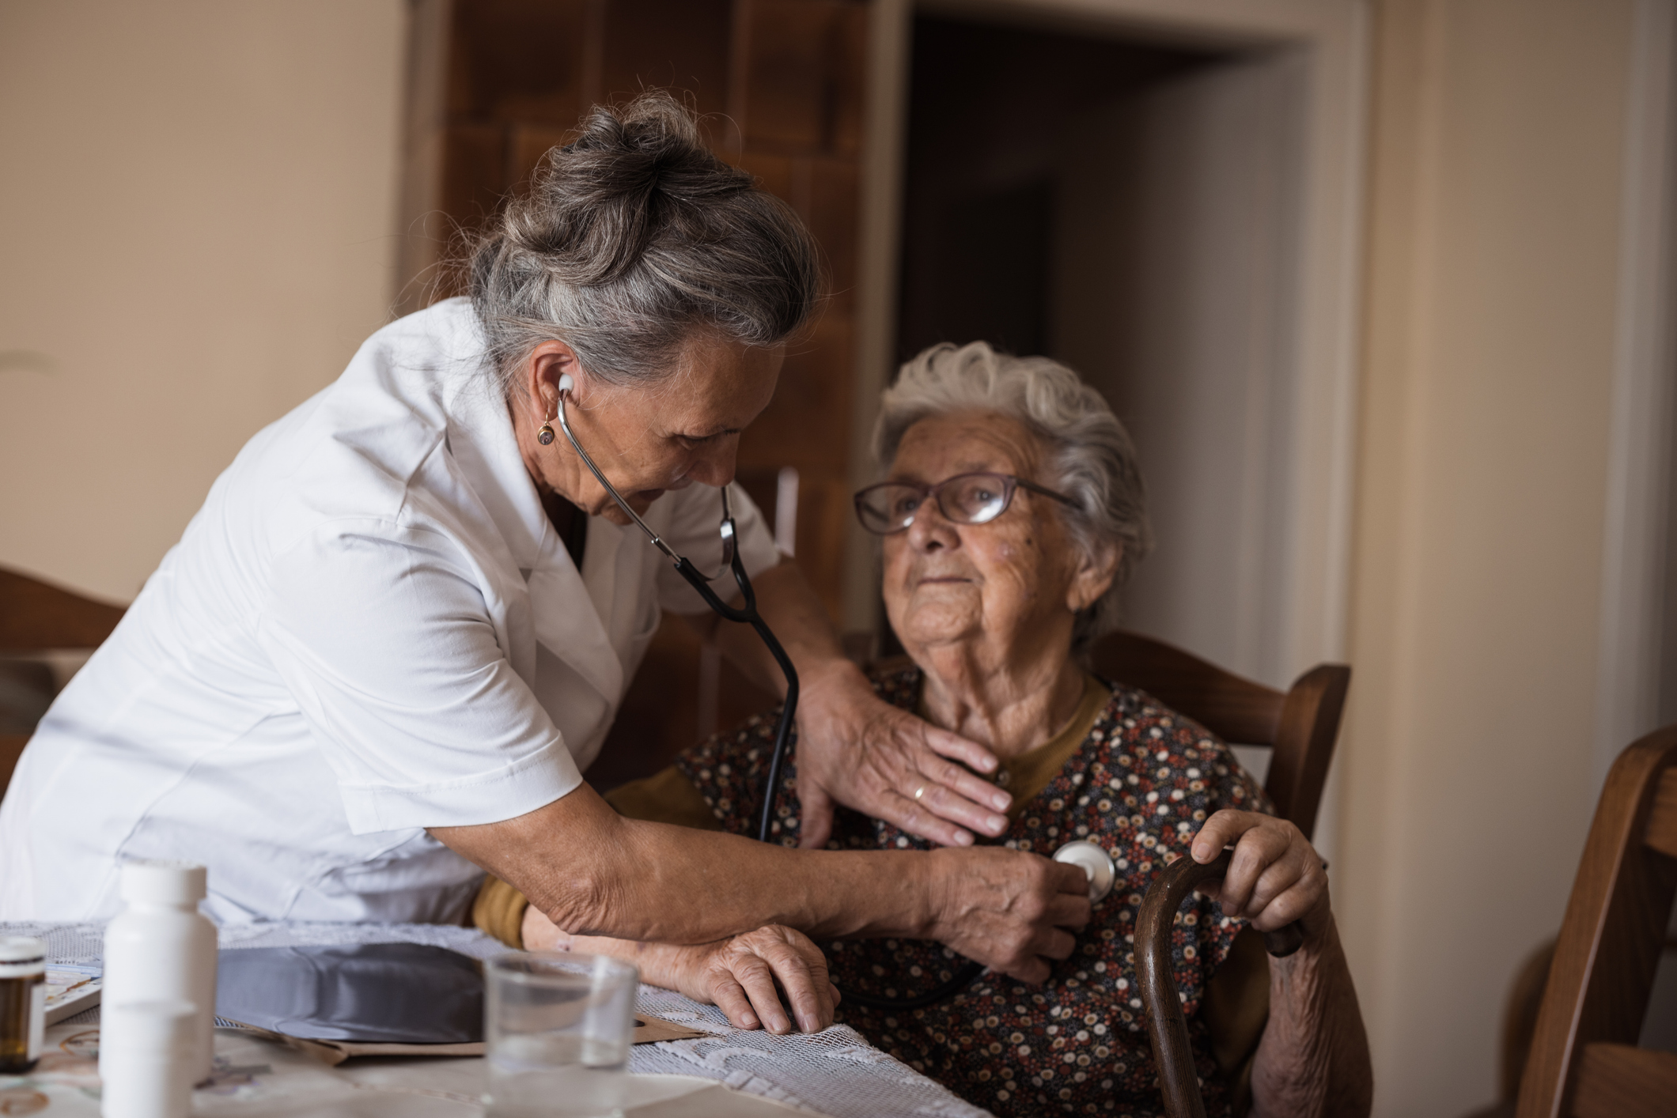
Talking to My Medical Provider About Dementia Concerns
After Your Visit
1
Acknowledge your feelings
2
Review your notes
3
Write down new questions
4
Identify your resources
Please Do Not Change Presentation Language
Brain Health & Dementia Awareness in Our Communities | 32

Slide 33

Benefits of Early Detection
Activity: Courageous Conversations
PROMPT:
INSTRUCTIONS:
Talking to My Medical Provider About Dementia Concerns
1
Review handout and helpful questions to ask
2
Mute yourself and practice asking one question aloud
Please Do Not Change Presentation Language
Brain Health & Dementia Awareness in Our Communities | 33

Slide 34

Benefits of Early Detection
Debrief
You can get assistance early, right when you need it
You can help your community
help you better
You have time to make changes that can influence your quality of life
Fear of diagnosis is typical and reasonable; and there are benefits to knowing more about how to cope with dementia.
Please Do Not Change Presentation Language
Brain Health & Dementia Awareness in Our Communities | 34

Slide 35
Resources
Learn more through the link below or using the QR code by pointing your phone camera at the QR code, then touching the prompt on the screen to open the website.
doh.wa.gov/brain-health-resources
Email Brain-Health@DOH.WA.Gov for further assistance.
Please Do Not Change Presentation Language
Brain Health & Dementia Awareness in Our Communities | 35

Slide 36


Potentially Modifiable
Risk Factors
It's never too early or too late to improve brain health. Small lifestyle changes can make a big difference.
What small means will be different for each person.
Please Do Not Change Presentation Language
Brain Health & Dementia Awareness in Our Communities | 36

Slide 37

Potentially Modifiable Risk Factors
Potentially Modifiable
Risk Factors
Means things in your life that you can choose to change.
Please Do Not Change Presentation Language
Brain Health & Dementia Awareness in Our Communities | 37

Slide 38
Potentially Modifiable Risk Factors
Potentially Modifiable Risk Factors
Making any change in these areas will make a big difference:
Depression
Diabetes
Excessive Alcohol Use
Hearing Loss
High Blood Pressure
Physical Inactivity
Poor Diet Quality
Poor Sleep Quality and Sleep Disorders
Tobacco Use
Traumatic Brain Injury (TBI)
Please Do Not Change Presentation Language
Brain Health & Dementia Awareness in Our Communities | 38

Slide 39
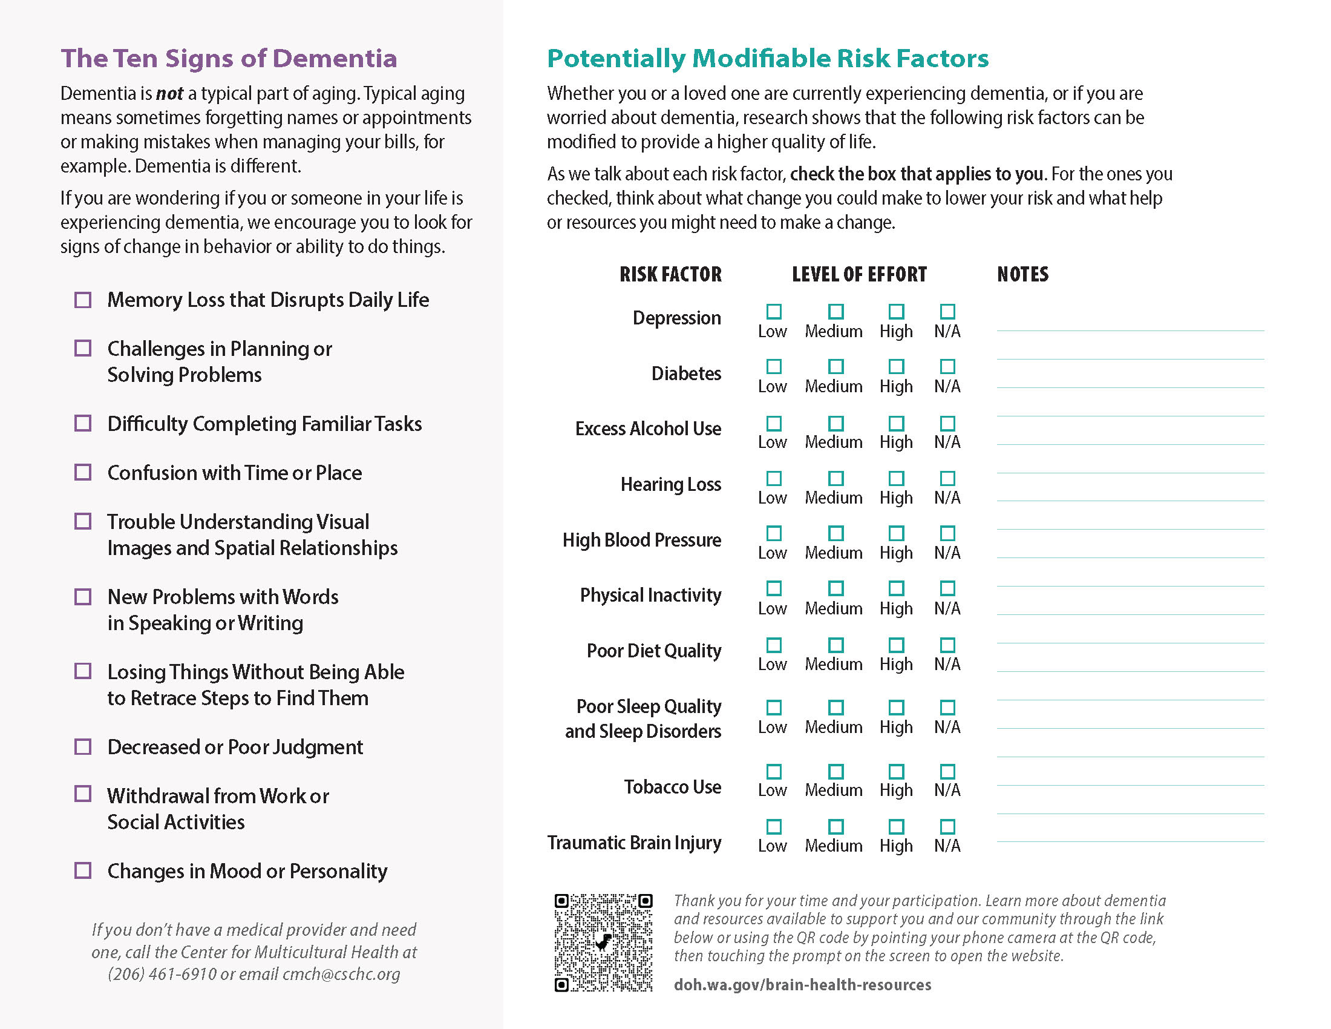
Potentially Modifiable Risk Factors
Activity
Choose to Make Change
INSTRUCTIONS:
Check the box that applies to you on your Participant Handout
Use your Participant Handout to rate each risk factor relative to how hard it might be to modify in your life.
Please Do Not Change Presentation Language
Brain Health & Dementia Awareness in Our Communities | 39

Slide 40
Potentially Modifiable Risk Factors
Potentially Modifiable Risk Factor
Depression
Definition:
A low mood or loss of pleasure or interest in activities for long periods of time.
Please Do Not Change Presentation Language
Brain Health & Dementia Awareness in Our Communities | 40

Slide 41
Potentially Modifiable Risk Factors
Risk Factor: Depression
Changes That Can Make a Big Difference
Talk to a Professional
Find a counselor or support group and talk to your medical provider.
Stay involved, even when you don’t feel like it.
Ask for help participating in activities you enjoy.
Check the box that applies to you on your Participant Handout
Please Do Not Change Presentation Language
Brain Health & Dementia Awareness in Our Communities | 41

Slide 42
Potentially Modifiable Risk Factors
Potentially Modifiable Risk Factor
Diabetes
Definition:
A disease that occurs when your blood sugar is too high or too low.
Please Do Not Change Presentation Language
Brain Health & Dementia Awareness in Our Communities | 42

Slide 43
Potentially Modifiable Risk Factors
Risk Factor: Diabetes
Changes That Can Make a Big Difference
Monitor Blood Sugar
Get tested for diabetes.
Limit processed foods and sugars in the home.
Keep healthy snacks available and easy to access.
Check the box that applies to you on your Participant Handout
Please Do Not Change Presentation Language
Brain Health & Dementia Awareness in Our Communities | 43

Slide 44
Potentially Modifiable Risk Factors
Potentially Modifiable Risk Factor
Excessive Alcohol Use
Definition:
Drinking more than the recommended amount of alcohol.
Please Do Not Change Presentation Language
Brain Health & Dementia Awareness in Our Communities | 44

Slide 45
Potentially Modifiable Risk Factors
Risk Factor: Excessive Alcohol Use
Changes That Can Make a Big Difference
Limit or Avoid Drinking Alcohol
Self limit the number of drinks you consume.
Keep less alcohol in the home.
Plan social events without alcohol.
Check the box that applies to you on your Participant Handout
Please Do Not Change Presentation Language
Brain Health & Dementia Awareness in Our Communities | 45

Slide 46
Potentially Modifiable Risk Factors
Potentially Modifiable Risk Factor
Hearing Loss
Definition:
Having trouble hearing due to a problem in your ears.
Please Do Not Change Presentation Language
Brain Health & Dementia Awareness in Our Communities | 46

Slide 47
Potentially Modifiable Risk Factors
Risk Factor: Hearing Loss
Changes That Can Make a Big Difference
Get & Use Hearing Aids
Check your hearing regularly.
Ask people to speak up if you cannot hear them.
Seek out state/community hearing aid resources.
Note: There is no standard recommended age at which to get a hearing test. If symptoms arise, get checked out.
Check the box that applies to you on your Participant Handout
Please Do Not Change Presentation Language
Brain Health & Dementia Awareness in Our Communities | 47

Slide 48
Potentially Modifiable Risk Factors
Potentially Modifiable Risk Factor
High Blood Pressure
Definition:
The force of your blood pushing against the walls of your blood vessels is too high.
Please Do Not Change Presentation Language
Brain Health & Dementia Awareness in Our Communities | 48

Slide 49
Potentially Modifiable Risk Factors
Risk Factor: High Blood Pressure
Ask a Medical Provider about Blood Pressure Medication
Changes That Can Make a Big Difference
Get your blood pressure tested regularly.
Make healthier food choices at gatherings.
Ask your medical provider about medication.
Check the box that applies to you on your Participant Handout
Please Do Not Change Presentation Language
Brain Health & Dementia Awareness in Our Communities | 49

Slide 50
Potentially Modifiable Risk Factors
Potentially Modifiable Risk Factor
Physical Inactivity
Definition:
Not moving your body for long periods of time.
Please Do Not Change Presentation Language
Brain Health & Dementia Awareness in Our Communities | 50

Slide 51
Potentially Modifiable Risk Factors
Risk Factor: Physical Inactivity
Changes That Can Make a Big Difference
Move Your Body More
Move your body at least 15 minutes/day.
Do chair exercises/chair yoga.
Use a walker or cane for safer movement.
Check the box that applies to you on your Participant Handout
Please Do Not Change Presentation Language
Brain Health & Dementia Awareness in Our Communities | 51

Slide 52
Potentially Modifiable Risk Factors
Potentially Modifiable Risk Factor
Poor Diet Quality
Definition:
Not eating healthy foods.
Please Do Not Change Presentation Language
Brain Health & Dementia Awareness in Our Communities | 52

Slide 53
Potentially Modifiable Risk Factors
Risk Factor: Poor Diet Quality
Changes That Can Make a Big Difference
Improve
Diet Quality
Talk with your medical provider about your diet.
Use single serving containers for portion control.
Buy and freeze seasonal fruits and vegetables.
Check the box that applies to you on your Participant Handout
Please Do Not Change Presentation Language
Brain Health & Dementia Awareness in Our Communities | 53

Slide 54
Potentially Modifiable Risk Factors
Potentially Modifiable Risk Factor
Poor Sleep Quality and Sleep Disorders
Definition:
You are having a lot of trouble sleeping, or when you get up in the morning, you still feel tired.
Please Do Not Change Presentation Language
Brain Health & Dementia Awareness in Our Communities | 54

Slide 55
Potentially Modifiable Risk Factors
Risk Factor: Poor Sleep Quality and Sleep Disorders
Changes That Can Make a Big Difference
Diagnose & Treat Sleep Disorders
Consult a sleep professional.
Set and keep a defined bedtime routine.
Remove distractions from sleeping area.
Check the box that applies to you on your Participant Handout
Please Do Not Change Presentation Language
Brain Health & Dementia Awareness in Our Communities | 55

Slide 56
Potentially Modifiable Risk Factors
Potentially Modifiable Risk Factor
Tobacco Use
Definition:
Smoking cigarettes, cigars, pipes or using other products like chewing tobacco or snuff.
Please Do Not Change Presentation Language
Brain Health & Dementia Awareness in Our Communities | 56

Slide 57
Potentially Modifiable Risk Factors
Risk Factor: Tobacco Use
Changes That Can Make a Big Difference
Stop or Reduce Smoking and/or Tobacco Use
Find an achievable stop-smoking program.
Talk with your medical provider about options.
Ask for help limiting tobacco use.
Check the box that applies to you on your Participant Handout
Please Do Not Change Presentation Language
Brain Health & Dementia Awareness in Our Communities | 57

Slide 58
Potentially Modifiable Risk Factors
Potentially Modifiable Risk Factor
Traumatic Brain Injury
Definition:
Traumatic brain injury can happen in many ways, such as a fall, a car or biking accident, or when you hit your head during a sporting activity.
Please Do Not Change Presentation Language
Brain Health & Dementia Awareness in Our Communities | 58

Slide 59
Potentially Modifiable Risk Factors
Risk Factor: Traumatic Brain Injury
Changes That Can Make a Big Difference
Take Precautions
Plan your space to avoid trip and fall hazards.
Place items you use regularly on low shelves.
Wear your seatbelt and/or helmet.
Check the box that applies to you on your Participant Handout
Please Do Not Change Presentation Language
Brain Health & Dementia Awareness in Our Communities | 59

Slide 60
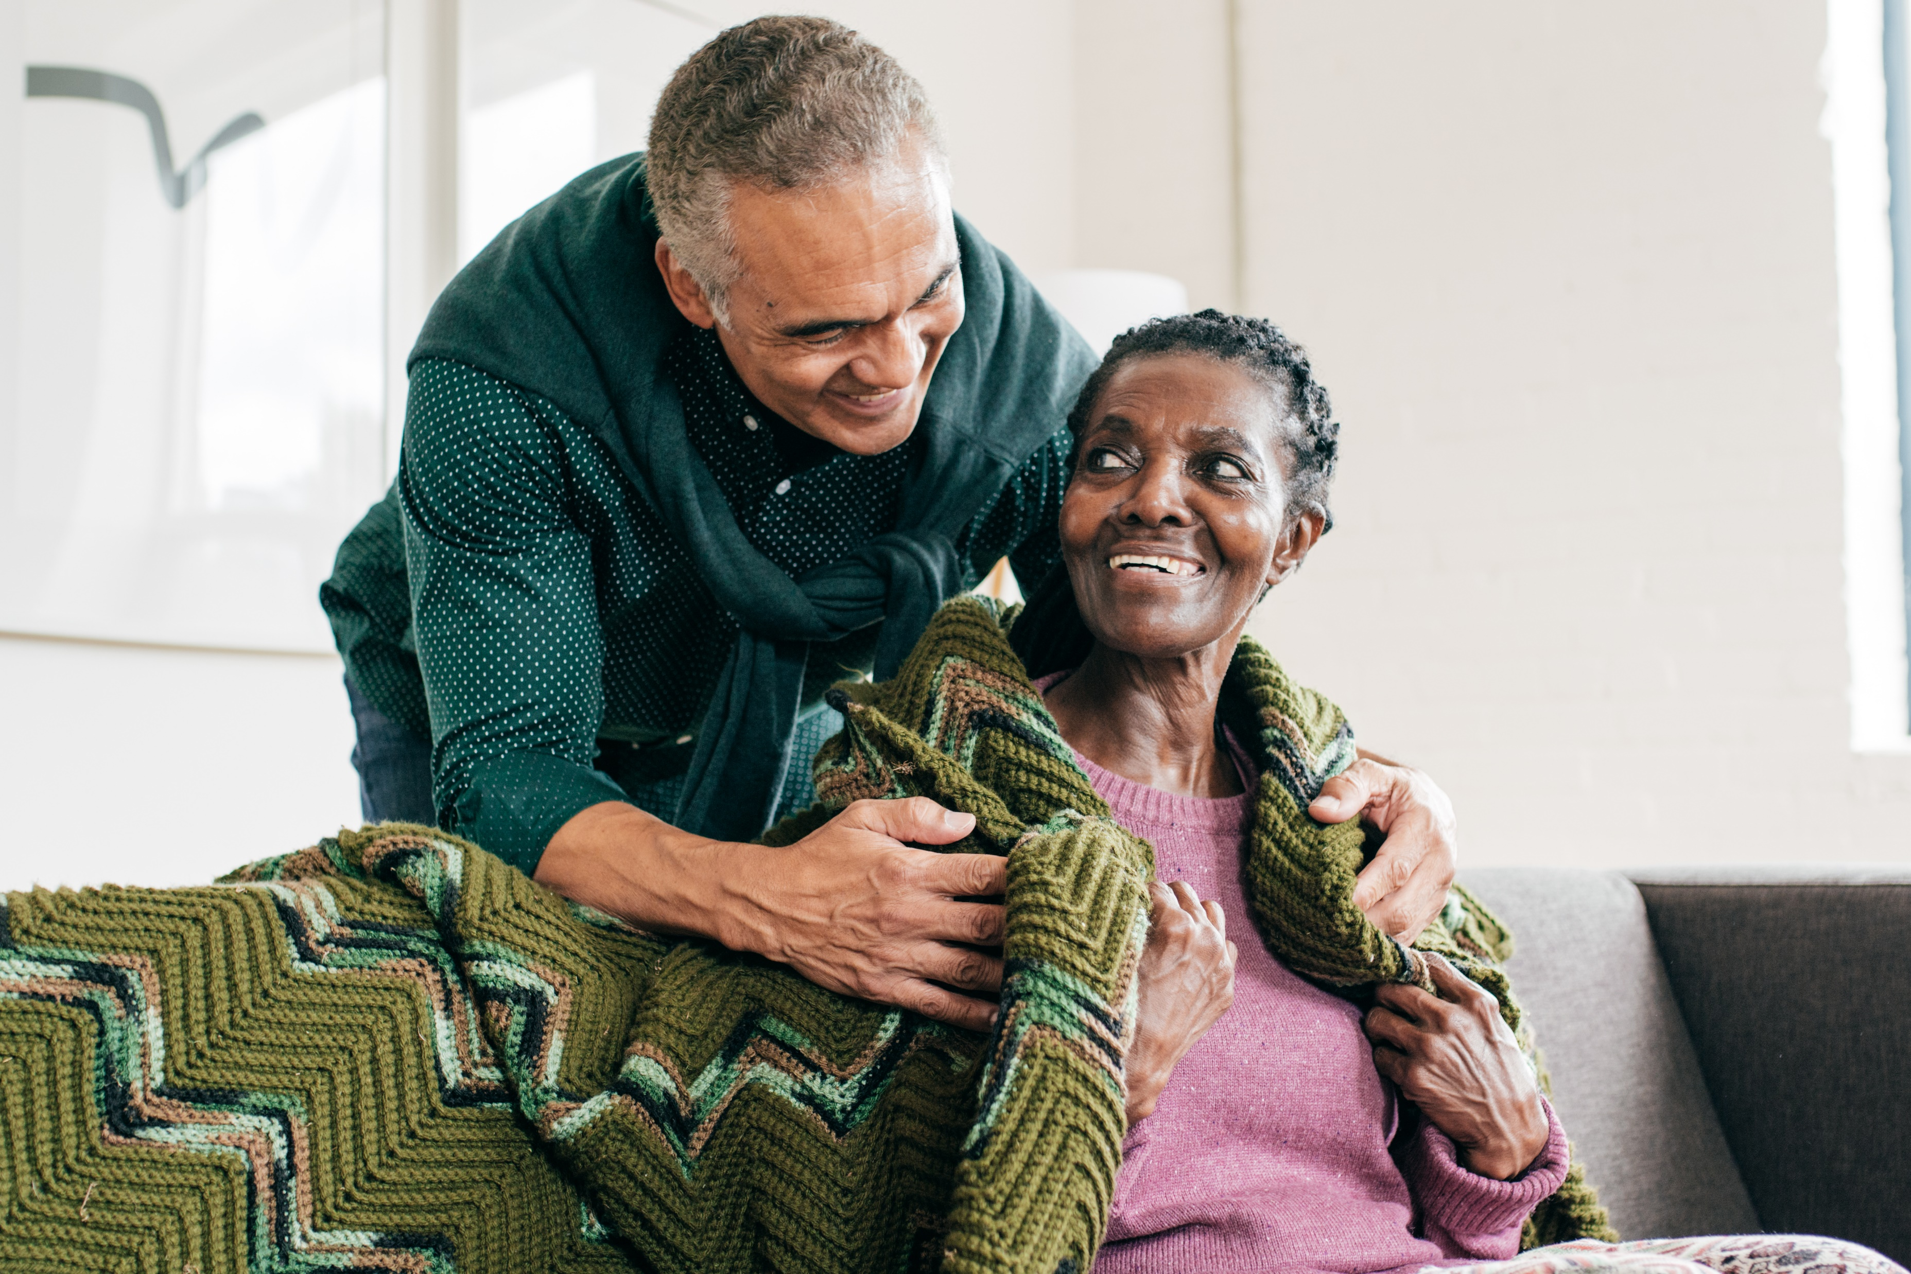
Potentially Modifiable Risk Factors
Activity: Choose to Make Change
Which Strategies Might Work For You?
Increasing Dementia Awareness in Our Communities | 2026
Please Do Not Change Presentation Language
Brain Health & Dementia Awareness in Our Communities | 60

Slide 61

Potentially Modifiable Risk Factors
Debrief
Which change would be easiest for you to make?
What are the barriers to making that change?
When will you commit to make that change?
How will you make that change?
What supports would you need?
Please Do Not Change Presentation Language
Brain Health & Dementia Awareness in Our Communities | 61

Slide 62
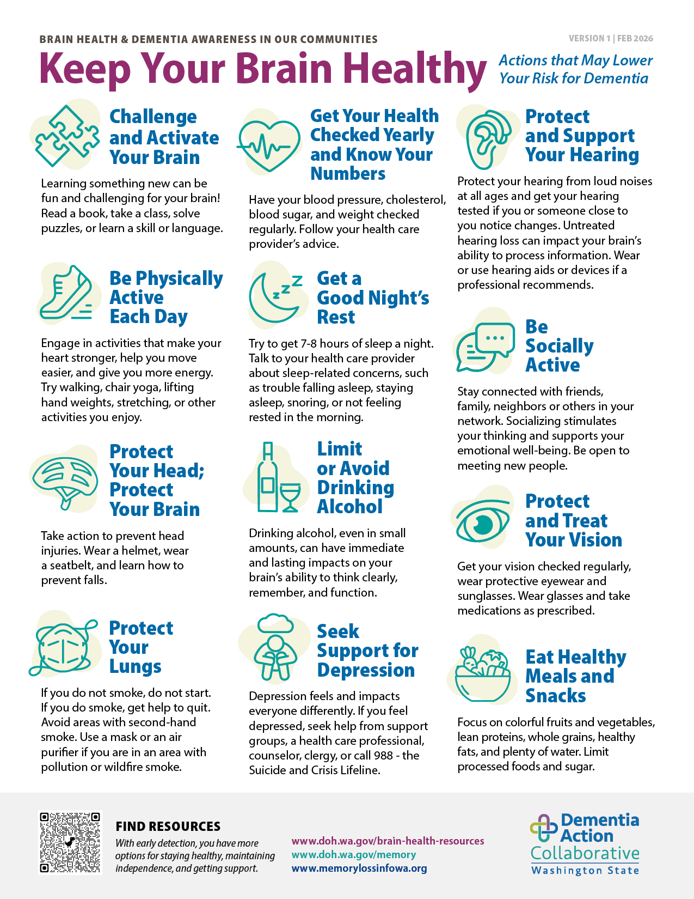
Potentially Modifiable Risk Factors
Learn More About Risk Factors
There are more potentially modifiable risk factors.
Check out the Keep Your Brain Healthy handout to learn more.
Please Do Not Change Presentation Language
Brain Health & Dementia Awareness in Our Communities | 62

Slide 63
Resources
Learn more through the link below or using the QR code by pointing your phone camera at the QR code, then touching the prompt on the screen to open the website.
doh.wa.gov/brain-health-resources
Email Brain-Health@DOH.WA.Gov for further assistance.
Please Do Not Change Presentation Language
Brain Health & Dementia Awareness in Our Communities | 63

Slide 64


Wrap-Up
We are committed to connecting with you and to connecting you with resources.
Please Do Not Change Presentation Language
Brain Health & Dementia Awareness in Our Communities | 64

Slide 65

Final Reflection
What is one change I will make
or action I will take based on our learning together today?
Use the provided handout to write down your commitment to change.
Please Do Not Change Presentation Language
Brain Health & Dementia Awareness in Our Communities | 65

Slide 66
Living with dementia has its challenges, and supportive community can help
Early dementia diagnosis can
increase quality of life
It’s never too early or too late
to improve brain health
Small lifestyle changes can
make a big difference
We are committed to connecting with you and connecting you with resources
Core
Messages
Please Do Not Change Presentation Language
Brain Health & Dementia Awareness in Our Communities | 66

Slide 67

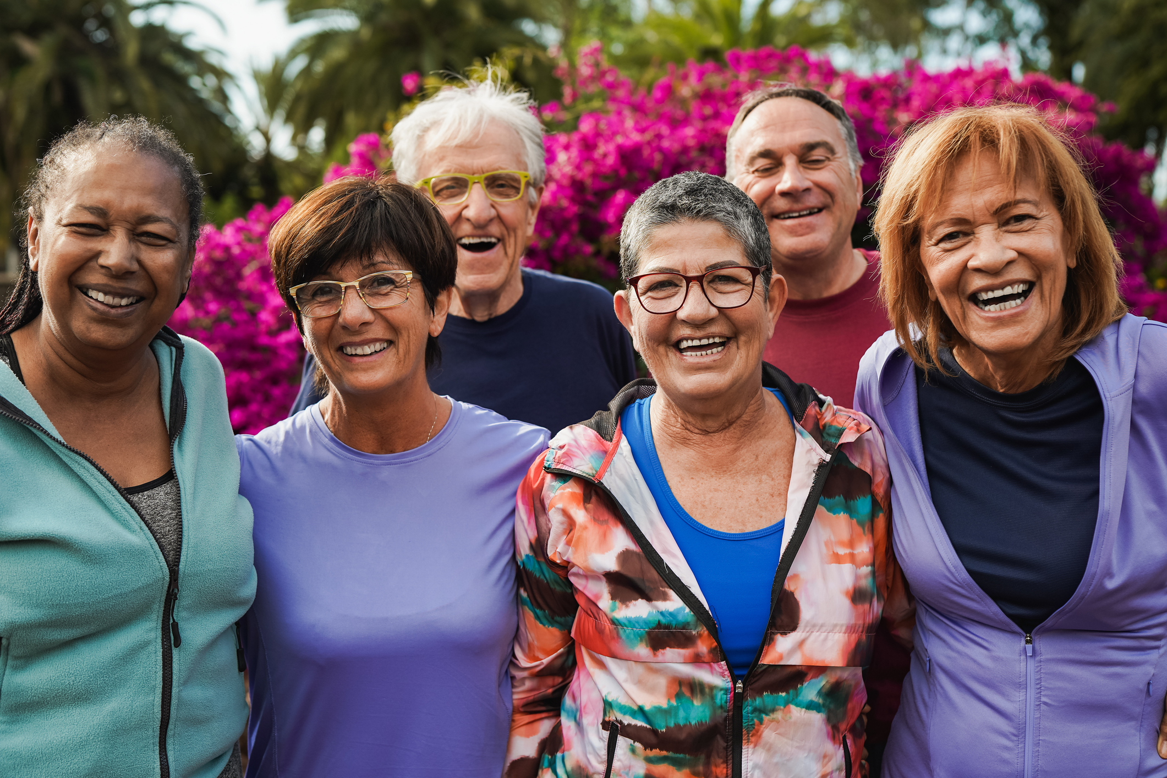
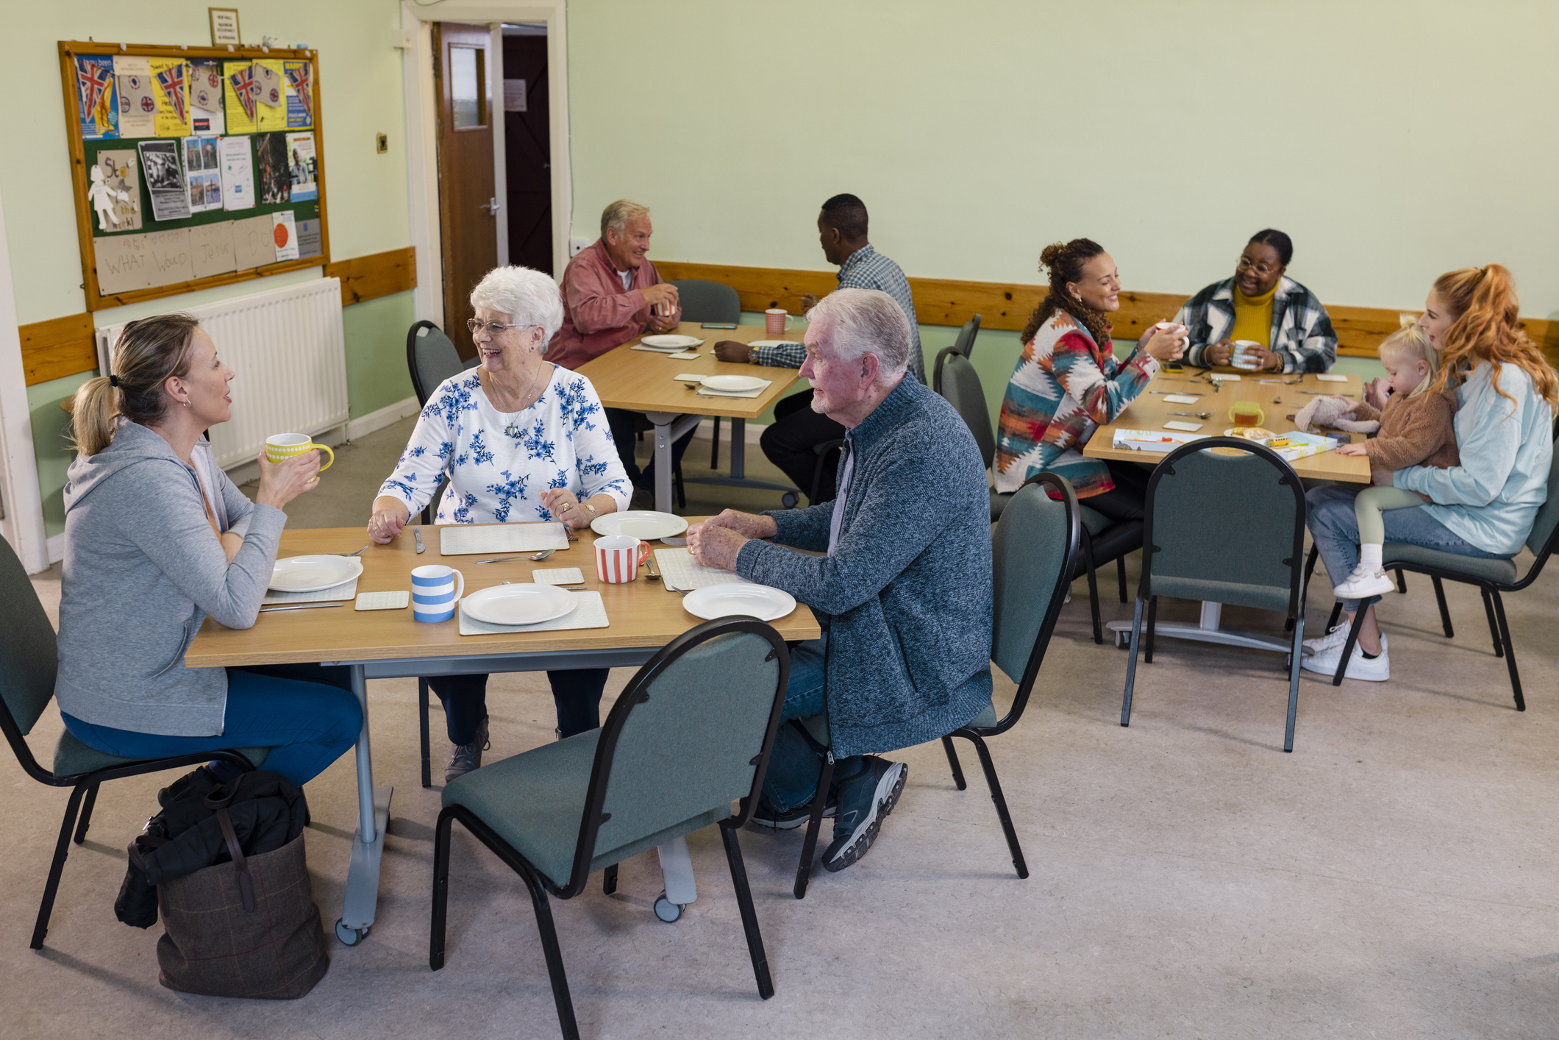
Discover Community
Events & Resources
Find additional resources, opportunities, and upcoming events offered by your host organization. Ask your trainer for more information.
Brain Health & Dementia Awareness in Our Communities | 67

Slide 68
Learn about and reflect on
brain health and dementia in
our communities
Understand potentially modifiable risk factors and the benefits of early detection for dementia
Explore resources for further learning, action, and support around brain health and dementia
1
Learning Objectives
2
3
Please Do Not Change Presentation Language
Brain Health & Dementia Awareness in Our Communities | 68

Slide 69
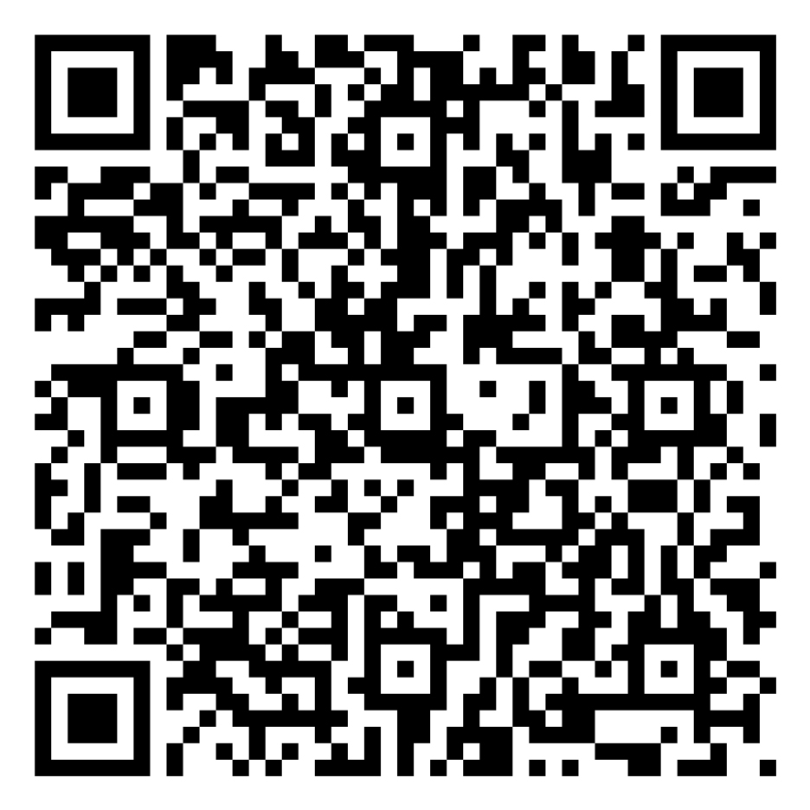
Training
Evaluation
Please complete the training evaluation.
forms.office.com/g/AJYbJGczWD
Brain Health & Dementia Awareness in Our Communities | 69

Slide 70

Thank You
for Attending
And for caring enough to grow brain health and dementia awareness in our communities.
Questions?
Please Do Not Change Presentation Language
Brain Health & Dementia Awareness in Our Communities | 70

