Slide 1
After Action Reviews…
Nathan Weed, MPH
Washington State Department of Health
May 26, 2022
Notes:
Good afternoon everyone!
My name is Nate Weed.
I use he/him pronouns.
For those who may not be able to see me, I’m a 40-something white male with graying red hair, a mid length beard, and I’m wearing…
I currently serve as the Acting Deputy Secretary for Emergency Preparedness, Resilience, and Response at the Washington State Department of Health.
Before I begin, I want to thank you all for the hard work that you’ve all done in response to the many challenging events over the past couple of years. It has truly been a time for emergency management to shine (and perhaps get a little tarnished at times). You all are amazing, and our communities are safer and healthier today because of the tireless work that you all do every day. National public health recognition week.

Slide 2
The Emergency Preparedness Cycle
The After Action Review
Planning
Equip Teams
Train
Exercise/ Response
Evaluate
Partners
Notes:
Level Setting on why After Action Reviews are important to further developing response capabilities.

Slide 3
Retrospective Learning
Every response provides an opportunity to learn
Capturing learning is best done in a structured way
Engaging those involved in the response
Providing the space for people to share
Collecting what worked well and opportunities
Root Cause Analysis
Committing to implementing corrective actions
Using the learning to improve systems, plans, training, teams, etc.

Slide 4
COVID-19 After Action Reviews
Statewide Comprehensive COVID-19 AAR
DOH In Action Reviews
Local and Agency AARs
Notes:
The COVID-19 pandemic is still with us and may be for some time. Reviewing what went well and should sustain in future responses; and learning what didn’t go so well and what we would like to improve for future responses is quite deep and broad.
To organize our efforts around the COVID-19 After Action Review process, we are working to first obtain and analyze both local, healthcare, and agency After Action Reports. This will give us a good baseline for understanding common themes across the response. Second, DOH has completed a 2020 “In Action Review” and is embarking on a 2021 “In Action Review”. The information that we gather from these reviews will help us improve agency plans, policies, systems, training, and exercises for the future. Finally, we are co-leading with the Washington State Military Department, a Comprehensive Statewide COVID-19 After Action Review. This process includes convening a 40+ person governor-appointed task force and synthesizing a considerable catalog of lessons learned into recommendations for the legislature by June 30, 2023.

Slide 5
Additional Learning
Ruckelshaus Research on Lessons Learned
National Institutes of Health
HHS Assistant Secretary for Preparedness and Response
Centers for Disease Control and Prevention
Association of State and Territorial Health Officials
Academic organizations
Notes:
Because the COVID pandemic has been a significant historical event and has affected so many people, organizations, and societal structures, there is considerable learning from this experience that goes well beyond After Action Reviews.

Slide 6
Pandemics in General
Novel communicable disease (we wouldn’t know much about it)
No natural immunity among people (everyone is vulnerable)
Easily transmitted (it would spread fast)
Significant health impacts (many people would be hospitalized)
Global event (it would affect the whole world at once)
Pandemic
Definition
Notes:
Pandemics are one of the most challenging planning scenarios that I can think of. They tend to emerge from seemingly common diseases and quickly escalate into an invisible force that overtakes the globe with illness, death, frustration, and sadness. They also last a really long time!
The first recorded pandemic was in 430BC, and they’ve been coming back to humanity about every 100 years (or so) since then. Pandemics have led to all sorts of scientific advances and they’ve also typically led to a distrust in governmental authority. With almost every pandemic, disinformation (I’m including superstitions in this one) has been prevalent. Pandemics have always resulted in economic shifts with some winners and some losers. They have always had groups who are disproportionally impacted and those who aren’t. And, they’ve always had a political aspect to them that those who have not experienced a pandemic might not fully appreciate… (it’s a joke)…
These are all learnings from almost 2500 years of pandemics… yet, we seem to have learned many of these same lessons again over the past two and a half years…
Going back in time but not very far back in time – not to 430BC or anything…

Slide 7
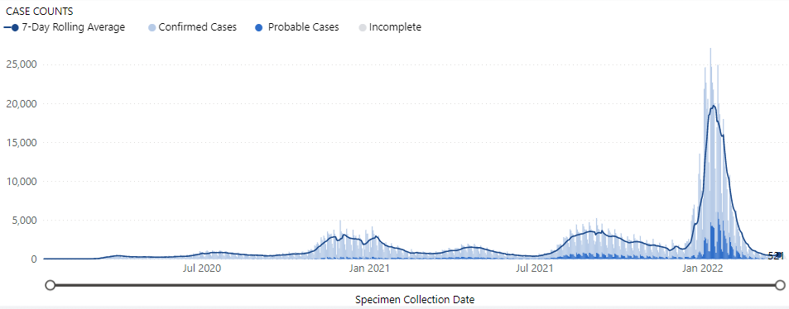
Waves of the Pandemic
December 31, 2019 – COVID-19 was initially detected
January 20, 2020 – First case of COVID, in Washington State
February 28, 2020 – First evidence of community transmission in Washington
March 2020 – Applying basic outbreak control strategies to limit transmission
June 2020 – September 2020 Implementing NPI, building infrastructure to respond
September 1, 2020 – February 2021 “The Fall Wave”
December 7, 2020 – First COVID vaccine arrived in Washington
February 2021 – June 2021 “The Spring Wave” mass vaccination
July 2021 – December 2021 “Delta Wave”
December 2021 – Present “Omicron Wave
Notes:
Transition to a brief timeline…
Describe the shape of the pandemic and some of the key milestones… Personalize this and draw people into this…

Slide 8
How did Washington do?
7,705,281 - Washington State’s Population (2020 Census)
1,458,424 - Confirmed COVID-19 Cases in Washington
59,333 - COVID-19 Hospitalizations in Washington
12,515 - COVID-19 Deaths in Washington
Washington had one of the lower death rates in the U.S.
164 per 100,000 people
5th lowest death rate (tied with Maine)
Vaccination efforts were generally effective
13,273,098 COVID vaccines were given in Washington
Over 80% of people over 5 have received at least one dose
Washington is ranked 11th in the % of population fully vaccinated
Washington’s healthcare system was stressed yet overcame
Millions of pieces of medical materiel was surged to support
Healthcare adapted new processes and tools
Washington surged but didn’t declare crisis standards of care
Notes:
Given all of the planning, training, exercising, and learning that public health and emergency management have done in the past 20 years, here is our overall scorecard…
Generally, Washington did well… and we still tragically lost many lives and many others are still dealing with the long-term complications from COVID-19

Slide 9
Delaware
(Similar to
US overall)
Washington
CDC COVID Data Tracker: https://covid.cdc.gov/covid-data-tracker/#compare-trends_comptrends-deaths-cum-rate-lin 03.29.22

Slide 10
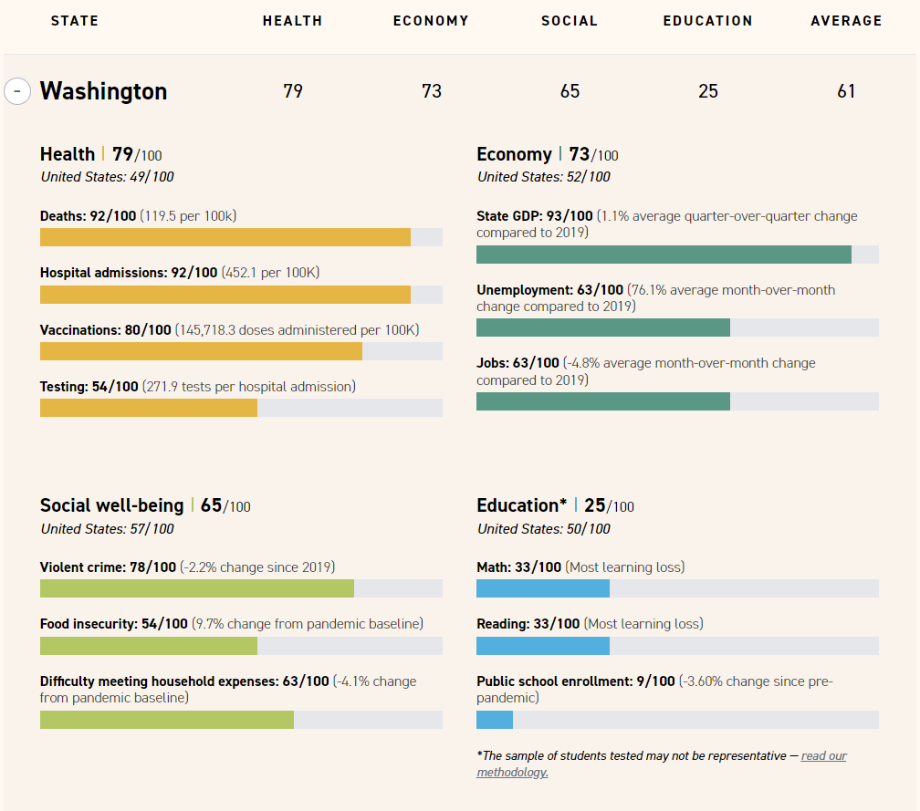
POLITICO’s State Pandemic Scorecard - December 2021
Covid by the numbers: How each state fared on our pandemic scorecard (politico.com)
Notes:
When we compare how Washington did relative to other states across the country, we did pretty well. This December 2021 “scorecard” from Politico describes some of our statistics.
Overall Washington received the seventh highest score of all states.
And there are trade offs… To improve in some areas meant that sacrifices had to be made in other areas. I’m personally proud of Washington for prioritizing health in the face of this pandemic. But doing that had costs associated with the decisions driven by that prioritization.
So what are we learning from our experience so far?
Given that we generally fared well in our response to COVID, perhaps we should ask ourselves, did we all fare well in this pandemic?
The answer is a clear no!
As we get into the next couple of slides, I invite you to be uncomfortable… it’s ok to be uncomfortable and we should all consider what that discomfort is telling us…

Slide 11
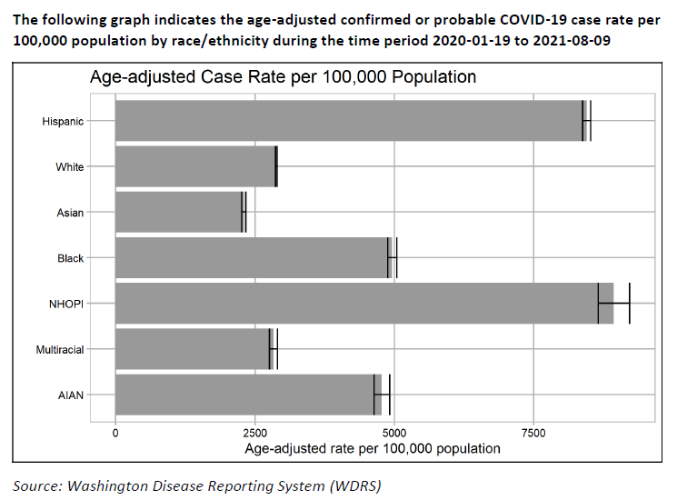
COVID-19 Cases by Race in WA
Notes:
When we look deeper at the data around COVID-19 in Washington, we see that the impacts of the pandemic were not equitable across the whole population or the whole state…
This slide demonstrates the age-adjusted case rate by race and ethnicity. We see that Native Hawaiian and Other Pacific Islander, Hispanic, Black, and American Indian and Alaska Native Washingtonians experienced a greater disease burden than White or Asian Washingtonians.
In Washington, the age adjusted case rate for people who identify as White was about 2900/100,000 between January 19, 2021 and August 9, 2021. In that same time period, the age adjusted case rate for people who identify as Hispanic was around 8500/100,000. And, the age adjusted case rate was about 8800/100,000 for people who identify as Native Hawaiian and Other Pacific Islanders.
These are substantial differences!

Slide 12
DOH In Action Review
Significant Findings
Theme | Strengths | Opportunities for Success
Medical Surge | Volunteers assisted greatly in the rollout of mass vaccination sites | Some of the relationships between DOH and healthcare associations were not strong prior to COVID-19 and that impacted early decision-making
Testing Operations | The Public Health Laboratory worked with partner organization to create new processes and tools that improved laboratory operations and testing | Development of communication tools, information sharing systems and dashboards were insufficient to address the demands of the pandemic and required a lot of time and resources to re-invent.
Surveillance & Information Management | DOH created a new Training Group to support an expansive case investigations and contact tracing system | Increasing collaboration between DOH and local health jurisdictions on building statewide data systems
Mass Vaccination Planning | Washington State excelled at deploying its mass vaccination program | Improving public education around vaccine safety and effectiveness
Demobilization | The Demobilization Unit developed new tools and processes for optimizing public health staffing availability | The demobilization process created challenges for staff getting sufficient rest periods

Slide 13
DOH In Action Review Cont.
Public Information & Messaging | DOH was committed to providing accurate public messaging while battling misinformation. | Inconsistent/non-standard process for integrating trusted community partners who could support communications to vulnerable into messaging efforts
Resource Management | Coordination with local health, health care, and private industry in getting health care workers needed resources. | Funding for staffing surge was unclear early in the pandemic which slowed response
Staff Safety & Wellness | Staff exhibited great passion and commitment at DOH | The lengthy response to the COVID-19 pandemic took a dramatic toll on staff members.
Tribal Relations | Tribal representatives and leaders reported feeling supported by the state in many ways during the pandemic. | There are still many opportunities for DOH staff to better recognize the sovereignty of tribal nations
Internal Communications | DOH prioritized open and transparent internal communication during the initial phases of the response. | As operations transitioned into a sustained response model, communication became inconsistent

Slide 14
In Action Cont.
Theme | Strengths | Opportunities for Success
Activation & ACC Operations | DOH initially activated quickly, scaling up their response to meet incident needs | Improvements could be made to the activation and Incident Management Team (IMT) onboarding process
Community Needs & Impacts | DOH undertook creative and innovative methods to address community needs | Despite outreach, vulnerable populations still did not receive resources necessary to ease the disproportionate impact of the pandemic.
Continuity of Operations | Despite the challenges of a large-scale and multi-dimensional crisis, DOH maintained many elements of steady-state functions | Leadership communicated conflicting priorities which generated confusion.
Public Private Partnership | The Public-Private Partnerships developed by DOH during the pandemic were critical to the overall success of the response. | A formal process for public-private partnerships to flourish does not yet exist and needs to be developed.
Interagency Coordination – Local to State | The COVID-19 response fostered greater relationships between DOH and local communities. | There is a lack of understanding within DOH regarding the capabilities of local health care coalitions and associations
Interagency Coordination – State to State | The Governor’s Office and DOH fostered a strong relationship throughout the response. | Other state departments and entities felt the lack of Unified Command during certain portions of the response
Interagency Coordination – Federal to State | The DOH and the Centers for Disease Control and Prevention (CDC) coordinated effectively. | The response to the COVID-19 pandemic by the 2020 federal administration increased the difficulty of the response

Slide 15
National Institutes of Health
NIH researchers collaborating with an international team interested in priority setting and resource allocation during the COVID-19 pandemic.
Sampling countries representing all the WHO regions, including the United States.
Washington was selected as one of the states
This information will be used to glean key lessons that could be used in planning for any future disease outbreaks.

Slide 16
General Retrospective Themes
Networks - The pandemic transcended partnerships to require a capability to leverage networks of organizations …
Engagement - Pandemics affect everyone in different ways building systems for engaging with communities and connecting them to the resources and information necessary for success is critical…
Connecting - Connecting networks of people in this way requires communications and information sharing systems robust enough to endure through the response…
Trust - Our organizations must build trust with the communities we serve and with each other if we want to be successful in the next response…

Slide 17
Speaker
Nathan “Nate” Weed
Acting Deputy Secretary
Emergency Preparedness, Resilience, and Response
Notes:
Gratitude and supporting these efforts moving forward…
Invite everyone to stand up and take 3 deep breaths…

Slide 18
Notes:
END SLIDE
Quick Help Tips
Insert this slide at the end of the presentation. It is not editable.

