Slide 1
Public Health Transformation
Foundational Public Health Services Healthy. Vital. Everyone. Everywhere.
FPHS Overview for the Public Health Advisory Board
04-28-22

Slide 2
Outline
Introduction
People
Process
Progress
What’s Next

Slide 3
Introduction
Foundational Public Health Services

Slide 4
* Vital statistics
*
*

Slide 5
FPHS Parameters
Definitions
Government is the primary or unique provider of the services
Population-based
Need to be available everywhere

Slide 6
FPHS Goal
Full funding and implementation of FPHS statewide
Full funding of FPHS
with adequate, dedicated, stable funding that keeps pace with inflation and demand for services
Full implementation of FPHS
that includes system transformation and modernization to deliver services in the most effective, efficient, and equitable manner possible for the funds available.

Slide 7
PEOPLE
Foundational Public Health Services

Slide 8
Governmental Public Health System
State Board of Health
(SBOH)
State Department of Health (DOH)
Local Health Jurisdictions
(LHJ)
Sovereign Tribal Nations & Indian Health Programs (IHP)

Slide 9
FPHS Committee Structure
April 2022
FPHS Steering Committee
FPHS Support Staff
FPHS Project Management Team (PMT) & Co-Chairs
SBOH
DOH
State
Board of Health
State Department of Health
Local
Health Jurisdictions
Sovereign Tribal Nations & Indian Health Programs
WSALPHO
AIHC
Subject Matter Expert (SME) Workgroups Co-Leads
CD
Communicable Disease
EPH
Environmental Public Health
Assessment
(Epi/Surveillance)
EP
Emergency Preparedness
Life Course
Chronic Disease, Injury & Violence Prevention (CDIVP)
Maternal Child Health (MCH)
Access/Linkage to Care

Slide 10
RCW 43.70.515
Foundational public health services—Funding.
(1) With any state funding of foundational public health services, the state expects that measurable benefits will be realized to the health of communities in Washington as a result of the improved capacity of the governmental public health system. Close coordination and sharing of services are integral to increasing system capacity.
(2)(a) Funding for foundational public health services shall be appropriated to the office of financial management. The office of financial management may only allocate funding to the department if the department, after consultation with federally recognized Indian tribes pursuant to chapter 43.376 RCW, jointly certifies with a state association representing local health jurisdictions and the state board of health, to the office of financial management that they are in agreement on the distribution and uses of state foundational public health services funding across the public health system.
(b) If joint certification is provided, the department shall distribute foundational public health services funding according to the agreed-upon distribution and uses. If joint certification is not provided, appropriations for this purpose shall lapse.

Slide 11
RCW 43.70.675
Public health advisory board.
(1) The public health advisory board is established within the department. The advisory board shall:
(a) Advise and provide feedback to the governmental public health system and provide formal public recommendations on public health;
(b) Monitor the performance of the governmental public health system;
(c) Develop goals and a direction for public health in Washington and provide recommendations to improve public health performance and to achieve the identified goals and direction;
(d) Advise and report to the secretary;
(e) Coordinate with the governor's office, department, state board of health, local health jurisdictions, and the secretary;
(f) Evaluate public health emergency response and provide recommendations for future response, including coordinating with relevant committees, task forces, and stakeholders to analyze the COVID-19 public health response; and
(g) Evaluate the use of foundational public health services funding by the governmental public health system.

Slide 12
PROCESS
Foundational Public Health Services

Slide 13
FPHS Funding Need
Additional Funds Needed from State Government for Full Implementation of FPHS (Baseline)
State DOH, State BOH, Local Health Jurisdictions
Foundational Program or Capability | 2018 Baseline* Additional Funds Needed from State Government, in millions (rounded)
Environmental Public Health | $39 / year; $78 / biennium
Prevention and Control of Communicable Disease & Other Notifiable Conditions | $37 year; $74 / biennium
Maternal/Child/Family Health | $16 / year; $32 / biennium
Access/Linkage with Medical, Oral, and Behavioral Health Care Services | $7 / year; $14 / biennium
Chronic Disease, Injury and Violence Prevention | $14 / year; $28 / biennium
Vital Records | $0
Assessment (Surveillance and Epidemiology) | $30 / year; $60 / biennium
Emergency Preparedness (All Hazards) | $9 / year; $18 / biennium
Communication | $10 / year; $20 / biennium
Policy Development and Support | $8 / year; $16 / biennium
Community Partnership Development | $10 / year; $20 / biennium
Business Competencies | $45 / year; $90 / biennium
Total | $225 / year; $450 / biennium
* Berk 2018. Washington State Public Health Transformation Assessment Report

Slide 15
Charge to Subject Matter Expert (SME) Workgroups
Using a systems perspective that includes all parts of the governmental public health system:
Develop high level budget proposals that deliver the programs/capabilities for the specific subject areas within the FPHS functional definitions.
Identify areas of programs/capabilities that could be better implemented through innovative efforts such as cross-jurisdictional sharing, new service delivery models, or other methods that emphasize equity, efficiency, and effectiveness
Plan implementation strategies for investments such as describing one-time investments, pilot models, phased funding approaches
Develop outputs and metrics for indicators that measure the systemwide impacts of proposed FPHS investments

Slide 16
Continuum Concept
To identity new service delivery models options that best fit the work,
FPHS activity or groups of FPHS activities are evaluated on multiple continuums,
A continuum for each of the following types of characteristics:
Specific Local Needs
Local Physical Delivery or Expertise
Level of Local Demand
Economies of Scale
Technical Expertise
Technology
Necessary Statewide Standardization

Slide 17
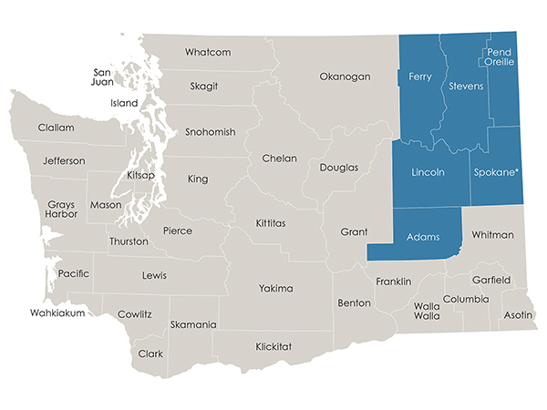
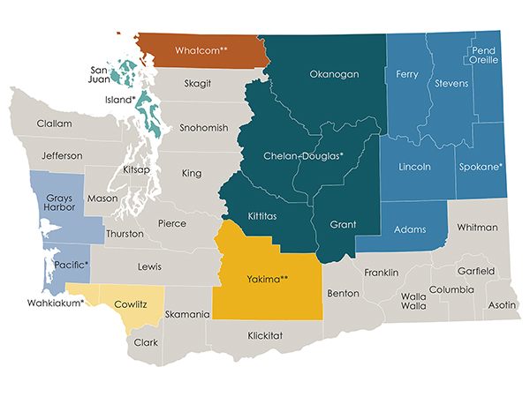
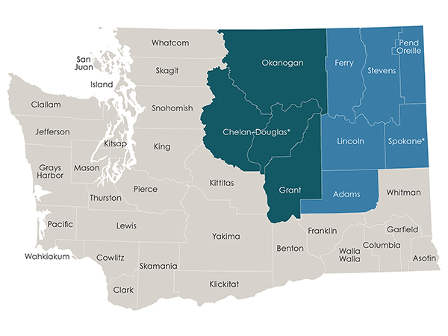
Expanding New Service Delivery Models
Shared General Epidemiology Staff
FPHS Definition Addressed: Access, analyze, use and interpret data. Conduct community health assessment and community health improvement planning including analysis of health disparities and social determinants of health.
2017 - 2019
2021 – 2023
2019 - 2021
* LHJ where shared epidemiologist will be employed
**Epidemiologist funded with FPHS funds to serve 1 LHJ

Slide 18
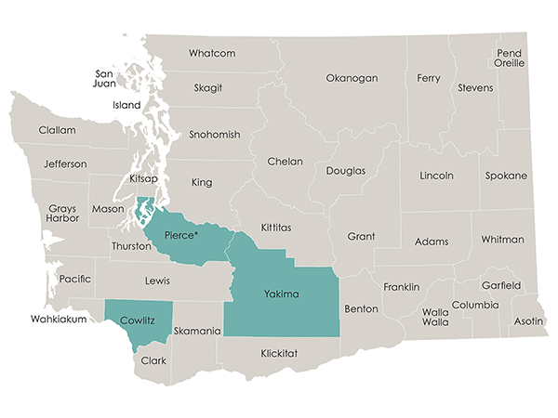
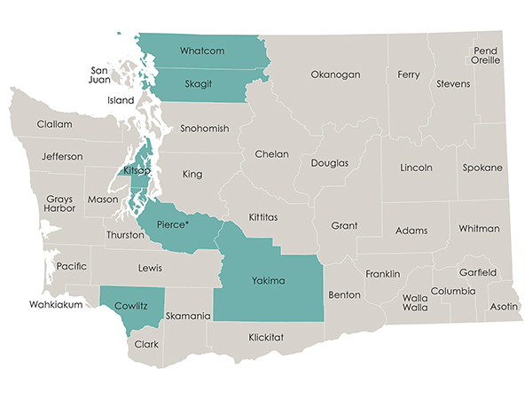
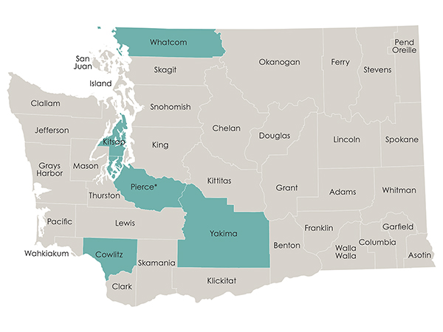
Expanding New Service Delivery Models
Healthcare Provide Resource Webpages
FPHS Definition Addressed: Provide information on prevention and control of communicable disease
2017 - 2019
2021 - 2022
2019 - 2021
* Tacoma-Pierce County Health Department is providing this service for other LHJs. $20,000 1x cost per LHJ to establish their website and $27,000 per year to maintain all websites.
https://www.yakimacounty.us/2140/NEW-Provider-Resource-Page
http://providers.whatcomcounty.org/
https://cchhsproviderresources.org/
https://providers.kitsappublichealth.org/

Slide 19
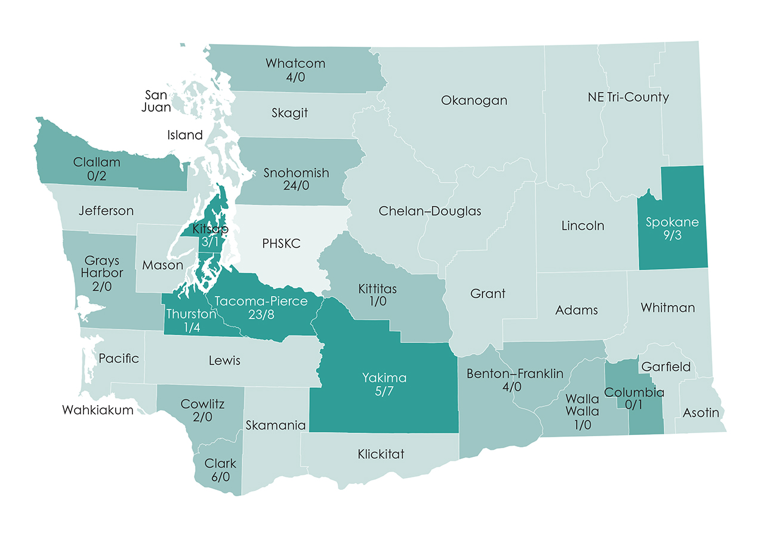
New Service Delivery Models
Center of Excellence Model for TB
FPHS Definition Addressed: Ensure disease surveillance, investigation and control for communicable disease
Public Health – Seattle-King Co (PHSKC) provides expertise, staff, TA, training and QF testing for all other LHJs
2019 – Active TB Cases: WA 221; King 136 (62%); All Other LHJs 85 (38%)
DRAFT
PHSKC
LHJ with no cases and no services from PHSKC
LHJ with cases and no services from PHSKC
LHJs with no cases and received services from PHSKC
LHJ with cases and
received services from PHSKC
5

Slide 20
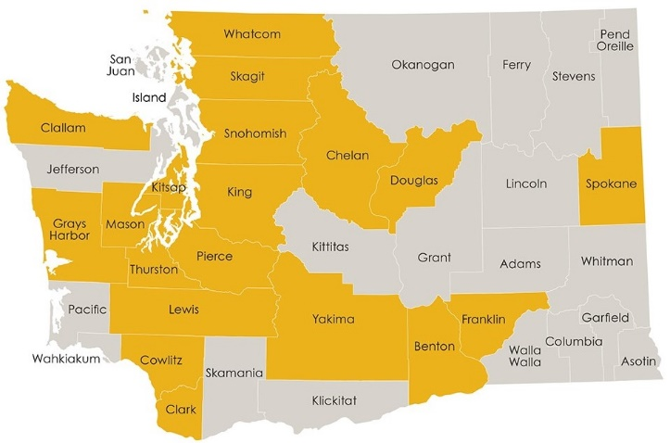
New Service Delivery Models
Investing in Outcomes – Burden of Disease Model
FPHS Definition Addressed: Ensure disease surveillance, investigation and control for communicable disease
2019-2021 & 2021-2023

Slide 22
progress
Foundational Public Health Services

Slide 23
Progress
Funds needed $450M/biennium
2017-2019
Requested $60M for CD
Appropriated $15M, 1x
2019-2021
Requested $296M for CD, EPH, Assessment and portion of CCC
Appropriated $28M/biennium, ongoing
2021-2023
Requested $285M for CD, EPH, Assessment and portion of CCC
Appropriated $147M and in the subsequent biennium $296M, ongoing
CCC = Cross-cutting capabilities

Slide 24
FPHS Funding Need & Legislative Appropriation BIENNIAL
Additional funds needed
Investment

Slide 25
Impact
Evaluation / Accountability
What are we measuring so far?
Availability of FPHS– FPHS Annual Report and Analysis by REDE
Indicators - Measuring Our Work and System Output (epi data via DOH)
Narrative / Stories – FPHS Annual Report and Analysis by REDE

Slide 26
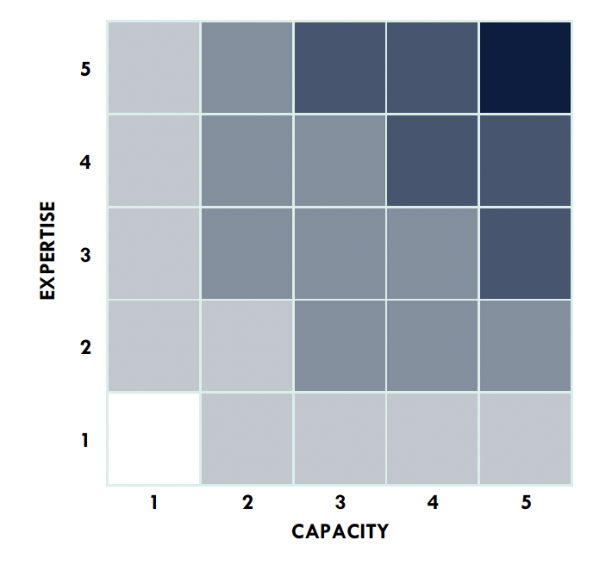
Availability of Foundational Public Health Services
Availability of FPH Services
Full availability
Significant availability
Partial availability
Limited availability
No availability
CAPACITY
EXPERTISE
Agencies rate the availability of FPHS in their jurisdiction terms of capacity and expertise (on a scale of 1–5)
These measures are combined during analysis
The combined measure interprets availability of FPH services

Slide 27
Baseline availability of FPH services
Availability of FPH Services
-DRAFT-
Full
Significant
Partial
Limited
None
Data missing

Slide 28
Baseline availability of FPH services
Availability of FPH Services
-DRAFT-
Full
Significant
Partial
Limited
None
Data missing

Slide 29
Baseline availability of FPH services
Availability of FPH Services
Full
Significant
Partial
Limited
None
Data missing

Slide 30
SFY21 availability of FPH services
Availability of FPH Services
Full
Significant
Partial
Limited
None
Data missing

Slide 31
Indicators – Measuring Our Work and System Output
Epi Data from DOH
Immunization Series Completion
Percent of kids with completed immunization series
Toddlers (19-35 months)
Pre-school (4–6-year-olds)
Cases Investigated – Using sentinel conditions
Gonorrhea
Syphilis
Hepatitis C
Data & Community Engagement
Community Health Assessment (CHA) Completed
Community Health Improvement Plans (CHIP) Completed

Slide 32
Narrative / Stories
FPHS Annual Report & Analysis by REDE
What changed for the people of your jurisdiction about the FPHS available to them?
What changed in capacity, expertise or structure of how FPHS are delivered in your jurisdiction?
Examples of how past FPHS investments impacted your jurisdiction’s ability to response to the pandemic
Examples of new ways FPHS services were delivered during the pandemic response that are improvements over the old ways

Slide 33
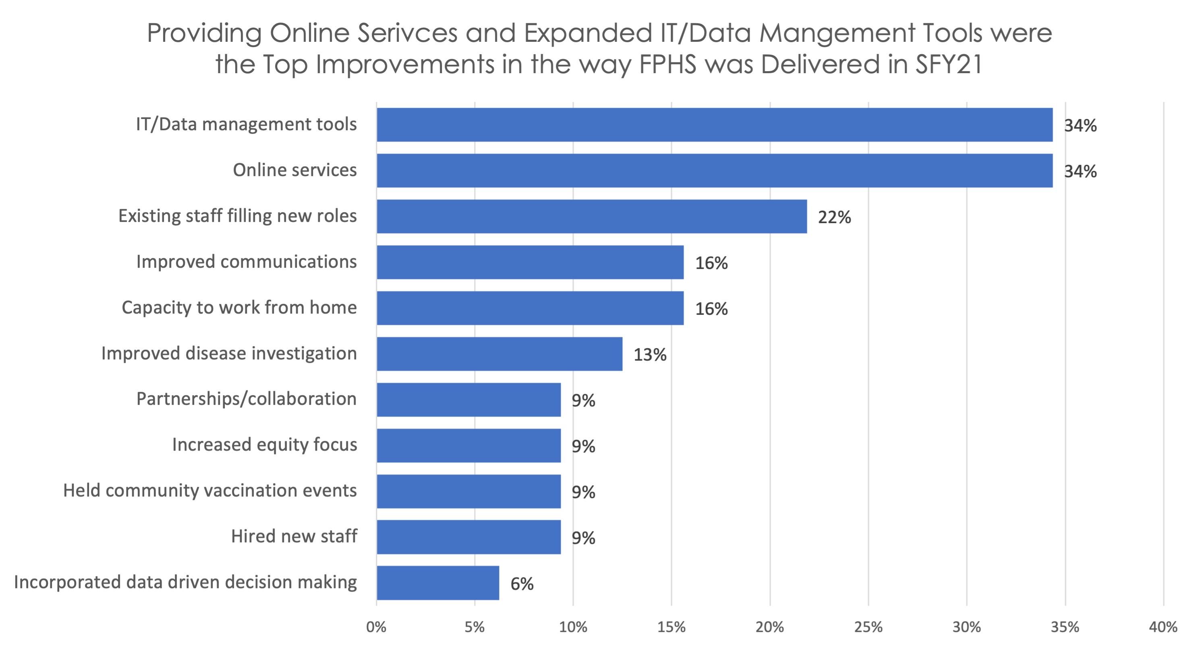
New Ways FPHS Services Were Delivered the Pandemic Response That Are Improvements Over the Old Ways

Slide 34
Measures to Add
Level of implementation and indicators
Additional program areas
Additional capability areas
Evaluation
Spending
Health equity measures
Health outcome measures
Service delivery model measures

Slide 35
What’S next
Foundational Public Health Services

Slide 36
Work ahead for 2022
W
Finalize allocations for SFY23
Proposals and priorities for SFY24
Reset and renew
Focus on workforce
Work with PHAB on orientation, measures, recommendations

Slide 37
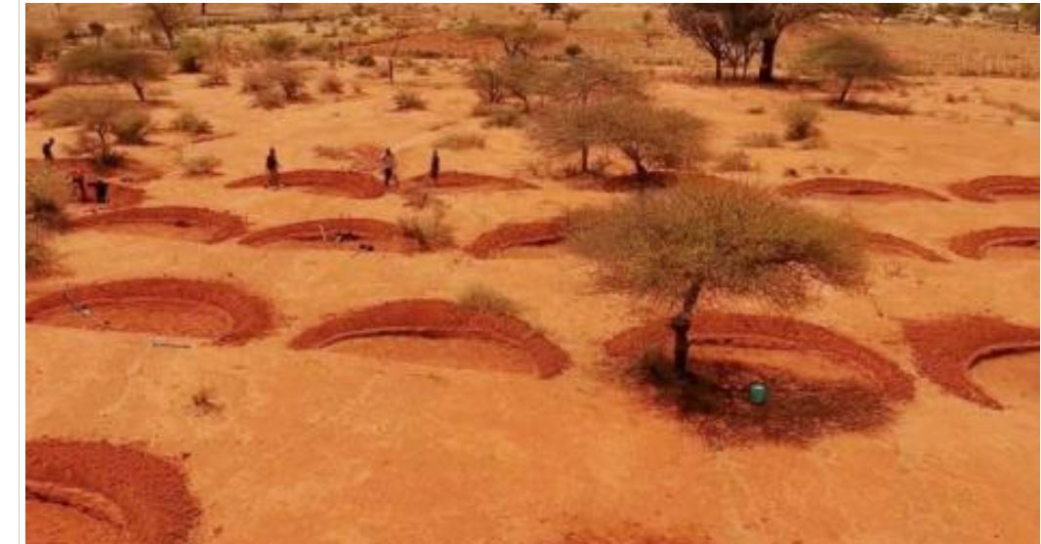
Bund

Slide 38
Foundational Public Health Services Healthy. Vital. Everyone. Everywhere.
Jaime Bodden
Washington State Association of Local Health Officials
jbodden@wsac.org
Maria Courogen
Washington State Department of Health
maria.courogen@doh.wa.gov
Notes:
A responsive and viable governmental public health system is essential for healthy and economically vital communities across Washington.

